Slide 1
PLUTO
BY SMAYAN SAHU
Cheap and Accessible Computers for Everyone
THE-PLUTO-PROJECT

Slide 2
<WOAH!>
Welcome to The-Pluto-Project!
This Project was made for the STEM Competition in DPS Dehradun.
Enjoy this Presentation!
THE-PLUTO-PROJECT

Slide 3
THE TEAM BEHIND PLUTO
Pluto is an ambitious entrepreneurial project taken on by 4 innovative entrepreneurs. They are :-
Smayan Sahu
Adityan Rangar
Arihant Singh
Harshit Joshi
INDEX.HTML

Slide 4
TABLE OF CONTENTS
01
MEET PLUTO
02
WHY PLUTO?
03
LIGHTOS
04
SEMICONDUCTORS
Meet Pluto, a
compact & powerful mini computer
Why's Pluto So Revolutionary? Why Invest in Pluto?
LightOS is a light, compact & Powerful Operating System
Indian Semiconductors can shape a new future for Pluto
THE-PLUTO-PROJECT

Slide 5
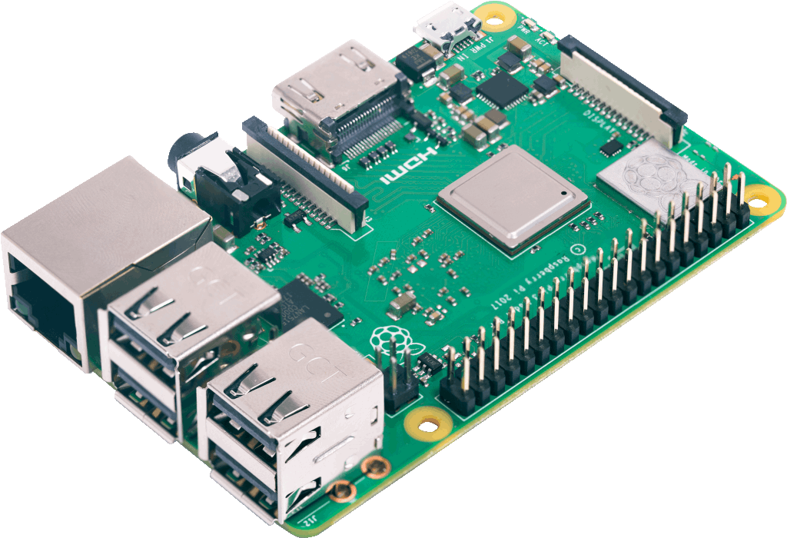
01
MEET PLUTO
A Compact, Powerful Mini-Computer
THE PLUTO PROJECT

Slide 6
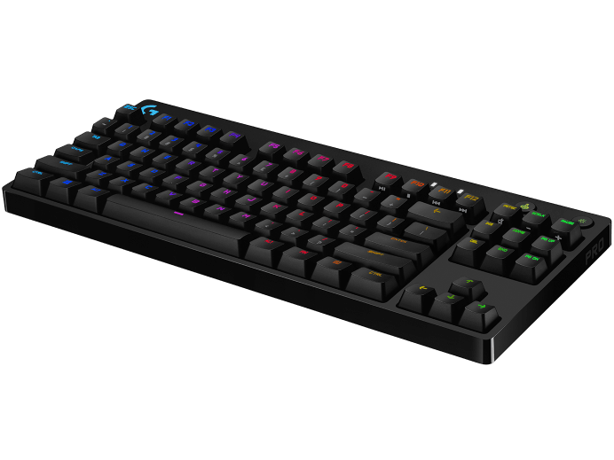
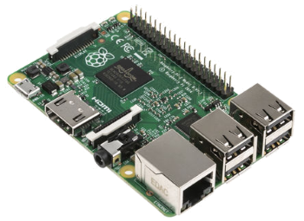
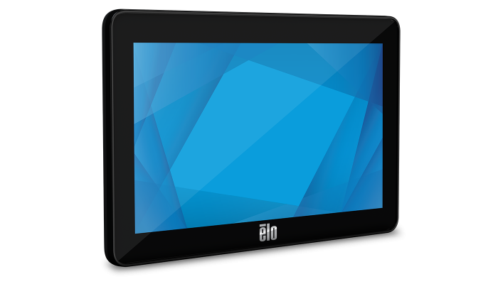
WHATS PLUTO?
Pluto is a fully fledged, highly productive and capable computer system that's packed into a container barely the size of your palm! The System is powerful, cheap and easily manufacturable on a small and large scale.
THE PLUTO PROJECT

Slide 7
DISSECTING PLUTO
YOUR LOGO HERE
Raspberry Pi Zero
NeoSec 7 Inch Display
Zebronics 50% Keyboard
THE PLUTO PROJECT

Slide 8
02
WHY PLUTO?
What does Pluto do better than others?
THE PLUTO PROJECT

Slide 9
ADVANTAGES OF PLUTO
CHEAP
COMPACT
POWERFUL
Pluto has been made with cost in mind, the Pluto system will cost only ₹3,000
Pluto fits into the palm of your hand, its easily made and shipped in bulk.
Pluto comes with LightOS, a modern and very capable OS that can run like any modern desktop OS
THE PLUTO PROJECT

Slide 10
OUR GOALS, WHY PLUTO EXISTS :
Computers are expensive! The cheapest computers are around ₹10K – ₹15K, that's a lot! Pluto exists to :-
Bring Computers to every corner of India as well as the World
Provide Educational Institutions with an economic way of teaching students programming // other subjects
Provide companies which may require cheap and easily accessible mini computers with them.
THE PLUTO PROJECT

Slide 11
03
LIGHT OS
LightOS, a fast & nimble operating system
THE PLUTO PROJECT

Slide 12

WHAT IS LIGHTOS?
LightOS is a Minimal, Pragmatic, Fast, Light & Modern Operating System. Some features include :-
Built in Support for the AUR via the Chaotic AUR Project
Light Weight IDE integrated into the OS for learning
Support for over 58,000 Packages and applications for all kinds of requirements
THE PLUTO PROJECT

Slide 13
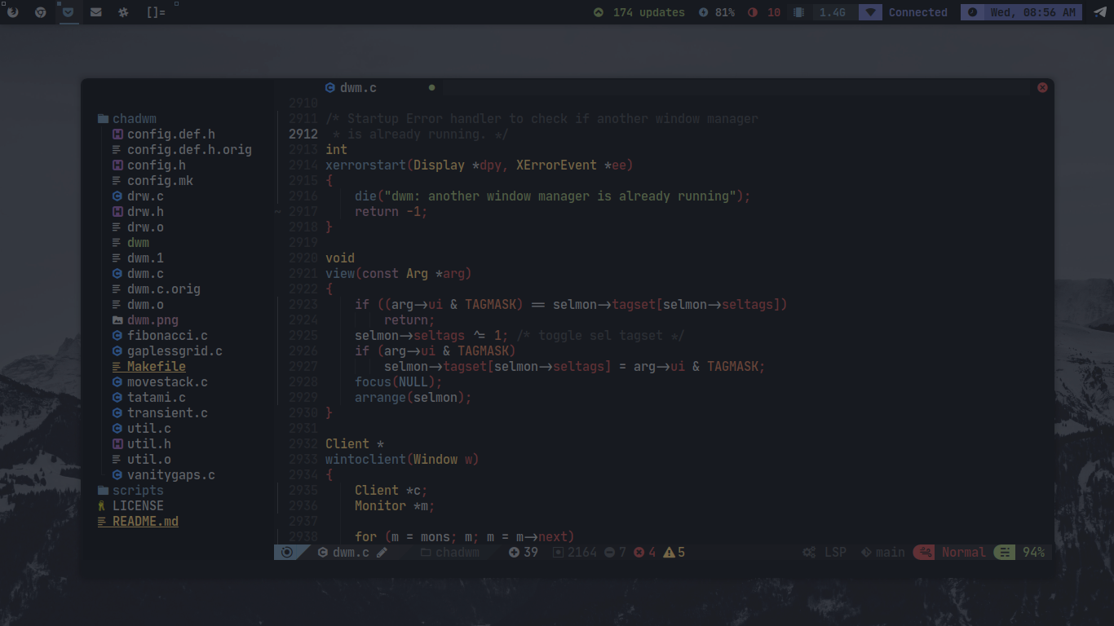
The LightOS Desktop:
INDEX.HTML

Slide 14
ADVANTAGES OF LIGHTOS
COMPACT
NOT RESOURCE HEAVY
FAST
FREE & OPEN SOURCE
LightOS is tiny! It is only ~1 GB Big! Almost 10x – 50x smaller than more popular operating systems
LightOS needs ~200 MB RAM on idle and 1% CPU Usage
LightOS is extremely fast, its able to boot in less than a couple seconds and generally runs lag free
LightOS is completely free & open source software, Licensed under the GPL
THE PLUTO PROJECT

Slide 15
HOW PROFITABLE IS LIGHTOS?
YOUR LOGO HERE
LightOS is 100% free and open source, which begs the question, How is is Profitable? The answer is quite simple, Instead of charging for the system upfront, we will charge for setup and consultation // support fees. Another company, RedHat followed this same approach, where their Operating System (RedHat Enterprise Linux) was free and open source, but their support and consultation was paid. They have an average revenue of $3 billion per year and counting. Today, they serve clients like Microsoft, Google, Oracle, etc.
As shown by RedHat, this kind of business model is highly lucrative and is still largely untapped.
INDEX.HTML

Slide 16
<$34,000,000,000>
YOUR LOGO HERE
The Price RedHat was acquired for by IBM in 2019
THE PLUTO PROJECT

Slide 17
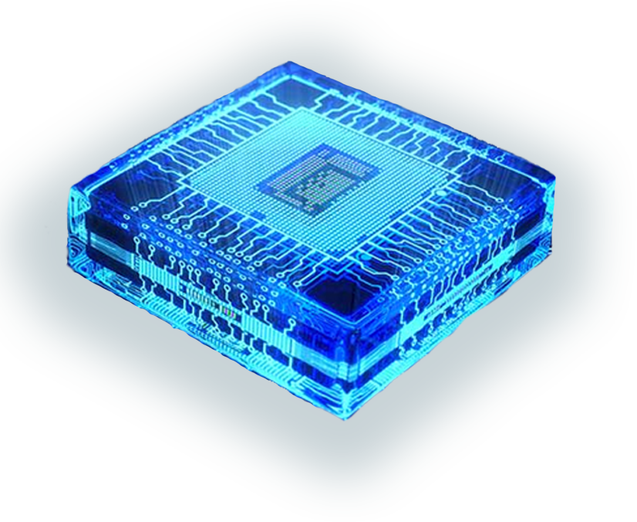
04
SEMICONDUCTORS
What will India's Semiconductor Revolution mean for Pluto?
THE PLUTO PROJECT

Slide 18
— Pat Gelsinger, CEO at Intel
“The World is run by the Semiconductor Industry”
THE PLUTO PROJECT

Slide 19
India And Semiconductors
NEW FABS IN INDIA
WHAT THIS MEANS FOR PLUTO
The Government has been working closely with various Indian and Taiwanese Semiconductor Companies like Foxconn and Vedanta, providing them with up to 50% fiscal support, providing land and logistics among other things. It is clear Indian Semicondutors are coming.
Instead of relying on foreign companies for the chips used in Pluto, we can acquire them for much cheaper. This lets us competitively price our chips and make ourselves a fierce competitor for creating embedded systems and such. Possibly shaping Pluto into a global competitor
THE PLUTO PROJECT

Slide 20

THANKS!
Thanks for going through this Presentation!
-> Smayan Sahu (Team Lead At Pluto)
Please keep this slide for attribution
THE PLUTO PROJECT

