Slide 1

What is the threat of data to security
Jack patton

Slide 2
Any exploit is a total exploit
A hacker with access to a system and unlimited time has a 100% chance of breaking in
The only question is how long it will take and if its worth the grind
The weakest point in any system is always human through user error or oversights in the code.
A system cannot be completely isolated and still remain usefull

Slide 3
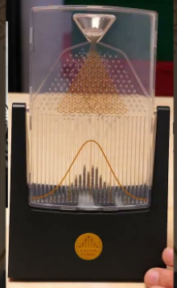
Data cuts down the required time via predictable chaos
The Barnum effect
A tactic used by magicians for century’s
It states that specific things about someone will seem very personal and accurate to just them
But in reality they apply to the vast majority of the population
A basic example is “you project an outward persona of confidence, yet you are quite timid and anxious on the inside”
By playing the numbers and knowing the data, you can appear almost telepathic 99% of the time.

Slide 4
Rockyou.txt
A LONG list of the most popular passwords
Heres some examples
123456, 12345, 123456789, password, iloveyou, princess, 1234567, rockyou, 12345678, abc123, Nicole, Daniel, babygirl, monkey, lovely, Jessica, 654321, Michael, Ashley, qwerty, 111111, iloveu, 000000

Slide 5
Precalculated hashes
Passwords are processed via a one-way hashing algorithm
To turn a password back into human readable format, you need to hash potential passwords and see if they match
Rainbow tables contain a dataframe of millions of passwords and their hashes together, so cracking the password becomes the much easier search operation.

Slide 6
Mask & brute force attacks
Let me guess your passwords for a one cap and number password
Cap in front, lower case, then the numbers.
This cuts down the possible combinations by quadrillions
Alternatively I can generate data and brute force it

Slide 7
Cookie theft
Its not as innocent as stealing from the cookie jar as a kid
Cookies track everything
Even your screen size
It can be used to find things that make you stand out on the internet and thus track you.
Governments and hackers are both guilty of this

Slide 8
What do hackers do with the data they collect
Essentially, sell the account information to other hackers who can then use the information to further exploit other systems.
Its very common for a credit card data theif to never even touch the banks of his victims.
They sell the information at a fixed price and let others do the real dirty work.
The economy is mostly data

Slide 9






Any questions

