Slide 1
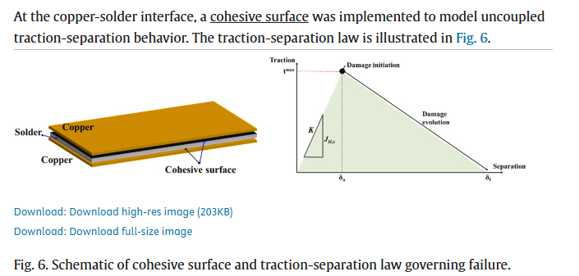
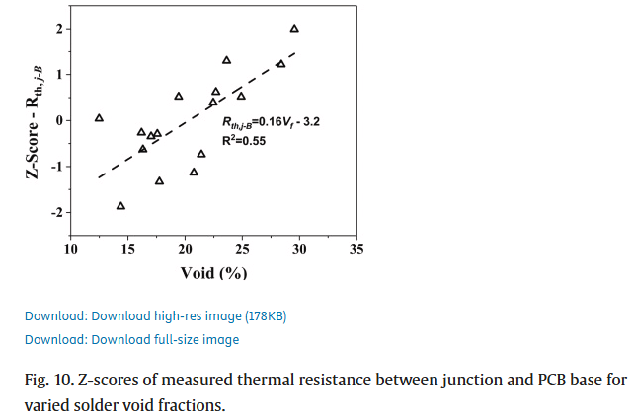
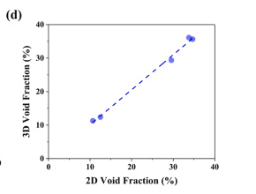
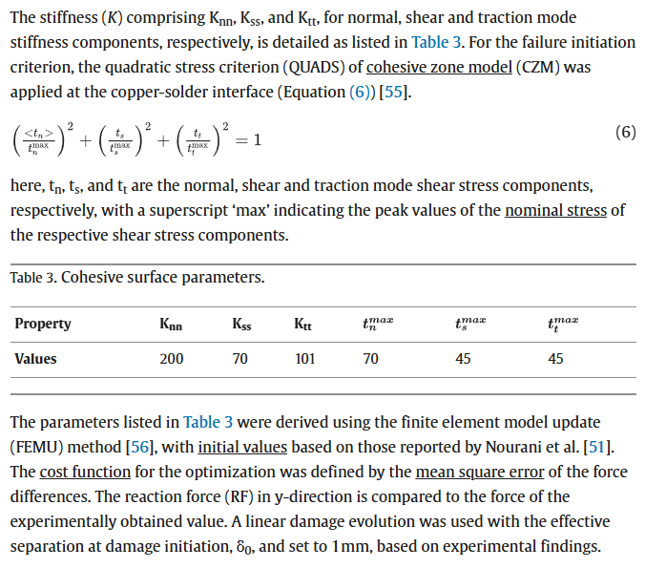
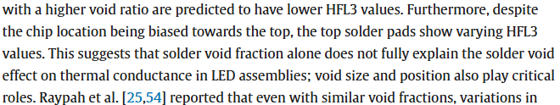
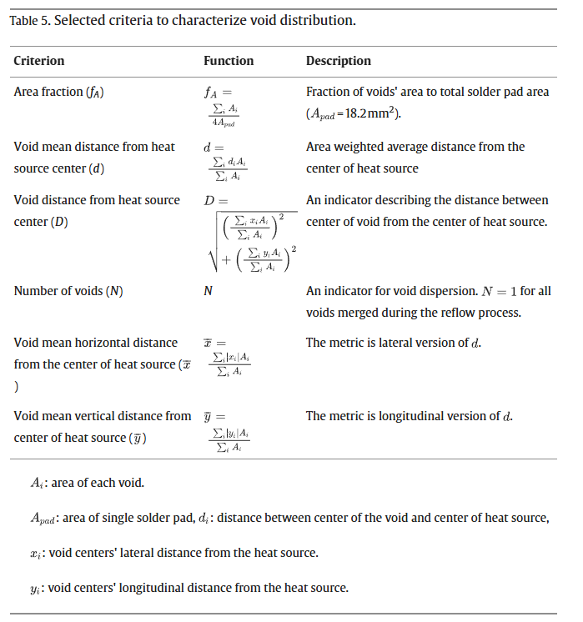
Seo Yeon Jo, Gyu-Jang Sim, Eun Jeong Park, Jinheung Park, Jung Yun Won, Hansol Kim, Myoung-Gyu Lee,
Effect of solder void on mechanical and thermal properties of flip-chip light-emitting diode: Statistical analysis based on finite element modeling,
Heliyon,
Volume 10, Issue 12,
2024,
e33242,
ISSN 2405-8440,
https://doi.org/10.1016/j.heliyon.2024.e33242.
(https://www.sciencedirect.com/science/article/pii/S2405844024092739)
Single reference point for strain
Modeled solder-copper bond as a cohesive surface
Used linear regression for void position as well as percentage
Good general source

Slide 2
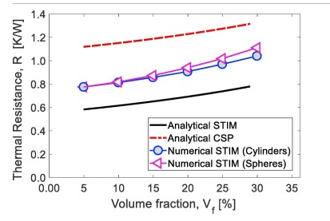
Michael I. Okereke, Yuxiao Ling,
A computational investigation of the effect of three-dimensional void morphology on the thermal resistance of solder thermal interface materials,
Applied Thermal Engineering,
Volume 142,
2018,
Pages 346-360,
ISSN 1359-4311,
https://doi.org/10.1016/j.applthermaleng.2018.07.002.
(https://www.sciencedirect.com/science/article/pii/S1359431118320465)
This study generates 3-D voids and then computes the thermal resistance. One problem is that it just sets a temperature boundary condition on the chip and not electrically models it.
Slight thermal differences between spherical and cylindrical shapes, but not enough to be super important. It might have a bigger impact on stress though.

Slide 3
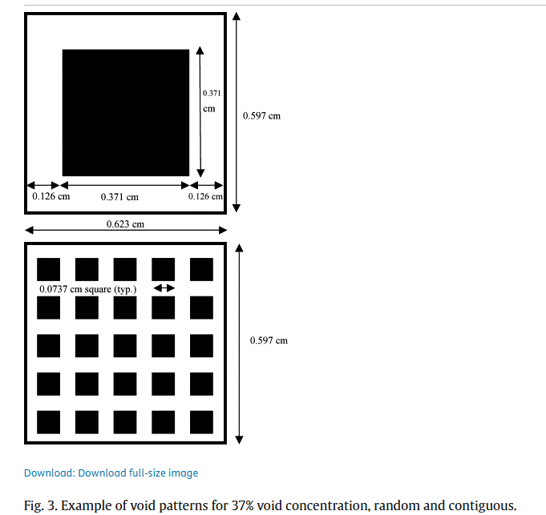
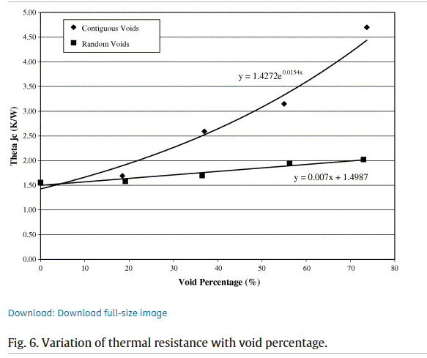
Amy S. Fleischer, Li-hsin Chang, Barry C. Johnson,
The effect of die attach voiding on the thermal resistance of chip level packages,
Microelectronics Reliability,
Volume 46, Issues 5–6,
2006,
Pages 794-804,
ISSN 0026-2714,
https://doi.org/10.1016/j.microrel.2005.01.019.
(https://www.sciencedirect.com/science/article/pii/S0026271405002945)
Etches small voids into the back of the chip which allows the precise control of void % and spacing
Main thing showed is that a large central void is very bad
EXPERIMENTAL evidence for large vs distributed

Slide 4
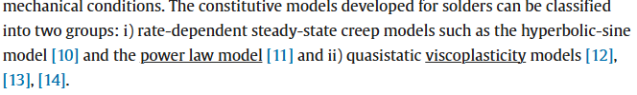
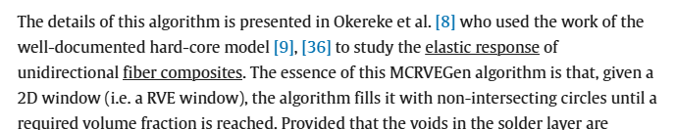
Van Nhat Le, Lahouari Benabou, Victor Etgens, Quang Bang Tao,
Finite element analysis of the effect of process-induced voids on the fatigue lifetime of a lead-free solder joint under thermal cycling,
Microelectronics Reliability,
Volume 65,
2016,
Pages 243-254,
ISSN 0026-2714,
https://doi.org/10.1016/j.microrel.2016.07.098.
(https://www.sciencedirect.com/science/article/pii/S0026271416302426)
Uses Anand’s visco-plastic model (most popular model)
Focused on power electronics
Uses MCRVEGen program to automatically generate voids based on the experimental diameter distribution (lognormal distribution)
Uses a cyclical loading profile based on environmental temp change

Slide 5
Kenny C. Otiaba, M.I. Okereke, R.S. Bhatti,
Numerical assessment of the effect of void morphology on thermo-mechanical performance of solder thermal interface material,
Applied Thermal Engineering,
Volume 64, Issues 1–2,
2014,
Pages 51-63,
ISSN 1359-4311,
https://doi.org/10.1016/j.applthermaleng.2013.12.006.
(https://www.sciencedirect.com/science/article/pii/S1359431113008831)
COME BACK LATER
Uses Anand’s vistoplastic material model
Also uses volumetric strain energy concentration to show where the damage sites are

Slide 6
S. Fukunaga and T. Funaki, "A Novel Transient Thermal Characterization System for Power Modules," in IEEE Journal of Emerging and Selected Topics in Power Electronics, doi: 10.1109/JESTPE.2025.3561893.
Uses structure function method on power modules
Shows the maximum cut-off time for square root of t extrapolation
Improves on the moving average filter
Decent explanation of algorithm, but doesn’t really add anything new other than the better filter

Slide 7

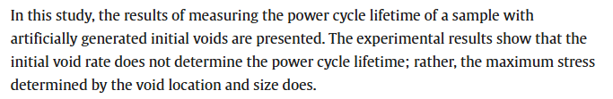
Relationship between void ratio and
Hiroshi Onodera, Nobuyuki Shishido, Daisuke Asari, Hiroshi Isono, Wataru Saito,
Effect of solder junction void variation in power semiconductor package on power cycle lifetime,
Microelectronics Reliability,
Volume 161,
2024,
115471,
ISSN 0026-2714,
https://doi.org/10.1016/j.microrel.2024.115471.
(https://www.sciencedirect.com/science/article/pii/S0026271424001513)
Relationship between voids and Power Module cycling lifetime
The location of the voids had a bigger impact on lifetime than void %

Slide 8

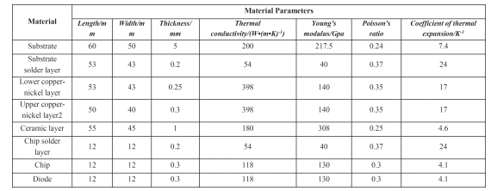
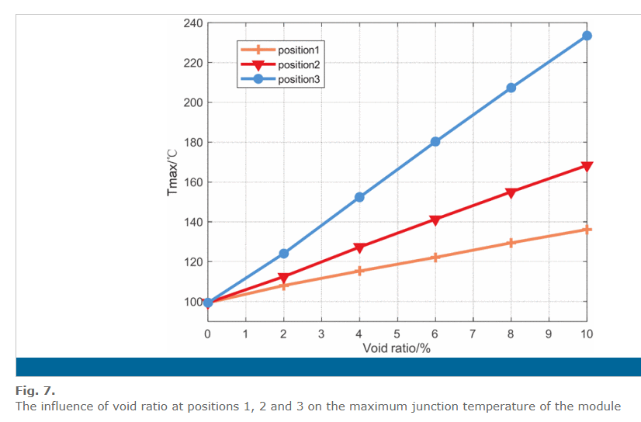
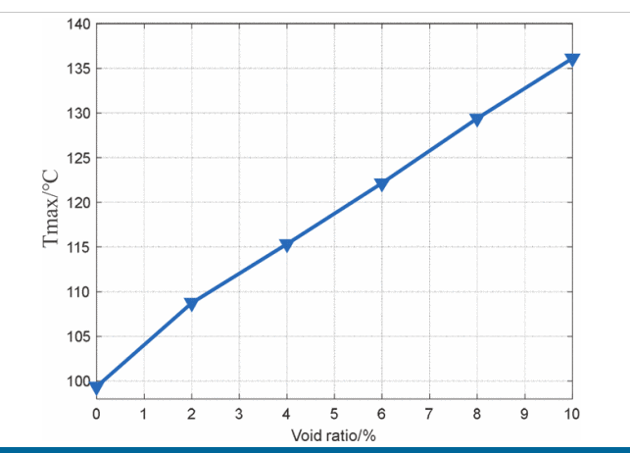
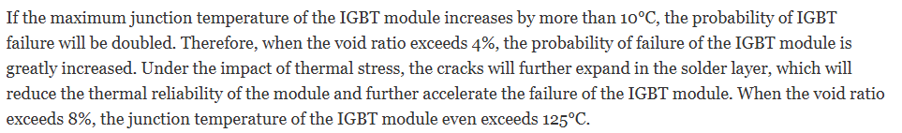
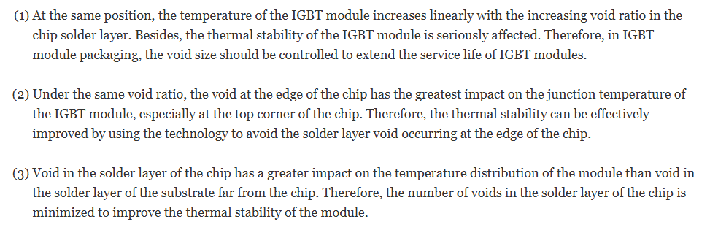
Relationship between void ratio and
G. Yang, D. Liu, Z. Li, W. Wang, T. Wang and X. Heng, "Analysis of the influence of voids in solder layer on IGBT failure based on ANSYS," 2021 IEEE 16th Conference on Industrial Electronics and Applications (ICIEA), Chengdu, China, 2021, pp. 768-773, doi: 10.1109/ICIEA51954.2021.9516102.
IGBT temperature distribution under different void sizes and positions
#2 dubious

Slide 9

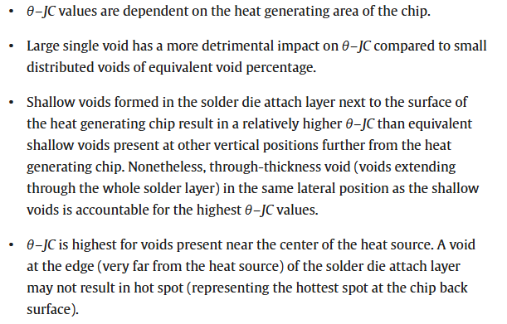
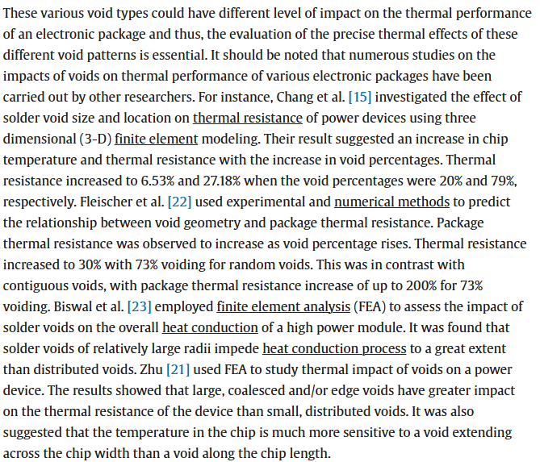
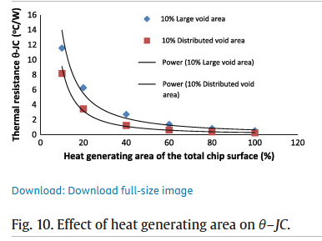
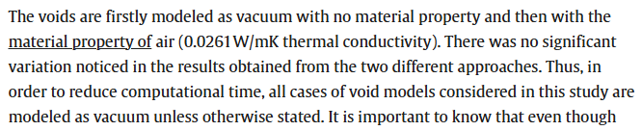
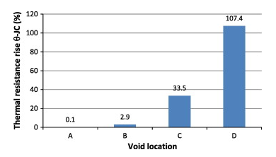
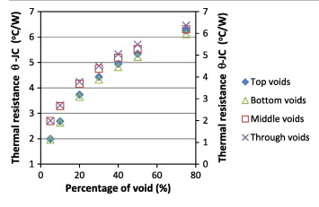
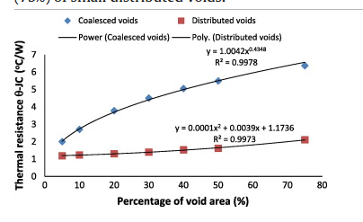
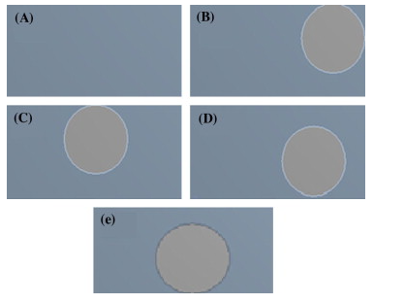
Relationship between void ratio and
Kenny C. Otiaba, R.S. Bhatti, N.N. Ekere, S. Mallik, M.O. Alam, E.H. Amalu, M. Ekpu,
Numerical study on thermal impacts of different void patterns on performance of chip-scale packaged power device,
Microelectronics Reliability,
Volume 52, Issue 7,
2012,
Pages 1409-1419,
ISSN 0026-2714,
https://doi.org/10.1016/j.microrel.2012.01.015.
(https://www.sciencedirect.com/science/article/pii/S0026271412000339)
Smaller-scale power packages

Slide 11
Auxillary Sources
Details about Anand model: https://scholar.google.com/scholar_lookup?title=Constitutive%20equations%20for%20hot-working%20of%20metals&publication_year=1985&author=L.%20Anand

