Slide 1
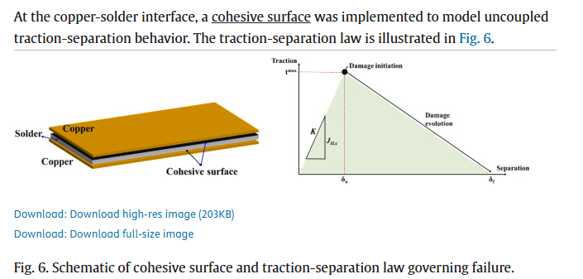
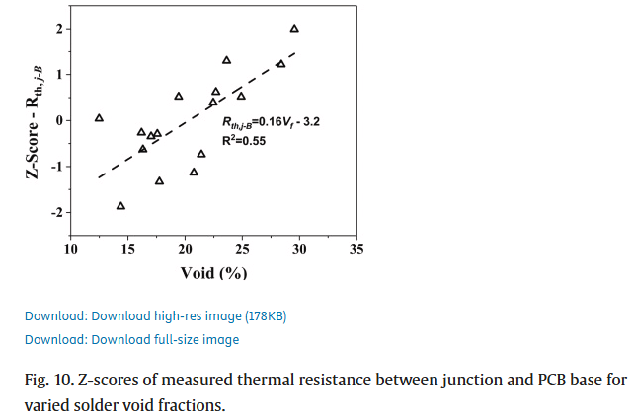
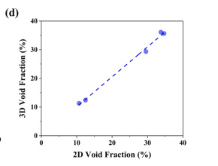
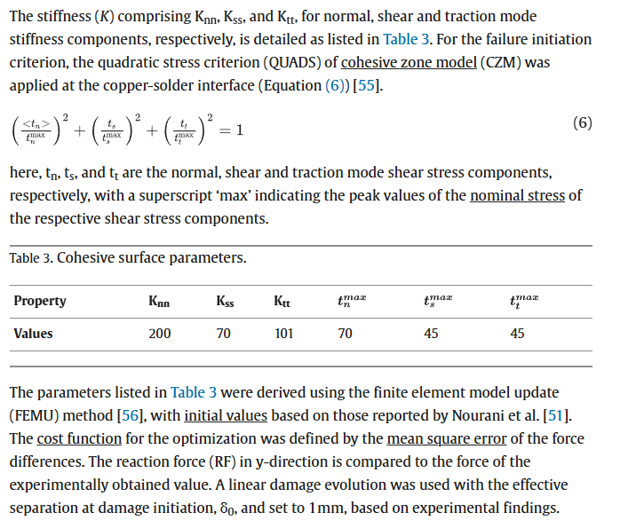
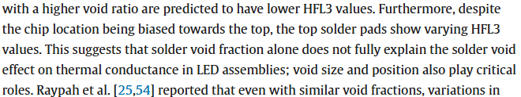
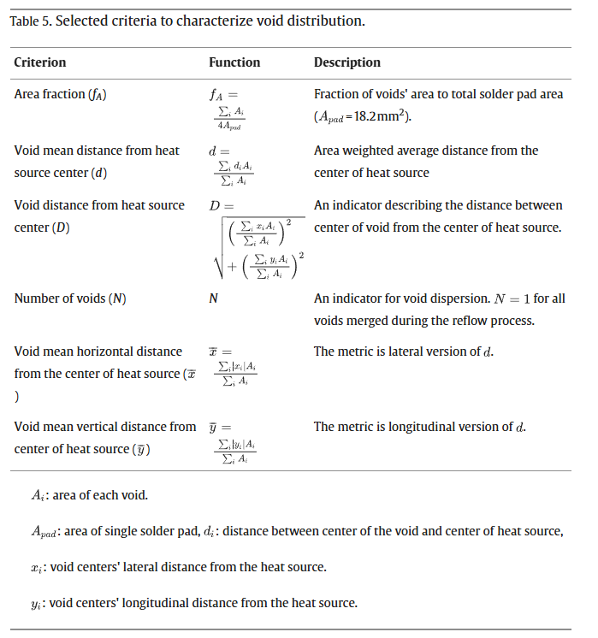
Seo Yeon Jo, Gyu-Jang Sim, Eun Jeong Park, Jinheung Park, Jung Yun Won, Hansol Kim, Myoung-Gyu Lee,
Effect of solder void on mechanical and thermal properties of flip-chip light-emitting diode: Statistical analysis based on finite element modeling,
Heliyon,
Volume 10, Issue 12,
2024,
e33242,
ISSN 2405-8440,
https://doi.org/10.1016/j.heliyon.2024.e33242.
(https://www.sciencedirect.com/science/article/pii/S2405844024092739)
Single reference point for strain
Modeled solder-copper bond as a cohesive surface
Used linear regression for void position as well as percentage
Good general source

Slide 2
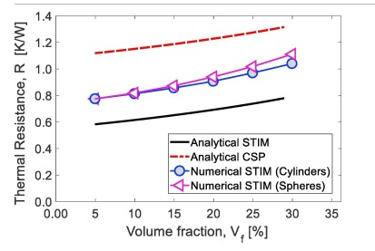
Michael I. Okereke, Yuxiao Ling,
A computational investigation of the effect of three-dimensional void morphology on the thermal resistance of solder thermal interface materials,
Applied Thermal Engineering,
Volume 142,
2018,
Pages 346-360,
ISSN 1359-4311,
https://doi.org/10.1016/j.applthermaleng.2018.07.002.
(https://www.sciencedirect.com/science/article/pii/S1359431118320465)
This study generates 3-D voids and then computes the thermal resistance. One problem is that it just sets a temperature boundary condition on the chip and not electrically models it.
Slight thermal differences between spherical and cylindrical shapes, but not enough to be super important. It might have a bigger impact on stress though.

Slide 3
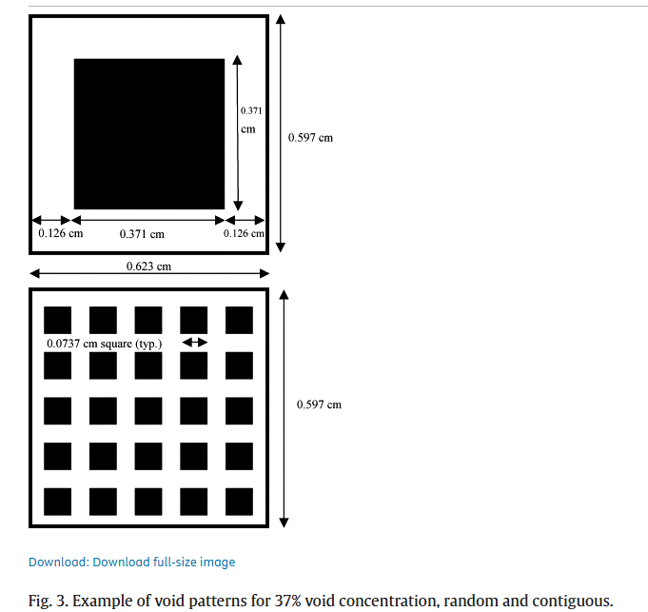
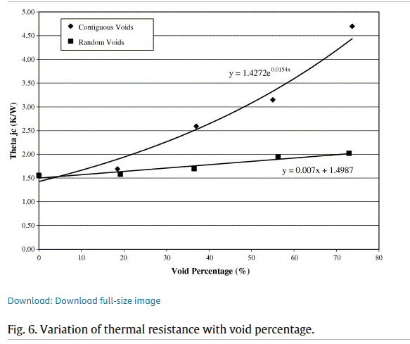
Amy S. Fleischer, Li-hsin Chang, Barry C. Johnson,
The effect of die attach voiding on the thermal resistance of chip level packages,
Microelectronics Reliability,
Volume 46, Issues 5–6,
2006,
Pages 794-804,
ISSN 0026-2714,
https://doi.org/10.1016/j.microrel.2005.01.019.
(https://www.sciencedirect.com/science/article/pii/S0026271405002945)
Etches small voids into the back of the chip which allows the precise control of void % and spacing
Main thing showed is that a large central void is very bad

Slide 4
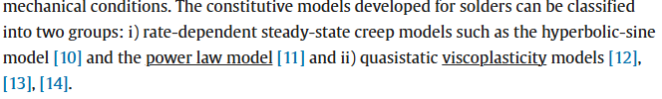
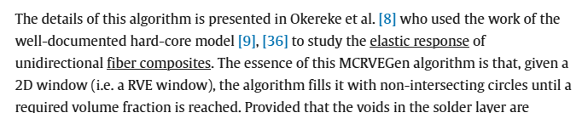
Van Nhat Le, Lahouari Benabou, Victor Etgens, Quang Bang Tao,
Finite element analysis of the effect of process-induced voids on the fatigue lifetime of a lead-free solder joint under thermal cycling,
Microelectronics Reliability,
Volume 65,
2016,
Pages 243-254,
ISSN 0026-2714,
https://doi.org/10.1016/j.microrel.2016.07.098.
(https://www.sciencedirect.com/science/article/pii/S0026271416302426)
Uses Anand’s visco-plastic model (most popular model)
Focused on power electronics
Uses MCRVEGen program to automatically generate voids based on the experimental diameter distribution (lognormal distribution)
Uses a cyclical loading profile based on environmental temp change

Slide 5
Kenny C. Otiaba, M.I. Okereke, R.S. Bhatti,
Numerical assessment of the effect of void morphology on thermo-mechanical performance of solder thermal interface material,
Applied Thermal Engineering,
Volume 64, Issues 1–2,
2014,
Pages 51-63,
ISSN 1359-4311,
https://doi.org/10.1016/j.applthermaleng.2013.12.006.
(https://www.sciencedirect.com/science/article/pii/S1359431113008831)
Uses Anand’s vistoplastic material model
Also uses volumetric strain energy concentration to show where the damage sites are

Slide 6
Auxillary Sources
Details about Anand model: https://scholar.google.com/scholar_lookup?title=Constitutive%20equations%20for%20hot-working%20of%20metals&publication_year=1985&author=L.%20Anand

