Slide 1
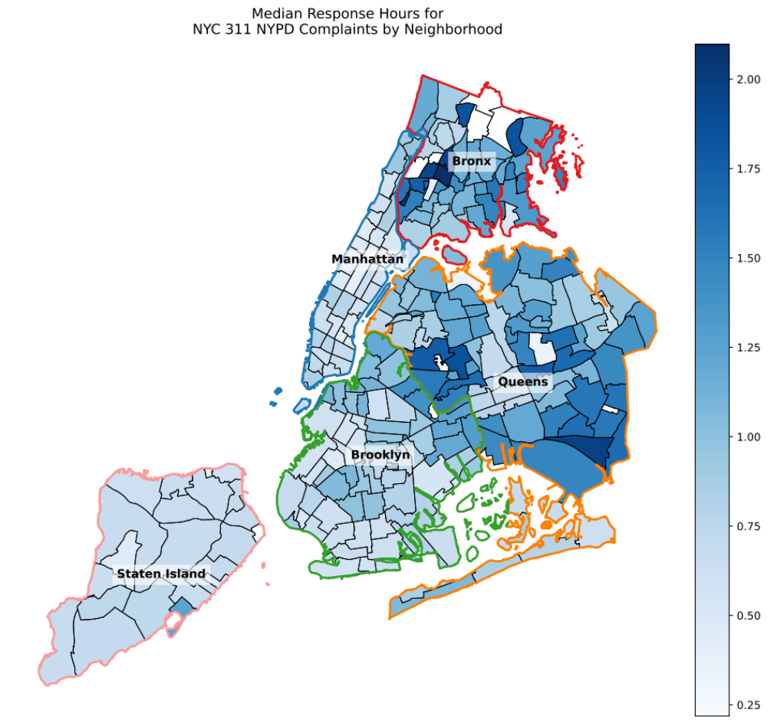
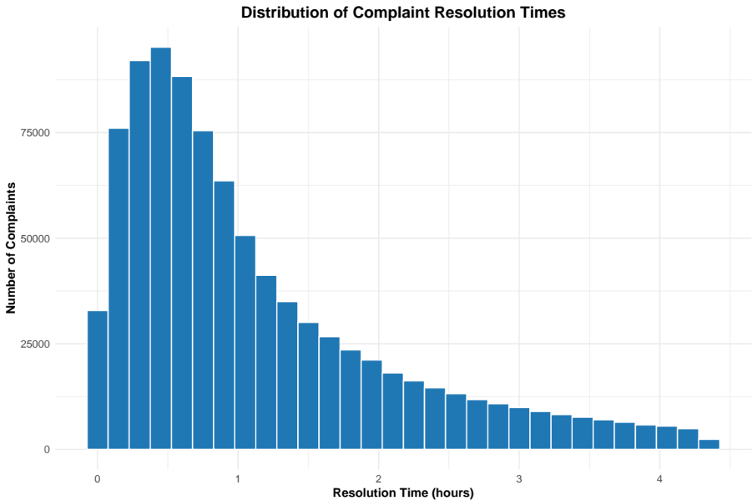
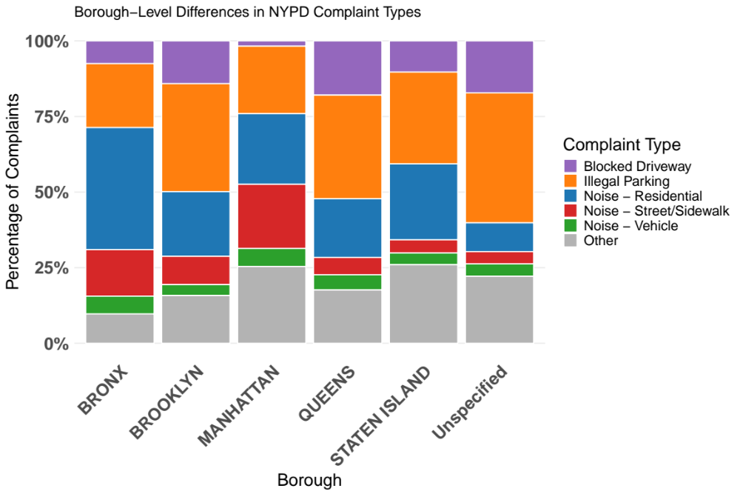
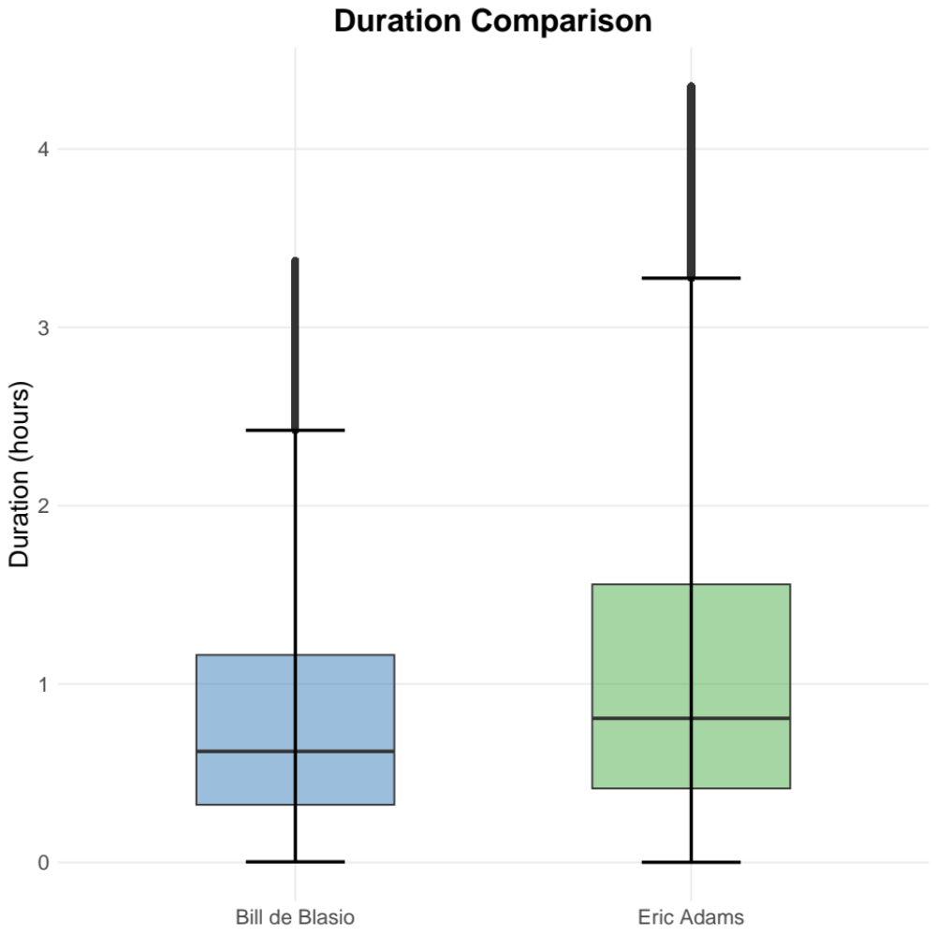
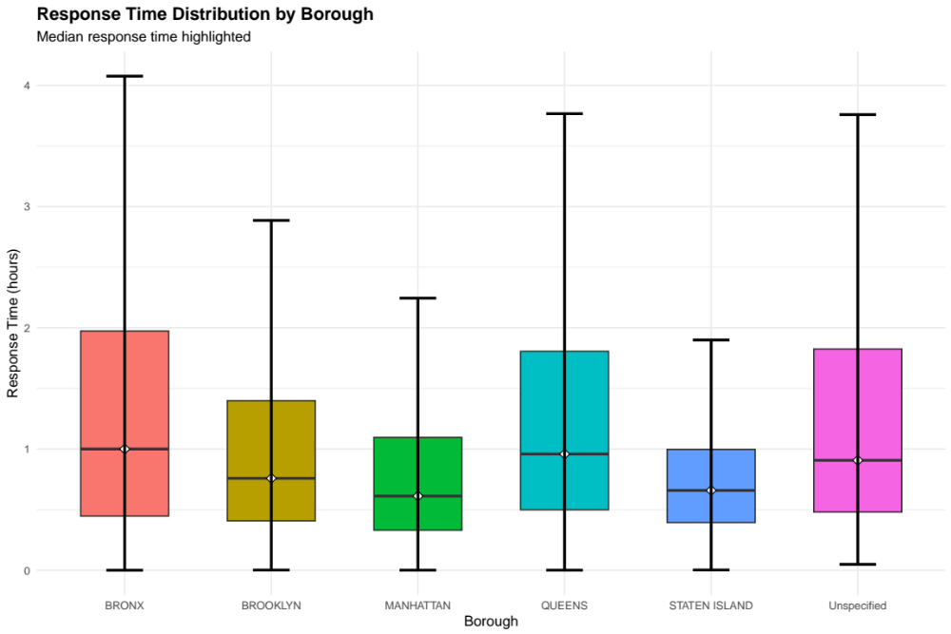
NYC Service Request Statistical Analysis
Abdelrahman Aggour
Hochschule Mittweida
Abstract
In light of recent discussions surrounding equity and accountability in public services following New York City’s mayoral election, this study examines whether the New York City Police Department (NYPD) resolves service requests uniformly across boroughs. Using publicly available data and non-parametric tests, the analysis finds significant borough-level differences in complaint resolution times and police action rates, indicating disparities in NYPD service outcomes across the city.
Methods
This study uses publicly available NYPD service request data collected through an application programming interface (API). Python was used to retrieve the data, inspect available variables, and select those most relevant to the research questions, including borough, complaint type, police action, and complaint open and close dates. Complaint resolution time was calculated as the difference between the complaint close and open timestamps, and open complaints were removed to ensure accurate measurement of resolution duration. Duration had to be calculated manually by subtracting the Open_date from the Closed_date and dividing the resulting time by 3600 to get the hours.
The final dataset contains approximately 1 million observations across 20 variables. Exploratory data analysis revealed that resolution times were not normally distributed, with a strong right skew. As a result, non-parametric statistical tests were used. The Chi-square test of independence was applied to examine whether police action rates differed by borough, while the Kruskal–Wallis test was used to compare resolution times across boroughs. Additionally, Wilcoxon rank-sum tests compared resolution times across the mayoral administrations of Bill de Blasio and Eric Adams.
Results
Relationship Between Borough and Complaint Type
A Chi-square test of independence was conducted to examine whether complaint type is independent of borough. The results show a statistically significant association between borough and complaint type (p < 0.05), indicating that the distribution of complaint types varies across boroughs rather than being uniform citywide.
Effect of Borough on Complaint Resolution Time
A Kruskal–Wallis test was used to compare complaint resolution times across boroughs due to the non-normal distribution of the data. The test revealed a statistically significant difference in resolution times among boroughs (p < 0.05), suggesting that the borough in which a complaint is filed has an effect on how quickly it is resolved.
Differences in Resolution Time Across Mayoral Administrations
A Mann Whitney U test was conducted to compare complaint resolution times between the mayoral administrations of Bill de Blasio and Eric Adams. The results indicate a statistically significant difference in resolution times between the two periods (p < 0.05), suggesting that complaint handling timelines differ across administrations.
Using Chi-squared test the results show that complaint response times differ significantly across boroughs. Median response times is the longest in the Bronx despite its relatively small population.
Introduction
New York City is the largest city in the United States, with a population of over 8 million residents. It is divided into five boroughs by population size, Brooklyn, Queens, Manhattan , the Bronx, and Staten Island, each with distinct population sizes, population densities, and socioeconomic characteristics. These boroughs vary widely in land area, infrastructure, and demand for public services, which can influence how city agencies operate and allocate resources.
Figure 3: Borough−Level Differences in NYPD Complaint Types
source: study.com
Figure 4: Duration comparision under diffrent Mayors
source: EGU blogs
Figure 2:Distribution of Complaint Resolution Time.
Figure 1: Median Response Hours for each Neighborhood
All statistical analyses were conducted in R, while Python was used for data acquisition, preprocessing, and visualization. Geographic visualizations, including maps, were also created using Python to illustrate borough-level patterns.
This study examines whether the NYPD provides service requests equally across New York City’s boroughs. By analyzing complaint resolution times and police action outcomes, the research aims to determine whether differences in service delivery exist that may indicate unequal treatment across the city. Because the data is not normally distributed, non-parametric statistical tests are used.
Figure 5: We Can see the response time in the Bronx is the longest
source: study.com
Acknowledgements
Portions of the data preprocessing code used in this study were adapted from publicly available scripts in the NYC-311-Street-Flooding GitHub repository by Mark Bauer.

