Slide 1









4th Snow Science Winter School
Martin Schneebeli¹ and Marie Dumont²
1: WSL/SLF, Davos, Suisse
2:Météo-France – CNRS, CNRM/CEN, Grenoble, France
4th Snow Science Winter School, Col du Lautaret, February 2018

Slide 2
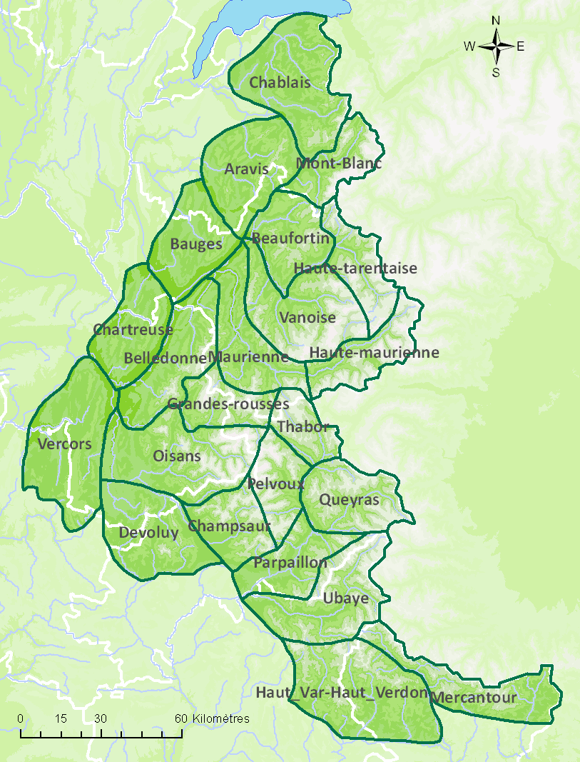
Massifs
Oisans
2100 m, 2400m
Flat + 20° slopes
8 aspects
We are here !
Pelvoux
2100 m, 2400m
Flat + 20° slopes
8 aspects
Notes:
What is snow modelling useful for ?

Slide 3
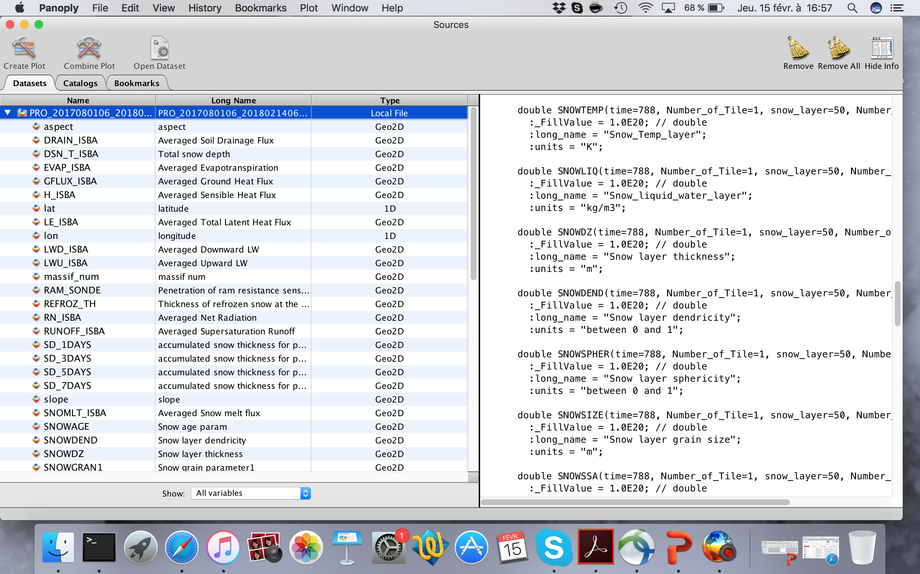
Crocus file outputs = netCDF
Dimensions : time, number_of_tile, number_of_points, snow_layers
Notes:
What is snow modelling useful for ?

Slide 4
Crocus file outputs : different formulation of metamorphism (written in the name of the file)
F06 : Flanner and Zender, 2006 formulation for metamorphism
B92 : Original (Brun et al., 1992) Crocus formulation
C13 : B92 with prognostic SSA (Carmagnola et al., 2014)
Analysis till 2018-02-15 06h , forecast afterwards
6-hours outputs
Notes:
What is snow modelling useful for ?

Slide 5
Python package and notebook example
Python package provided for data plotting
Copy the folder SSWS_notebook_clean on your computer
It contains : python package, PROXXX.nc and read_crocus.ipynb
Before running the notebook
Export PYTHONPATH=PYTHONPATH:Your_folder/snowtools_git/
Notes:
What is snow modelling useful for ?

