Slide 1
Reminder: My story was perfectly told in my “Forge_project.ipynb” file. Telling stories in code files can make the audience feel more involved, and can also enhance the audience's curiosity with relatively simple Python code. In addition, the markdown syntax in the ipynb file makes various title fonts have a good display effect. Please find everything in that file. This is just a abstraction for what I’ve done in the ipynb file.

Slide 2
Can You Get Rich by Doing Machine Learning?
Peggy Cui
10/27/2024

Slide 3
Why This Dataset?
Dataset Motivation: The dataset examines various factors in machine learning (ML) careers, giving insights into salary, skills, and the industry.
Interest: With ML as a rapidly growing field, understanding career opportunities and financial potential can be motivating for students and professionals.
Questions:
"What skills are most valued in machine learning careers?"
"What salary ranges exist based on skills or job roles in ML?"
"What factors contribute most to higher salaries?"

Slide 4
Data Cleaning and Preprocessing
Cleaning Steps:
Handled missing values by filling with median or dropping irrelevant rows.
Removed duplicates to ensure data accuracy.
Standardized formatting for consistent variable types.
Challenges:
Handling extensive missing values in columns crucial to analysis.
Solution: Used imputation and relevant transformations to retain meaningful data.

Slide 5
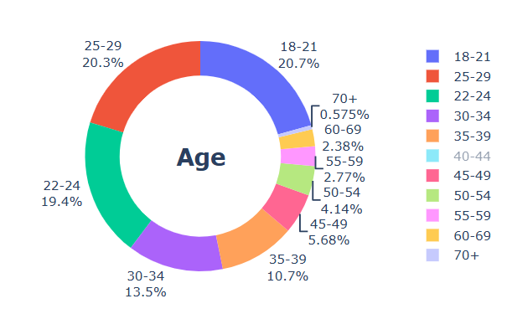
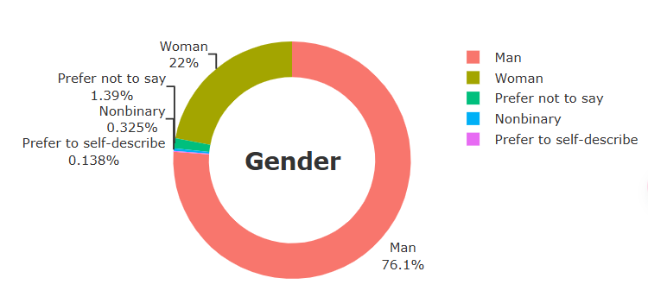
Exploratory Data Analysis

Slide 6
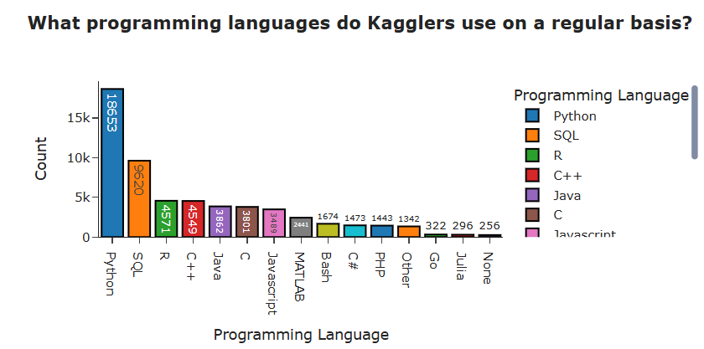
Analysis Question 1 - What Skills Are Most Valued?
Approach:
Analyzed the frequency and salary impact of various skills (e.g., Python, SQL, cloud platforms).
Findings:
Skills in Python, deep learning, and cloud technologies like AWS had a strong positive correlation with higher salaries.
Visualization:
Bar chart of skills vs. average salary, highlighting skills with the greatest impact.

Slide 7
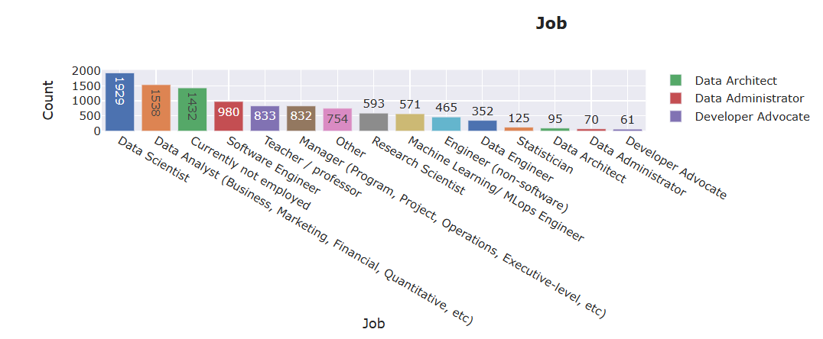
Analysis Question 2 - How Does Job Role Affect Salary?
Approach:
Examined job titles and corresponding salaries to find role-based salary patterns.
Findings:
Data scientists, ML engineers, and AI researchers had higher average salaries compared to junior roles.
Seniority and specialization in specific domains resulted in noticeable salary increases.
Visualization:
Line graph showing average salary by role and experience level.

Slide 8
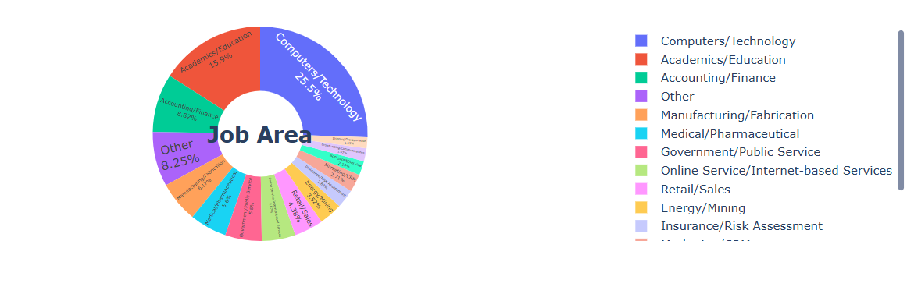
Analysis Question 3 - Does Industry Influence Salary?
Approach:
Compared salaries across different industry sectors (e.g., finance, tech, healthcare).
Findings:
Tech and finance sectors consistently offered higher salaries.
Non-profits and academia had the lowest average salaries in the dataset.
Visualization:
Heatmap or clustered bar chart of industry vs. salary, emphasizing salary peaks in high-paying sectors.

Slide 9
Key Insights Summary
Summary of Findings:
Advanced ML skills and industry-specific knowledge significantly increase earning potential.
High-paying sectors include tech and finance, while roles such as AI researchers and senior data scientists show top compensation levels.
Salary increases with experience and specialization, especially for niche skills like cloud computing.

Slide 10
Challenges and Future Work
Challenges:
Handling a large amount of missing data in critical columns required creative imputation techniques.
Difficulties in accurately analyzing salary trends due to potential outliers.
Future Exploration:
Further investigation into geographic salary variations or gender-based salary disparities.
Analyzing additional datasets for longitudinal trends in ML career development.

Slide 11
Conclusion
Wrap-Up:
The dataset provided valuable insights into the career landscape for machine learning professionals.
Real-World Implication: Emphasizing advanced ML skills, sector-specific expertise, and role specialization is key for career success in ML.
Q&A: Invite questions from the audience.

