Slide 1

[webinar title]
[date]
Presented by the Arctos Working Group
arctos-working-group@googlegroups.com

Slide 2
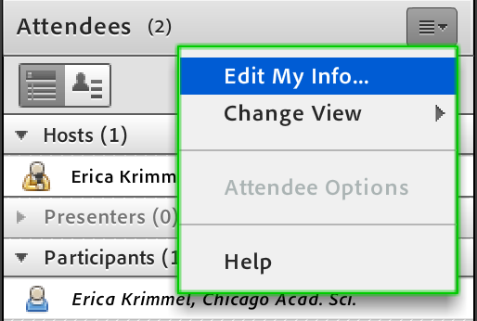
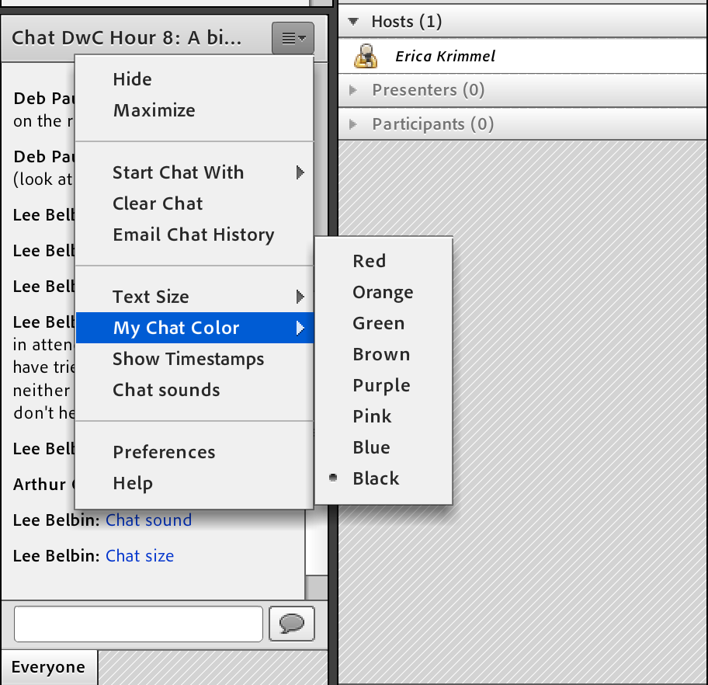
Adobe Connect basics
Post-webinar survey: [link]
Add your affiliation to your name
Use the chat box for questions during the presentation
Participant microphones will be turned on at the end for questions
Headphones work best for audio

Slide 3
Where can I go to learn more?
Arctos webinar recordings: arctosdb.org/learn/webinars
Arctos user information: handbook.arctosdb.org
Arctos database access: arctos.database.museum
NEXT WEBINAR...
[next webinar title]
[next webinar short link]
[next webinar date & time]

