Slide 1



Android Chinese Words Game App
Final Viva Presentation
Liu Weiliang
Telecommunications Engineering with Management
BUPT / QMUL · 2025/26
1

Slide 2

Background, Problem, and Objectives
What CatLingo tries to solve and what the final system delivers
Problem
Objectives
• Existing tools often separate character, pronunciation, and sentence practice.
• Learners need repeated feedback, not only static vocabulary display.
• Progress should be visible across sessions.
1. Build a native Android learning app.
2. Implement three mini-games with different language skills.
3. Store scores, question details, achievements, and progress locally.
4. Keep the system maintainable and explainable.
Target: beginner/intermediate
Android Chinese learners
Core message: the project is an integrated Android prototype, not three isolated demos.
2

Slide 3
System Overview: Game Technologies
Each mini-game has a learning goal and a concrete implementation technique
Character Matching
Pronunciation Quiz
Word Puzzle
Pinyin-to-character recognition
Spoken Chinese practice
Sentence order and meaning
Core technology
Core technology
Core technology
• SQLite random selection
• DAO question loading
• POS-tag distractors
• iFLYTEK ISE scoring
• Microphone workflow
• Score mapping
• SQLite sentence tokens
• HanLP preprocessing
• Reorder / blank mode
Shared workflow
Login
Select
Difficulty
Play
Store
Review
All three games write comparable session scores and question-level records.
3

Slide 4
Architecture and Technology Stack
Native Android layers connect UI, gameplay, persistence, and services
Runtime layers
Main stack
UI layer
Activities + XML layouts
• Java 11
• XML UI
• SQLite + DAO
• JSON import
• HanLP / pinyin4j
• iFLYTEK ISE
GameActivity dispatches the three modes
Game control
Persistence
DAO classes + SQLite tables
Why this matters: native Android makes the speech SDK, UI lifecycle, and local persistence easier to integrate.
Services
iFLYTEK ISE, HanLP, pinyin4j
The original Unity/C# concept became a native Android implementation while keeping the same learning goals.
4

Slide 5
Data Model and Persistence
SQLite turns separate game sessions into one learner history
What is stored
11
Learner
Evidence
profile, login streak
scores, question details
SQLite tables
grouped by role
Content
Motivation
words, sentences, tokens
achievements, progress
Users + achievements
Game records
Content resources
Question banks
JSON to SQLite pipeline
JSON assets -> DataManager -> SeedDataLoader -> SQLite
GameActivity -> Profile / Records
Defence point: the same data model supports all games, so progress is persistent and comparable.
5

Slide 6
Character Matching: Question Selection
Core technology: SQLite-backed question loading and distractor generation
Runtime flow
Why it matters
1
GameActivity receives difficulty
• Difficulty-aware practice
• Plausible wrong options
• Fast local interaction
• Clear evidence for marking
2
DAO queries random words from SQLite
3
Distractors are selected by POS tag
4
Answer feedback is shown immediately
5
Result is saved to game_question_details
6

Slide 7
Pronunciation Quiz: iFLYTEK Scoring
Core technology: microphone input, ISE evaluation, and score mapping
Speech evaluation flow
Saved evidence
1
User holds the mic button
• Recognised content
• Total pronunciation score
• Accuracy / fluency / completeness
• Per-question SQLite result
2
IseEvaluator records audio frames
3
Audio is sent to iFLYTEK ISE
4
XML scores are parsed
5
0-100 score maps to 0-10 game score
Limitation: scores can vary with noise, device, and external service behaviour.
7

Slide 8
Word Puzzle: NLP Token Pipeline
Core technology: HanLP segmentation and sentence-token reconstruction
NLP preprocessing flow
Why it matters
1
Sentences are imported from JSON
• Sentence-level learning
• Blank mode for long sentences
• Sentence answers saved
2
HanLP segments each Chinese sentence
3
pinyin4j adds pinyin labels
4
word_order and word_position are stored
5
GameActivity builds reorder or blank tasks
8

Slide 9
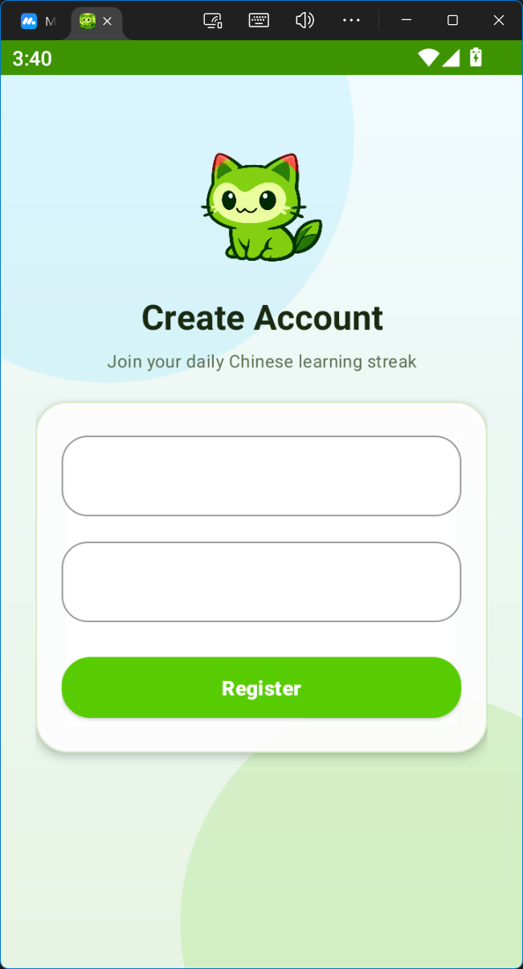
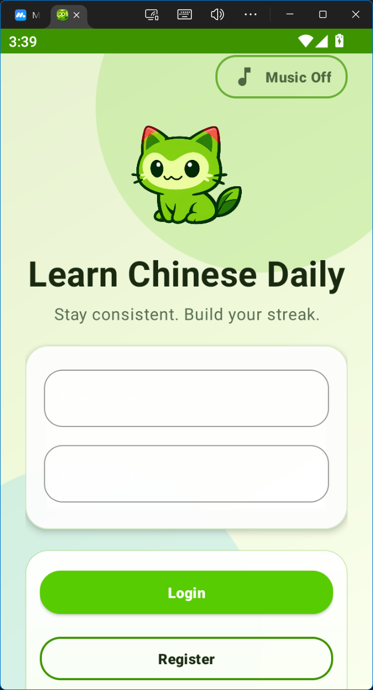
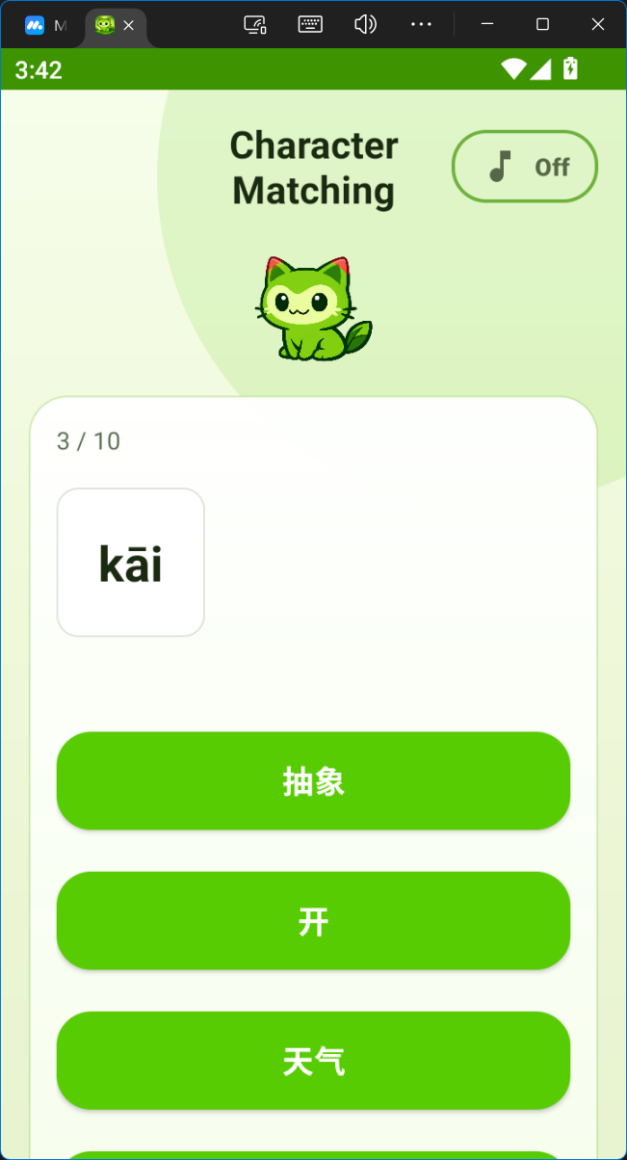
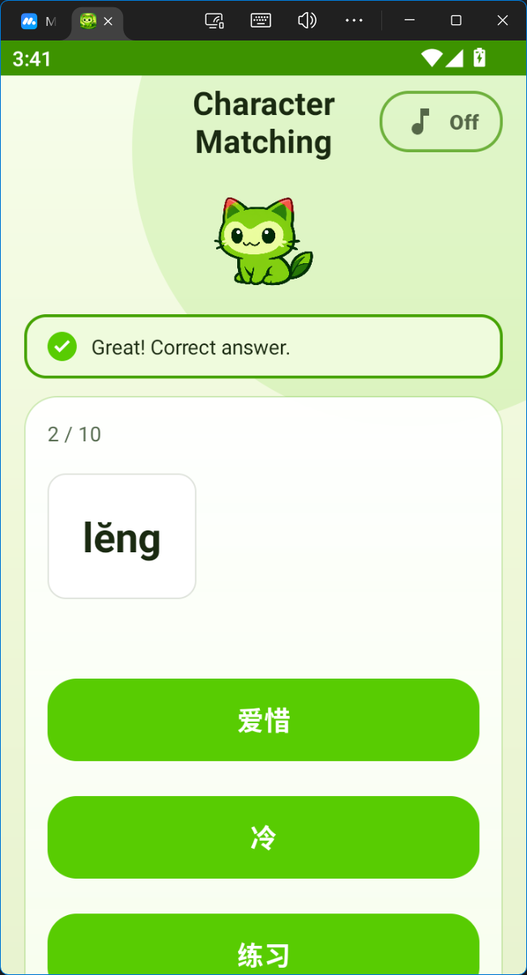
Evidence: User Flow and Matching Game
Screenshots demonstrate implemented login, registration, and immediate answer feedback
User/account flow
Character Matching feedback
9

Slide 10
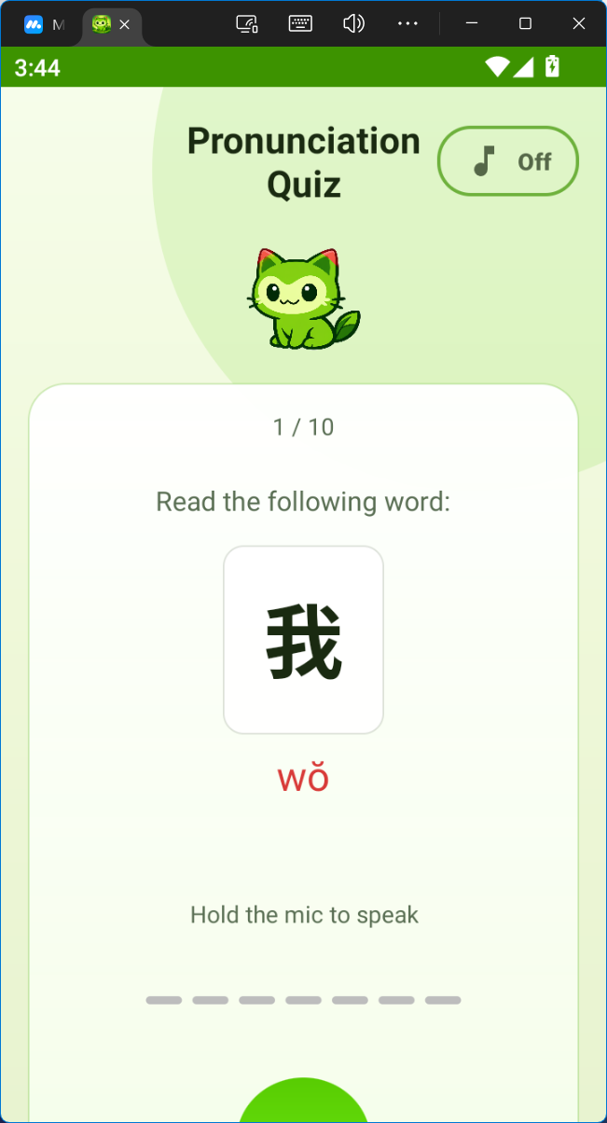
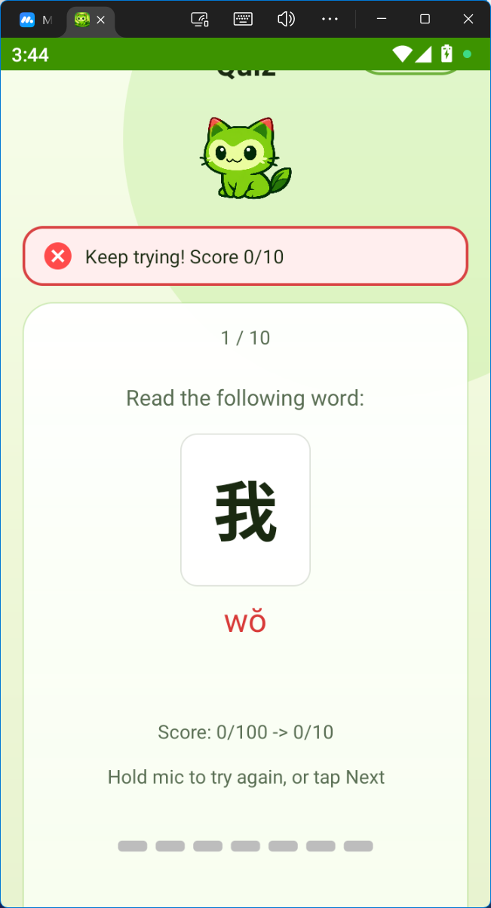
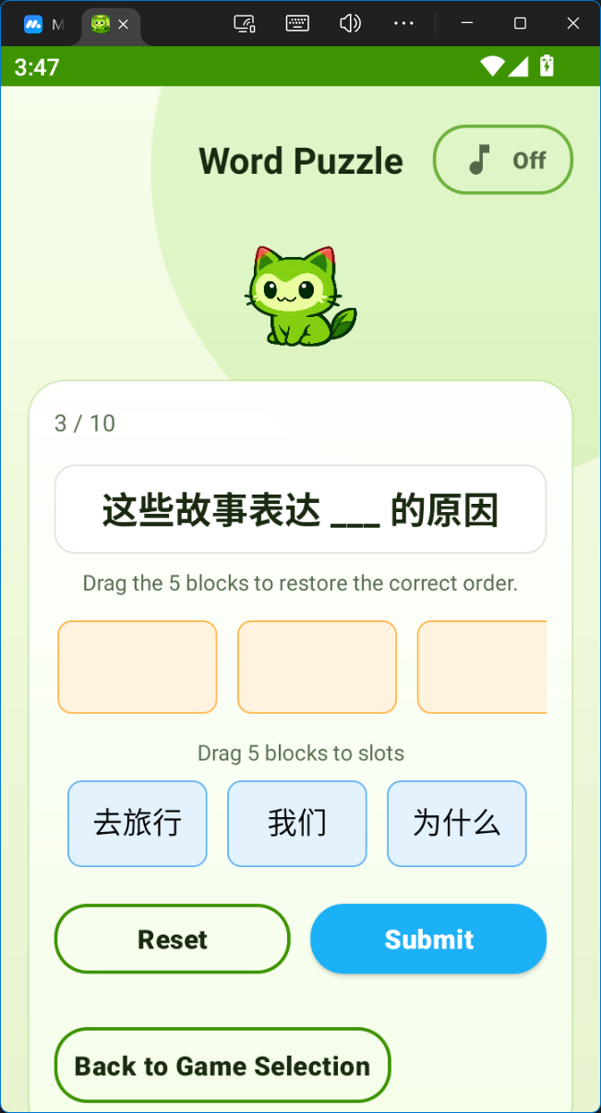
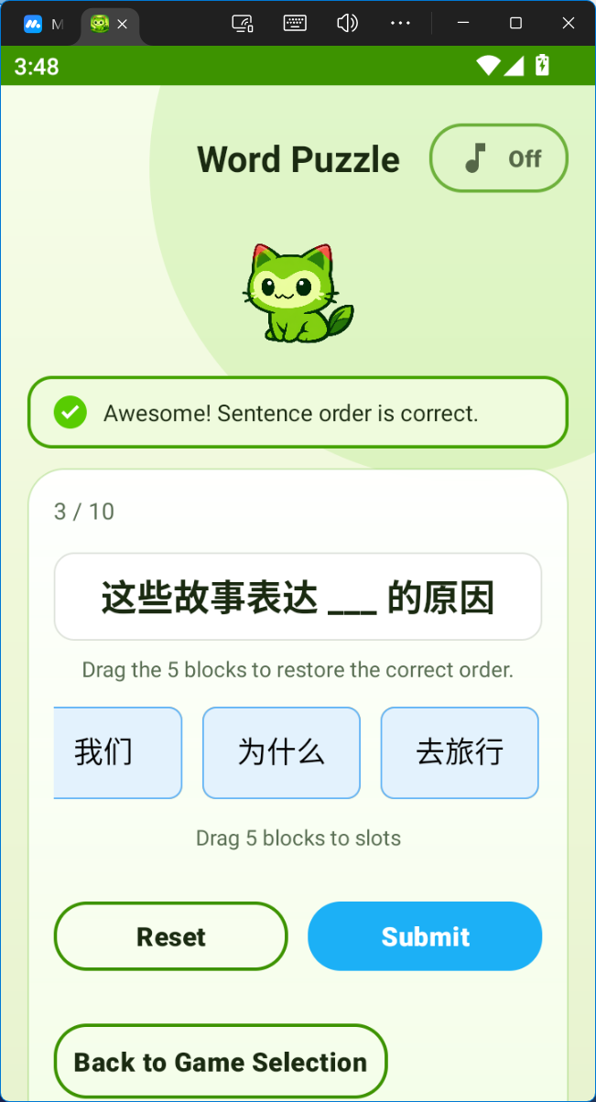
Evidence: Speech and Sentence Tasks
Pronunciation Quiz and Word Puzzle show the two more technical game modes
Pronunciation evaluation
Word Puzzle interaction
10

Slide 11
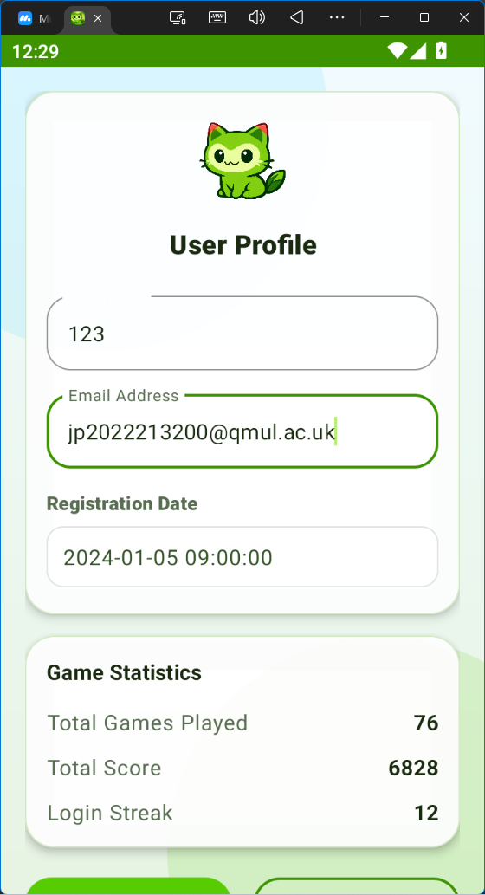
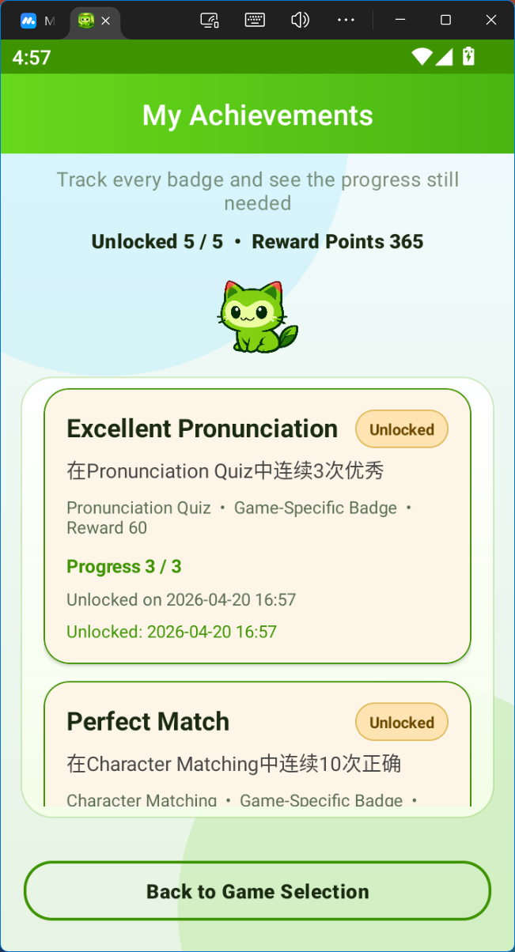
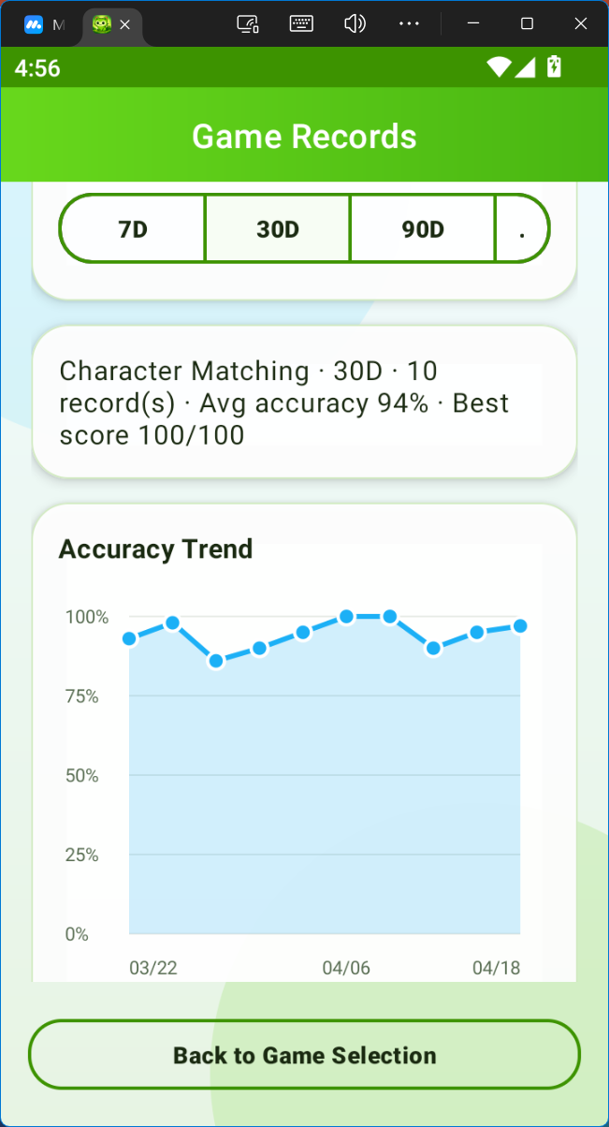
Evidence: Progress and Records
Profile, achievements, and records prove persistent learner tracking
Profile / achievements / records
11

Slide 12
Evaluation Against Objectives
Most core goals were achieved; large-scale user evaluation remains future work
Objective status
Key takeaways
Native Android architecture
Done
• Complete learner workflow
• Strongest evidence: integration, persistence, and speech workflow
• Evaluation is technical feasibility, not long-term learning impact
Three educational mini-games
Done
SQLite + JSON content pipeline
Done
Progress + achievements
Done
Speech evaluation prototype
Done
This is the main answer to the viva panel: the implementation matches the specification outcomes and demonstrates added value.
12

Slide 13
Limitations and Future Work
The prototype is credible, but it is not a finished commercial product
Limitations
Future work
• Local-only storage
• Pronunciation depends on device, noise, and external service behaviour
• Dataset quality affects distractors and sentence tasks
• Cloud account sync
• Richer pronunciation feedback
• Stronger Word Puzzle difficulty modelling
• Larger user study
Positioning: a strong integrated prototype and a clear foundation for extension.
13

Slide 14
Thank you
Questions and discussion
14

