Slide 1
Speech Enhancement Based on Deep Neural Networks
Group 16
Arda C. Bati
Marjan Emadi
Weinan Li
Mingchao Liang

Slide 2

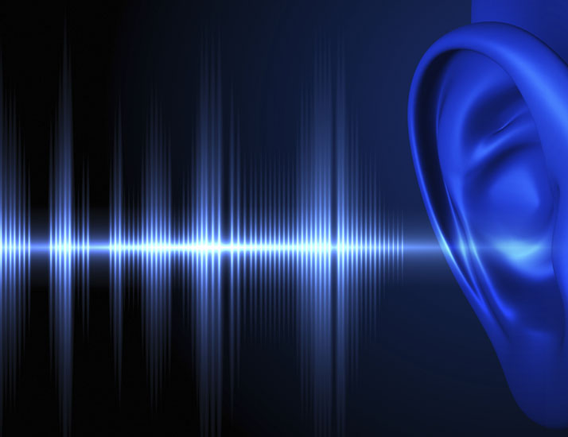
Introduction
The purpose of our project is to reduce the noise present in speech recordings.
There is a noise source in almost any recording we come across such as restaurants, streets, airports, recording equipment etc.
Extracting the clean speech out of these maybe beneficial in many areas, such as telecommunications, voice recognition etc.

Slide 3
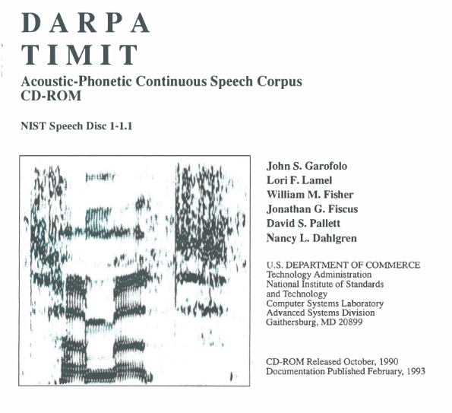
Dataset
Clean Speech
The dataset we use is TIMIT corpus of read speech,
6300 sentences, 630 speakers, different dialects
Divided into train and set: 4620 train, 1680 test
Noise Sources
Noisex: (15 Total, 6 currently used) [3]
Aurora 2: (8 Total, 6 currently used) [4]

Slide 4

Methodology (Overview)
Noise Addition
Preprocessing
Training
Testing
We are mainly inspired by the work of Xu, Yong, et al. [2]
"An experimental study on speech enhancement based on deep neural networks." IEEE Signal processing letters
We are using Deep Neural Networks as the
learner, aided by multiple preprocessing tools
Our work flow is illustrated diagram to
the left

Slide 5
Methodology (Dataset Generation)
Noise Addition
Preprocessing
Training
Testing
4 different noise types with 6 different SNRs: -5, 0, …, 20dB are added to each speech file
For a single speech file, this makes 4 x 6 = 24 combinations, therefore the datasets grows 24 times in size
For train set: all the originl TIMIT train files are used
For test set: 200 file are randomly selected from TIMIT test data
Above 4 plus 2 new noise types are added, to test the DNN with unseen noise types (mismatch evaluation)

Slide 6
Methodology (Preprocessing)
Noise Addition
Preprocessing
Training
Testing
Speech signals are converted into log-spectrum (Fourier Transform)
The log-spectrum data is serialized
The resulting data is fed to an Autoencoder for preliminary feature extraction [5]
Pre training with Restricted Boltzmann Machine [6]
What else?

Slide 7
Methodology (Training)
Noise Addition
Preprocessing
Training
Testing
Minimum mean square error(MMSE) will be used as objective function in the back propagation process.
The weights will be updated based on the gradient and learning rate, after each training epoch or mini-batch
What else?

Slide 8
Methodology (Testing)
Noise Addition
Preprocessing
Training
Testing
Should explain 2 unused noise types & mismatch evaluation / generalization??
For objective evaluation of the results we use two approaches:
Segmental SNR (SSNR) analysis, comparing the original and final SSNR values
Comparison of our model with traditional methods: Spectral Subtraction, Log-MMSE, Wavelet Shrinkage

Slide 9
Results

Slide 10
Results

Slide 11
Further Work
Steps to take until submission

Slide 12
References
[1] https://github.com/philipperemy/timit
[2] Xu, Yong, et al. "An experimental study on speech enhancement based on deep neural networks." IEEE Signal processing letters 21.1 (2014): 65-68.
[3] Varga, Andrew, and Herman JM Steeneken. "Assessment for automatic speech recognition: II. NOISEX-92: A database and an experiment to study the effect of additive noise on speech recognition systems." Speech communication 12.3 (1993): 247-251.
[4] Hirsch, Hans-Günter, and David Pearce. "The Aurora experimental framework for the performance evaluation of speech recognition systems under noisy conditions." ASR2000-Automatic Speech Recognition: Challenges for the new Millenium ISCA Tutorial and Research Workshop (ITRW). 2000.
[5] Lu, Xugang, et al. "Speech enhancement based on deep denoising autoencoder." Interspeech. 2013.
[6] Y. Bengio, “Learning deep architectures for AI,” Found. Trends Mach. Learn., vol. 2, no. 1, pp. 1–127, 2009.

