Slide 1
Speech Enhancement Based on Deep Neural Networks
Group 16
Arda C. Bati
Marjan Emadi
Weinan Li
Mingchao Liang

Slide 2

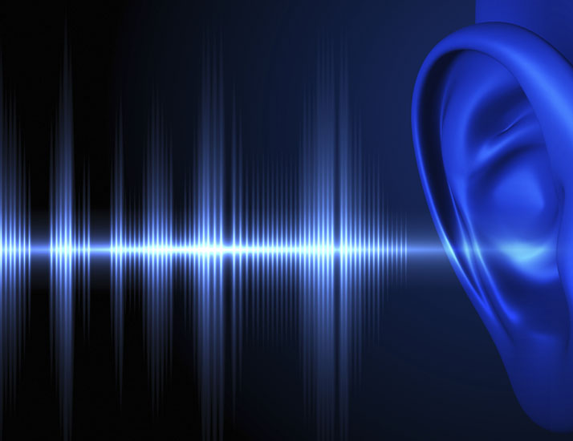
Introduction
The purpose of our project is to reduce the noise present in speech recordings.
There is a noise source in almost any recording we come across such as restaurants, streets, airports, recording equipment etc.
Extracting the clean speech out of these maybe beneficial in many areas, such as telecommunications, voice recognition etc.

Slide 3
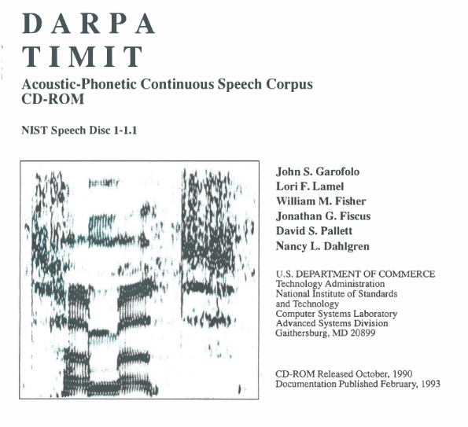
Dataset
Clean Speech
The dataset we use is TIMIT corpus of read speech,
6300 sentences, 630 speakers, different dialects
Divided into train and set: 4620 train, 1680 test
Noise Sources
Noisex: (15 Total, 6 currently used) [3]
Aurora 2: (8 Total, 6 currently used) [4]

Slide 4
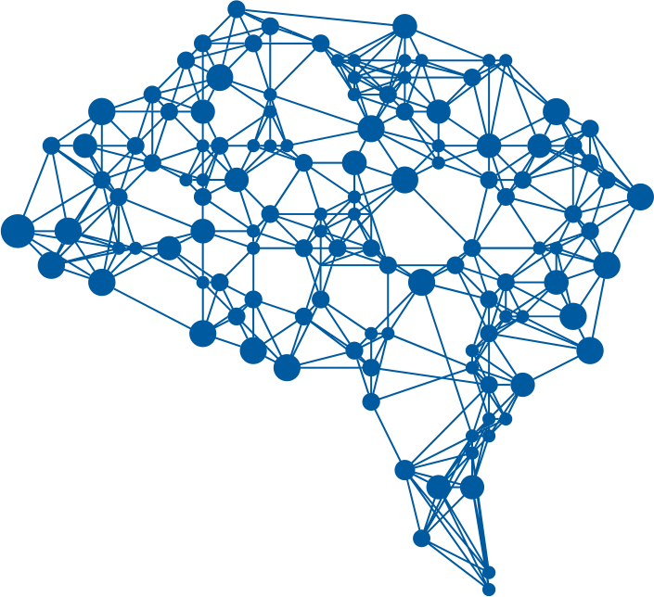
Methodology (Overview)
Noise Addition
Preprocessing
Training
Testing
We are mainly inspired by the work of Xu, Yong, et al. [2]
"An experimental study on speech enhancement based on deep neural networks." IEEE Signal processing letters
We are using Deep Neural Networks as the
learner, aided by multiple preprocessing tools
Our work flow is illustrated diagram to
the left

Slide 5
Methodology (Dataset Generation)
Noise Addition
Preprocessing
Training
Testing
4 different noise types with 6 different SNRs: -5, 0, …, 20dB are added to each speech file
For a single speech file, this makes 4 x 6 = 24 combinations
For train set: all the original TIMIT train files are used
For test set: 200 file are randomly selected from TIMIT test data
The above 4 plus 2 new noise types are added, to test the DNN with unseen noise types (mismatch evaluation)
Down-sampling the speech files from 512 to 128kbps

Slide 6
Methodology (Preprocessing)
Noise Addition
Preprocessing
Training
Testing
Short Time Fourier Transform (STFT) is applied to the train and test files
The resulting files are normalized
Amplitude is coverted into decibels

Slide 7
Methodology (Training)
Noise Addition
Preprocessing
Training
Testing
We are currently using the Autoencoder as the architecture of our DNN network [5]
Minimum mean square error(MMSE) is used as objective function in the back propagation process.
Adam algorithm used for the training process [6]
Currently, we run 10 Epochs, and we use n = 50 mini-batches in each iteration
For each mini-batch, the weights are updated based on the gradient and learning rate

Slide 8
Methodology (Testing)
Noise Addition
Preprocessing
Training
Testing
Conversion back to speech files (the process in Spectogram.py)
Should explain 2 unused noise types & mismatch evaluation / generalization??
For objective evaluation of the results we use two approaches:
Segmental SNR (SSNR) analysis, comparing the original and final SSNR values

Slide 9
Results

Slide 10
Results

Slide 11
Further Work
We are planning to implement Restricted Boltzmann Machines (RBM), instead of Autoencoder architecture
Different evaluation methods than SSNR: Log-Spectral Distortion and Perceptual Evaluation of Speech Quality (PESQ)
We plan to try different Neural Network training tricks to boost performance such as Dropout, Batch Normalization and Adaptive Learning Rates
We plan to compare our model with the results of traditional methods: Spectral Subtraction, Log-MMSE, Wavelet Shrinkage

Slide 12
References
[1] https://github.com/philipperemy/timit
[2] Xu, Yong, et al. "An experimental study on speech enhancement based on deep neural networks." IEEE Signal processing letters 21.1 (2014): 65-68.
[3] Varga, Andrew, and Herman JM Steeneken. "Assessment for automatic speech recognition: II. NOISEX-92: A database and an experiment to study the effect of additive noise on speech recognition systems." Speech communication 12.3 (1993): 247-251.
[4] Hirsch, Hans-Günter, and David Pearce. "The Aurora experimental framework for the performance evaluation of speech recognition systems under noisy conditions." ASR2000-Automatic Speech Recognition: Challenges for the new Millenium ISCA Tutorial and Research Workshop (ITRW). 2000.
[5] Lu, Xugang, et al. "Speech enhancement based on deep denoising autoencoder." Interspeech. 2013.
[6] Kingma, Diederik P., and Jimmy Ba. "Adam: A method for stochastic optimization." arXiv preprint arXiv:1412.6980(2014).
[Boltzmann] Y. Bengio, “Learning deep architectures for AI,” Found. Trends Mach. Learn., vol. 2, no. 1, pp. 1–127, 2009.

