Slide 1
Vehicle Transportation-Logistics App
NAME-SURNAME: ARDA DUMANOĞLU
ID : 190315072
DEPARTMANT : COMPUTER ENGINEERING
GRADUATION PROJECT – II FINAL
SUPERVISOR : Dr. Öğr. Üyesi Zeynep ÇİPİLOĞLU YILDIZ

Slide 2
PROBLEM AND DEFINITION OF THE PROJECT
The problem is that it is very important for companies dealing with transportation to control their vehicles, get a list of all vehicles via API, show the information about these vehicles and the products they carry, record them and organize the information about these vehicles. Adding and removing vehicles from their databases, adding information about these vehicles, and adding images from vehicles make their job easier.
The main purpose of this project was to make an application that controls vehicles, makes entry-exit operations of vehicles, allows us to control, record, and edit these vehicles, adding new vehicle registrations and adding-removing pictures of these vehicles. It was created for use in waste paper reception areas. For vehicles entering from the scale, selecting a vehicle over the application and ensuring that the information of the scrap papers in this vehicle is integrated into the existing Scrap Paper program
And by putting all these options in our application, I aimed to create an application for transport companies where they can see and record information about vehicles and products that they carry and let them control their vehicles.

Slide 3
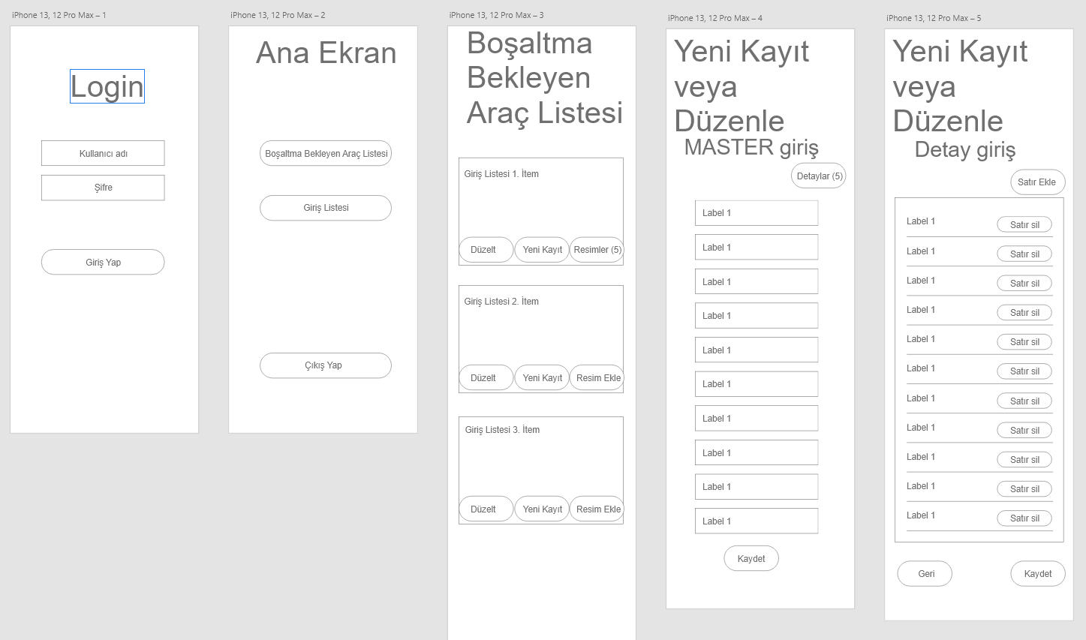
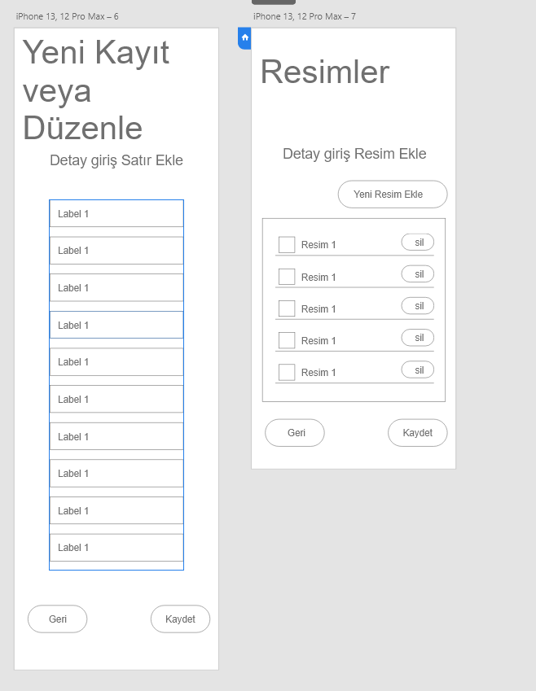
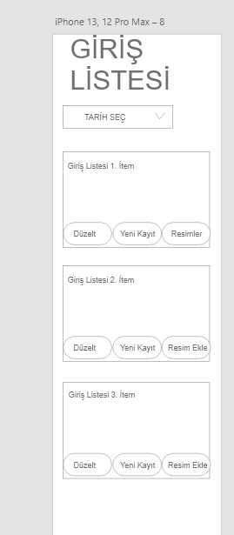
WIREFRAME DESIGN FOR THE PROJECT

Slide 4
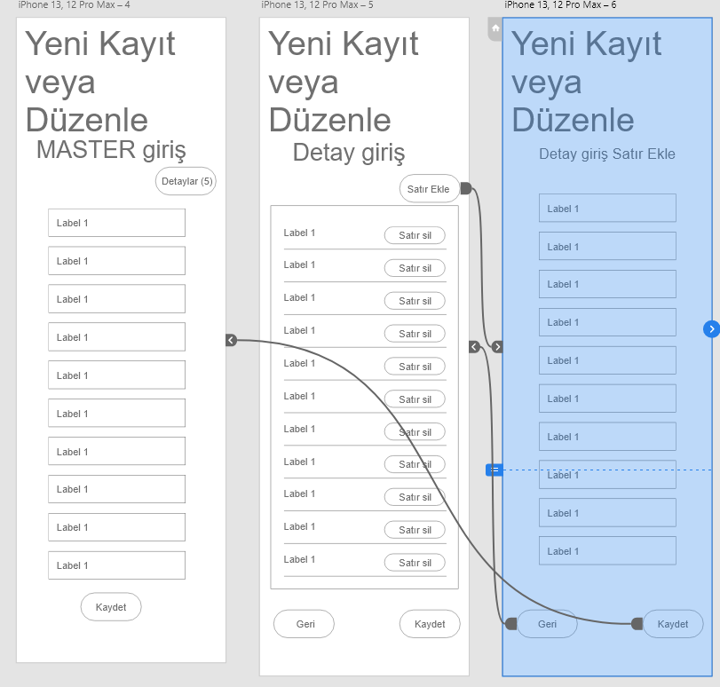
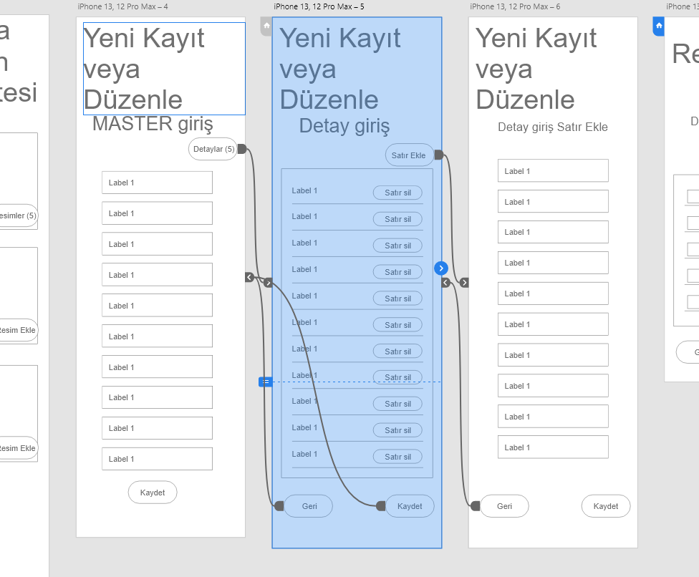
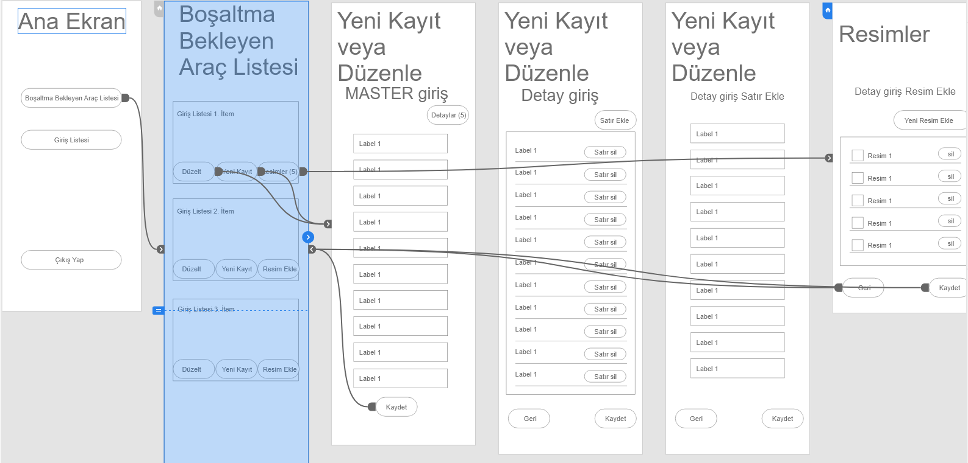
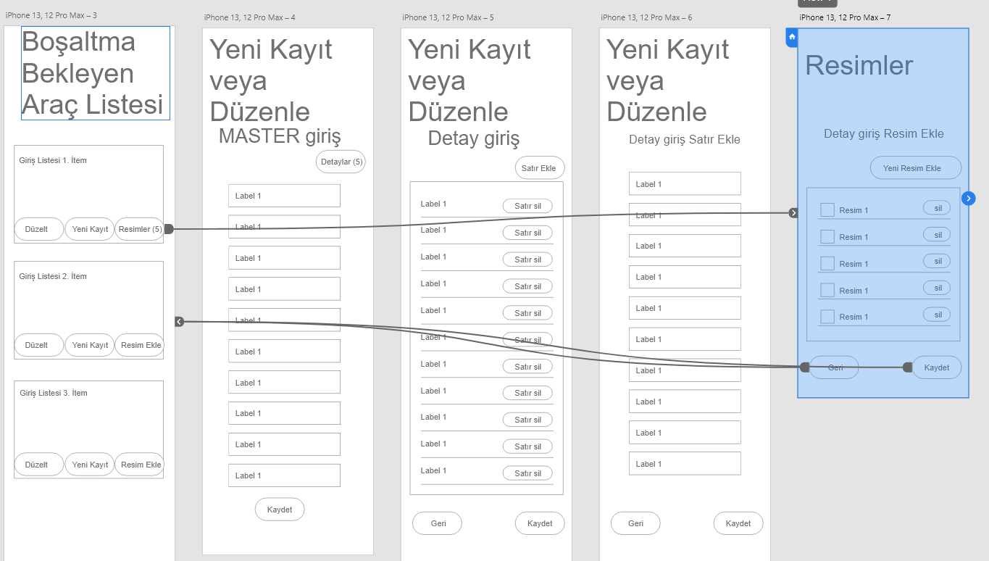
PROTOTYPES FOR WIREFRAME DESIGN

Slide 5
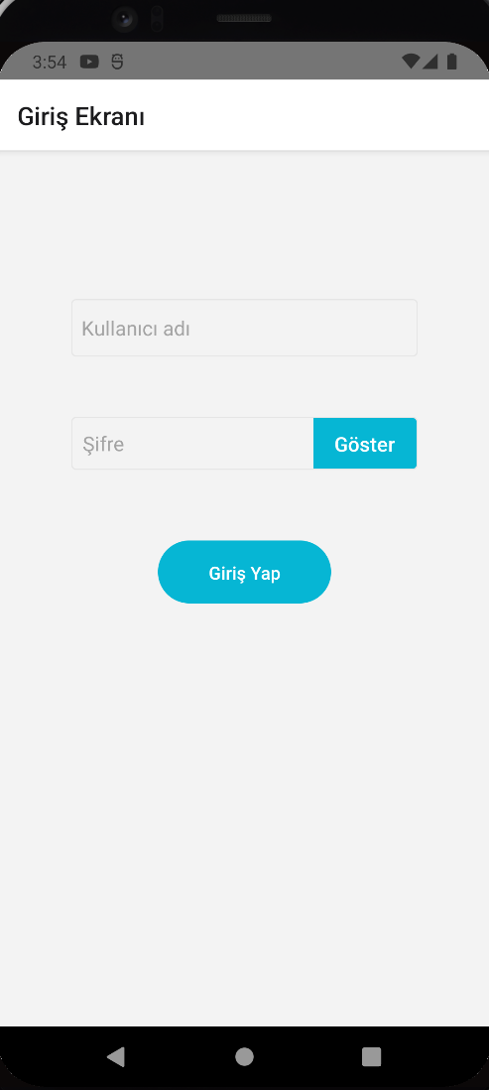
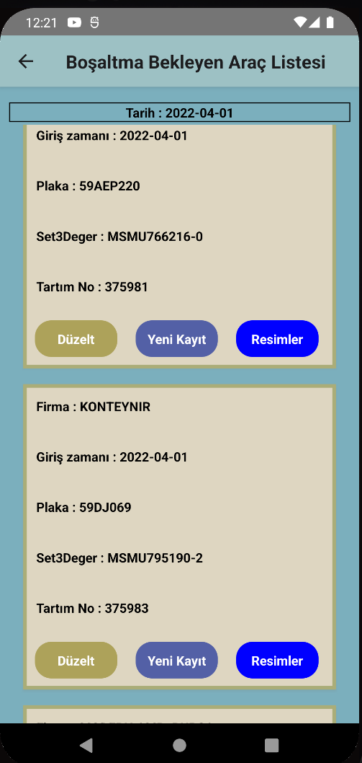
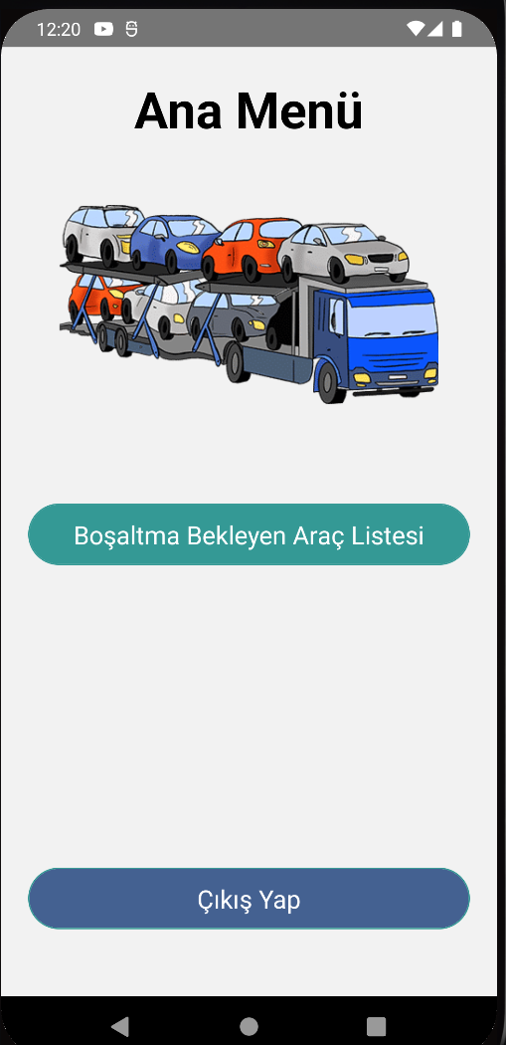
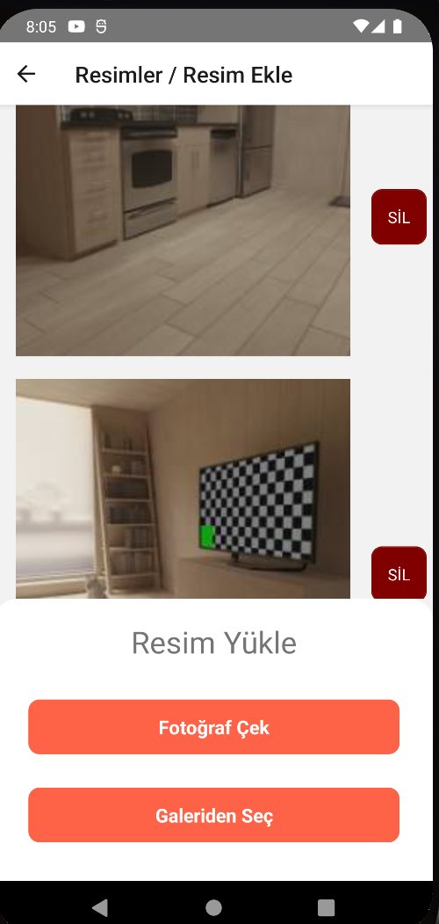
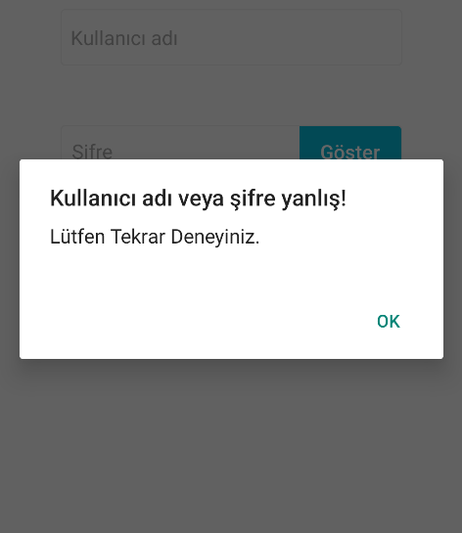
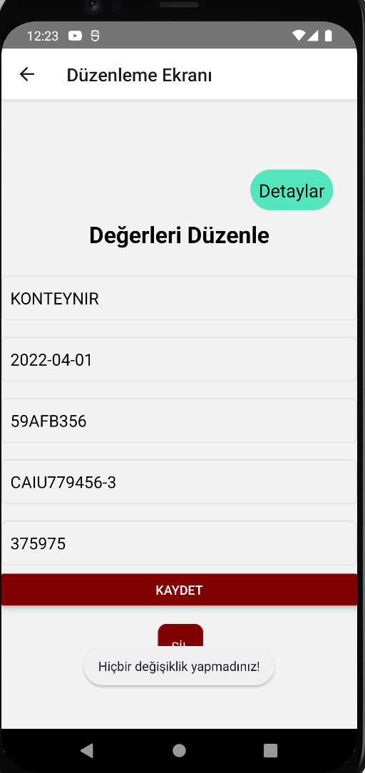
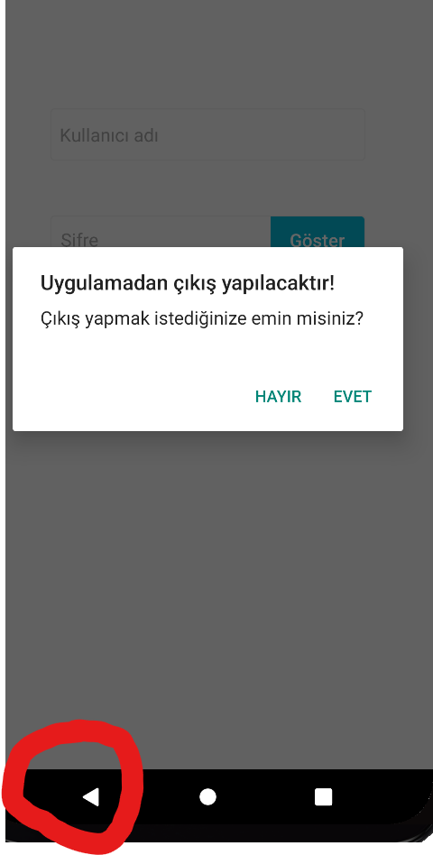
Some Outputs From App

Slide 6
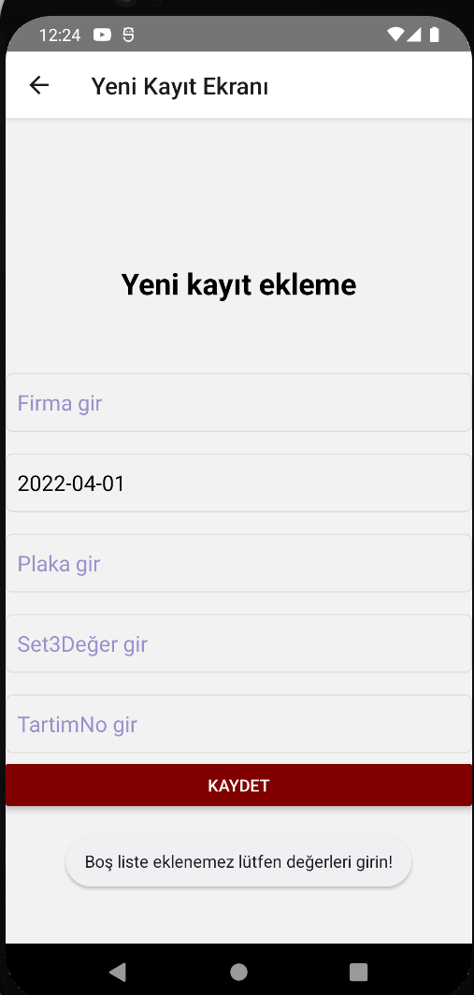
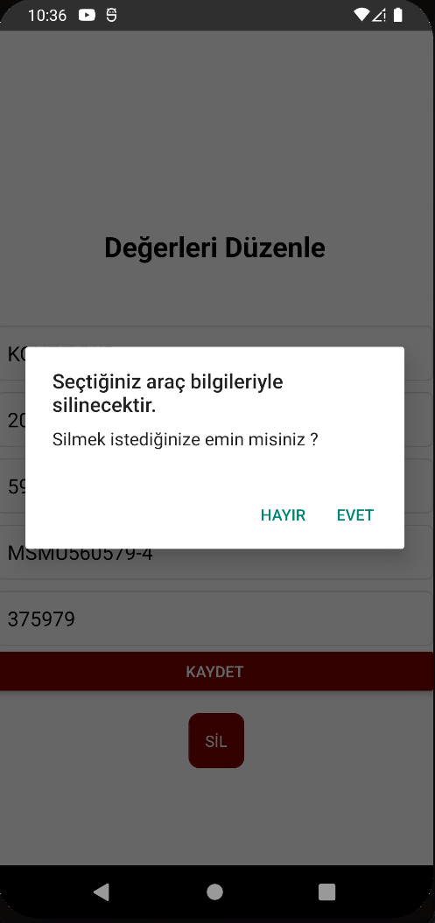
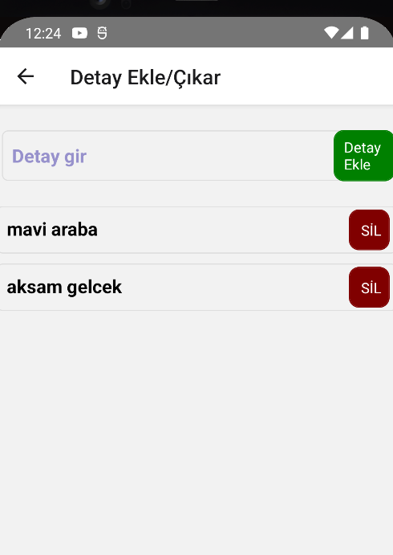
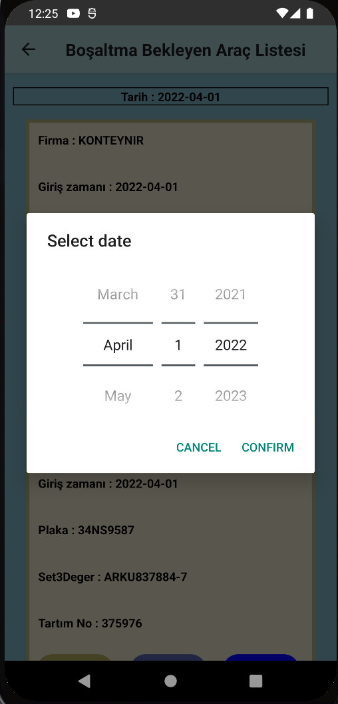
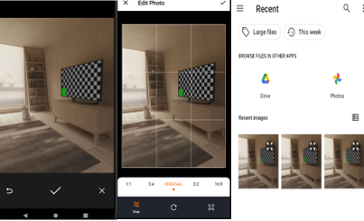
Some Outputs From App

