Slide 1
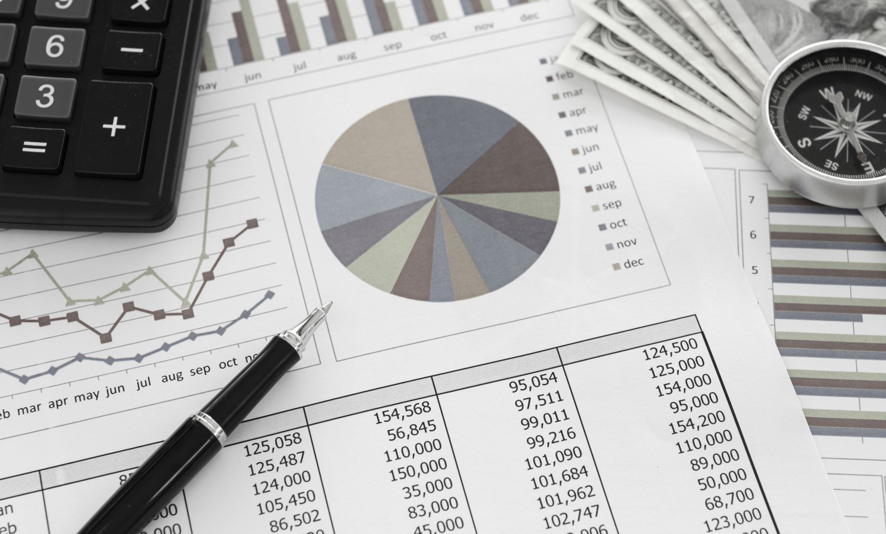
Analysis of Caffeine's Effects on Money Spending Trends
Arda Fırat Cevheroğlu
32508

Slide 2
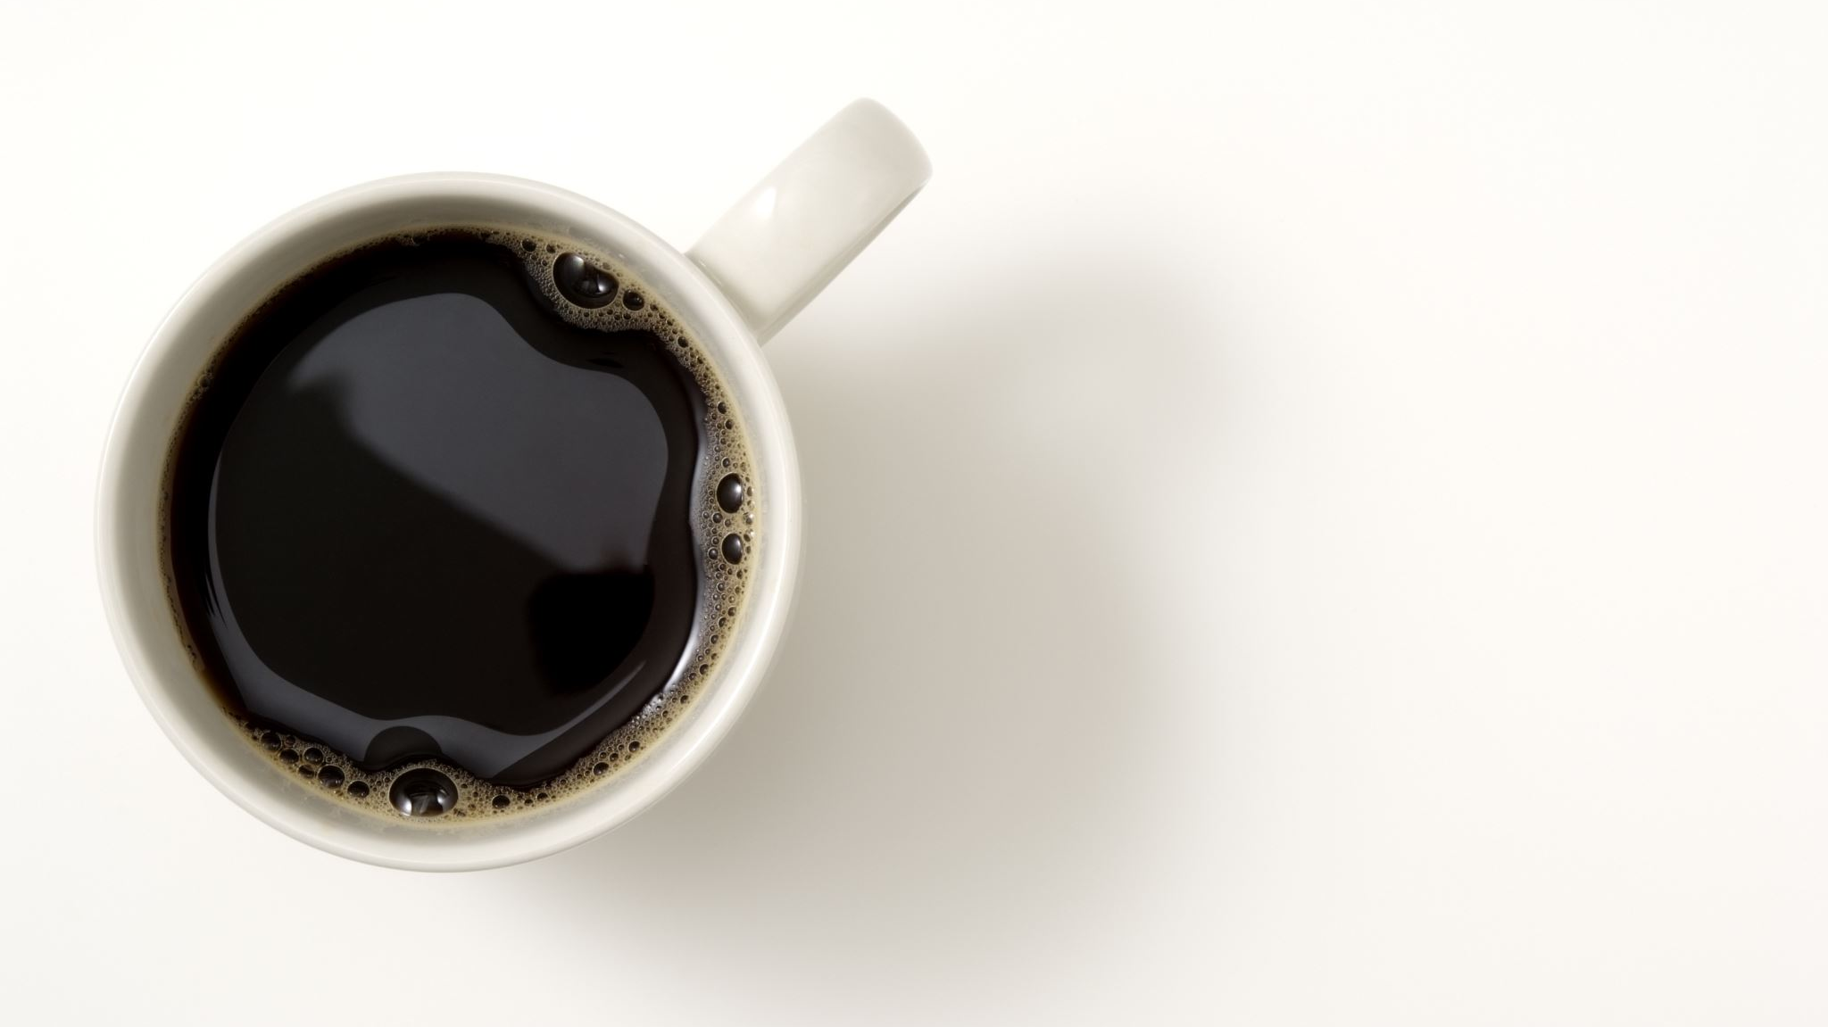
Alternative Hypothesis Higher levels of caffeine intake would lead to higher amounts of money spent through inducing a sub-euphoric state in which people tend to make more purchases
Null Hypothesis Caffeine intake doesn’t significantly influence spending trends.

Slide 3
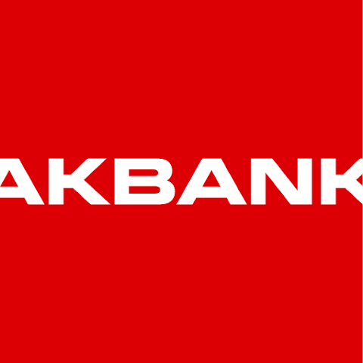

Datasets

Slide 4
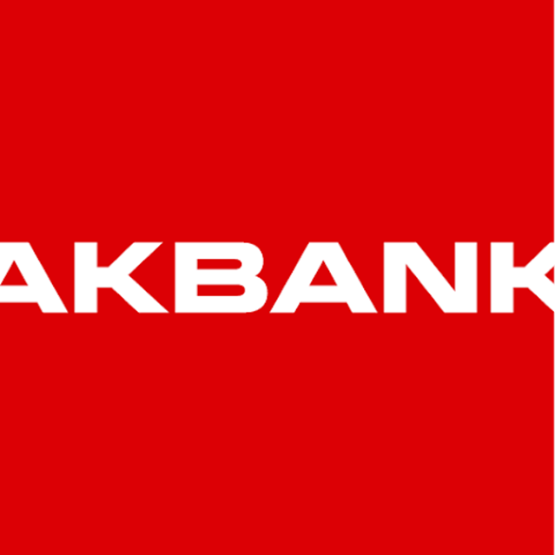

Slide 5
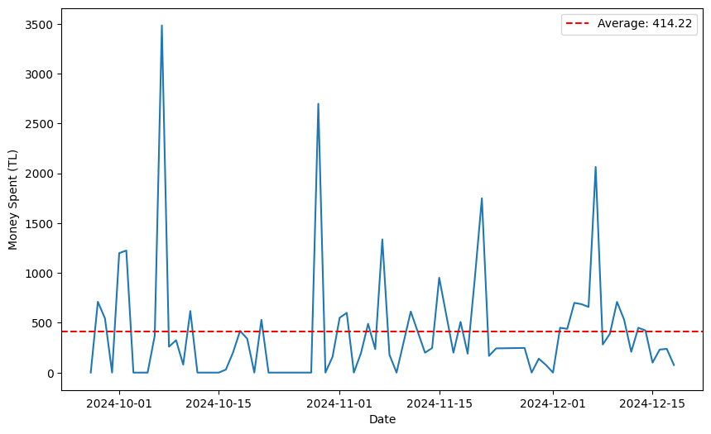
First, I started analyzing the amount of money I spent daily and made a line plot graph to visualize it
There are some minor outliers but the amount I spent daily was mostly consistent

Slide 6
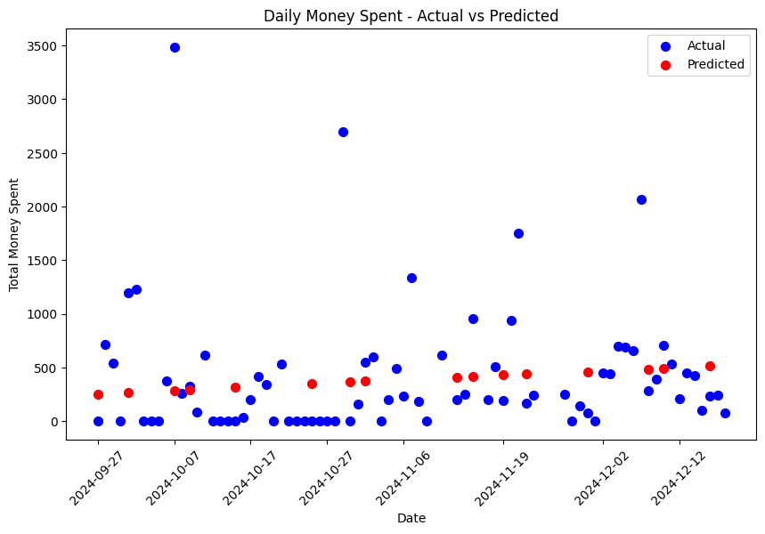
After that I built a linear regression model and visualized my findings of actual vs predicted values for spending trends
As you can see, predicted values don’t show a significant increase in spending trends

Slide 7

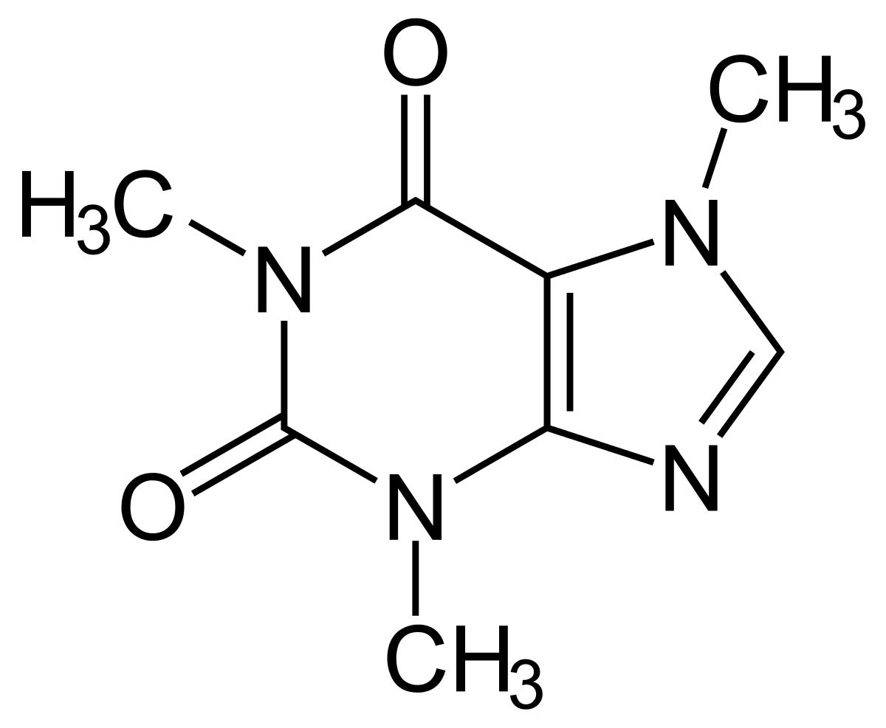

Slide 8
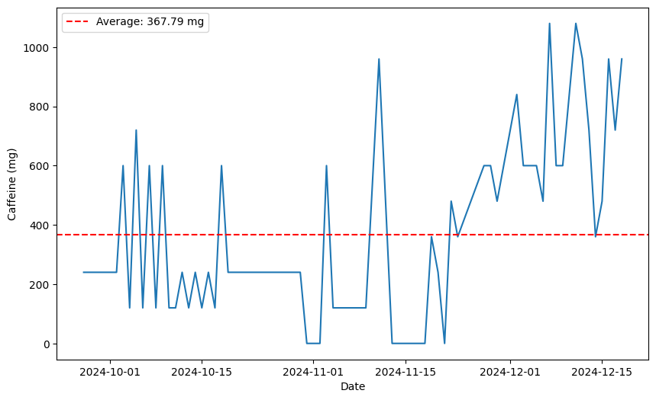
I visualized the amount of caffeine consumed per day using a line plot graph as well
Not so surprisingly, my caffeine consumption increased towards the end of semester, implying deadlines might have an impact

Slide 9
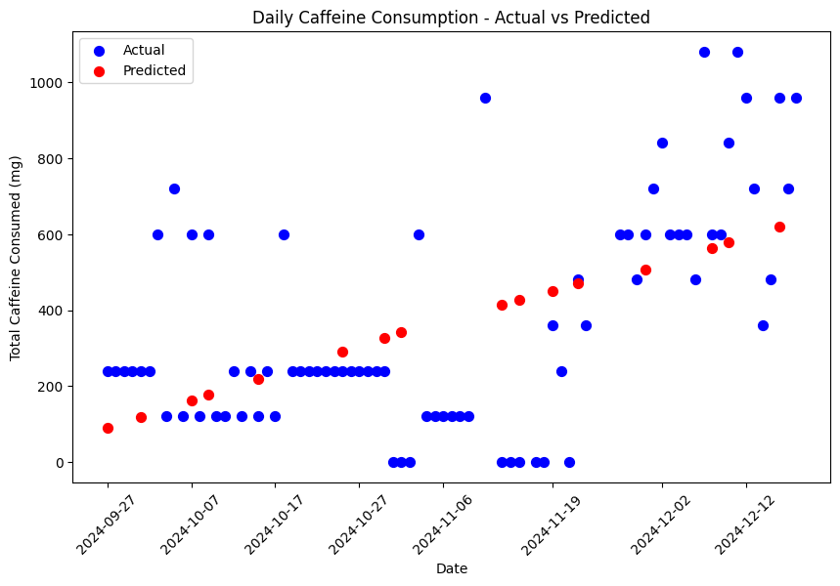
Using the linear regression model I visualized the difference between actual and predicted amounts of total caffeine consumed daily
Predicted values increased towards the end of December as it can be seen from the graph

Slide 10
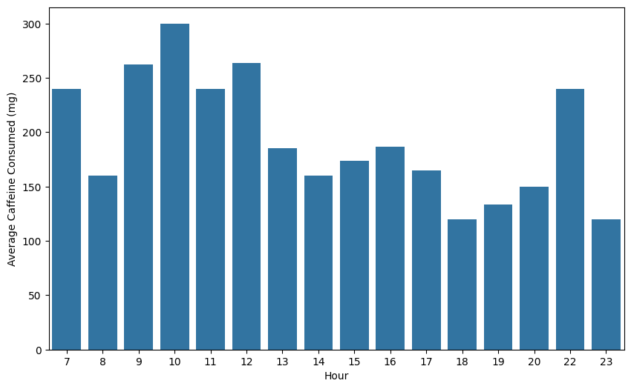
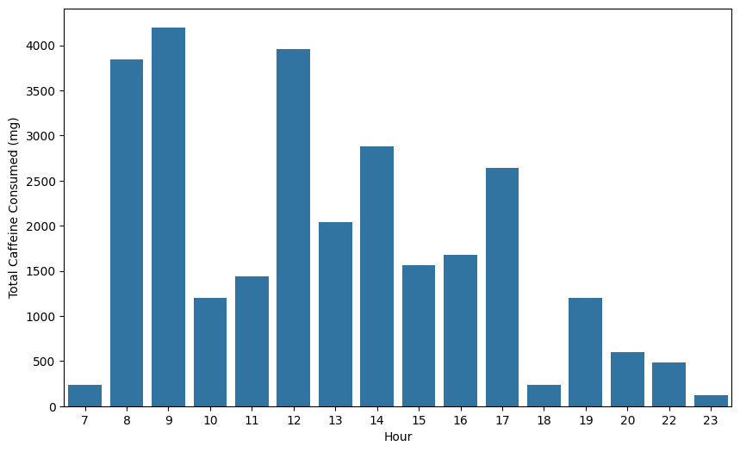
I analyzed my caffeine consumption further by using bar charts to visualize the relationship between time of day and total/average caffeine consumed

Slide 11
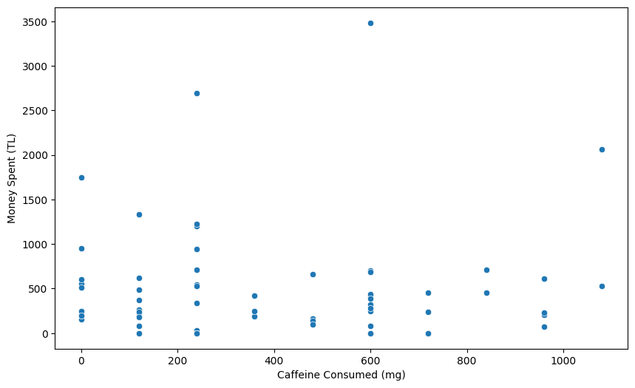
I merged the caffeine and spending data and created a scatter plot graph to visualize the correlation between them
So far it seems like there is no significant correlation

Slide 12
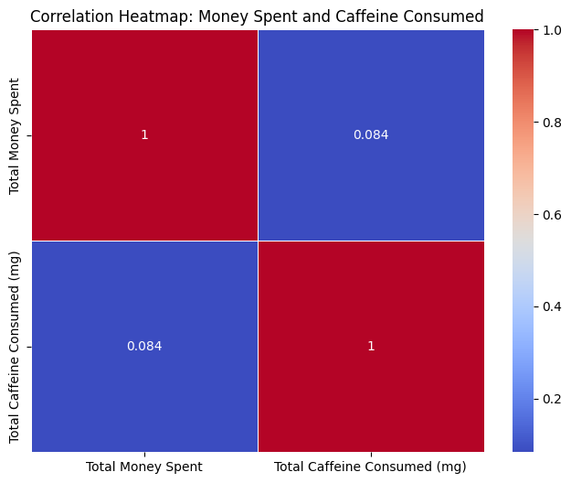
I used a heatmap to clearly understand whether there is a correlation between caffeine intake and spending trends
0.084 is a really low number for correlation which implies there’s little to no correlation

Slide 13

Findings
While the amount of money I spent daily was mostly stable, caffeine I consumed rose significantly towards the end of semester, implying deadlines and examinations might have an effect.
Higher amounts of caffeine consumption didn’t have a significant impact on the amount of money I spent daily, However without a larger dataset and more participants we can’t say for sure that caffeine doesn’t affect money spending trends
In the end I didn’t have enough evidence to reject my Null Hypothesis and concluded that caffeine intake didn’t have any significant influence on spending trends.

