Slide 1
Pet (Dog) Detection
Rahil Mehta
Ardalan Ahanchi
Drew Nelson

Slide 2
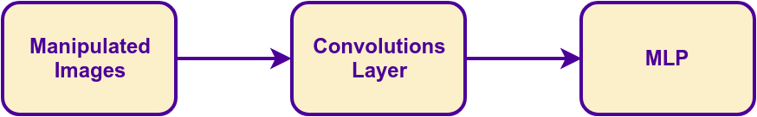
Project Overview
Project aimed to improve performance of pet detection algorithms.
  Limited our scope to detect dogs in images.
Performance focus on MLP algorithm
For MLP to work, need to manipulate images and implement convolution layer as input to MLP

Slide 3
Image Manipulation
Use the data from OpenImages and convert the data into a format easier for the rest of the application
Steps
  Load the image
  Convert to grayscale
  Get boundary box of image
  Resize the image
  Normalize data

Slide 4
Convolution Layer
Hope to improve accuracy and performance
Applying Gaussian filter for now
Max-pooling reduces dimensions
Still being integrated into rest of the code

Slide 5
Multi-Layer Perceptron (MLP)
Trained to find patterns from the input
  Tested directly on the images
Uses a custom operations interface
  Supports CPU, GPU, and Hybrid modes.
Tested MLP independently
  XOR function
  Linear function

Slide 6
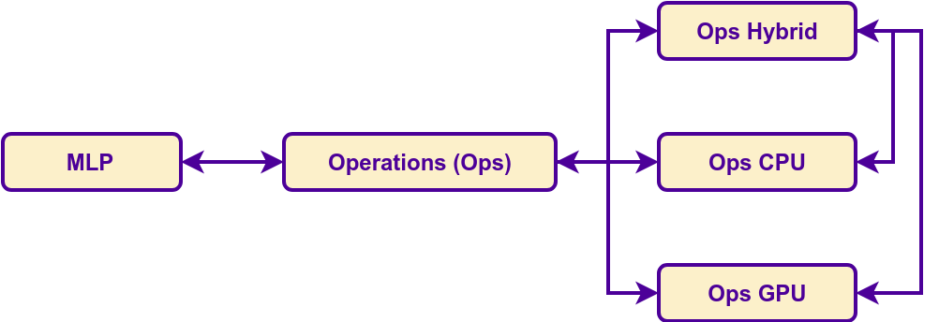
Operations
Many operations are used in Deep Learning.
Add, Subtract
Multiply, One-by-One Multiply
Scale
ReLu, Inverse ReLu
Sigmoid, Sigmoid Prime

Slide 7
Other Potential Improvements
More MLP and convolution layers
Make CPU operations parallel
Parallelize image manipulation
  Time to parse images and manipulate images became time consuming. After realizing the time it takes to process, we could have parallelized this operation.

Slide 8
Other Technologies
CMake
  Used to help configure on build our source on different platforms.
OpenImages
  Primary resource for gathering images.
OIDv4_Toolkit
  Python script to get specific image types from OpenImages.
  Allowed us to specify dog images from OpenImages
  As well as other miscellaneous images for testing.

Slide 9
Demo

Slide 10
Questions?

Slide 11
Thank you!

Slide 12
Backup Slides

Slide 13
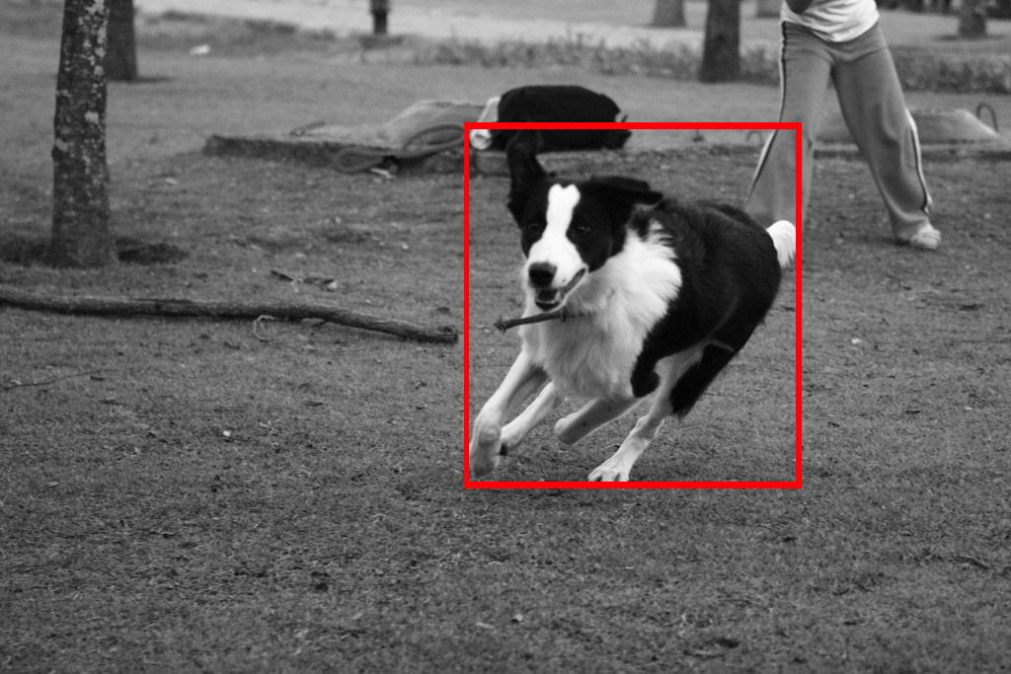
Formatting Data

