Slide 1
Pet (Dog) Detection
Rahil Mehta
Ardalan Ahanchi
Drew Nelson

Slide 2
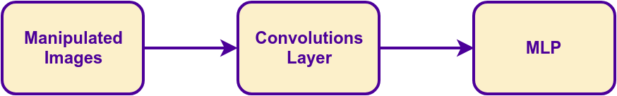
Project Overview
Project aimed to improve performance of pet detection algorithms.
Limited our scope to detect dogs in images.
Performance focus on MLP algorithm
For MLP to work, need to manipulate images and implement convolution layer as input to MLP

Slide 3
Image Manipulation
Use the data from OpenImages and convert the data into a format easier for the rest of the application
Steps
Load the image
Convert to grayscale
Get boundary box of image
Resize the image
Normalize data

Slide 4
Convolution Layer
Hope to improve accuracy and performance
Applying Gaussian filter for now
Max-pooling reduces dimensions
Still being integrated into rest of the code

Slide 5
Multi-Layer Perceptron (MLP)
Trained to find patterns from the input
Tested directly on the images
Uses a custom operations interface
Supports CPU, GPU, and Hybrid modes.
Tested MLP independently
XOR function
Linear function

Slide 6
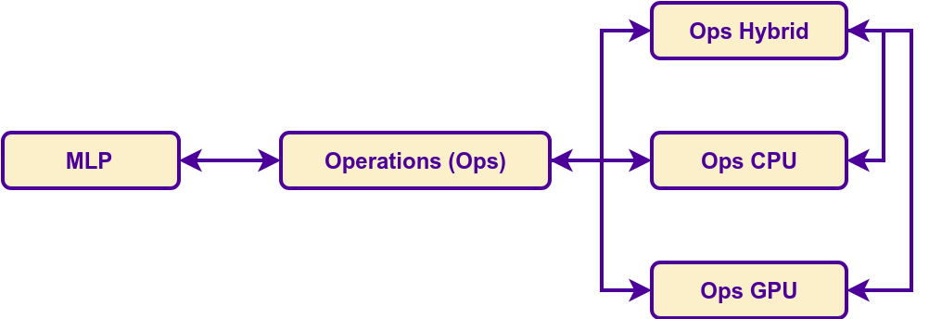
Operations
Many operations are used in Deep Learning.
Add, Subtract
Multiply, One-by-One Multiply
Scale
ReLu, Inverse ReLu
Sigmoid, Sigmoid Prime

Slide 7
Other Potential Improvements
More MLP and convolution layers
Make CPU operations parallel
Parallelize image manipulation
Time to parse images and manipulate images became time consuming. After realizing the time it takes to process, we could have parallelized this operation.

Slide 8
Other Technologies
CMake
Used to help configure on build our source on different platforms.
OpenImages
Primary resource for gathering images.
OIDv4_Toolkit
Python script to get specific image types from OpenImages.
Allowed us to specify dog images from OpenImages
As well as other miscellaneous images for testing.

Slide 9
Demo

Slide 10
Questions?

Slide 11
Thank you!

Slide 12
Backup Slides

Slide 13
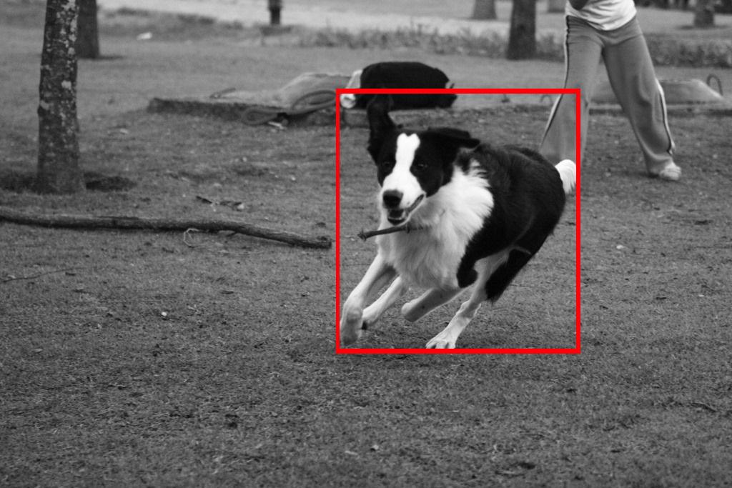
Formatting Data

