Slide 1
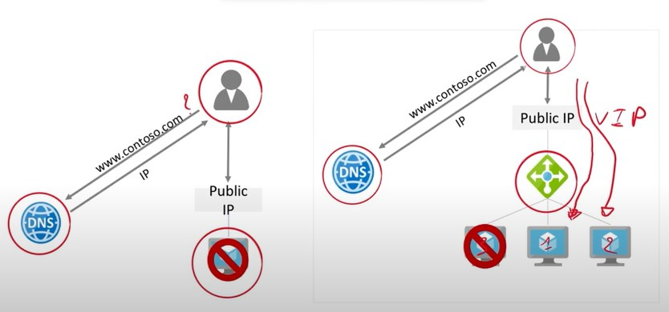
1
3
2
1
3
2
Backend pool

