Slide 1
Container ecosystem

Slide 2
Huuuu… Container = Docker no ???

Slide 3


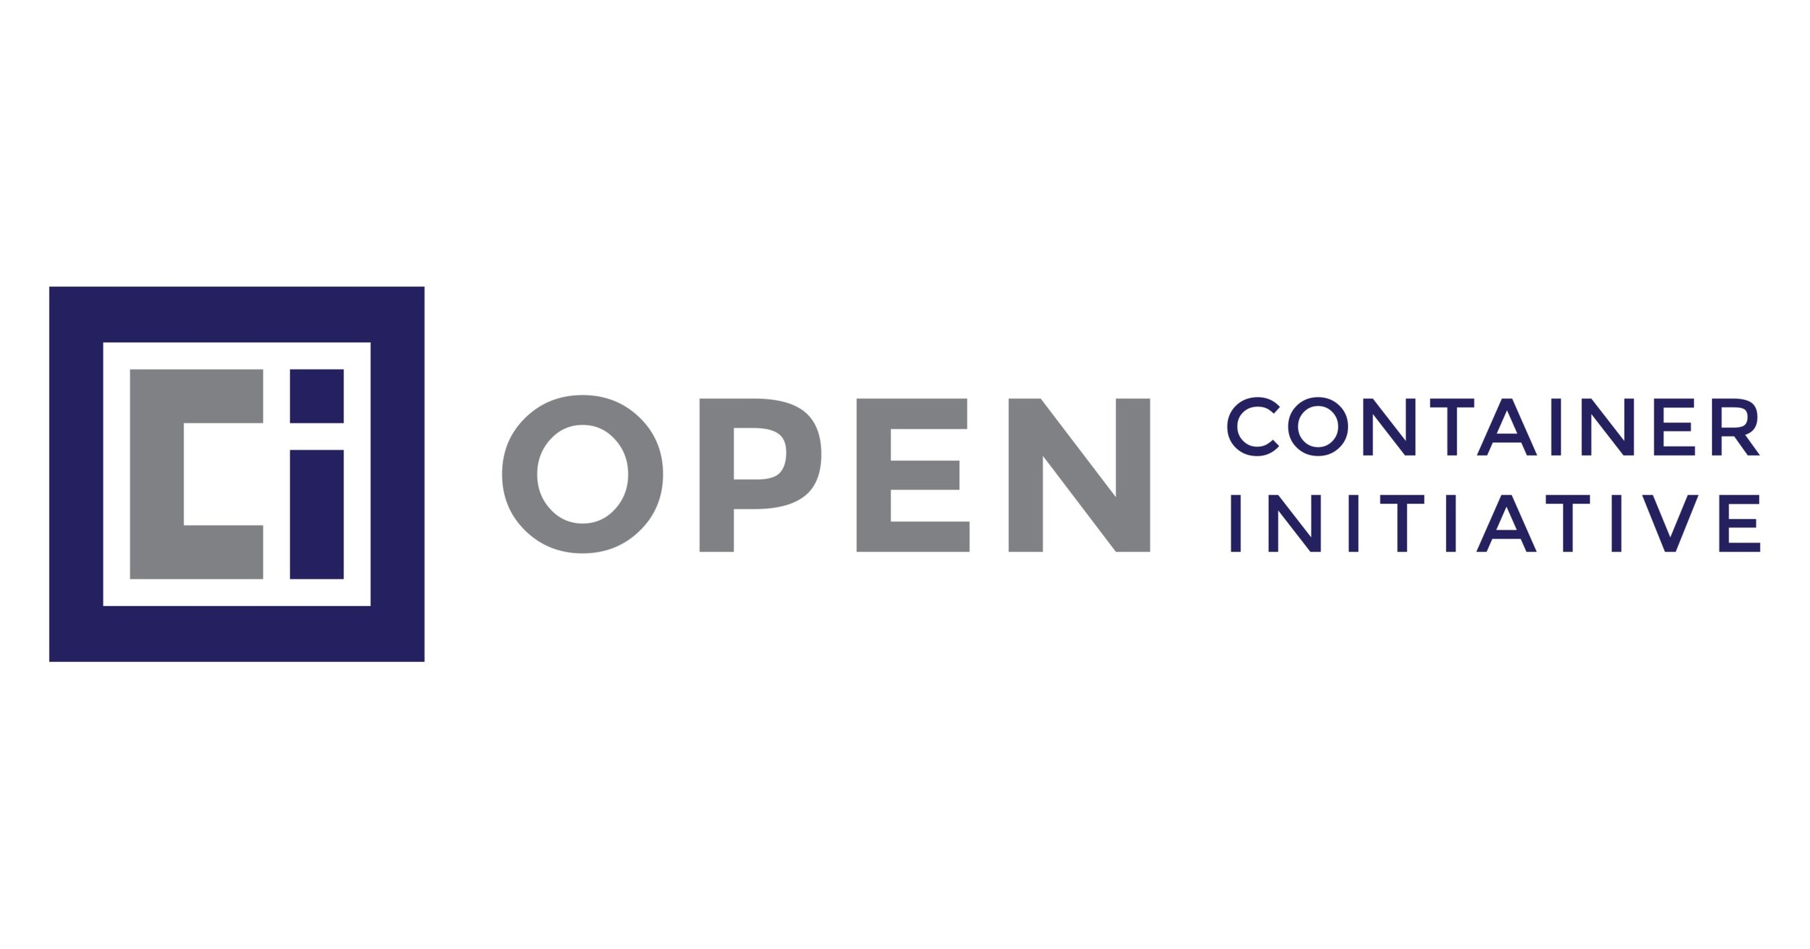

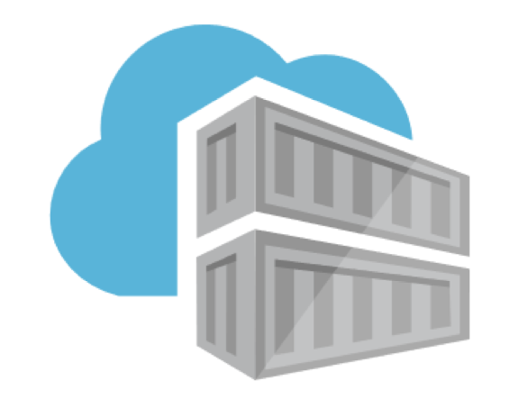

Docker client
(CLI, UI)
Calls using
Docker Engine API
Docker daemon
(dockerd)
Calls
Calls
Containerd is a runtime (another daemon) implementing the Container Runtime Interface (CRI) coming from CNCF (Cloud Native Computing Foundation).
Pulls an image and gives it to runc
Uses
runc is the implementation of Open Container Initiative (OCI) which provides specifications for images (Image Spec) and containers (Runtime spec).
Image Registry
Spawns
Running container
(isolated process)

Slide 4
Docker client
(CLI, UI)
Calls using
Docker Engine API
Docker daemon
(dockerd)
Calls
Containerd is a runtime (another daemon) implementing the Container Runtime Interface (CRI) coming from CNCF (Cloud Native Computing Foundation).
Pulls an image and gives it to runc
Uses
runc is the implementation of Open Container Initiative (OCI) which provides specifications for images (Image Spec) and containers (Runtime spec).
Image Registry
Spawns
Running container
(isolated process)

