Slide 1

Data Scientist Interview
Technical Challenge Results, 12/03/2026
ANDREU ARDERIU

Slide 2
Outline
Problem framing
Data preprocessing (cleaning)
Exploratory Data Analysis
Feature engineering
Correlations and sensitivity analysis
PCA and feature reduction
Clustering and profiling
Conclusions
Limitations & next steps
2

Slide 3
Problem framing
Time series:
Physiological: Gaze, pulse physiological time series
Quality: ppg_QI, motiong quality time series
Tabular data:
Target: STAI_T/S
Patient data: Gender, Handedness, Glasses, BloodType
Objective: link time series data with the target.
2

Slide 4
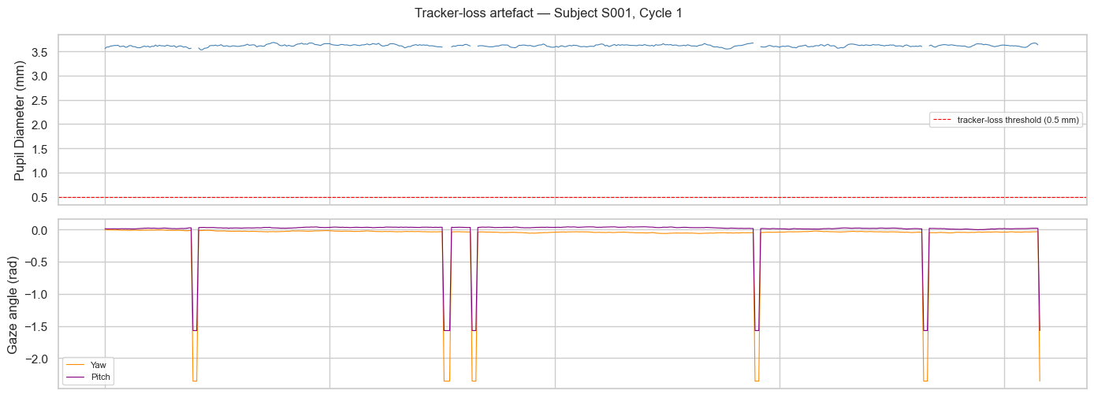
Data Preprocessing (cleaning)
Duplicate timestamps: 14.5% of the rows
Tracking artifacts (pupil size, gaze) : 15.13% of rows
Low PPG quality Unreliable HR values
2

Slide 5
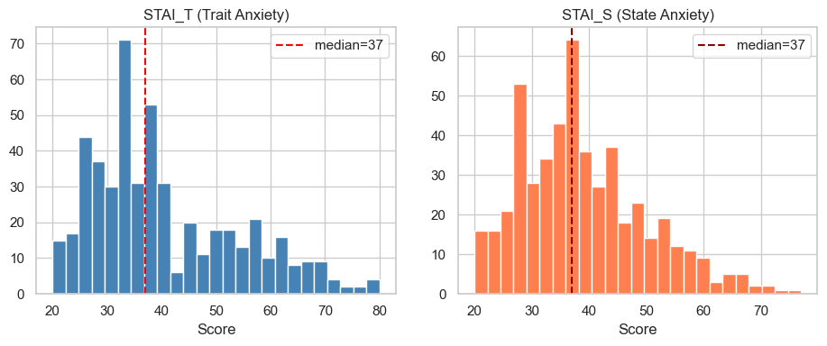
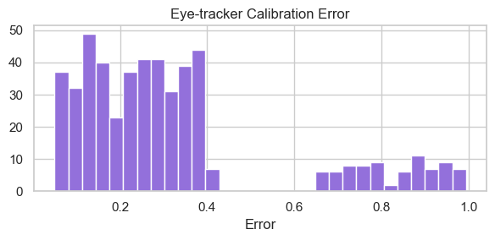
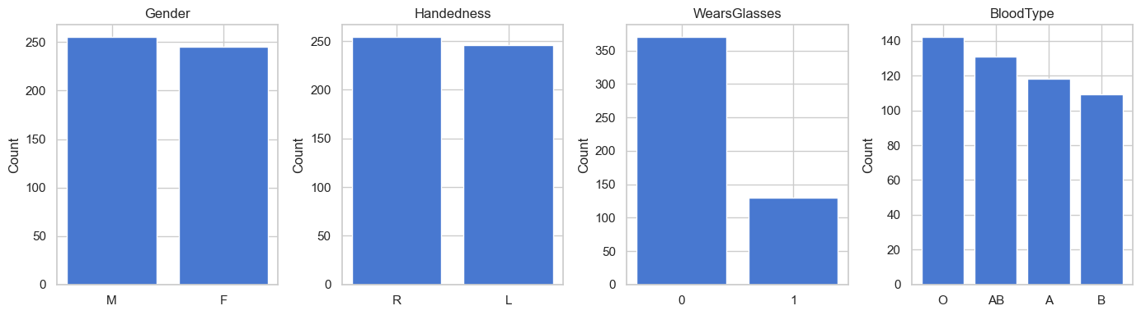
EDA - Metadata
2

Slide 6
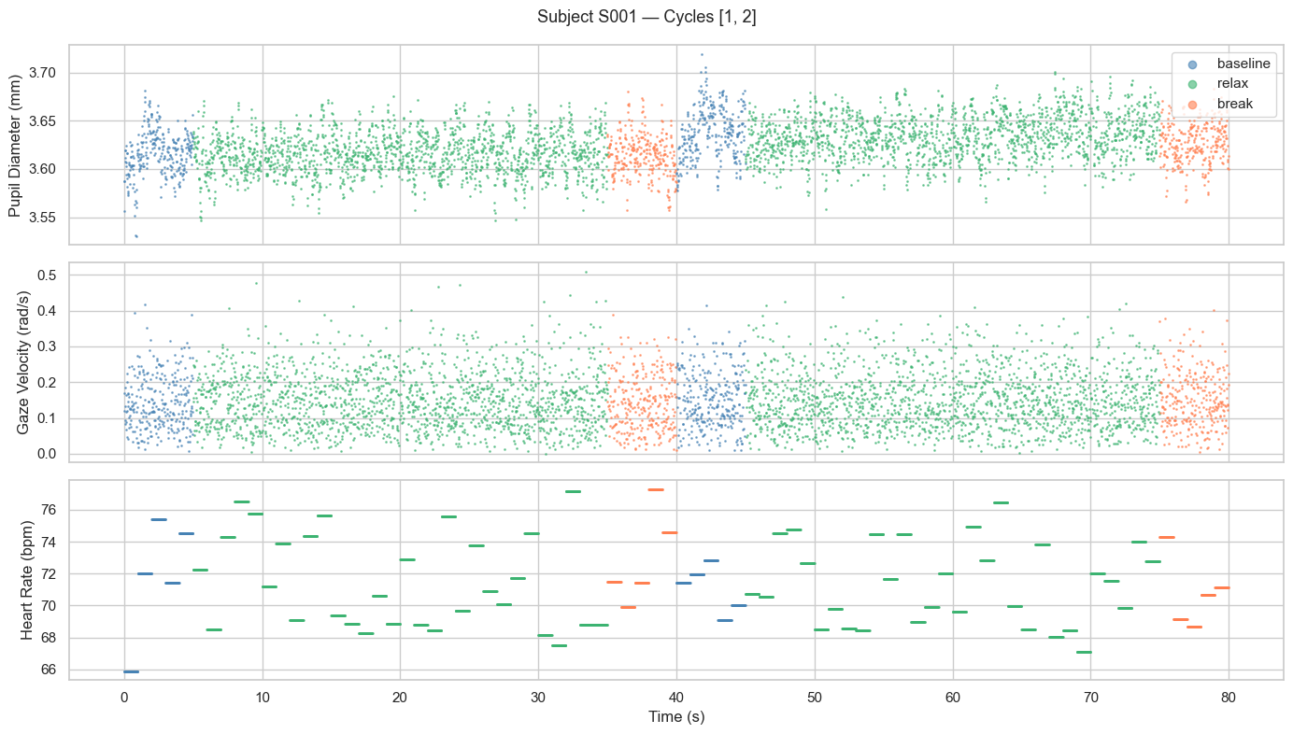
EDA - Physiological Signal
2

Slide 7
Feature engineering
Mean and std of all features (pupil, gaze, motion, QI) are computed per Subject x Trial x Phase.
New transformed features:
Gaze velocity
Gaze angles (pitch & yaw)
Cross-trial aggregation features:
Mean, std and trend across trials.
New delta features:
relax-baseline (down-regulation)
break-baseline (recovery proxy)
Total 132 features
2

Slide 8
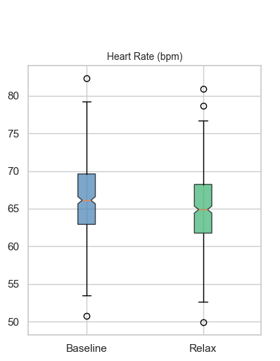
Results - Biomarker sensitivity
Wilcoxon + Cohen’s statistical tests:
Pupil diameter: reduction on relaxation, mild recovery on break.
Heart rate: reduction on relaxation, recovery on break.
Gaze: Yaw pitch spread increase during relaxation.
Trend: No significant trend effect found across trials.
2

Slide 9
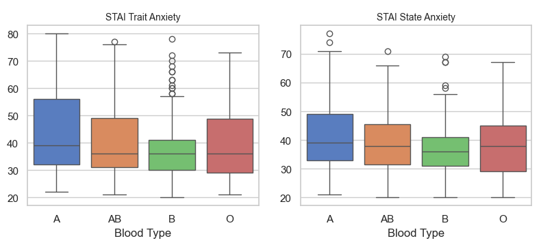
Results - Metadata correlations
STAI_S/T: Positive correlation with pupil diameter baseline and reductions (relax & break).
Gender: Men present higher resting heart rate.
Blood types: Type B mildly lower anxiety levels
2

Slide 10
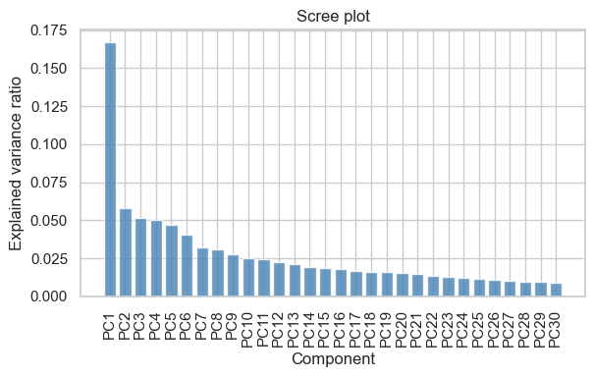
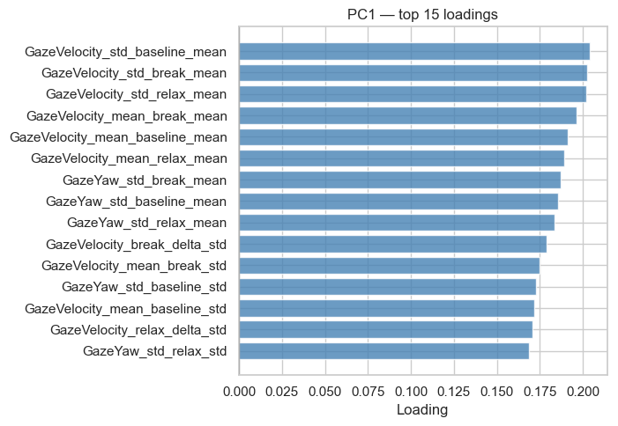
Dimensionality reduction - PCA
Need 27 PCA components for 80% explained variance
3

Slide 11
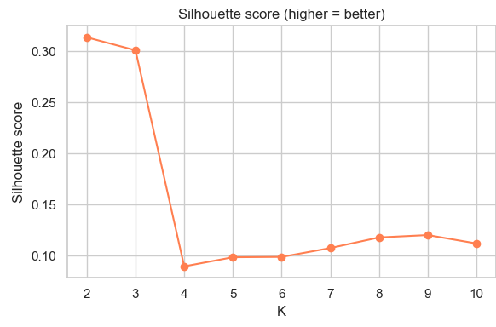
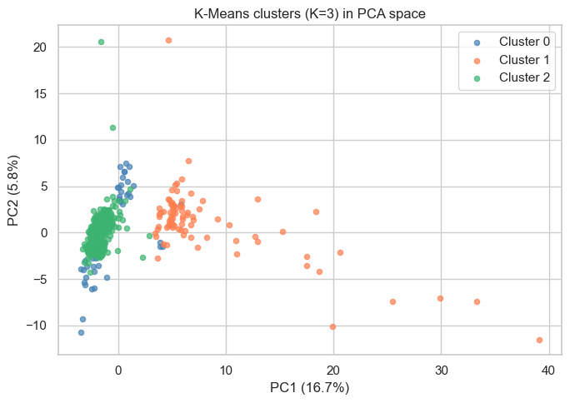
Clustering - KMeans
Weak clustering, optimal choice K=3
3

Slide 12
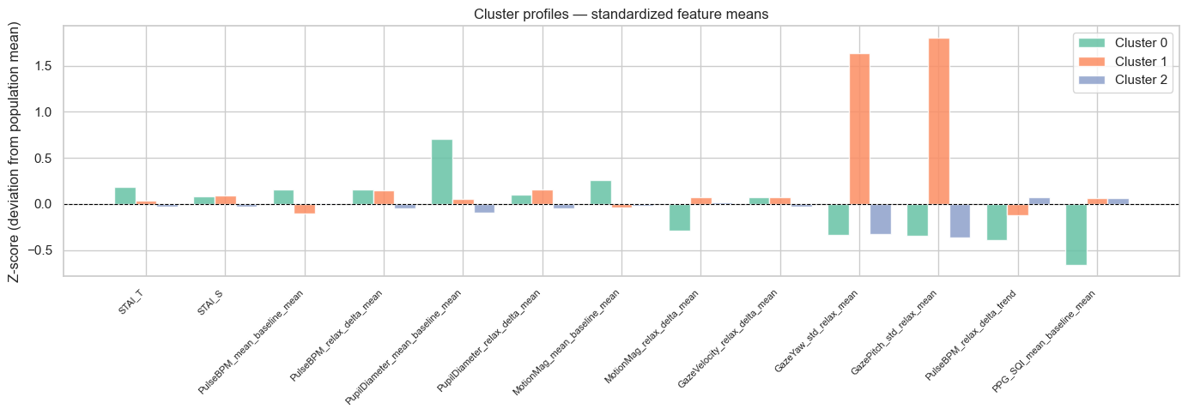
Clustering - group profiles
3

Slide 13
Clustering - group profiles
Group 0: High baseline pupil size, STAI_T, motion, and worse PPG quality.
Group 1: High gaze variability.
Group 2: Strongest pupil constriction and HR drop during relaxation, lowest anxiety scores.
3

Slide 14
Conclusions
Pupil dynamics reflect both relaxation and anxiety differences.
Gaze behavior reveals heterogeneous participant response profiles.
Heart rate reflects the relaxation effect, but appears less sensitive to individual anxiety
3

Slide 15
Limitations & next steps
Investigate tracking artifacts - proper processing
Investigate time-series (DL) approach for a richer feature space.
Implement predictive modelling (e.g XGBoost) for better feature selection.
Revisit protocol (5s baseline/break might be too short)
Additional sources of data (e.g whole PPG)
3

Slide 16
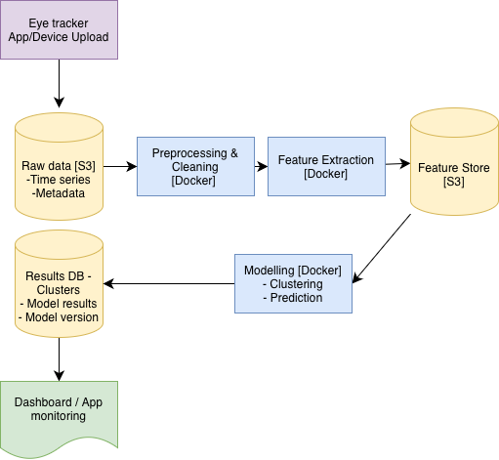
[Extra] - Backend integration
Data anonymization
Granular control access, GDPR
Model/data versioning
Unit/integration tests
3

Slide 17
Thank You
Questions & Discussion
Andreu Arderiu · arderiubcn@gmail.com

