Slide 1
FAKE JOB DETECTION
ARDHRA P R
S3 MCA-A

Slide 2
Objective of the project
We can apply machine learning to train a model for fake job classification. It can be trained on the previous real and fake job advertisements and it can identify a fake job accurately.
We will train the machine on fake job postings dataset to identify the fake job advertisement and then we use classification algorithm in this task which will predict the real and fraudulent class labels for the job advertisements after successful training.
We will evaluate the performance of our classifier using several evaluation metrics.

Slide 3
A description of the project
Fake Job Detection is an automated tool using machine learning to detect fraud post for jobs in the internet. The fake job detection technique focuses on obtaining an automated tool for identifying fake jobs and helps people to avoid application for these jobs. Therefore, machine learning approach is applied which employs several classification algorithms for recognizing fake posts. In that case, a classification tool detects fake job posts from a larger number of job posts and makes aware of the user. Supervised learning algorithm as classification techniques are first considered to manage the problem of identifying scams on posting jobs. By considering the training data a classifier maps input variable to target classes. The classification models which can learn the job descriptions which are fraudulent can be created.

Slide 4
Input/Output and Code Description
CODE:
import joblib
from os import listdir
class PredictionProcess:
"""
This class handles the whole prediction process
- it finds the probability prediction of output by each value or feature
- uses those values to predict the class or final output
def __init__(self, data):
self.proba_model_path = "Probability_finding_models"
self.clf_model_path = "Classifier_model/classifier.joblib"
self.data = {}
self.data['title'] = data['title']
self.data['location'] = data['location']
self.data['department'] = data['department']
self.data['salary_range'] = data['salary_range']
self.data['company_profile'] = data['company_profile']
self.probability_list = []

Slide 5
def find_probabilities(self):
"""
This method
- loads the models (pipeline -[CountVectorizer, LogisticRegression])
- uses them to get the probability prediction of each of the values/features
returns: probabilities
"""
try:
proba_model_files = [f for f in listdir(self.proba_model_path)]
for filename in proba_model_files:
# get feature name from filename
featureName = filename.split(" ")[0]
# load the vector
prob_predictor = joblib.load(self.proba_model_path + "/" + filename)
exec("self.probability_list.append( list(prob_predictor.predict_proba([self.data['%s']]))[0][1] )" % featureName)
return
except Exception as e:
print(e)
def get_prediction(self):
"""
This method
- loads the final classifier model(knn)
- predicts the output/class
returns: prediction
"""
try:
clf = joblib.load(self.clf_model_path)
prediction = clf.predict([self.probability_list])[0]
return prediction
except Exception as e:
print(e)

Slide 6
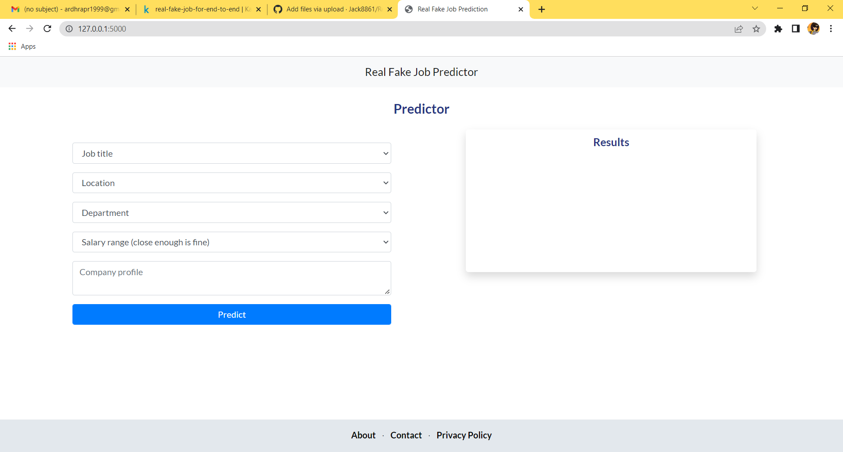
UI Design & Implementation details
templates/index.html

Slide 7
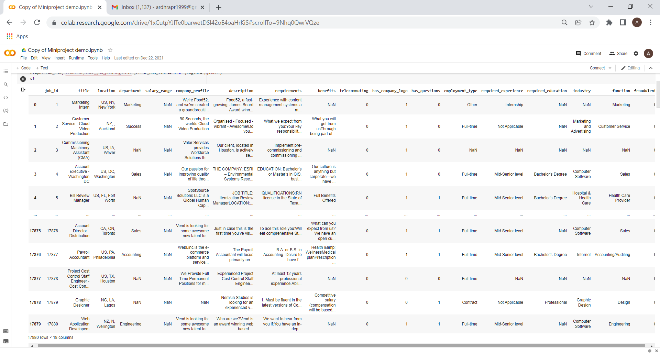

Use case or Process Diagram
Preprocessing
Feature Extraction
Training and Testing Data
Fraud
Classification
Not fraud

Slide 8
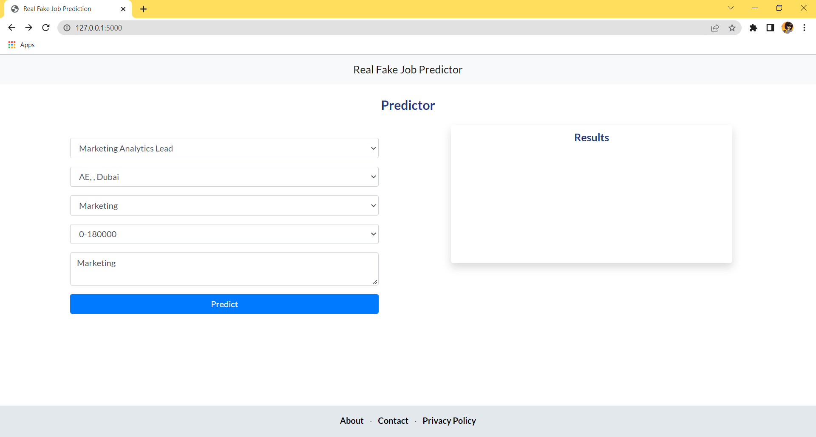
Sample Screen Shots

Slide 9
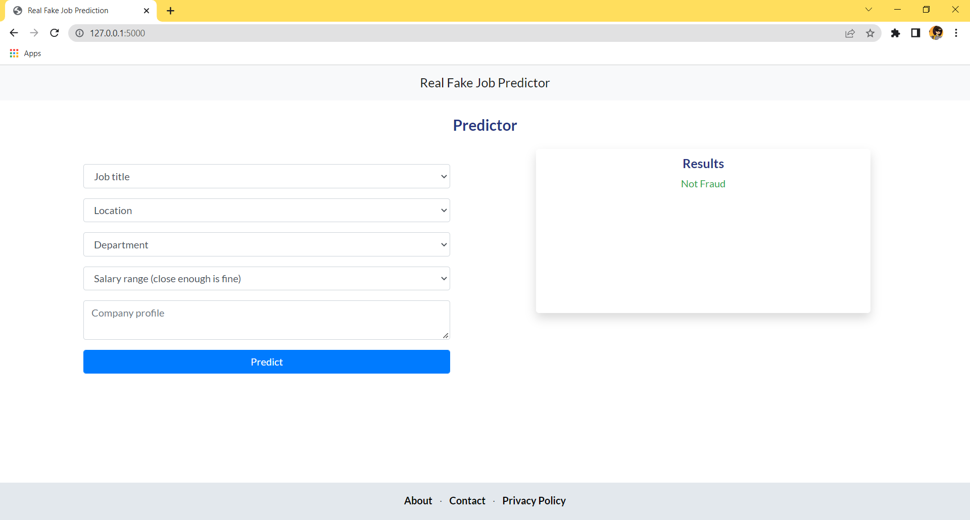

Slide 10
Future Scope of the Project
More data can be collected and used to improve the model performance
model retraining approach can be used if data collection is possible...
can use logging
should explore a range of algorithms and techniques
the real jobs data was 17,000 records and fake data was 800 records so used oversampling. This might have increased our accuracy by causing data leakage... without oversampling we were able to get 90%-92% accuracy in predicting the fake jobs correctly ( overall accuracy was 99.9% )
can Dockerize it

