Slide 1
Line, Contour, and Corner Detection
Shinta Estri
11 Nov 2024

Slide 2
Line Detection
Line detection is a fundamental task in image processing that involves identifying linear features within an image.
These lines can represent edges, boundaries, or other significant structures that define the image content.

Slide 3
Line Detection Methods:
Hough Transform:
Principle: Converts image space to parameter space (Hough space). Each point in the image space corresponds to a curve in the Hough space. Lines in the image space are represented by peaks in the Hough space.
Steps:
Corner or edge detection. (E.g. using canny, sobel, adaptive thresholding). The resultant binary/grey image will have 0s indicating non-edges and 1s or above indicating edges.
Rho range and Theta range creation. ρ ranges from -max_dist to max_dist where max_dist is the diagonal length of the input image. θ ranges from −90∘ to 90∘. You can have more or less bins in the ranges to tradeoff accuracy, space and speed.
Hough accumulator of θ vs ρ. It is a 2D array with the number of rows equal to the number of ρ values and the number of columns equal to the number of θ values.
Voting in the accumulator. For each edge point and for each θ value, find the nearest ρ value and increment that index in the accumulator. Each element tells how many points/pixels contributed “votes” for potential line candidates with parameters (ρ,θ).
Peak finding. Local maxima in the accumulator indicates the parameters of the most prominent lines in the input image. Peaks can be found most easily by applying a threshold or a relative threshold (values equal to or greater than some fixed percentage of the global maximum value).

Slide 4
Line Detection Methods:
Convolution-Based Methods:
Principle: Use filters or kernels to detect lines of specific orientations and widths.
Steps:
Filter Design: Create filters that respond to lines of different orientations (horizontal, vertical, diagonal).
Convolution: Apply the filters to the image using convolution operation.
Thresholding: Threshold the output of the convolution to identify line segments.

Slide 5
How Line Detection Works:
Edge Detection:
Identify points in the image where there is a significant change in intensity.
Techniques like Canny edge detection are commonly used to extract edges.
Line Parameterization:
Represent lines using mathematical equations (e.g., y = mx + b or ρ = x cos θ + y sin θ).
Line Detection Algorithm:
Apply the chosen method (Hough transform or convolution-based) to identify lines in the image.
The algorithm typically involves voting or filtering to accumulate evidence for line segments.
Post-Processing:
Refine the detected lines by removing false positives or merging overlapping segments.
Apply techniques like line thinning or smoothing to improve the quality of the detected lines.

Slide 6
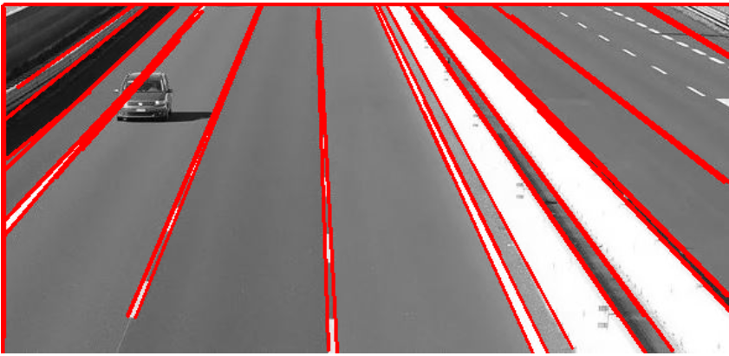
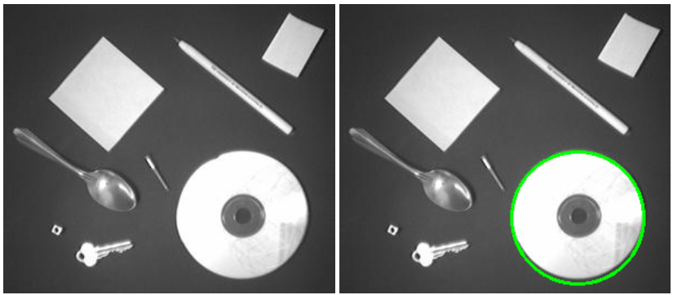
HOUGH Detection
lines = cv2.HoughLinesP(edges, 1, np.pi/180,
100, minLineLength=100, maxLineGap=10)
circles_img = cv2.HoughCircles(image_edges, cv2.HOUGH_GRADIENT,1,20, param1=50,param2=30,minRadius=40)

Slide 7
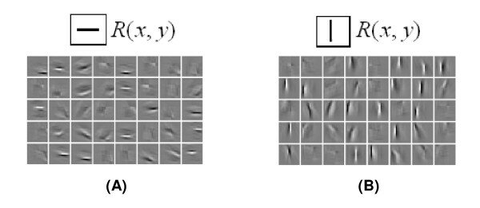
Convolution-Based Line Detection
kernel_horizontal = np.array([[-1, -1, -1],
[ 0, 0, 0],
[ 1, 1, 1]])
# Apply convolution
img_filtered = cv2.filter2D(img, -1, kernel_horizontal)
# Threshold the result
thresh = cv2.threshold(img_filtered, 50, 255, cv2.THRESH_BINARY)[1]

Slide 8
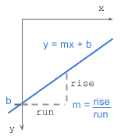
gradient-intercept
y = mx + b
where:
m = gradient or slope of the line (rise/run)
b = y-intercept

Slide 9
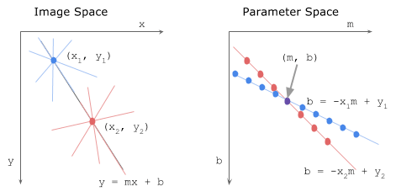
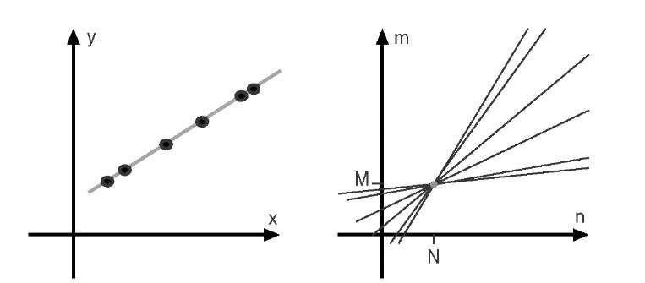

Slide 10
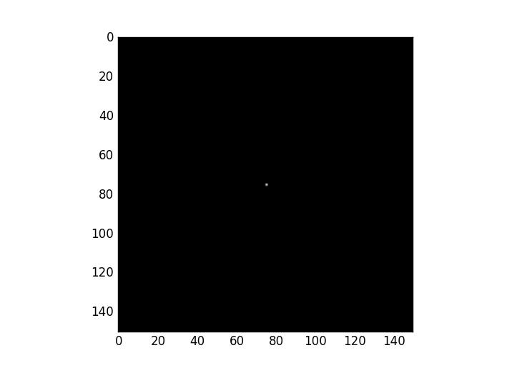
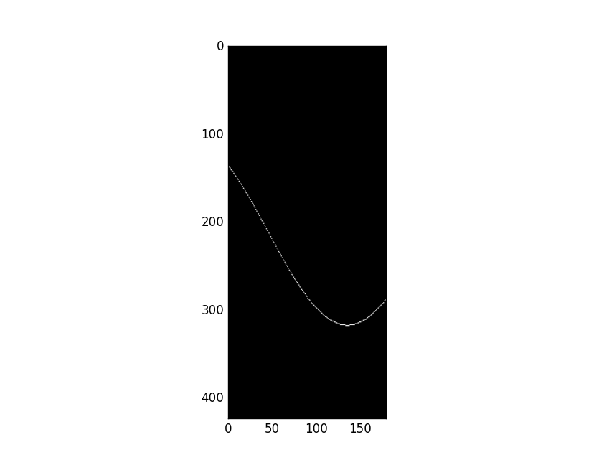

Slide 11
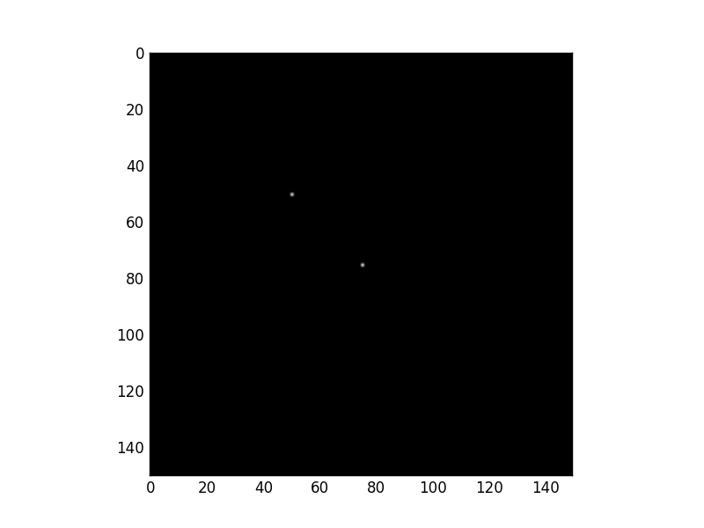
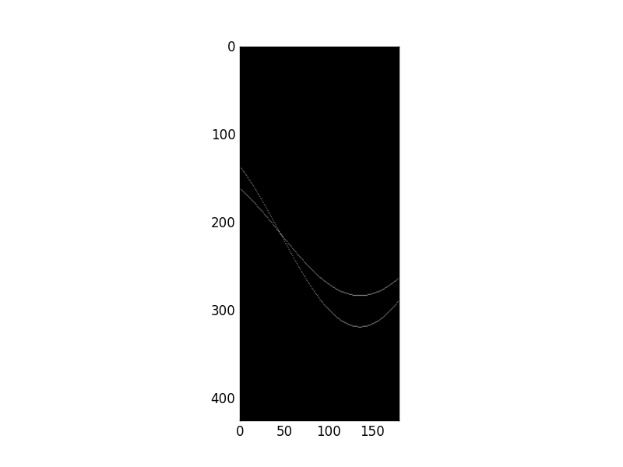

Slide 12
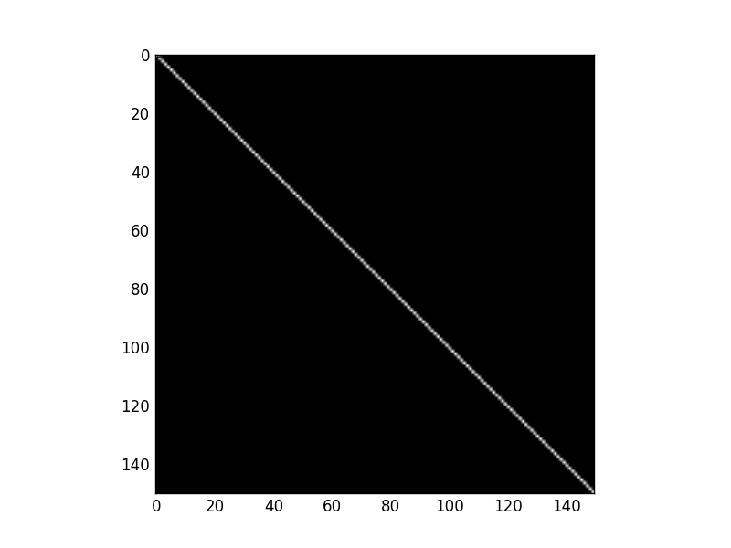
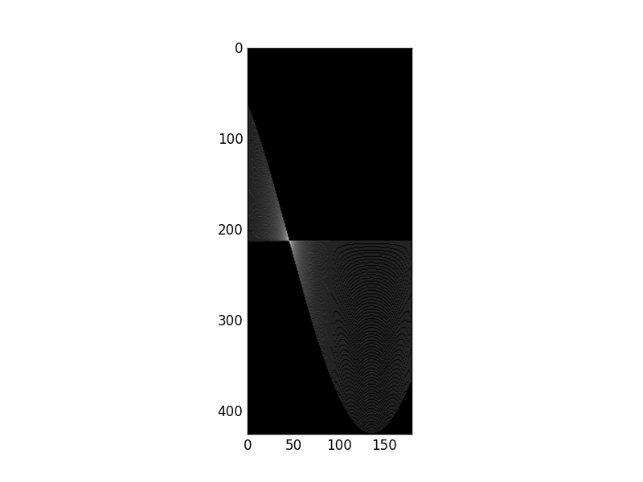

Slide 13
Contour Detection
Contour detection is the process of identifying the boundaries of objects within an image.
Applications: Shape analysis, object detection, and recognition.

Slide 14
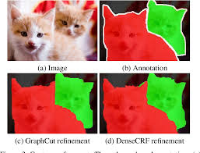
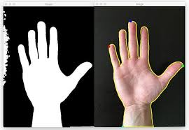
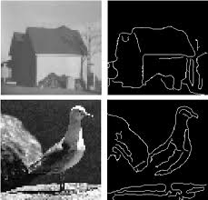
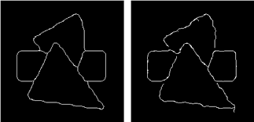
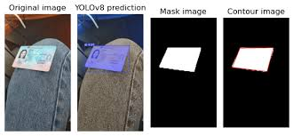

Slide 15
Thresholding-Based Contour Detection
Method: Thresholding converts a grayscale image into a binary image (black and white), which simplifies contour detection by isolating the objects from the background.
Usage:
Use functions like cv2.threshold() or cv2.adaptiveThreshold() to create a binary image.
Apply cv2.findContours() to detect the contours in the binary image.

Slide 16
Canny Edge Detection-Based Contour Detection
Method: Canny edge detection is a multi-stage edge detection algorithm that identifies edges in the image based on gradients. These edges can then be used as contours.
Usage:
Apply cv2.Canny() to detect edges in the image.
Use cv2.findContours() on the edge-detected image.

Slide 17
Gradient-Based Contour Detection (Sobel, Laplacian)
Method: Gradients like Sobel and Laplacian calculate intensity changes in an image, highlighting edges that can then be used to detect contours.
Usage:
Apply cv2.Sobel() or cv2.Laplacian() to detect gradients.
Use cv2.findContours() to detect contours from the gradient-based image.

Slide 18
Watershed Algorithm for Contour Detection
Method: The watershed algorithm is a region-based segmentation technique used to detect object boundaries, often applied when objects are touching.
Usage:
Convert the image to grayscale, apply thresholding, and use distance transforms to separate objects.
Mark the sure background and foreground regions, then use cv2.watershed() to refine contours.

Slide 19
Active Contours (Snakes)
Method: Active contour models (Snakes) iteratively adjust a curve around the object’s boundary to "snap" onto the edges.
Usage:
Initialize the contour around the object.
Use cv2.createActiveContourModel() and adjust with energy functions.
Note: Active contours are more complex to implement and are not directly available in OpenCV but can be used via libraries like scikit-image.

Slide 20
Contour Approximation (Polygonal Approximation)
Method: Contour approximation simplifies contours by reducing the number of points, making them easier to analyze.
Usage:
Use cv2.approxPolyDP() to approximate contours, typically after detection with one of the above methods.

Slide 21
Hierarchical Contour Detection
Method: This method groups contours hierarchically (e.g., parent-child relationships), useful for detecting nested contours like holes within objects.
Usage:
Use cv2.findContours() with retrieval modes like cv2.RETR_TREE for hierarchical contour detection.

Slide 22
Advantages of each methods
Thresholding and Canny Edge Detection are straightforward for clear images.
Gradient-based methods handle varying lighting conditions.
Watershed is effective for segmenting touching objects.
Active contours work well for complex shapes, and hierarchical detection aids in structured scenes.

