Slide 1
Image Processing
G1 2024
Shinta Estri

Slide 2
Overview of Image Processing Applications
Image processing is a rapidly growing field with applications in various domains. Here are some key areas:
Medical Imaging: Diagnosing diseases, analyzing medical images (X-rays, MRIs, CT scans).
Computer Vision: Enabling machines to understand and interpret visual information (object recognition, facial recognition, motion analysis).
Remote Sensing: Analyzing images captured from satellites or drones for land use, environmental monitoring, and disaster management.
Graphics and Multimedia: Creating and manipulating digital images for artistic expression, video editing, and game development.
Industrial Automation: Inspecting products for defects, guiding robotic systems, and automating quality control processes.

Slide 3
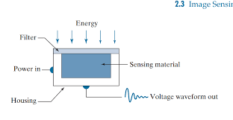
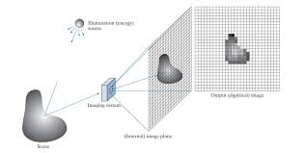
Image Sensing and Acquisition
The process of capturing an image begins with image sensing. This involves converting light energy into electrical signals. The most common sensors used for image acquisition include:
CCD (Charge-Coupled Device): A semiconductor device that converts light into electrical charges.
CMOS (Complementary Metal-Oxide-Semiconductor): A type of semiconductor technology that offers lower power consumption and higher integration density compared to CCDs.
Photodiodes: Semiconductor devices that generate a current when exposed to light.
After sensing, the electrical signals are digitized to create a digital representation of the image. This involves sampling and quantization.
In Digital Image Processing, signals captured from the physical world need to be translated into digital form by “Digitization” Process.

Slide 4
Image Sampling and Quantization
In order to become suitable for digital processing, an image function f(x,y) must be digitized both spatially and in amplitude.
Sampling: The process of dividing an image into a discrete number of pixels (Digitizing the co-ordinate value). The sampling rate determines the spatial resolution of the image. A higher sampling rate results in a finer-grained image.
Quantization: The process of assigning a discrete value to each pixel intensity (Digitizing the amplitude value). The number of quantization levels determines the color depth of the image. A higher number of levels results in a wider range of colors.

Slide 5
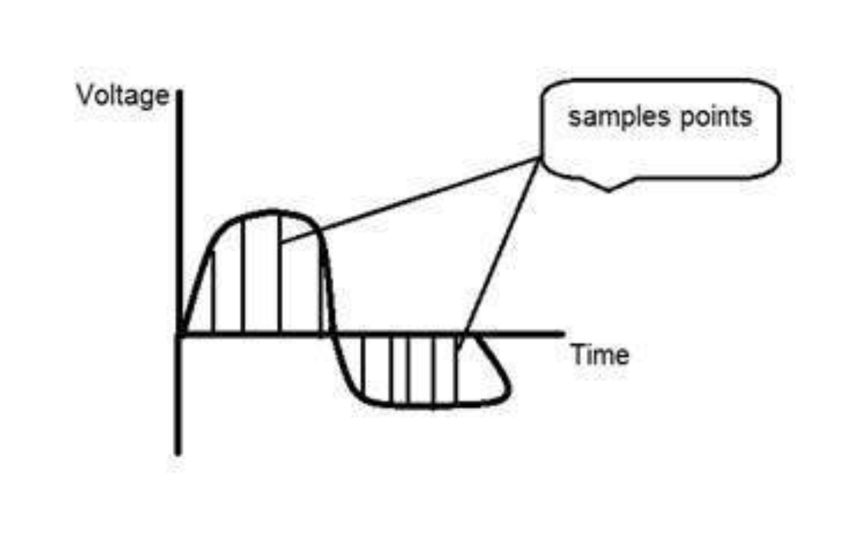
Image sampling is a fundamental process in digital image processing. It involves converting a continuous image into a discrete representation, where the image is divided into a grid of pixels. Each pixel represents a specific region of the original image.

Slide 6
The Sampling Process:
Grid Creation: A grid is superimposed over the continuous image. The grid's density determines the resolution of the sampled image. A denser grid results in a higher-resolution image.
Pixel Assignment: For each pixel in the grid, the intensity value of the corresponding region in the continuous image is determined. This value is typically calculated by averaging the intensity values within the region.
Pixel Representation: The calculated intensity value is stored as a digital value representing the color or brightness of the pixel.

Slide 7
The Sampling Process:
Sampling has a relationship with image pixels. The total number of pixels in an image can be calculated as Pixels = total no of rows * total no of columns.
For example, let’s say we have total of 36 pixels, that means we have a square image of 6X 6. As we know in sampling, that more samples eventually result in more pixels.
So it means that of our continuous signal, we have taken 36 samples on x axis.
That refers to 36 pixels of this image. Also thenumber sample is directly equal to the number of sensors on CCD array.

Slide 8
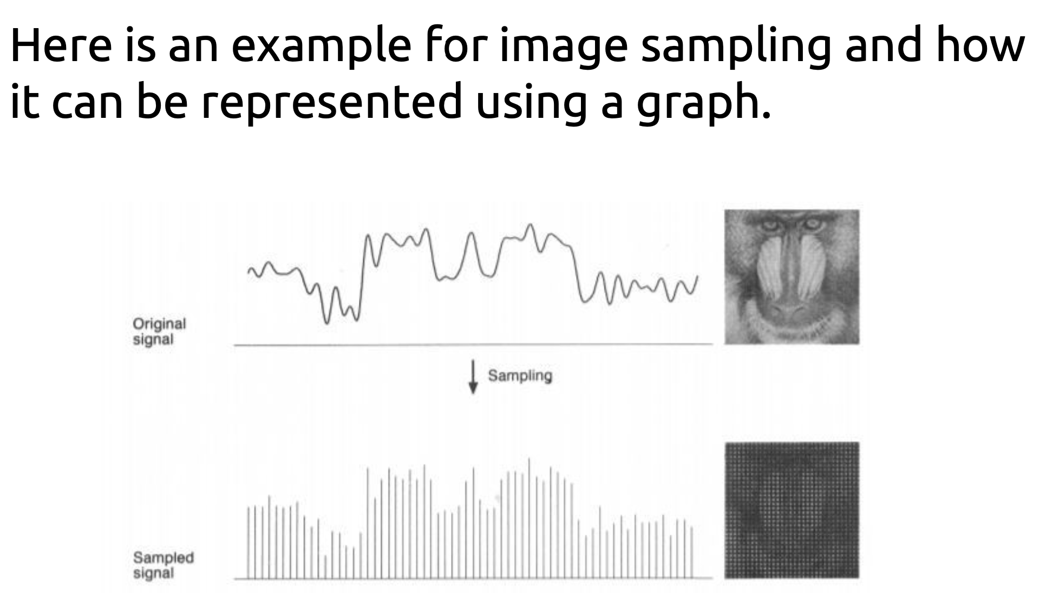

Slide 9
Quantization
Quantization is opposite to sampling because it is done on “y axis” while sampling is done on “x axis”.
Quantization is a process of transforming a real valued sampled image to one taking only a finite number of distinct values.
Under quantization process the amplitude values of the image are digitized. In simple words, when you are quantizing an image, you are actually dividing a signal into quanta(partitions).

Slide 10
Quantization
Now let’s see how quantization is done. Here we assign levels to the values generated by sampling process.
In the image showed in sampling explanation, although the samples has been taken, but they were still spanning vertically to a continuous range of gray level values.
In the image shown below, these vertically ranging values have been quantized into 5 different levels or partitions. Ranging from 0 black to 4 white. This level could vary according to the type of image you want.

Slide 11
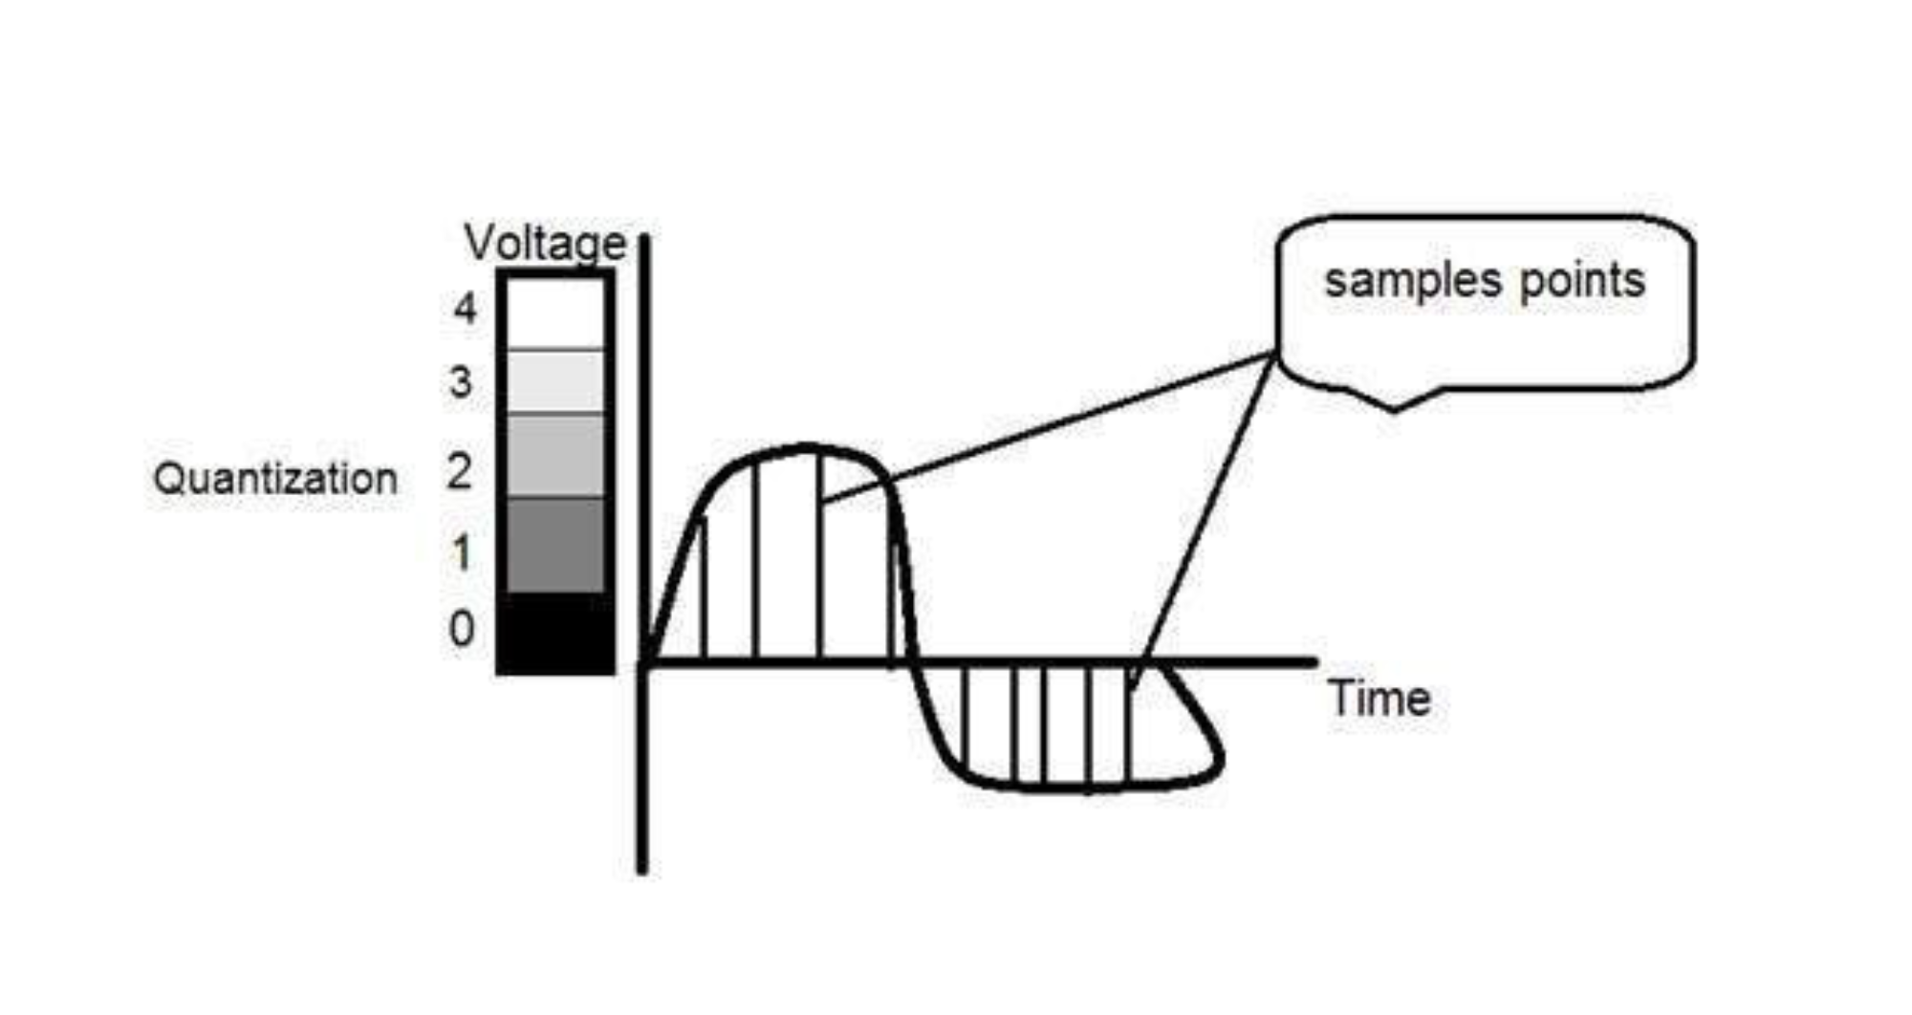

Slide 12
Quantization
When we want to improve the quality of image, we can increase the levels assign to the sampled image.
If we increase this level to 256, it means we have a gray scale image. Whatever the level which we assign is called as the gray level.

