Slide 1
Point Operation
Second Meeting

Slide 2
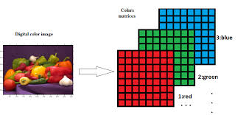
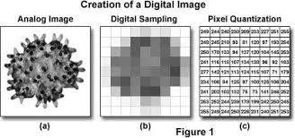
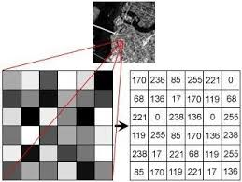
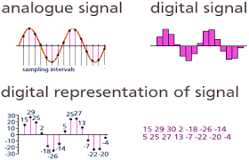
Image representation

Slide 3
Representing Digital Images
The representation of an M×N numerical array as

Slide 4
Representing Digital Images
The representation of an M×N numerical array as

Slide 5
from cv2 import imread
import matplotlib.pyplot as plt
from cv2 import imshow, waitKey
img = imread('orange.jpg')
print('Datatype:', img.dtype, '\nDimensions:', img.shape)
print(img[0, 0])
plt.imshow(img)
plt.title('Displaying image using Matplotlib’)
plt.show()
imgcv2 = cv2.imread('orange.jpg’)
cv2.imshow('Displaying image using OpenCV', imgcv2)
cv2.waitKey(0)
cv2.destroyAllWindows()
IMAGE LOADING

Slide 6
OPENCV VS MATPLOTLIB
If you are surprised with the output produced by Matplotlib and are wondering how this happened, the reason for this is that OpenCV reads and displays the image in BGR rather than RGB order.
Initial developers at OpenCV chose the BGR color format (instead of the RGB one) because at the time, the BGR color format was very popular among software providers and camera manufacturers. (Mastering OpenCV 4 with Python, 2019).
Matplotlib, on the other hand, uses the RGB color format and, hence, requires that the BGR image is first converted to RGB before it can be displayed well.

Slide 7
Image enhancement
Image enhancement is a process of improving the quality of an image for human viewing or for further processing.
It involves various techniques to modify the image's characteristics, such as brightness, contrast, sharpness, noise, color, and more.

Slide 8


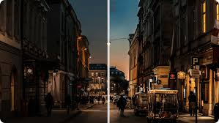
brightness

Slide 9
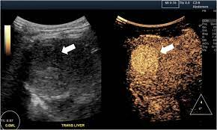
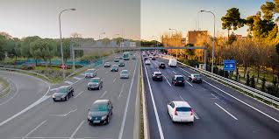
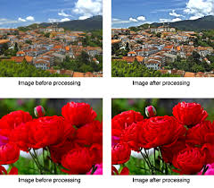
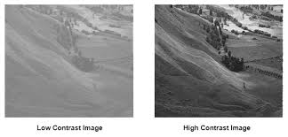
contrast

Slide 10
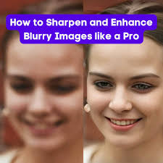
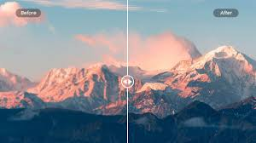
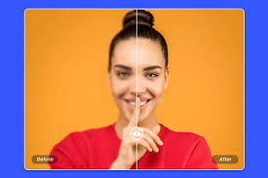

sharpness

Slide 11
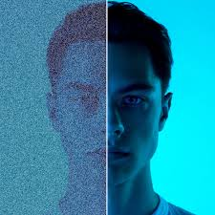
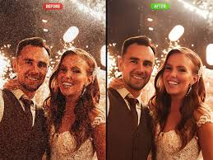
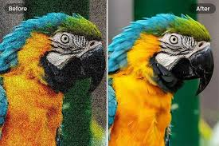
Denoise

Slide 12
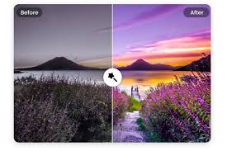


color

Slide 13
Common image enhancement techniques
Point operations: These involve modifying the pixel values individually, such as histogram equalization, gamma correction, and contrast stretching.
Spatial filtering: This involves applying a kernel or mask to the image to modify its local properties, such as smoothing, sharpening, edge detection, and noise reduction.
Frequency domain techniques: These involve transforming the image into the frequency domain, modifying the frequency components, and then transforming it back into the spatial domain.
Color enhancement: This involves adjusting the color balance, saturation, and hue of the image.

Slide 14
Point operations
Point operations are a fundamental class of image processing techniques that modify pixel values independently.
This means that the value of each pixel in the output image depends solely on the value of the corresponding pixel in the input image.

Slide 15
Point Operations --- Image Negation:
Purpose:
Reverses the intensity levels of an image.
Dark pixels become light, and light pixels become dark.
Explanation:
Each pixel's value is subtracted from the maximum possible value (usually 255 for 8-bit images).
This effectively flips the image's contrast.
Formula:
Output Pixel Value = Maximum Pixel Value - Input Pixel Value

Slide 16
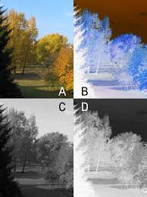
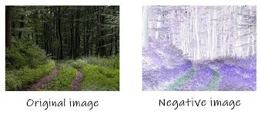
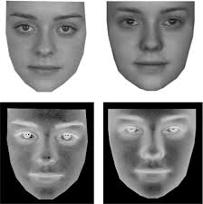
import cv2
import numpy as np
def negate_image(image):
"""Negates the given image.
Args:
image: The input image as a NumPy array.
Returns:
The negated image as a NumPy array.
""”
# Calculate the negated image
negated_image = 255 - image
return negated_image
# Load an image
image = cv2.imread('your_image.jpg')
# Negate the image
negated_image = negate_image(image)
# Display the original and negated images
cv2.imshow('Original Image', image)
cv2.imshow('Negated Image', negated_image)
cv2.waitKey(0)
cv2.destroyAllWindows()

Slide 17
Point Operations -- Thresholding:
Purpose:
Converts an image into a binary image.
Sets pixels above a threshold to 1 (white) and below to 0 (black).
Explanation:
A threshold value is chosen.
Pixels with values above the threshold are considered "foreground" and set to 1.
Pixels with values below the threshold are considered "background" and set to 0.
Formula:
Output Pixel Value = 1 if Input Pixel Value >= Threshold
Output Pixel Value = 0 otherwise

Slide 18
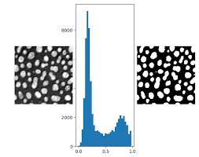
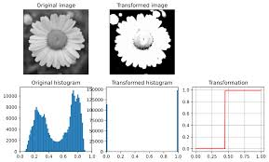
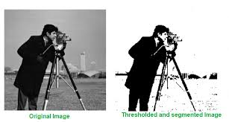
# Converting color mode to Grayscale
# as thresholding requires a single channeled image
img = cv2.cvtColor(img, cv2.COLOR_BGR2GRAY)
# Thresholding the image placing 127 intensity level as threshold
# Pixel values below 127 would be changed to Black
# Pixel values above 127 would be changed to White (255)
ret, binary = cv2.threshold(img, 127, 255, cv2.THRESH_BINARY)
ret, binary_inverse = cv2.threshold(img, 127, 255, cv2.THRESH_BINARY_INV)
ret, thresh_trunc = cv2.threshold(img, 127, 255, cv2.THRESH_TRUNC)
ret, thresh_tozero = cv2.threshold(img, 127, 255, cv2.THRESH_TOZERO)
ret, thresh_tozeroinv = cv2.threshold(img, 127, 255, cv2.THRESH_TOZERO_INV)

Slide 19
Point Operations -- Contrast Stretching:
Purpose:
Increases or decreases the contrast of an image.
Makes details more visible or reduces the dynamic range.
Explanation:
Maps the pixel values from a narrow range to a wider range (or vice versa).
This can enhance the visibility of details that were previously obscured by low contrast.
Formula:
Output Pixel Value = (Input Pixel Value - Min Input Value) / (Max Input Value - Min Input Value) * (Max Output Value - Min Output Value) + Min Output Value

Slide 20
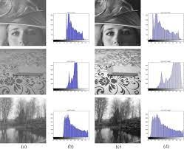
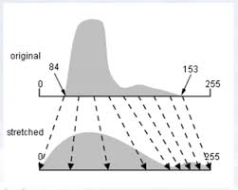
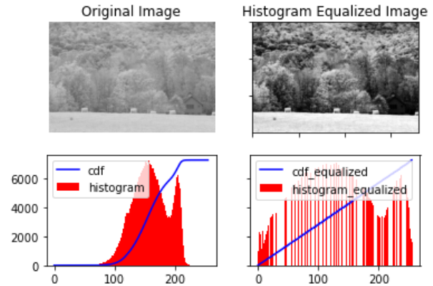
def contrast_stretch(image, min_percentile=1, max_percentile=99):
# Check if the image is grayscale or color
if len(image.shape) == 3:
# Color image: Apply contrast stretching to each channel separately
stretched_image = np.zeros_like(image)
for channel in range(3):
stretched_channel = contrast_stretch(image[:, :, channel], min_percentile, max_percentile)
stretched_image[:, :, channel] = stretched_channel
return stretched_image
else:
# Grayscale image
min_val = np.percentile(image, min_percentile)
max_val = np.percentile(image, max_percentile)
# Normalize the image to the range [0, 255]
stretched_image = (image - min_val) / (max_val - min_val) * 255
stretched_image = np.clip(stretched_image, 0, 255).astype(np.uint8)
return stretched_image

Slide 21
Point Operations -- Histogram Equalization
Purpose:
Redistributes the pixel values in an image more evenly.
Improves contrast, especially in images with a large number of pixels with similar values.
Explanation:
Calculate the histogram: Determine the frequency of each pixel value in the image.
Compute the cumulative distribution function (CDF): This is the cumulative sum of the histogram.
Map pixel values: For each pixel, its new value is determined by multiplying its CDF value by the maximum possible pixel value (e.g., 255 for 8-bit images).

Slide 22
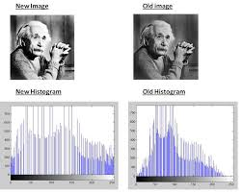
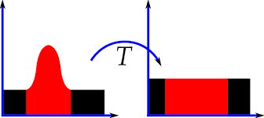
import cv2
import numpy as np
def histogram_equalization(image):
"""Performs histogram equalization on the given image.
Args:
image: The input image as a NumPy array.
Returns:
The histogram-equalized image as a NumPy array.
"""
# Calculate the histogram
histogram = cv2.calcHist([image], [0], None, [256], [0, 256])
# Calculate the cumulative distribution function (CDF)
cdf = np.cumsum(histogram) / np.sum(histogram)
# Map pixel values using the CDF
equalized_image = np.interp(image.flatten(), np.arange(0, 256), cdf * 255)
equalized_image = equalized_image.reshape(image.shape)
return equalized_image
# Load an image
image = cv2.imread('your_image.jpg')
# Apply histogram equalization
equalized_image = histogram_equalization(image)
# Display the original and equalized images
cv2.imshow('Original Image', image)
cv2.imshow('Histogram
Equalized Image', equalized_image)
cv2.waitKey(0)
cv2.destroyAllWindows()

Slide 23
Histogram
import cv2
import matplotlib.pyplot as plt
# Load the image
image = cv2.imread('image.jpg')
# Convert the image to grayscale
gray_image = cv2.cvtColor(image, cv2.COLOR_BGR2GRAY)
# Calculate the histogram
histogram = cv2.calcHist([gray_image], [0], None, [256], [0,
256])
# Plot the histogram
plt.figure(figsize=(10, 5))
plt.plot(histogram)
plt.xlabel('Pixel Intensity')
plt.ylabel('Frequency')
plt.title('Histogram of the Image')
plt.show()
A graphical representation of the distribution of pixel intensities in an image. It shows the frequency of each pixel value.

Slide 24
Key points to observe:
Discuss in group!
What is meaning of peak, shape and skewness in the context of image data.
Peak: The highest point on the histogram indicates the intensity level that occurs most frequently in the image.
Shape: The shape of the histogram can reveal information about the image's contrast and distribution of pixel values.
Skewness: If the histogram is skewed to the left or right, it indicates that the majority of pixel values are concentrated on one side of the intensity range.

Slide 25
Applications of histograms in image processing:
Image enhancement: Histogram equalization is a common technique used to improve contrast.
Image segmentation: Thresholding based on histogram analysis can be used to extract objects or regions of interest.
Image analysis: Histograms can provide insights into the overall characteristics of an image.

Slide 26
Exercise
Thresholding:
Load an image and experiment with different threshold values.
Observe how the image is converted into a binary image.
Use this method to segmented an object? Use different value of threshold.
Contrast Stretching:
Load an image with low contrast and apply contrast stretching.
Observe how the image's details become more visible.
Try different stretching parameters to see the effect.

Slide 27
TASKs additional
Combine point operations: Experiment with combining multiple point operations to achieve different effects.
Analyze the effects: Quantify the effects of point operations using metrics like mean, standard deviation, and histogram analysis.

