Slide 1
Updated Northeast Region I/O Model
Construct an I/O model that could be used for:
  Contribution assessments
  Relative policy appraisals of fishery management actions in a timely manner
  Linking to ecosystem models to calculate changes in economic indicators (e.g., jobs and income)
Notes:
Will help us fend off unsubstantiated claims that a proposed management action will doom the entire Northeast region to economic oblivion (e.g., Amend 13, paying for observer coverage or EM).

Slide 2
I/O Models
I/O models track the linkages between businesses and businesses and final consumers
I/O SAM models capture both market and non-market financial flows
Assumptions
Constant returns to scale
No supply constraints
Fixed commodity input structure
Notes:
IMPLAN’s Type SAM multipliers which include both market and non-market financial flows. SAM’s capture industry-to-industry transactions and non-market transactions such as payments of taxes by individuals and businesses, transfers of government funds to people and businesses (e.g., social security, unemployment compensation), transfers from businesses to households (interest and dividend payments). Thus, Type SAM multipliers use information about inter-institutional transfers to account for commuting , social security tax payments as well as household income taxes and savings. SAM’s track the flow of money between institutions.
Constant returns to scale - production functions are linear, if additional output is required, all inputs increase proportionately
No supply constraints - supplies are unlimited, output is limited only by the demand for its products
Fixed commodity input structure - implies that price changes do not cause a firm to buy substitute goods (i.e., supplies are perfectly elastic)
So these are the inherent weaknesses of I/O that users must be willing to accept. There are other types of models that overcome some of the weaknesses, such as applied or computable generable equilibrium models, but then additional data and time constraints are introduced so at the present time we’ve decided to use I/O to estimate impacts.

Slide 3
Limitations
Limitations
I/O analysis is not a substitute for benefit cost analysis
  I/O describes the effects of expenditures
I/O models are generally static and simply provide a snapshot of impacts at a current point in time
I/O models are driven by changes in final demand
  Harvesters are regulated and not households
  Developed an approach for dealing with this in:
Steinback, S.R. 2004. Using ready‑made regional input‑output models to estimate backward linkage effects of exogenous output shocks. The Review of Regional Studies, 34(1):57-71.
Notes:
Adjustments made to the RPCs (regional purchase coefficients) – indicate the portion of total regional demand supplied by local producers.
How much output is actually used locally. There’s a different econometric equation used to generate these estimates for each commodity in the model.

Slide 4
IMPLAN
Software
Simply provides a user-friendly platform from which I/O models of regional economies can be developed
Data
Estimates of sectoral activity for industry output,
  employment, value-added, and final demand for each county in the U.S. for 536 industrial sectors (NAICS codes)

Slide 5
IMPLAN
Default IMPLAN data and sector breakouts are generally not capable of being used to describe the economic activity associated with fishery management actions
IMPLAN Sector | Description
14 | Animal Production, except Cattle and Poultry and Eggs
17 | Commercial Fishing
93 | Seafood Product Preparation and Packaging
395 | Wholesale Trade

Slide 6
IMPLAN Model
Commercial Harvesting
Estimate annual Northeast ex-vessel revenue by species/species group and gear type (DMIS)
1) Black sea bass
2) Bluefish
3) Groundfish
4) Herring
5) Jonah crab
6) Lobster
7) Mackerel
8) Monkfish
9) Other species
10) Red crab
11) Scup
12) Sea scallop
13) Skate
14) Spiny dogfish
15) Squid
16) Summer flounder
17) Surf clam/ocean quahog
18) Tilefish
19) Whiting

Slide 7
IMPLAN Model
Commercial Harvesting
Observer and fixed cost data used to create production functions by gear type & size class
1) Gillnet large
2) Gillnet small
3) Handgear
4) Longline
5) Midwater trawl
6) Otter trawl large
7) Otter trawl small
8) Pot/trap large
9) Pot/trap small
10) Purse seine
11) Surf clam/ocean quahog dredge
12) Scallop dredge large
13) Scallop dredge small

Slide 8
IMPLAN Model
Commercial Harvesting
Estimate crew jobs by gear type (direct employment)
Estimate harvesting income (direct income)
Notes:
Direct - sales, income and employment generated from x-vessel purchases of seafood
Indirect - sales, income and employment of businesses that supply seafood harvesters (e.g., commercial fishers must purchase fuel, oil, bait, insurance, etc.). The fishing support sectors (indirect sectors), in turn, also purchase goods and services and this continues until leakages from the region (imports, wages, etc) stop the cycle.
Induced - sales, income and employment resulting from expenditures by employees of the direct and indirect sectors (e.g., crew purchase groceries and incur auto loans)

Slide 9
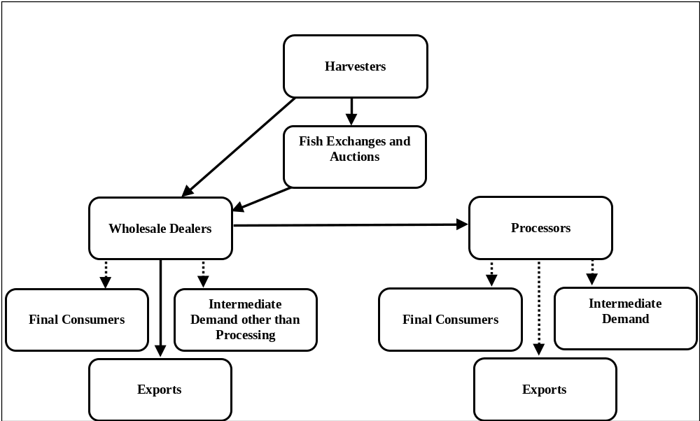
Model Product Flows
Product flows illustrated by solid lines could be captured in the model. Product flows illustrated with the dashed lines will be excluded.

