Slide 1
Salient Object Detection
End-to-End ML/DL Project
CNN encoder-decoder model built from scratch
No pretrained models or pretrained weights used
Dataset: ECSSD | Framework: PyTorch
Environment: Google Colab with T4 GPU

Slide 2
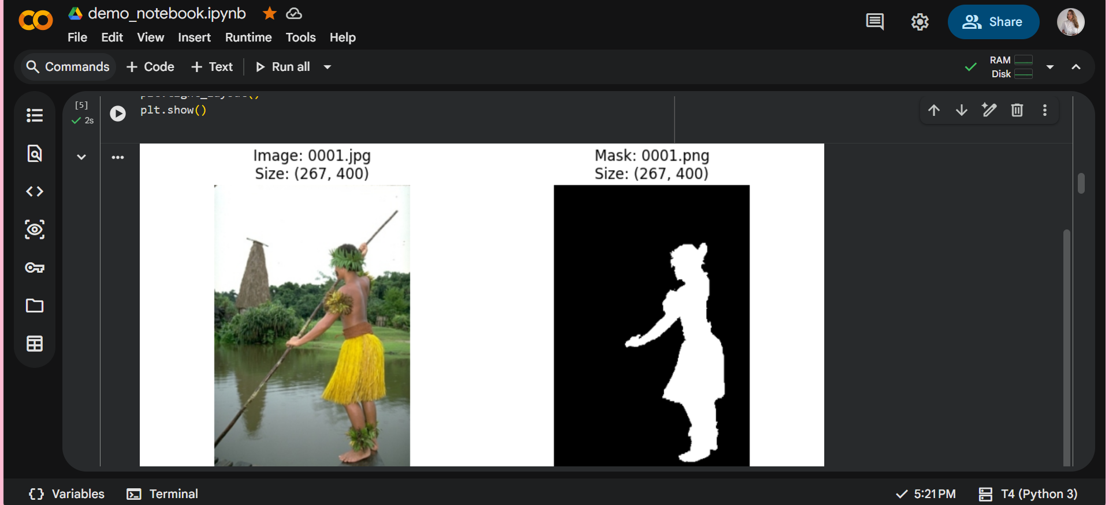
Dataset and Preprocessing
ECSSD dataset
Public SOD dataset with 1000 image-mask pairs
Images resized to 128x128 and normalized to 0-1
Split: 700 train, 150 validation, 150 test
Augmentations: horizontal flip, random crop, brightness variation

Slide 3
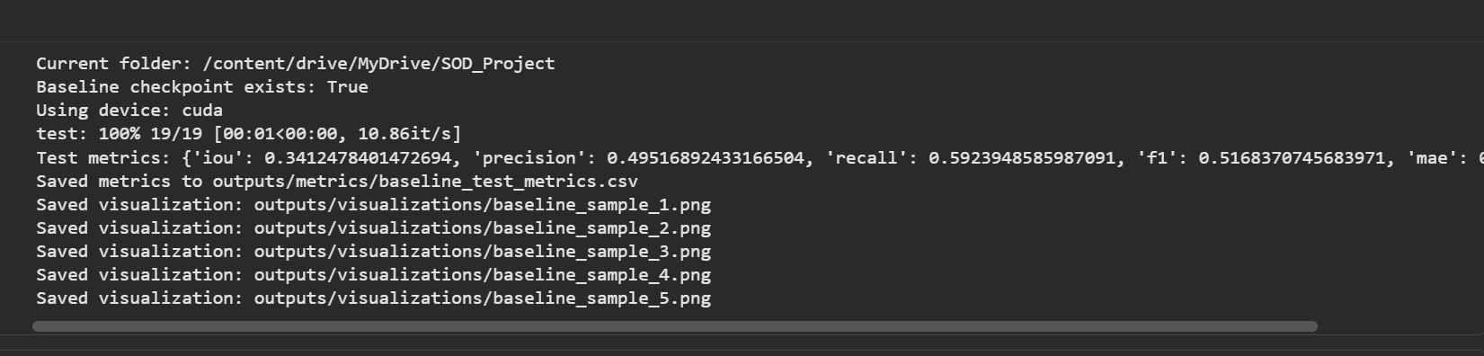
Model and Training
CNN encoder-decoder from scratch
Encoder: Conv2D + ReLU + MaxPooling blocks
Decoder: ConvTranspose2D + ReLU upsampling blocks
Output: 1-channel sigmoid saliency mask
Loss: BCE + 0.5 * (1 - IoU)
Optimizer: Adam, learning rate 0.001
Baseline stopped early at epoch 11 using early stopping

Slide 4
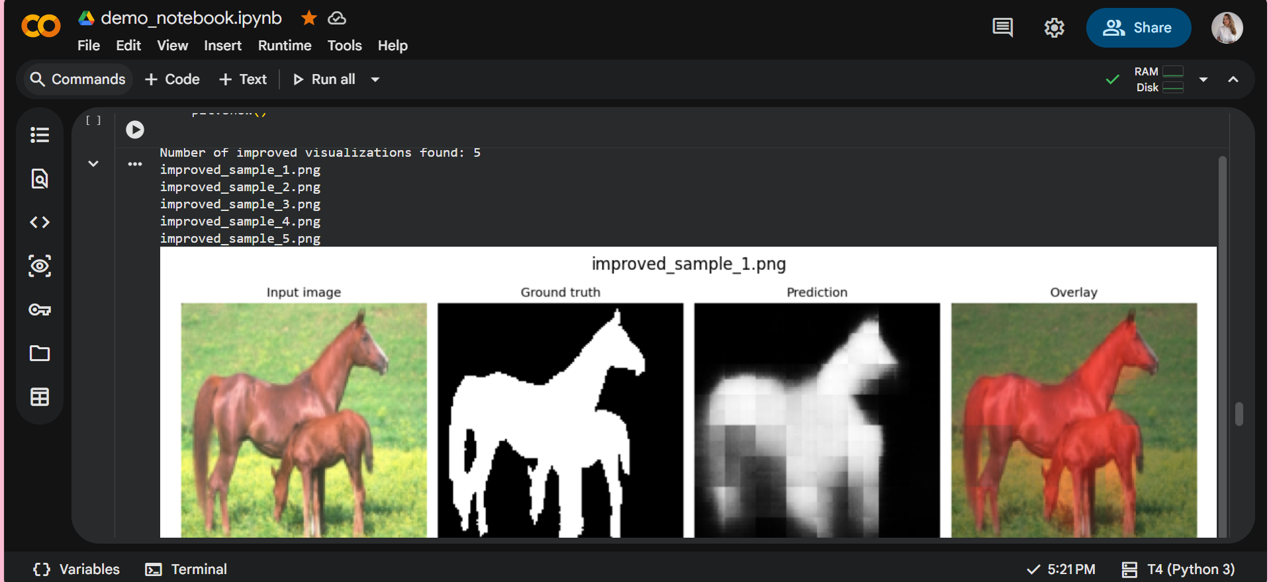
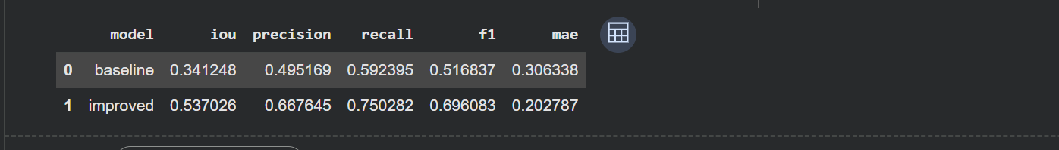
Experiments and Results
Baseline vs improved model
Improved model added Batch Normalization, Dropout, and deeper conv blocks
Both models evaluated on the same test set
Metrics: IoU, Precision, Recall, F1-score, MAE
Visual results compare input, ground truth, prediction, and overlay
If improved is not best in every metric, it still shows the effect of architecture changes

Slide 5
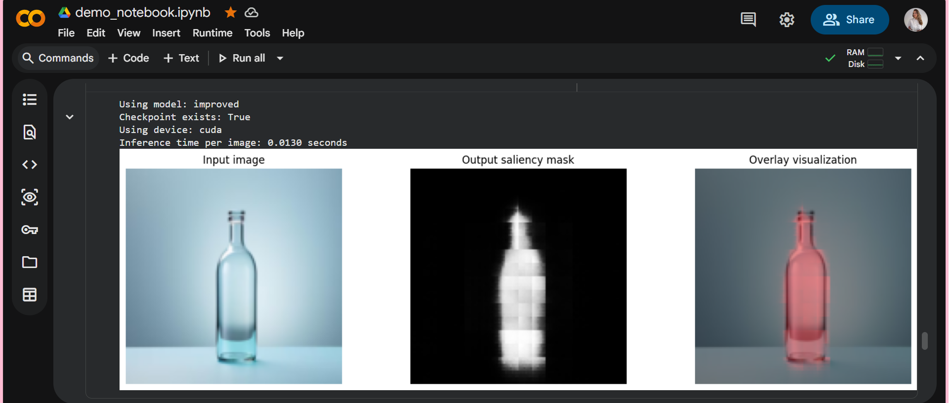
Demo and Learnings
Final end-to-end inference
Colab demo uploads a new image and runs inference
Shows input image, predicted mask, overlay, and inference time
Learned full DL pipeline: data, model, training, evaluation, visualization, demo
Main challenge: checking image-mask alignment and interpreting visual results

