Slide 1
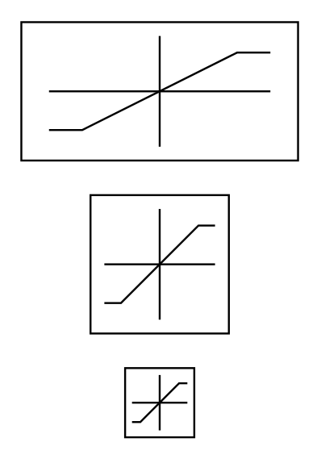






_FF
$$\frac{1}{\text{SS}\text{ ∗ }\text{EAS}\text{2}\text{TAS} }$$
Target
rate
$$\frac{d}{dt}$$
_DFF
$$\frac{1}{\text{SS}\text{ ∗ }\text{EAS}\text{2}\text{TAS} }$$
Angle
error
Filter target rate
Rad to rad/s
Speed
scaling
Rate
error
Target angle
+
+
+
+
$$\frac{1}{_TCONST}$$
_RMAX
$${SS}^{2}$$
_FLTT
_P
Dmod
PD
scale
+
∑
Output
∑
∑
_FLTE
-
-
+
+
Limit target
Rate _RMAX
Filter rate error
Slew rate limiter
PD limiter
Measured angle
Measured
rate
ʃ
_I
_IMAX
$${SS}^{2}$$
Anti-windup _IMAX
Speed
scaling
_FLTD
_D
Dmod
PD
scale
$$\frac{d}{dt}$$
Filter on D term
Slew rate limiter
PD limiter

