Slide 1
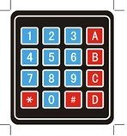
Max Value
Min Value
Locate Channel
Analog Value
Back Light, Key Light
External Light

