Slide 1
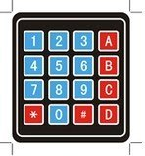
Value = 255
Value = 000
Value = Locate
Value = Analog
Enter
Back Light
On/Off

