Slide 1
I am listening
Anas Stitou, Emil Lambert, Tibo Verreycken, Kars van Velzen

Slide 2



Slide 3

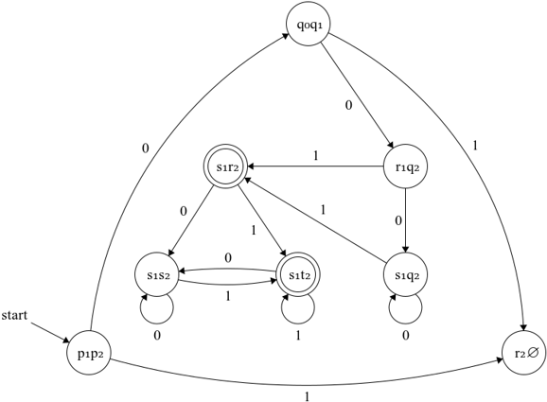

Slide 4


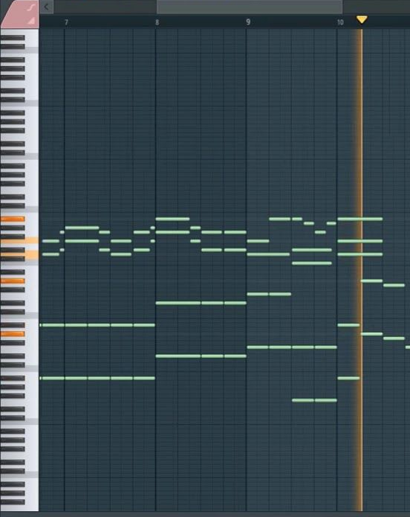
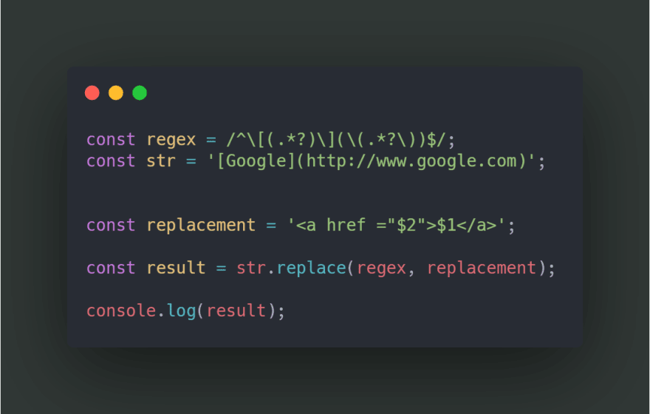

Slide 5


Slide 6


Slide 8
0:00
0:01
0:02
0:03
0:04
0:05
0:06
0:07
0:08
0:09
0:10
DFA | DFA | DFA | DFA | DFA | DFA | DFA | DFA | DFA | DFA
DFA | DFA | DFA | DFA | DFA | DFA | DFA | DFA | DFA | DFA
0:00
0:01
0:02
0:03
0:04
0:05
0:06
0:07
0:08
0:09
0:10

Slide 9

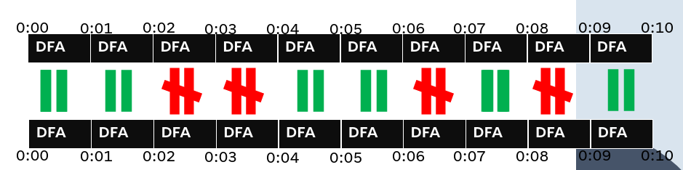




Slide 10


Slide 11
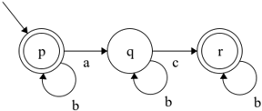
C | B | A | B | B | B

Slide 14
Are you still listening?

