Slide 1
Employee salary prediction using machine learning model
CAPSTONE PROJECT
Presented By: A. Imanth
Aicte id: STU677166733a70f1735485043
College Name: Madanapalle Institute of Technology and Science
Department: CSE-cybersecurity.

Slide 2
OUTLINE
Problem Statement (Should not include solution)
System Development Approach (Technology Used)
Algorithm & Deployment (Step by Step Procedure)
Result
Conclusion
Future Scope(Optonal)
References

Slide 3
Problem Statement
The objective is to develop an Employee Salary Prediction Model and evaluate various supervised machine learning models to accurately predict employee salaries based on a comprehensive set of relevant attributes. The aim is to identify the most effective algorithm that yields the highest predictive accuracy and provides actionable insights into the factors influencing employee compensation within the organization.

Slide 4
System Approach
Minimum System requirements:
OS – Windows 10/11, MacOS, Linux
Processors – Modern dual/quad core processors like [ Intel i3/i5 or Ryzen 3/5 ]
RAM – 8 GB for seamless loading of datasets and models
Storage – 256 GB SSD
Online Platforms –
Google colab
IBM Watson studios
Amazon SgaeMaker
Microsoft Azure Machine Learning

Slide 5
System Approach
Library required to build the model
pandas – for Data manipulation and analysis
matplotlib – for Data visualization, plotting graphs
sklearn – for Machine learning toolkit
sklearn.preproceesing – for data preparation, scaling, encoding
sklearn.pipeline – for workflow automation, model chaining
sklearn.model_selection – for model evaluation, splitting data
sklearn.linear_model – for linear regression model
sklearn.ensemble – for Ensemble methods [ example - RandomForest]
sklearn.neighbors – for K-Nearest Neighbors [ KNN ]
sklearn.svm – for support vector machines [ SVM ]
joblib – for Model saving and loading
stramlit – for web app creation for ML

Slide 6
Algorithm & Deployment
Phase 1: Data Acquisition and Initial Assessment
Data Ingestion: Securely load the raw dataset into the development environment.
Missing Value Analysis: Conduct a comprehensive assessment of null values using isna().sum() to quantify their presence within each attributes.
Data Imputation/Categorization: Address identified missing values. If they represent specific categories or have a meaningful absence, rename them appropriately for clearer interpretation.
Redundancy and Low-Variance Feature Identification: Analyze the dataset for redundant attributes or those with negligible variance that contribute minimally to the predictive power. Attributes with low or no contribution will be considered for removal to streamline the model.

Slide 7
Algorithm & Deployment
Phase 2: Data Preprocessing and Refinement
Noise and Anomaly Detection: Systematically identify and address noise, anomalies, or abnormal data points (e.g., outliers, NaN values resulting from data errors). Employ statistical methods and domain knowledge for robust detection.
Visual Data Exploration and Outlier Management: Utilize visualization libraries such as Matplotlib to graphically represent data distributions. This step aids in the visual detection of noise, outliers, and inconsistencies, which will then be appropriately handled (e.g., removal, transformation).
Data Encoding for Model Readability: Upon satisfactory data refinement, convert all categorical and textual features into numerical representations suitable for machine learning algorithms.
Strategic Preprocessing Algorithm Selection: Apply appropriate preprocessing algorithms (e.g., one-hot encoding, label encoding, scaling techniques) to ensure data is in an optimal format for model training.
Post-Encoding Data Validation: Re-validate the dataset for any residual NaN values or inconsistencies that may have emerged during the encoding process. Further refinement will be performed to ensure data integrity and consistency.

Slide 8
Algorithm & Deployment
Phase 3: Model Development and Evaluation
Data Partitioning (Input/Output Split): Strategically divide the refined dataset into input features (X) and the target variable (Y - salary). Subsequently, partition the data into training and testing sets (e.g., an 80% training, 20% testing split) to facilitate robust model validation.
Model Training and Testing: Utilize the partitioned data to train various supervised machine learning algorithms. Each model's performance will then be rigorously evaluated using the unseen test data to assess its predictive accuracy.
Comparative Model Performance Analysis: Train and test multiple machine learning algorithms (e.g., Linear Regression, Random Forest, Gradient Boosting) on the prepared data.
Predictive Performance Visualization: Generate comparative visualizations (e.g., actual vs. predicted plots, error distributions) for each algorithm's predictions. This visual analysis will aid in identifying the algorithm exhibiting the superior predictive performance.

Slide 9
Algorithm & Deployment
Phase 4: Application Development and Deployment
Interactive Application Development: Develop a user-friendly web application using the Streamlit library. This application will serve as the interface for interacting with the trained model, allowing users to input employee attributes and receive salary predictions.
Application Deployment: Deploy the Streamlit application either to a cloud hosting service or by leveraging tunneling solutions, making the salary prediction model accessible for practical use and demonstration.

Slide 10
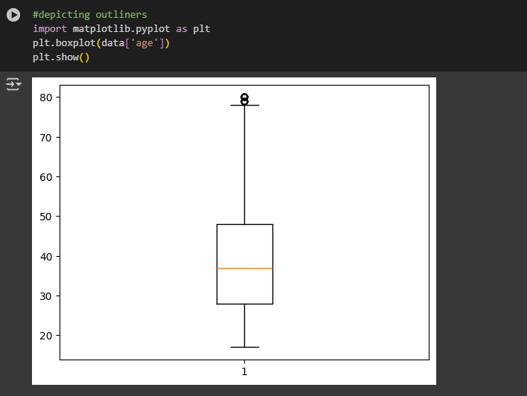
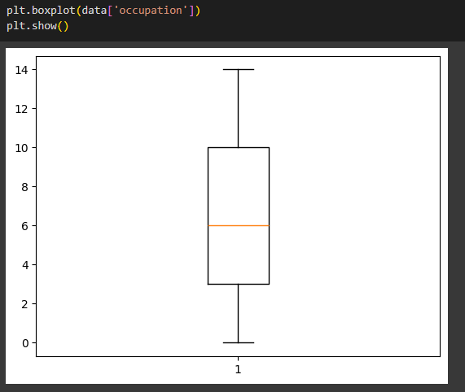
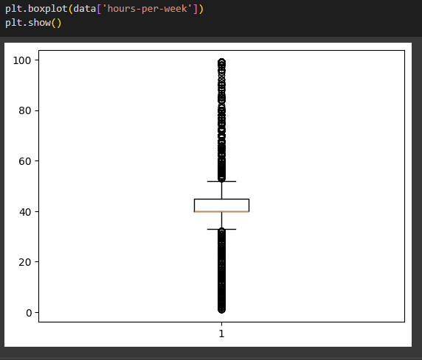
Result

Slide 11
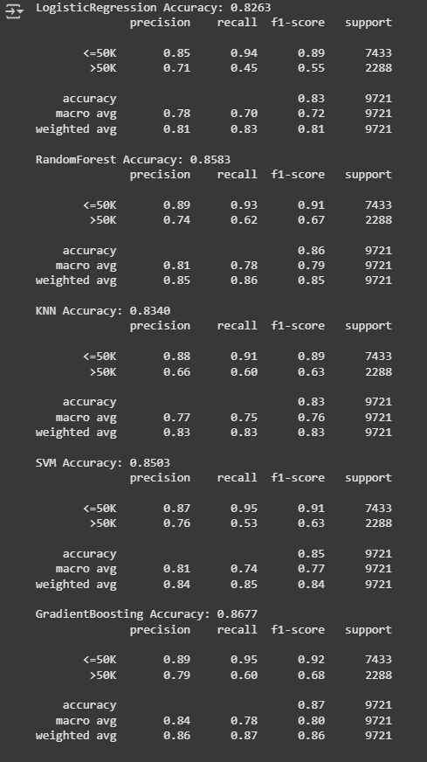
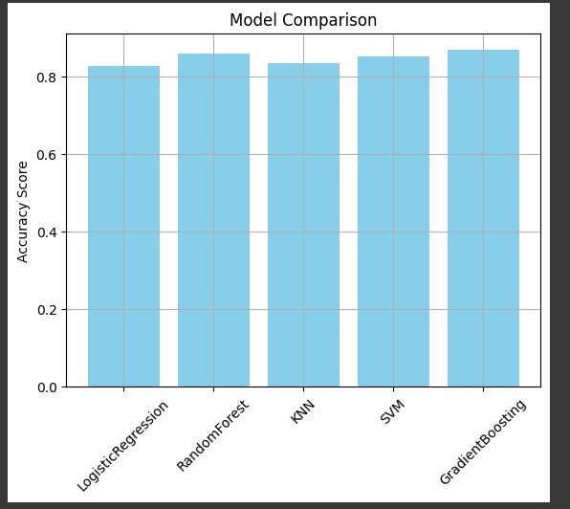
Result

Slide 12
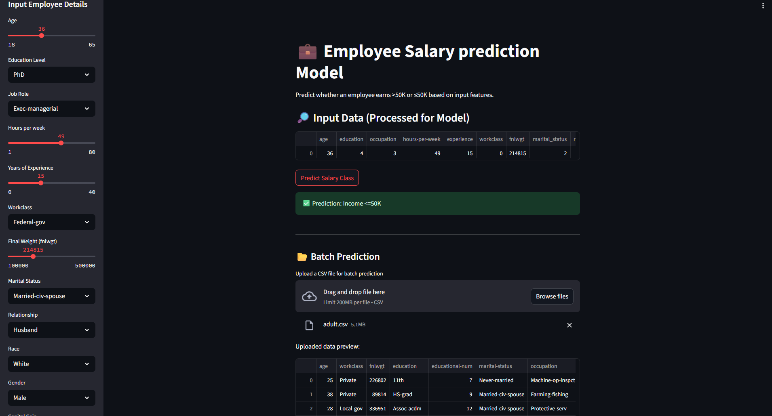
Result

Slide 13
Result
Attach your Github link: AreImanth_Github

Slide 14
Conclusion
The employee salary prediction model, leveraging five supervised learning algorithms, demonstrated strong effectiveness by achieving a 0.8677 prediction value, indicating its robust capability in forecasting salaries.
This solution provides valuable insights into compensation drivers within the organization.
During implementation, key challenges included managing NaN values and data redundancy within the dataset, which necessitated careful preprocessing. Additionally, the process of selecting the optimal machine learning algorithms and -the complexities associated with Streamlit application deployment were significant hurdles.
Looking forward, potential improvements involve addressing common challenges in salary prediction, such as mitigating inherent biases in historical data, refining feature engineering for deeper insights, and implementing strategies for concept drift to ensure the model's long-term accuracy and relevance.

Slide 15
Future scope(Optional)
Integrate External Market Data: Incorporate industry salary benchmarks and cost of living indices to provide more accurate, market aligned predictions.
Establish MLOps for Continuous Improvement: Set up automated pipelines for the model monitoring (detecting “concept drifts”) and regular retraining with new data.
Provide Deeper Insights and Scenarios: Offer predicted salary ranges instead of single points, and enable “what-if” analyses to understand feature impact on salaries.
Enhance User Experience and Integration: Improve the models app intuitiveness and expose the model via APIs for seamless integration with other HR systems.

Slide 16
References
Edunet Foundation - Mentor led classes on AI/ML and model building
link: Edunet Foundation
IBM Skillsbuild - Artificial Intelligence Fundamentals
link: IBM Skillsbuild
Google colab – Model development environment
link: Google colab
ngrok – Autherization token used for streamlit App
link: ngrok

Slide 17
THANK YOU

