Slide 2
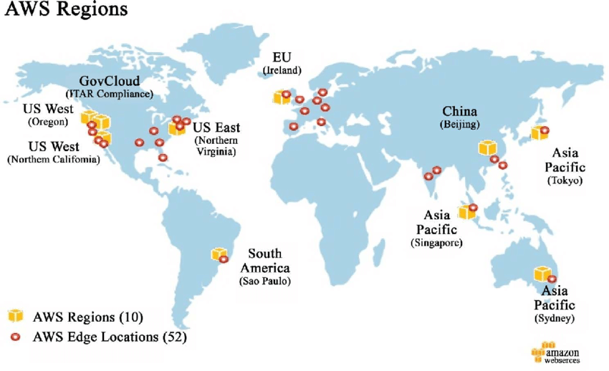

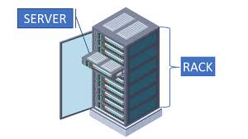
1. Regions
2. Data center = Availability zone
3. Server and rack

Slide 3
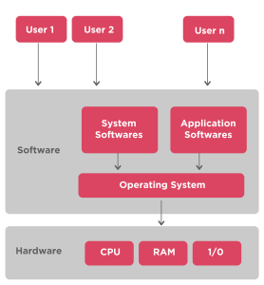
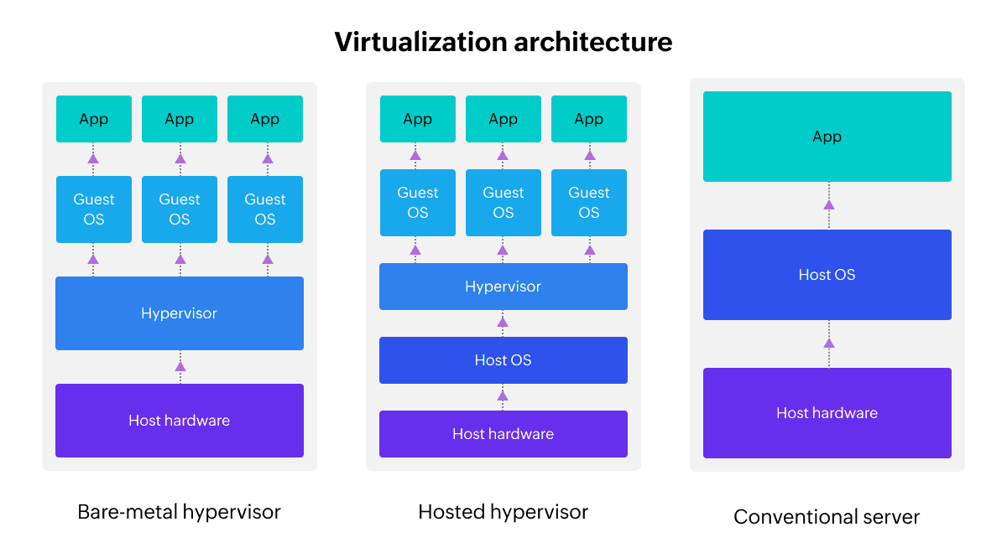
Virtualization
Machine-1
Machine-2
Machine-2
Traditional machine
Virtual machine

Slide 4
Steps to launch an ec2
Naming
OS
Instance type
Key pair
Networking
Configuration storage
Additional details ( user data, IAM role)

Slide 5
Day-2

