Slide 1
CI/CD portable environment
Martyniuk Oleksii
DevOps_online_Kyiv_2021Q2

Slide 2
Purpose:
Portable infrastructure with automatic AWS EC2 instance creation and installation Web Server. Used tools :
Docker
GitHUB
Jenkins
Terraform
Ansible
AWS

Slide 3
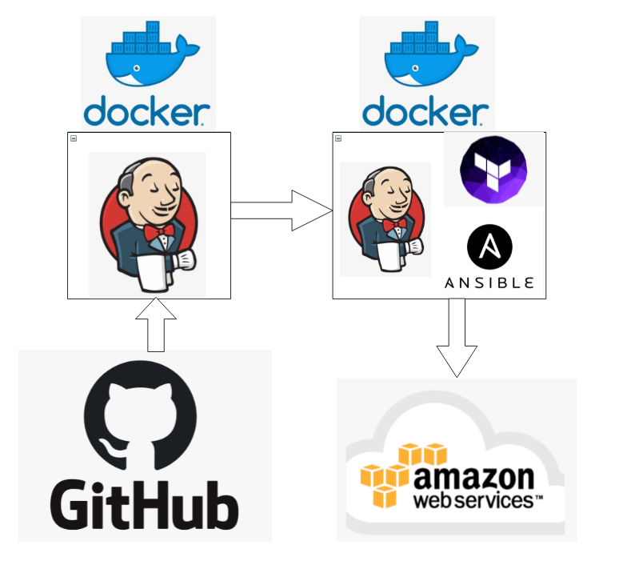
Схема проекту

Slide 4
Project steps
At first I wrote docker-compose.yml file and two Dockerfiles.
Using this files and installed docker I can easily run two containers with Jenkins
Master in first and with Jenkins Slave in second.
Jenkins Master store build on docker vault and transfer build with files from GitHUB to Jenkins Slave.
Jenkins Slave runs Terraform that creates EC2 instance.
After creation EC2, public IP address of the instance copied to Ansible hosts file.
In the end Ansible with IP installs Web Server and upload file.

Slide 5
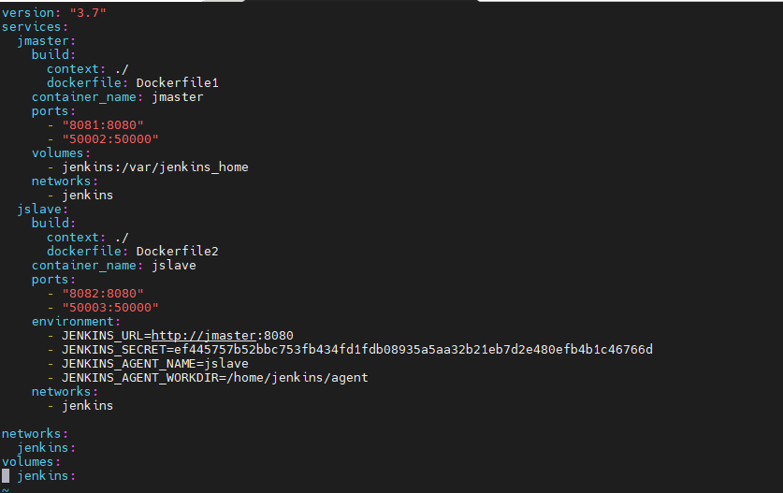
Docker
At first I wroute docker-compose.yml file and two Dockerfiles.

Slide 6
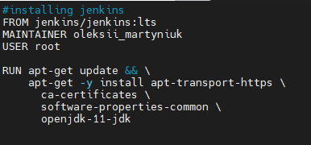
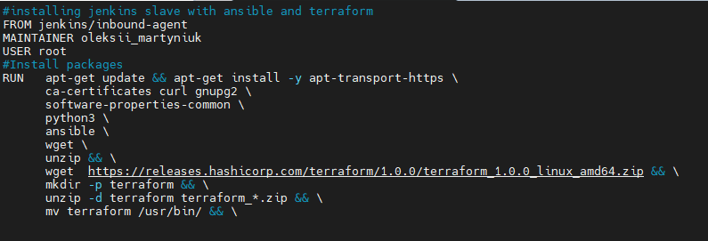
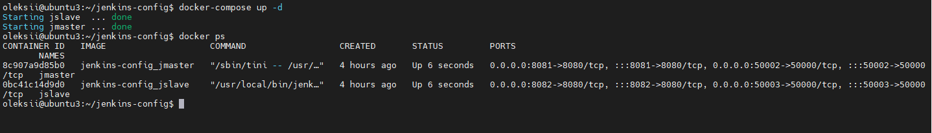
Dockerfile1 Dockerfile2

Slide 7
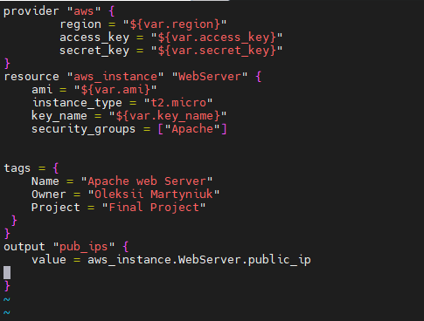
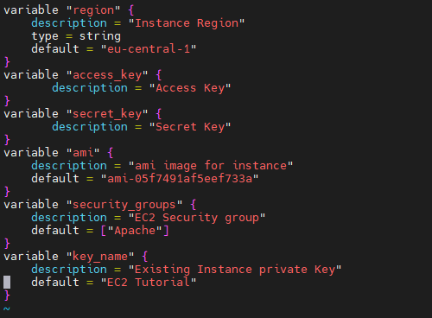
Terraform configuration files
main.tf variables.tf

Slide 8
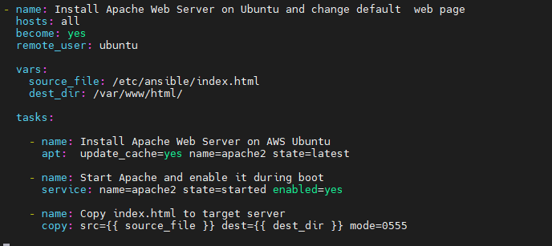
Ansible playbook

Slide 9
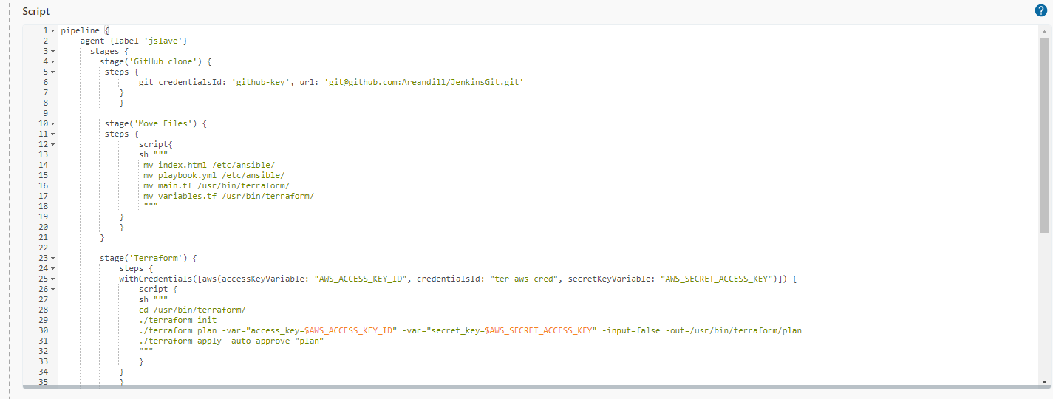
Jenkins code

Slide 10
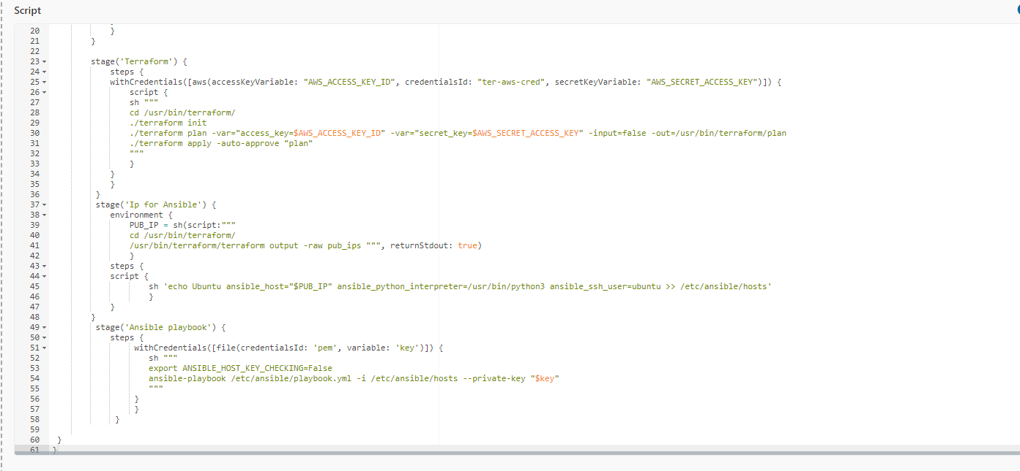

Slide 11
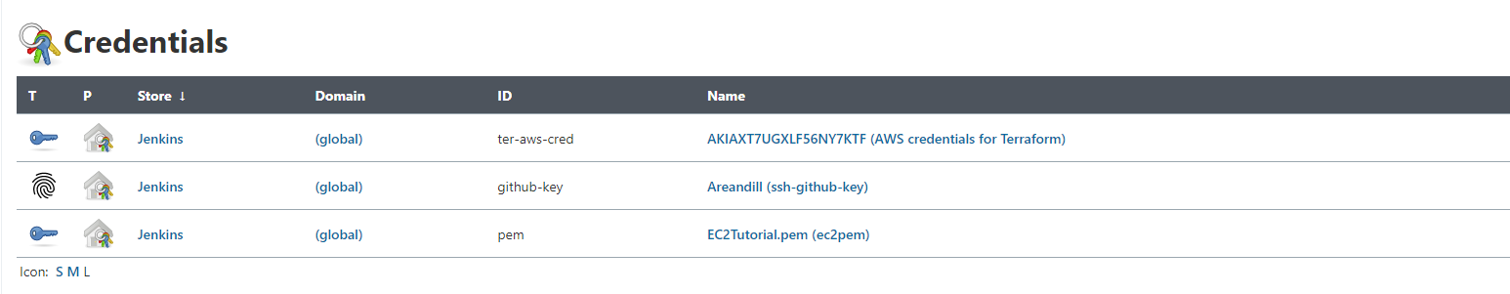
All credentials in project used with Credential plugin

Slide 12
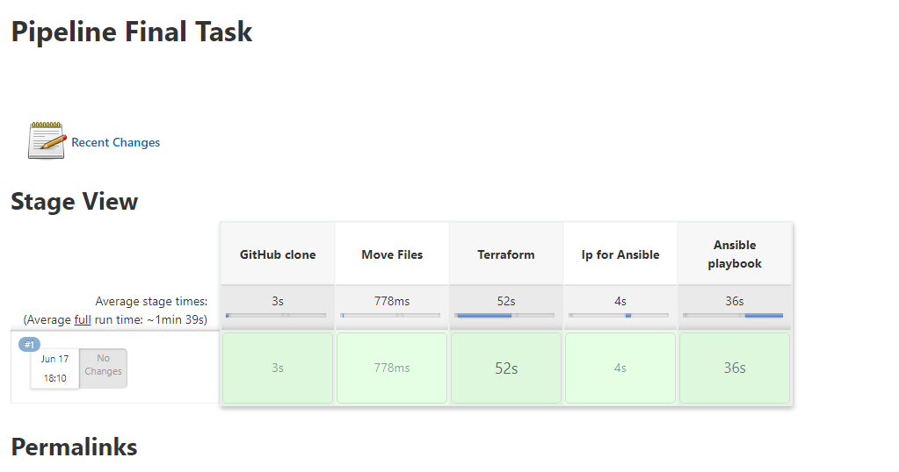

Slide 13
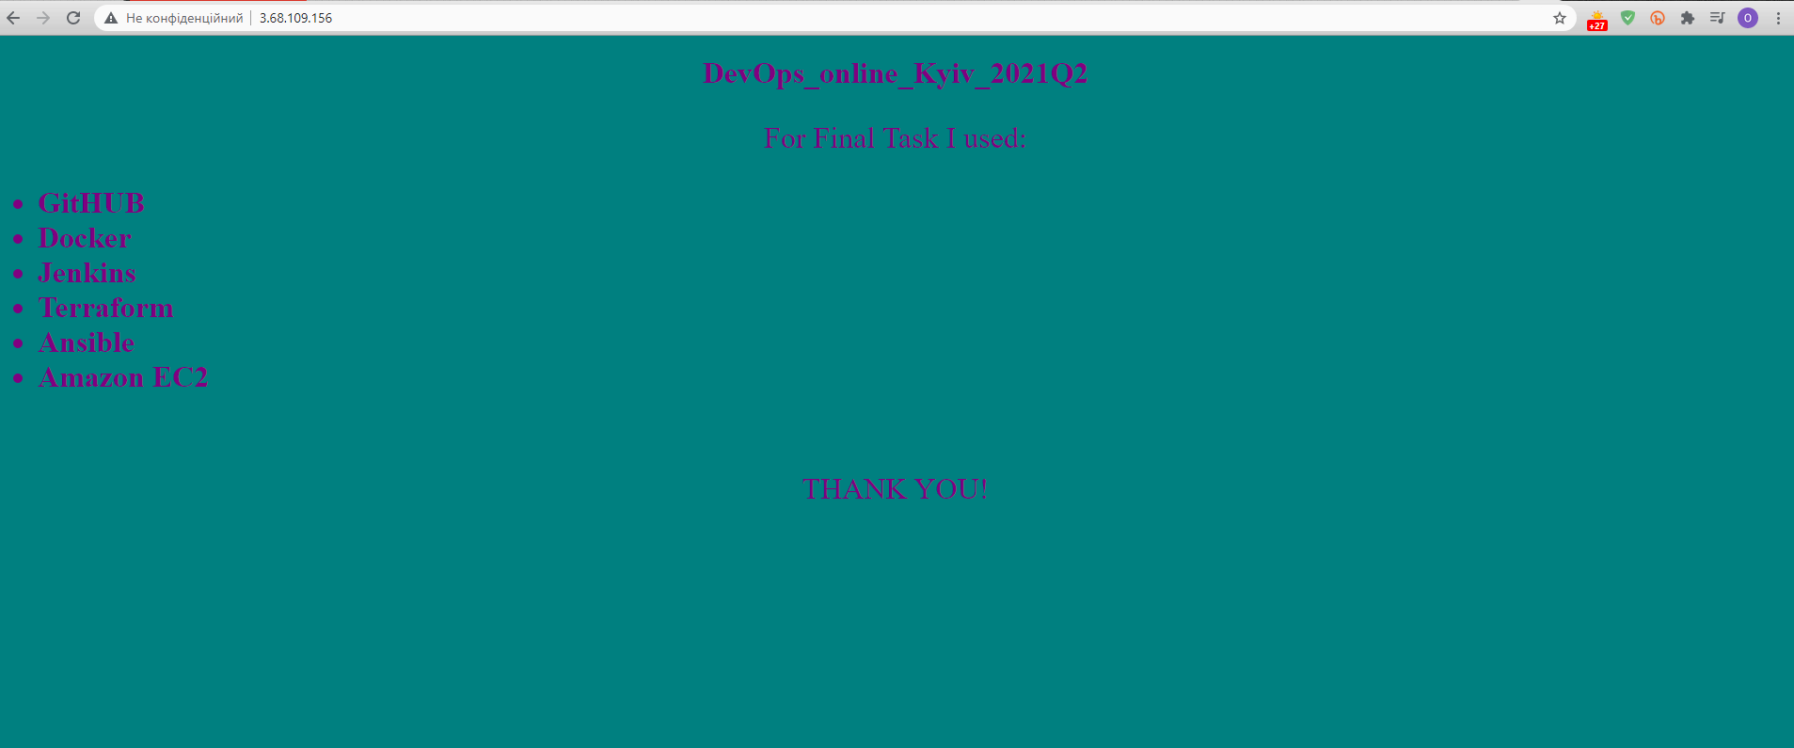

Slide 14
What could be improved in this project in future:
Prevent containers from starting simultaneously, especially for Jenkins Master and Slave.
Push add Elastic Load Balancer or push the image directly to Elastic Container
Service(for better availability and educational purposes).
Use AWS Dynamic Container for AWS Credentials.

Slide 15
THANK YOU

