Slide 1

Sign Language Translation using Convolutional Neural Network
Presented By -
Harsh Gupta (202025025)
Khriesezo Peseyie (202025016)
Under The Guidance of Mr. Spandan Kumar Barthakur

Slide 2
Contents
Introduction
Objectives
Libraries Used
Flowchart
Algorithm
Functions
Result
Training and Testing
Future Scope
References

Slide 3
Introduction
Convolutional Neural Network:
A Convolutional Neural Network (CNN) is a type of artificial neural network designed specifically for image recognition and processing. CNNs are particularly effective in tasks involving visual data, such as image classification, object detection, and image segmentation. They have revolutionized the field of computer vision and have been instrumental in achieving state-of-the-art performance in various image-related tasks.
Notes:
Open angle- develops slowly over time, damage to optic nerve cause blind spot in vision, tends to run in families
Closed angle- emergency, quick severe rise in eye pressure, Nausea, extreme discomfort, and blurred vision are all symptoms.
Normal Tension Glaucoma: Damage of the optic nerve in the eye causes normal tension glaucoma to develop. The main cause of this type of glaucoma is a lack of blood flow to the optic nerve and increase of pressure on the fundus.
Congenital Glaucoma: occurs in babies. Run in families, at birth, eye does not develop properly

Slide 4
Problem Statement:
The project's significance lies in its potential to transform lives. Deaf and Hard of Hearing individuals often face challenges in accessing information and participating fully in various aspects of life.
Our system, through its ability to convert sign language into text and speech, offers a powerful tool for communication and integration.
It opens doors to educational opportunities, facilitates effective communication in workplaces, and enhances social interactions.
This project represents not only a technical achievement but also a commitment to fostering inclusivity and understanding in our society, emphasizing that everyone, regardless of their hearing abilities, deserves to be an active and engaged part of our diverse world.

Slide 5
Objectives
Sign Language Recognition - To create a robust machine learning model capable of accurately recognising a wide range of sign language gestures, ensuring precision and reliablity in the converison process.
English Text Generation - To develop a natural language processing component that can seamlessly convert recognized sign language gestures into clear and choerent english text, preservving the intended meaning and naunces.
Speech Synthesis - To integrate text-to-speech synthesis technology that enables the conversion of the generated english text into natural sounding speech, ensuring effecting communication with the hearing word.

Slide 6


Libraries Used
CVZone:
It refers to a Python library created by the Computer Vision Zone (CVZone) community. The CVZone library serves as an extension to OpenCV (Open Source Computer Vision Library) and provides additional functionalities to make it easier for developers to work on computer vision projects.
OpenCV(Open Source Computer Vision) or CV2 is an open source
library of programming functions used for real-time computer-vision. It is mainly used for image processing, video capture and analysis for features like face and object recognition. It is written in C++ which is its primary interface, however bindings are available for Python, Java, MATLAB/OCTAVE.

Slide 7


Libraries Used
MediaPipe is an open-source framework developed by Google that provides a comprehensive set of tools for building applications with real-time perception capabilities, particularly in the fields of computer vision and machine learning.
It allows developers to build complex pipelines for processing multimedia data using modular components called graphs. These graphs are composed of reusable building blocks, making it easier to create and experiment with different configurations.
Keras is a high-level neural networks library written in python that works as a wrapper to TensorFlow. It is used in cases where we want to quickly build and test the neural network with minimal lines of code. It contains implementations of commonly used neural network elements like layers, objective, activation functions, optimizers, and tools to make working with images and text data easier.

Slide 8

Libraries Used
TensorFlow is an open source software library for numerical computation. First we define the nodes of the computation graph, and then inside a session, the actual computation takes place. It is widely used in Machine Learning.
Overall, TensorFlow has become a cornerstone in the field of machine learning, providing a powerful and flexible framework for building, training, and deploying a wide variety of machine learning models.

Slide 9
Libraries Used
Tkinter
Tkinter is a standard Python library for creating graphical user interfaces (GUIs). It provides a set of tools and widgets (graphical elements) that enable developers to build desktop applications with a graphical user interface. Tkinter is based on the Tk GUI toolkit, which originated as a part of the Tcl (Tool Command Language) scripting language.

Slide 10
Flowchart
Start
View Webcam for signs of Sign Language
Crop image specifically on the hand gesture and remove unnecessary background environment
Recognize various Hand Gestures depending on the illustration of the hand
Convert the Sign Language into written language or speech

Slide 11
Algorithm
Step 1: Gather a diverse dataset of sign language gestures. This dataset should include various signs, expressions, and individuals to ensure the model's generalization.
Step 2: Classify the dataset with corresponding text labels or class identifiers for each sign gesture. Each image in the dataset should be associated with the appropriate sign language translation.
Step 3: Define the architecture of the Convolutional Neural Network (CNN). Design a model that can effectively capture spatial hierarchies and patterns within the sign language gestures. Common architectures include a series of convolutional, pooling, and fully connected layers.
Step 4: Implement a real-time translation system that can capture live video frames or image sequences. Integrate the trained CNN model into the system to recognize and classify sign language gestures.

Slide 12
Algorithm
Step 5: Convert the recognized sign language gestures into text or spoken language. This step involves mapping the model's output to a corresponding translation using a predefined mapping or lookup table.
Step 6: Display the translated text onto the screen for the viewer to understand what the disabled person is saying.

Slide 13
Functions
Imported Libraries:
import cv2 import numpy as np from cvzone.HandTrackingModule import HandDetector import math import time . . . .
Webcam:
. . . .
cap = cv2.VideoCapture(0)
. . . .
while True:
success, img = cap.read()
cv2.imshow(“Image”, img)
cv2.waitKey(1)

Slide 14
Functions
Image Cropping/Detecting:
. . . .
detector = HandDetector(maxHands=1)
. . . .
while True:
. . . .
hands, img = detector.findHands(img)
if hands:
hand = hands[0]
x, y, w, h = hand[‘bbox’]
imgWhite = np.ones((imgSize, imgSize, 3), np.uint8 * 255
imgCrop = img[y:y + h, x:x+w]
cv2.imshow(“ImageCrop”, imgCrop) . . . .

Slide 15
Functions
Data Collection:
. . . .
offset = 20
imgSize = 300
folder = "Data/no"
counter = 0
. . . .
key = cv2.waitKey(1)
if key == ord("s"):
counter += 1
cv2.imwrite(f'{folder}/Image_{time.time()}.jpg', imgWhite)
print(counter)

Slide 16
Results
We have achieved an accuracy of 98.76% in our model using the fit generator model. Which is better accuracy than most of the current research papers on American Sign Language
Training of model was done 4 times. The fourth time the results were up to the mark before there high signs of errors and wrong readings.
Used a new symbol which applied the spacebar function.
Static data were used for J and Z letters since the model does not support movement based signs.

Slide 17
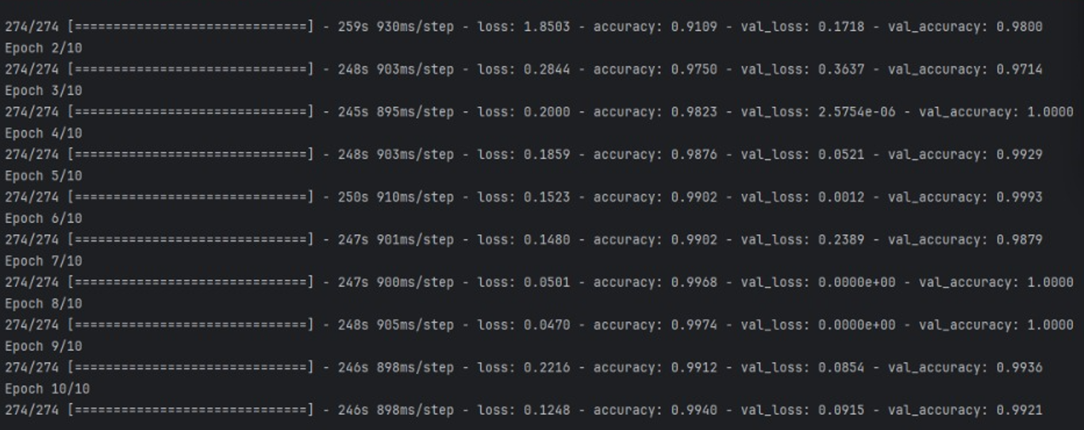
Results
Epoch –

Slide 18
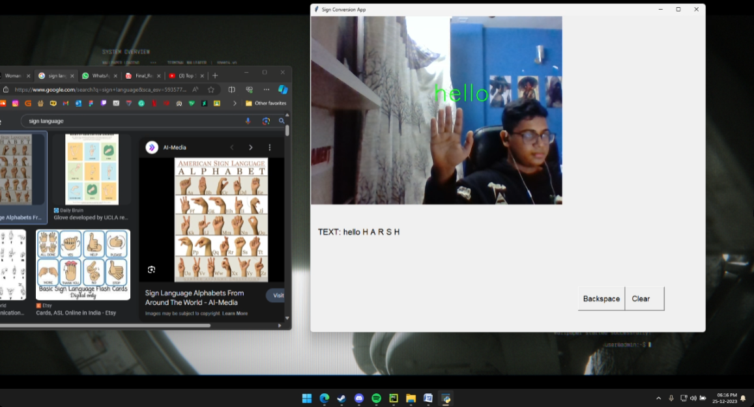
Results
Output -

Slide 19
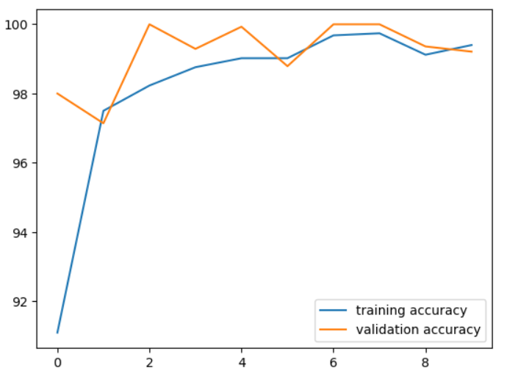
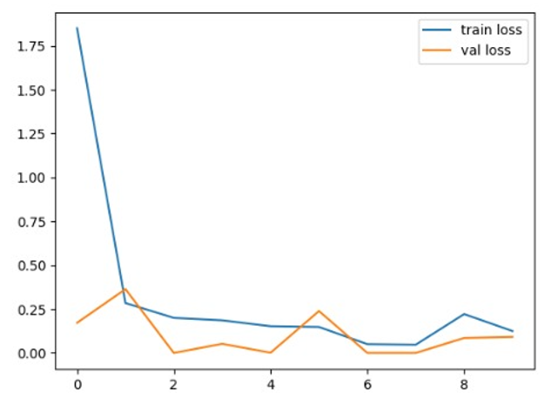
Training and Testing
We feed the input images after preprocessing to our CNN model for training and testing.
At first the output of the prediction layer will be somewhat far from the actual value. To make it better we have trained the networks using labeled data.
A graphical image is then generated to showcase the accuracy and loss of the trained model.
Fig. Accuracy Graph Fig. Loss Graph

Slide 20
Future Scope
To achieve higher accuracy even in case of complex backgrounds and dark places using various background subtraction algorithms.
To improve the preprocessing to predict gestures in low light conditions with a higher accuracy.
The project can be build into a web/mobile application to conveniently access the project and use it.
Currently the project only supports for ASL conversion but with the right data and training the project can be used for various other sign conversion.

Slide 21
References
[1] Yellapu Madhuri - “AUTOMATED SIGN LANGUAGE TRANSLATOR IEEE“
[2] Nicholas Renotte - “Real Time Sign Language Detection with Tensorflow”
[3] Laurence Moroney – “A Programmer’s Guide to AI and ML for Coders”
[4] Reddygari Sandhya Rani , R Rumana , R. Prema – “Sign Language Recognition for The Deaf and Dumb”
[5] Sukanya Dessai, Siddhi Naik – “Indian Sign Language Recognition System”
[6] Anil Sonawane , Vinit Shahane , Onkar Devkar , Prof. Ghadage R. – “Convolutional Neural Network Based Bidirectional Sign Language Translation System”
[7] https://en.wikipedia.org/wiki/Convolutional_neural_nework
[8] https://opencv.org/
Notes:
AI and Machine Learning for Coders
Book by Laurence Moroney A Programmer's Guide to Artificial Intelligence

Slide 22
Thank You!

