Slide 1
Machine Learning in Python
Introduction
Mirosław Ochodek

Slide 2
How can we solve that problem?
'FIXED',
'WORKSFORME',
'WONTFIX',
'DUPLICATE',
'INVALID'
Defect report
What will be
its resolution?

Slide 3

Machine learning vs. algorithmic approach
Algorithmic (traditional)
Design an algorithm
to classify defects
New Defect
Problem classify defects
Result
Training data
ML
Algorithm to classify
New Defect
Machine Learning

Slide 4
Definition of ML
“Machine learning is the subfield of computer science that gives computers the ability to learn without being explicitly programmed”
Arthur Samuel
"A computer program is said to learn from experience E with respect to some class of tasks T and performance measure P, if its performance at tasks in T, as measured by P, improves with experience E.”
Tom Mitchell

Slide 5
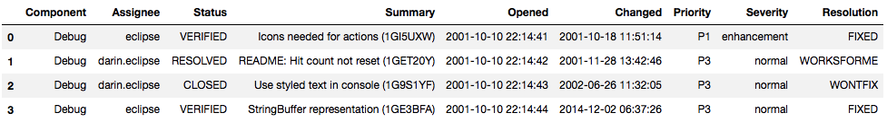
Defects data
Eclipse defects reports
Decision
class (y)
Features, attributes (X)

Slide 6
Typical tasks solved by Machine Learning algorithms
Only X is known
Unsupervised
…
Supervised
X, y are known
…
y is categorical
(class)
Classification
Regression
Clustering
y is numeric
How to label similar X?
Binary
Multi-class
Multi-label
Number of classes
Every X can be assigned
to more than one class

Slide 7
Defects data
Eclipse defects reports
Decision
class (y)
Features, attributes (X)
Multiclass classification problem

Slide 8
Typical process of working with supervised ML problems
Define the problem (e.g., we would like to predict Severity of TR...)
Repeat steps 2-5 until satisfied with the results (in next iterations some steps can be omitted):
Collect sample of labeled data (y is known)
Feature engineering (what could be the X to predict y?)
Feature directly available in collected data (e.g., defect priority is collected)
New features extracted from existing data (e.g., Time being handled = Now – Submitted on)
Feature selection (which features are important?)
ML Algorithm selection and tuning of parameters
Validation – what is the prediction quality (e.g., accuracy)?
Split available data into training data and test data (many techniques)
Evaluate the prediction quality on training data and unseen data
Train algorithm on all available data and use…

Slide 9
Environment
Python 3.6
(recommended installing Anaconda if don’t have experience with Python)
Libraries
pip install pandas sklearn jupyter
Jupyter notebook
pandas
sklearn

Slide 10
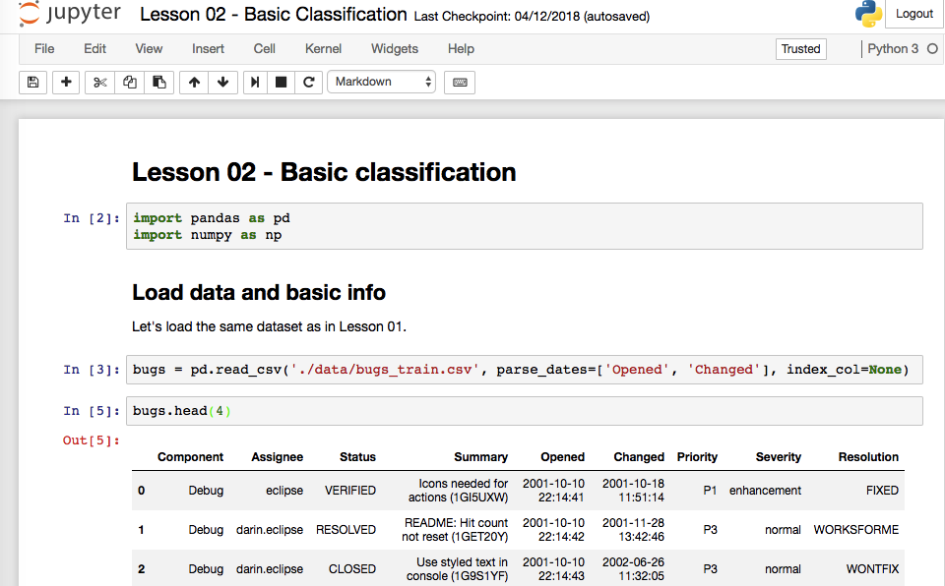
Jupyter notebook

Slide 11
Lesson 01
Data manipulation with Pandas
Loading csv files into dataframes
Inspecting dataframes
Selecting columns / rows
Filtering rows
Removing rows / columns
Merging dataframes

Slide 12
Lesson 02
Classification, categorical features, validation
Converting categorical variables
One-hot encoding
Integer
Training a classifier
Evaluating prediction quality of a classifier
Cross-validation

Slide 13
Lesson 03
Classification, text dates
Working with dates as features
Working with textual features
Bag of words

