Slide 1
HYBRID
VAE
Semi-Supervised Network Intrusion Detection for Resource-Constrained Edge Devices
Team (Group 2):
Yashodhar Rathod
Vinyas Ravi
Pouya Mohammadkhani
Vishvasundar
Yingjun Sun
Group 2 | Scalable Computing for Data Analytics (CS6423) | UCC 2026
Professor Gregory Provan

Slide 2
MOTIVATION
Why detect intrusions at the edge?
01
Edge deployment
IoT sensors, home gateways, and embedded controllers operate offline or on air-gapped networks. they cannot rely on cloud-based threat analysis.
02
Compute constraints
These devices have limited RAM, storage, and CPU cycles. Models must be small enough to run inference locally without a GPU.
03
Offline operation
Network connectivity may be intermittent or nonexistent. Detection must happen on-device in real-time, not after uploading logs to a server.
04
Zero-day threats
New, unseen attack types emerge constantly. A purely supervised classifier will miss them. we need anomaly awareness.
02

Slide 3
DATASET
Why CICIDS Dataset?
CICIDS is the most widely cited modern IDS benchmark. It captures five days of realistic network traffic (2.83M raw records) with both benign activity and 11 labelled attack types. providing ground truth for supervised and semi-supervised evaluation.
Class distribution
2,522,362
records after cleaning
Class | Count | %
BENIGN | 2,096,484 | 83.12%
DoS | 193,748 | 7.68%
DDoS | 128,016 | 5.08%
PortScan | 90,819 | 3.60%
BruteForce | 9,152 | 0.36%
Botnet | 1,953 | 0.08%
Web Attack* | 2,143 | 0.09%
Infiltration | 36 | 0.00%
Heartbleed | 11 | 0.00%
77
network flow features
11 → 9
attack classes (consolidated)
70 / 15 / 15
train / val / test split (%)
03
* 3 Web Attack subtypes merged into one class

Slide 4
CHALLENGES
What makes this dataset hard
& what we did about it
Why is class imbalance a problem?
PROBLEM
SOLUTION
Extreme imbalance BENIGN is 83%, Heartbleed is 0.0004%. Standard cross-entropy ignores minority classes entirely.
SMOTE oversampling for minorities + Focal Loss (γ=1.5) to down-weight easy-to-classify BENIGN samples.
Why whiten only BENIGN data?
PROBLEM
SOLUTION
Feature redundancy. 77 raw features include correlated and differently-scaled attributes.
ZCA Whitening Transform fitted on BENIGN-only distribution, so the autoencoder learns 'normal' data geometry and anomalies deviate more.
Why consolidate 11 classes to 9?
PROBLEM
SOLUTION
Web Attack sub-types (XSS, SQL Injection, Brute Force) have <700 total samples across 3 classes.
Merge into a single 'Web Attack' class to give the classifier enough signal. Reduces noise without losing information.
04

Slide 5
EVALUATION
Why these metrics?
Accuracy alone is misleading when 83% of traffic is benign. A model that predicts 'BENIGN' for everything scores 83% accuracy but catches zero attacks.
Macro F1-Score
Primary metric. Averages F1 across all 9 classes equally so a rare class (Heartbleed: 11 samples) matters as much as BENIGN (2M samples).
AUROC
Measures anomaly detection quality across all thresholds. Essential for the reconstruction-error scoring path.
Precision / Recall
Per-class precision catches over-alerting (false positives); recall catches missed attacks (false negatives).
False Positive Rate
Critical for edge deployment every false alarm consumes operator attention and device resources.
Weighted F1
Secondary check confirms overall volume-weighted performance hasn't degraded while optimizing Macro F1.
05

Slide 6
01
BUILDING
THE MODEL
Architecture · Baselines · Results

Slide 7
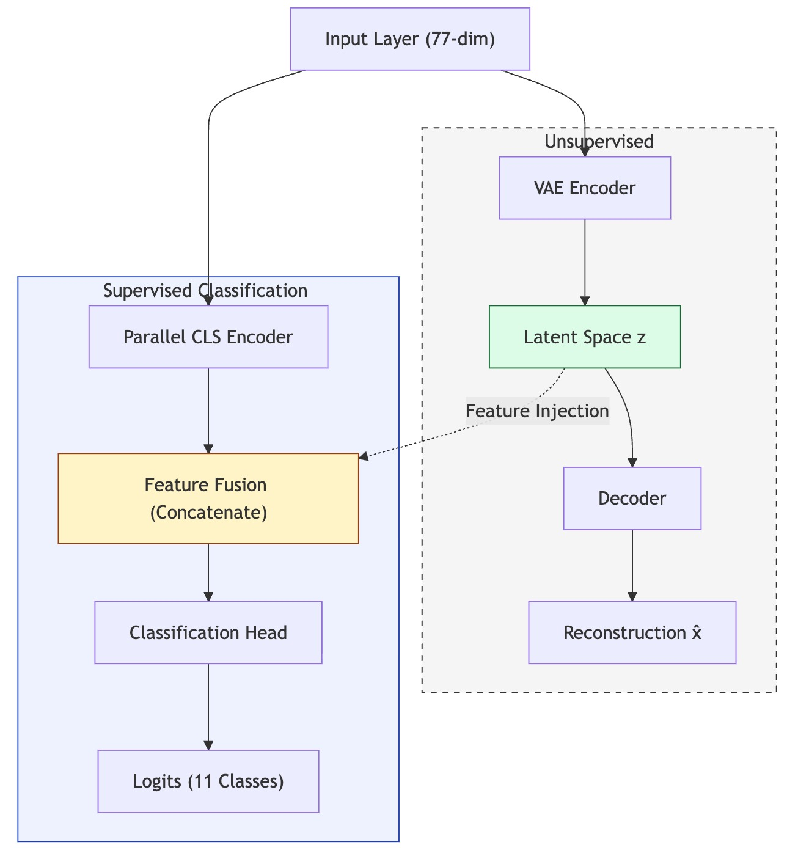
ARCHITECTURE
Why a dual-path hybrid?
A pure classifier (XGBoost) achieves strong seen-data accuracy but cannot flag unknown attacks. A pure autoencoder detects anomalies but cannot name the attack class. The HybridVAE fuses both capabilities in a single forward pass.
07

Slide 8
TRAINING
Why these hyperparameters?
Parameter | Value | Why?
Optimizer | AdamW | Decoupled weight decay improves generalisation over vanilla Adam
Scheduler | CosineAnnealing | Smooth LR decay; avoids sudden drops that destabilize VAE training
Learning rate | 1e-3 | Standard starting point for AdamW; scheduler handles decay
Batch size | 512 | Large enough for stable gradient estimates on 1.7M samples
Epochs | 75 | Cosine schedule completes one full cycle; early stopping by best val F1
Loss weights | α=0.20, β=0.65, γ=0.05 | Recon 20%, Classification 65%, KL 5% prioritises attack labelling
Focal γ | 1.5 | Moderate hard-example mining; γ=2 was too aggressive for rare classes
Latent dim | 64 | Sufficient information bottleneck; 32 lost too much, 128 didn't compress
Dropout | 0.3 | Regularisation in encoder to prevent overfitting on SMOTE-augmented data
Gradient clip | 1.0 | Prevents KL divergence explosions in early epochs
08

Slide 9
TRAINING
Key training decisions
WHY? Why train reconstruction on BENIGN only?
The autoencoder path learns the manifold of normal traffic. At inference, any input that deviates significantly (high reconstruction error) is flagged as anomalous.
WHY? Why merge 11 classes to 9?
Three Web Attack sub-types (Brute Force, XSS, SQL Injection) had <700 combined samples. Keeping them separate yields unstable per-class F1.
WHY? Why use a multi-component loss? (L = αL_recon + βL_cls + γL_KL)
Each loss term serves a distinct purpose: L_recon shapes the latent space for anomaly detection, L_cls drives supervised classification, and L_KL regularises the latent distribution to be smooth and continuous. Balancing them (α=0.20, β=0.65, γ=0.05) ensures the classification head is the dominant learning signal while the VAE path retains enough fidelity for anomaly scoring.
09

Slide 10
LOSS FUNCTIONS
Why this loss? Three objectives, one equation.
Ltotal = α · Lrecon + β · Lcls + γ · LKL α = 0.20 β = 0.65 γ = 0.05
L_recon — Reconstruction (α = 0.20)
L_cls — Focal Loss (β = 0.65)
L_KL — KL Divergence (γ = 0.05)
Why? Teaches the decoder to reconstruct normal traffic. High error at inference = anomaly.
Why? Standard CE ignores rare classes. Focal Loss down-weights easy examples, forcing the model to learn minorities.
Why? Regularises the latent space to be smooth and continuous — essential for meaningful reconstruction scores.
L_recon = (1/n) Σ |xᵢ − x̂ᵢ|
FL(pₜ) = −αₜ (1 − pₜ)^γ log(pₜ)
L_KL = −½ Σ (1 + log σ² − μ² − σ²)
L1 loss, trained on BENIGN batches only. Attacks are never reconstructed well → high error → anomaly flag.
γ = 1.5, class weights αₜ inversely proportional to frequency. Dominant term — classification is the primary task.
Small weight (0.05) prevents posterior collapse while keeping latent space structured for anomaly scoring.

Slide 11
BASELINE VANILLA AE
Why start with a Vanilla Autoencoder?
Establishes a pure anomaly-detection baseline. No classification head just BENIGN-only L1 reconstruction training. Any performance the HybridVAE adds beyond this is attributable to the dual-path design.
495,501
parameters
0.7587
test AUROC
60.15%
attacks flagged at 95th-pct threshold
0.4920
95th-pct reconstruction threshold
Verdict: Moderate anomaly detection, but misses 40% of attacks. No attack classification capability.
10

Slide 12
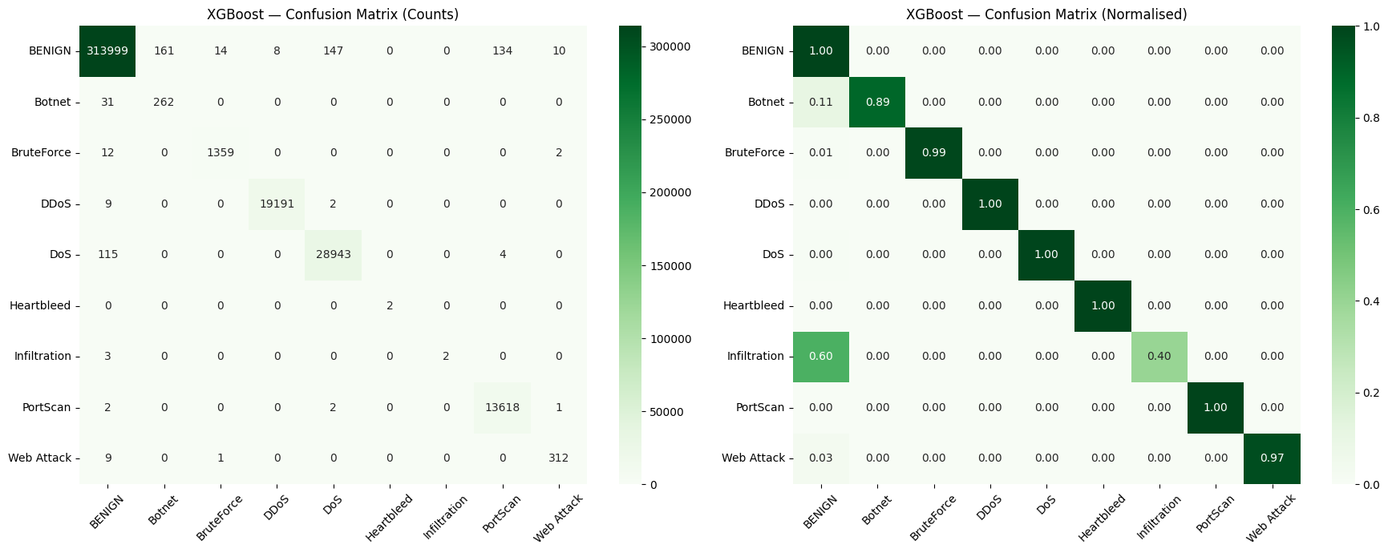
BASELINE XGBOOST
Why compare against XGBoost?
XGBoost is the dominant tabular-data classifier. It represents the best achievable closed-set supervised performance the ceiling the HybridVAE's classification head should approach.
0.9162
Macro F1
500
estimators
18.18 MB
model size (pickle)
Verdict: Best Macro F1 (0.9162), but zero anomaly detection completely blind to novel attacks.
11

Slide 13
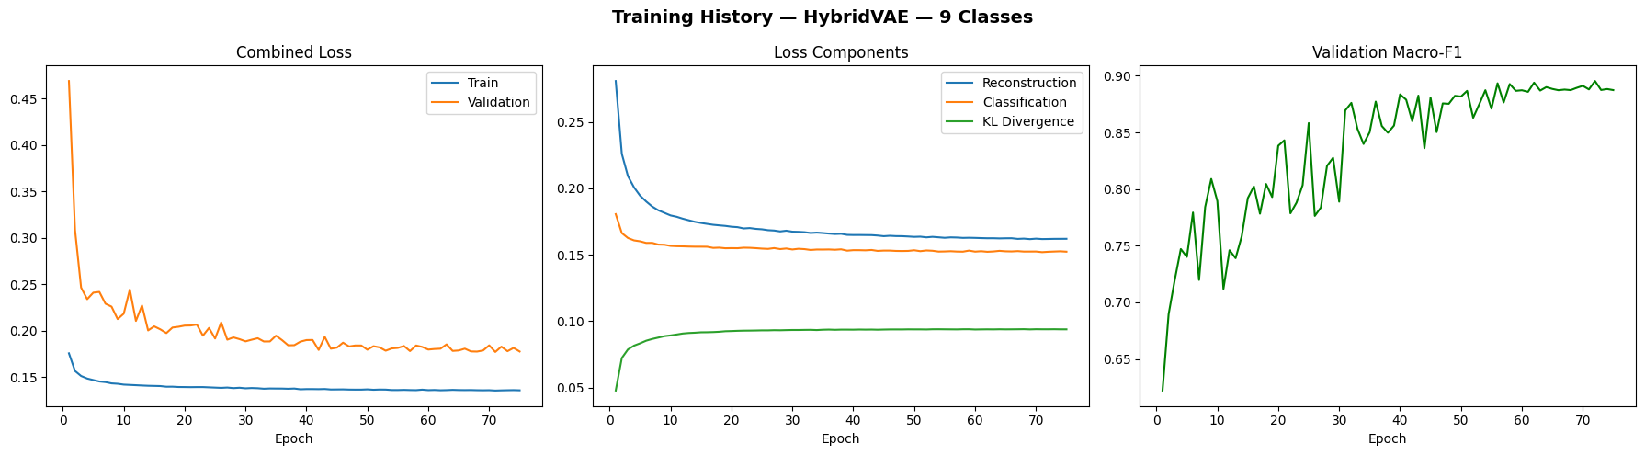
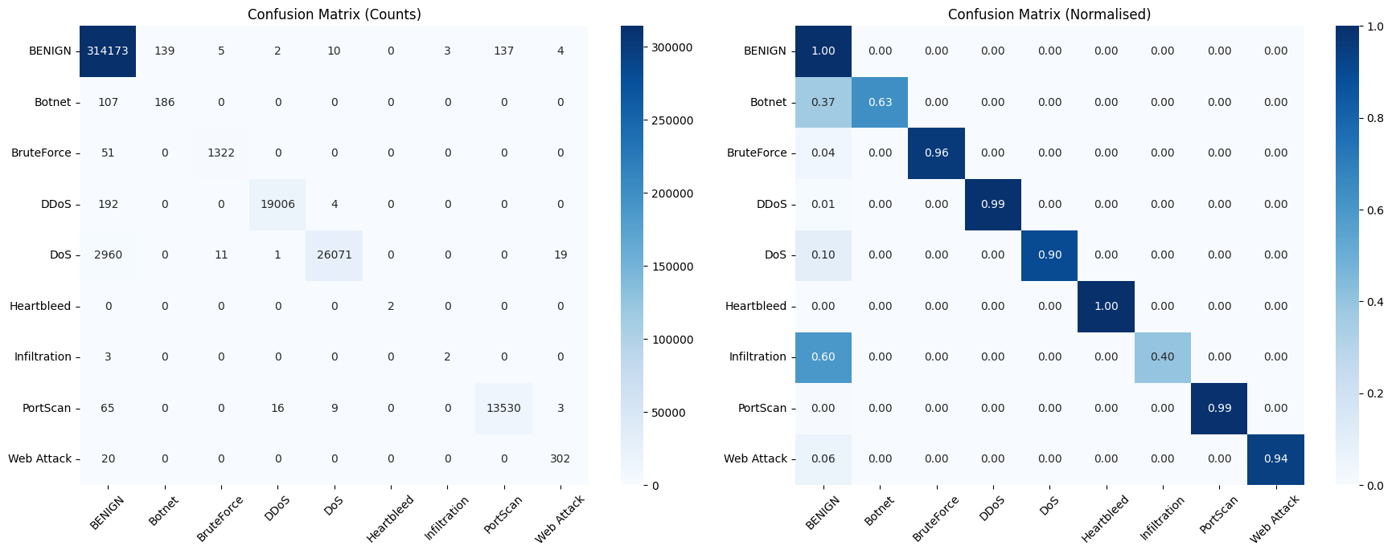
HYBRIDVAE RESULTS
Full HybridVAE 9 class results
0.8702
Macro F1
0.8740
Anomaly AUROC
0.9899
Weighted F1
749,270
parameters
2.92 MB
model size
12

Slide 14
COMPARISON
Three baselines, one verdict
Model | Params | Macro F1 | AUROC | Size (MB)
Vanilla AE | 495,501 | — | 0.7587 | 1.93
HybridVAE | 749,270 | 0.8702 | 0.8740 | 2.92
XGBoost | N/A (trees) | 0.9162 | N/A | 18.18
Vanilla AE
+ Simplest model; pure anomaly scoring
− No classification; lowest AUROC (0.76)
HybridVAE
+ Both classification + anomaly detection; smallest deployable binary (2.92 MB)
− Lower Macro F1 than XGBoost (0.87 vs 0.92)
XGBoost
+ Best closed-set Macro F1 (0.9162)
− No anomaly detection; 6× larger model (18 MB); blind to unknown attacks
13

Slide 15
02
TESTING FOR
ZERO-DAY THREATS
Withheld-class experiment · Heartbleed as unseen attack

Slide 16
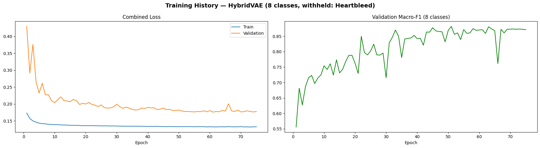
ZERO-DAY PROOF
Why withhold a class?
In production, new attack types emerge that were absent from training data. To simulate this, we remove Heartbleed entirely from training and retrain both models on 8 classes. At test time, we feed Heartbleed samples to both models and ask: can they detect something is wrong?
Experimental setup
Withheld class
Heartbleed (index 5)
Training set
1,780,534 samples (8 classes)
Withheld test
4 Heartbleed samples
XGBoost (8-class)
Retrained, identical hyperparameters
HybridVAE (8-class)
Retrained, model_d, 749,141 params
Anomaly threshold
95th percentile of BENIGN val recon error = 0.648
15

Slide 17
ZERO-DAY RESULTS
XGBoost is blind.
HybridVAE catches all 4.
# | XGBoost Output | HybridVAE Output | True Label
0 | BENIGN (99.98% conf) | ANOMALY | Heartbleed
1 | BENIGN (99.98% conf) | ANOMALY | Heartbleed
2 | BENIGN (99.98% conf) | ANOMALY | Heartbleed
3 | BENIGN (99.98% conf) | ANOMALY | Heartbleed
XGBoost (closed-set)
HybridVAE (open-set)
Predicts BENIGN with 99.98% confidence on all Heartbleed samples. No anomaly mechanism exists. Completely silent failure the most dangerous outcome in a security system.
Mean reconstruction error = 3.74 (BENIGN mean = 0.16). Exceeds 95th-pct threshold (0.648) by 5.8×. All 4 samples flagged as ANOMALY. The system alerts operators even though it has never seen Heartbleed.
16

Slide 18
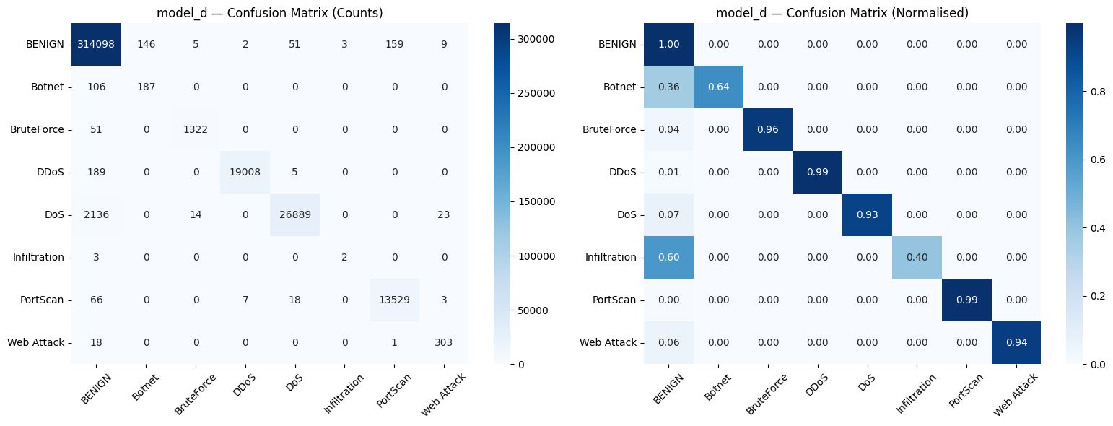
8-CLASS EVALUATION
8-class model retains performance
on known attacks
0.8538
Macro F1 (8-class)
0.9920
Weighted F1
Removing one class does not significantly degrade performance on the remaining eight validating that the withheld-class experiment is a fair test.
17

Slide 19
03
COMPRESSING
FOR THE EDGE
Knowledge Distillation · Magnitude Pruning · IMP

Slide 20
KNOWLEDGE DISTILLATION
Why distillation?
The HybridVAE teacher has 749K parameters and the XGBoost has 18 MB of trees. Edge devices need something smaller. Knowledge distillation transfers the teacher's learned decision boundaries into a compact student network that retains most of the teacher's accuracy at a fraction of the size.
Setup: Temperature T=4.0 · α=0.7 (70% soft labels, 30% focal loss) · Student: 221,462 params (3.38× smaller)
Experiment C-i
Experiment C-ii
HybridVAE → Student HybridVAE
XGBoost → Student HybridVAE
Teacher: HybridVAE (749K params, F1=0.87)
Student: HybridVAE (221K params)
Both models share the same architecture family, so the student can learn the teacher's latent-space structure directly through softened logits.
Teacher: XGBoost (F1=0.92, 18 MB)
Student: HybridVAE (221K params)
Cross-architecture distillation: transferring tabular decision boundaries from gradient-boosted trees into a neural network student gaining anomaly detection the teacher never had.
19

Slide 21
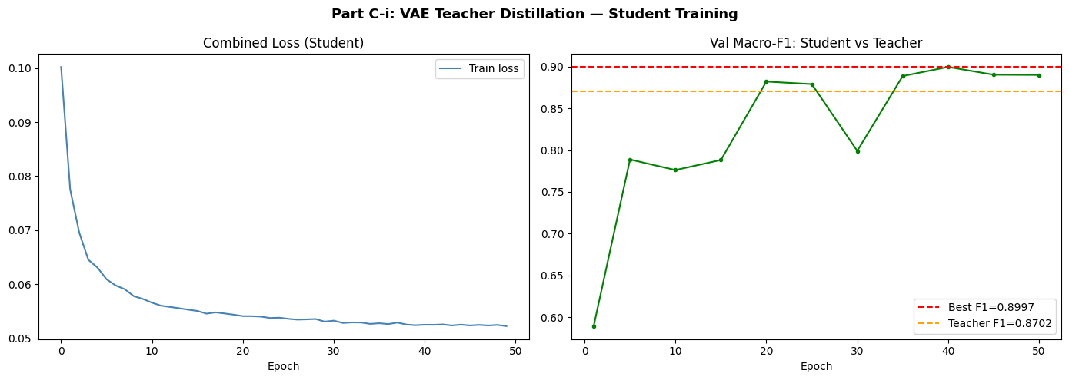

C-I: VAE → STUDENT
C-i: HybridVAE teacher → student
0.8621
Student Macro F1
99.1%
of teacher F1 retained
0.8500
Anomaly AUROC
221,462
params (3.38× smaller)
0.894 MB
model size
20

Slide 22
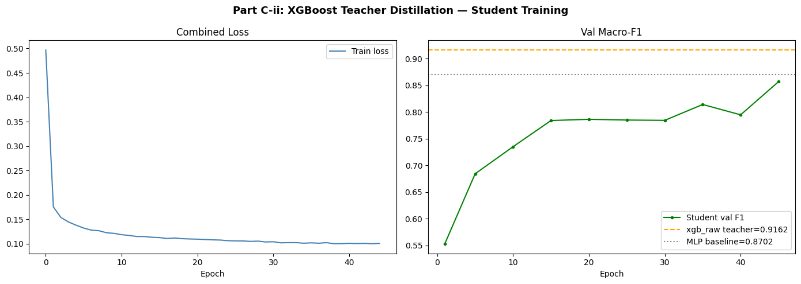
C-II: XGBOOST → STUDENT
C-ii: XGBoost teacher → student
WHY? Why distil from a completely different architecture (trees → neural net)?
XGBoost has the best Macro F1 (0.9162) but no anomaly channel and 18 MB of trees. By distilling its classification knowledge into a HybridVAE student, we gain anomaly detection the teacher never had while compressing the model by 20×.
0.8141
Student Macro F1
88.9%
of teacher F1 retained
221,462
params
0.894 MB
model size (20× smaller)
21

Slide 23
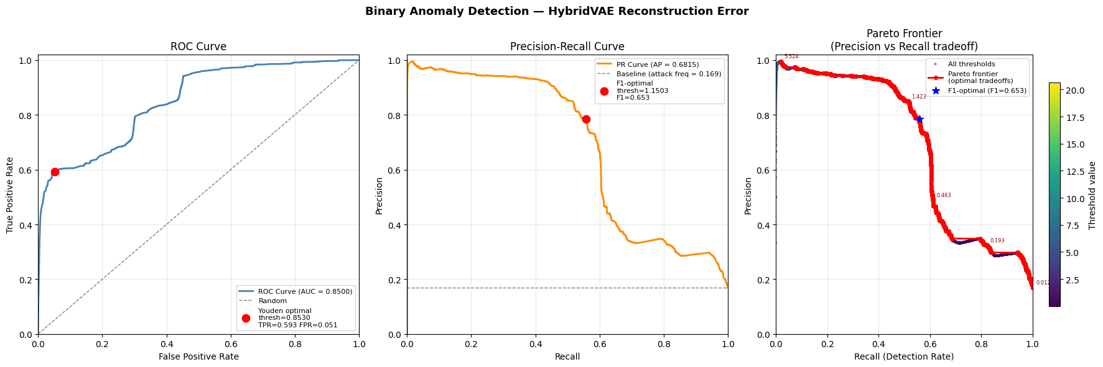
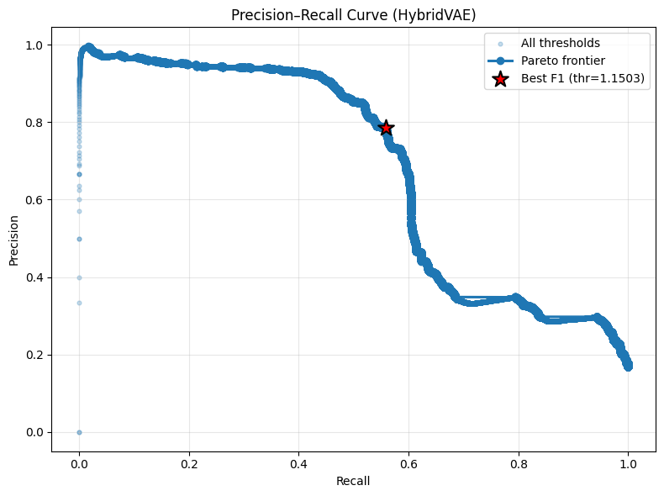
DISTILLATION SUMMARY
Distillation comparison
Model | Params | Size (MB) | Macro F1 | AUROC | F1 retained
HybridVAE Teacher | 749,270 | 2.921 | 0.8702 | 0.8740 | —
Student C-i (from VAE) | 221,462 | 0.894 | 0.8621 | 0.8500 | 99.1%
XGBoost Teacher | N/A | 18.176 | 0.9162 | N/A | —
Student C-ii (from XGB) | 221,462 | 0.894 | 0.8141 | — | 88.9%
22

Slide 24
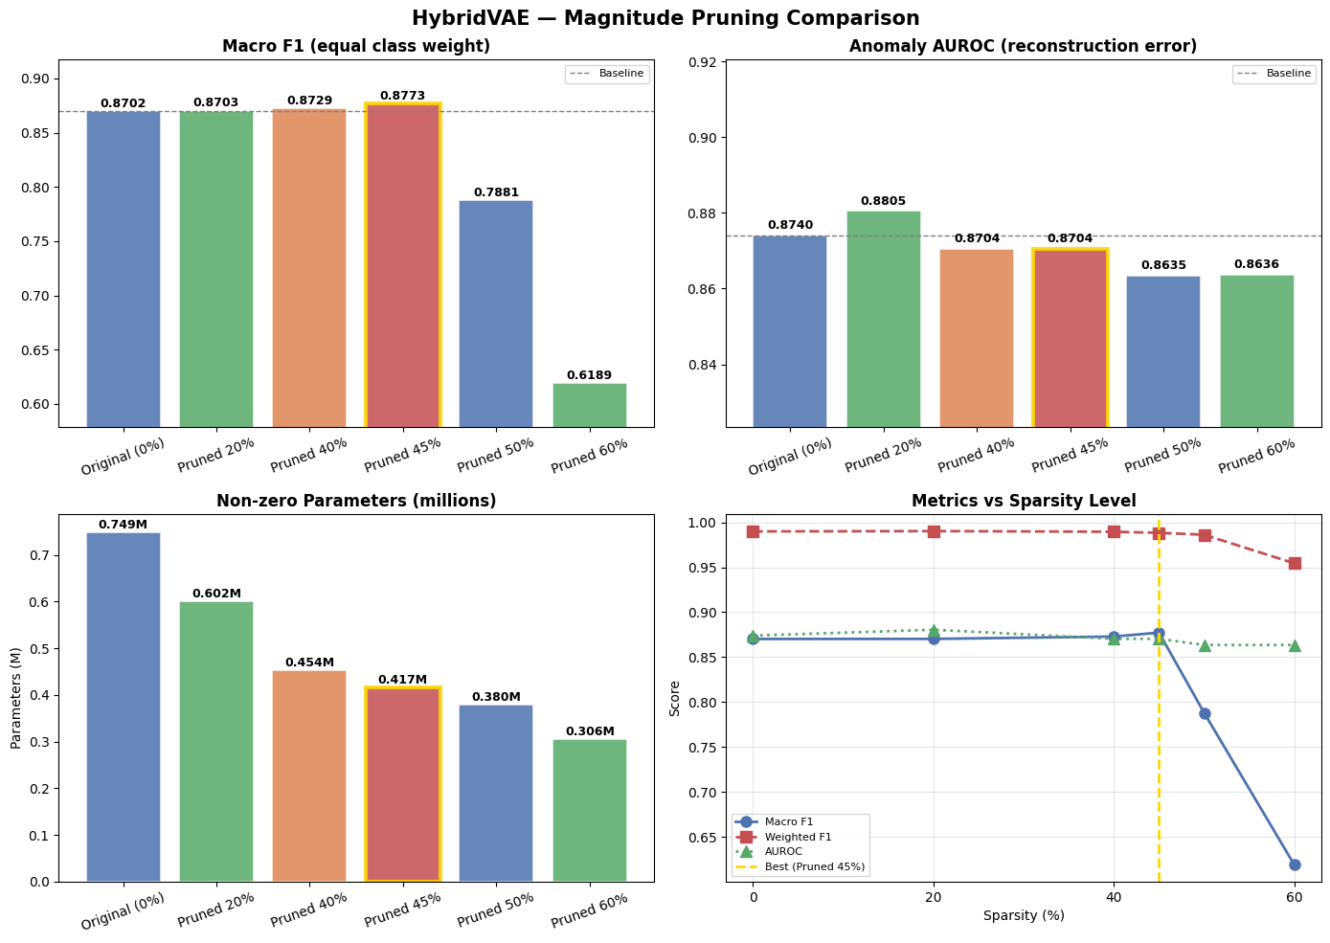
PRUNING ONE-SHOT
Why prune? Why magnitude-based?
Pruning zeroes out small-magnitude weights, reducing computation without changing the architecture. One-shot pruning is the simplest approach: prune once, evaluate immediately, no retraining. It reveals how much redundancy exists in the trained model.
KEY FINDINGS
20% sparsity: F1 unchanged (0.8703)
40% sparsity: F1 slightly up (0.8729)
45% sparsity: Best F1=0.8773 (+0.007)
50% sparsity: Cliff F1 drops to 0.788
60% sparsity: Collapse F1=0.619
One-shot pruning hits a cliff at 50%. Beyond that, critical weights are destroyed. Can we do better?
23

Slide 25
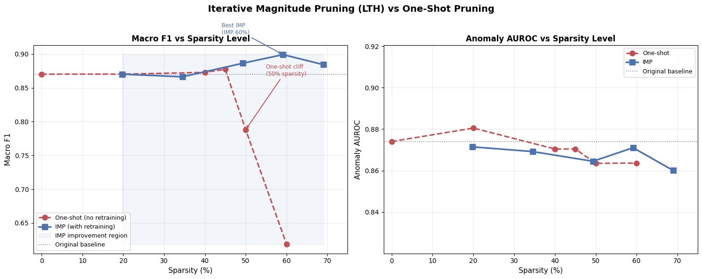
PRUNING IMP
Why iterative pruning (Lottery Ticket)?
The Lottery Ticket Hypothesis says dense networks contain sparse sub-networks ("winning tickets") that can match the original's accuracy. IMP finds them by iteratively pruning small fractions and retraining between rounds allowing the network to adapt its remaining weights before removing more.
Method | Sparsity | Macro F1 | AUROC
Baseline (0%) | 0% | 0.8702 | 0.8740
One-shot best | 45% | 0.8773 | 0.8704
IMP best | 60% | 0.8992 | 0.8710
One-shot @ 60% | 60% | 0.6189 | 0.8636
IMP at 60% sparsity achieves Macro F1 = 0.8992 surpassing the unpruned baseline (0.8702) while one-shot at 60% collapsed to 0.619.
24

Slide 26
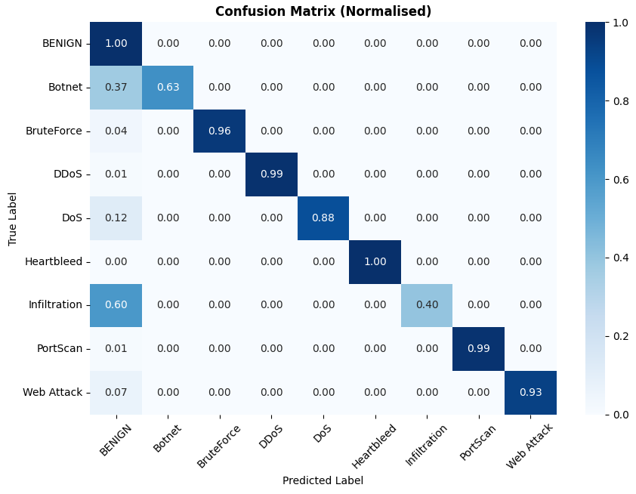
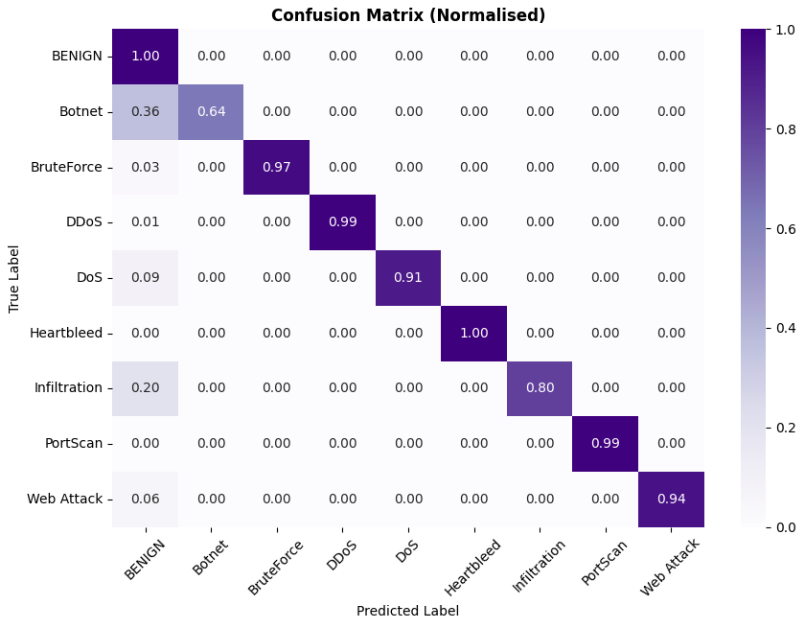
PRUNING CONFUSION MATRICES
Where IMP beats one-shot
One-shot 45% (best)
IMP 60% (best)
25

Slide 27
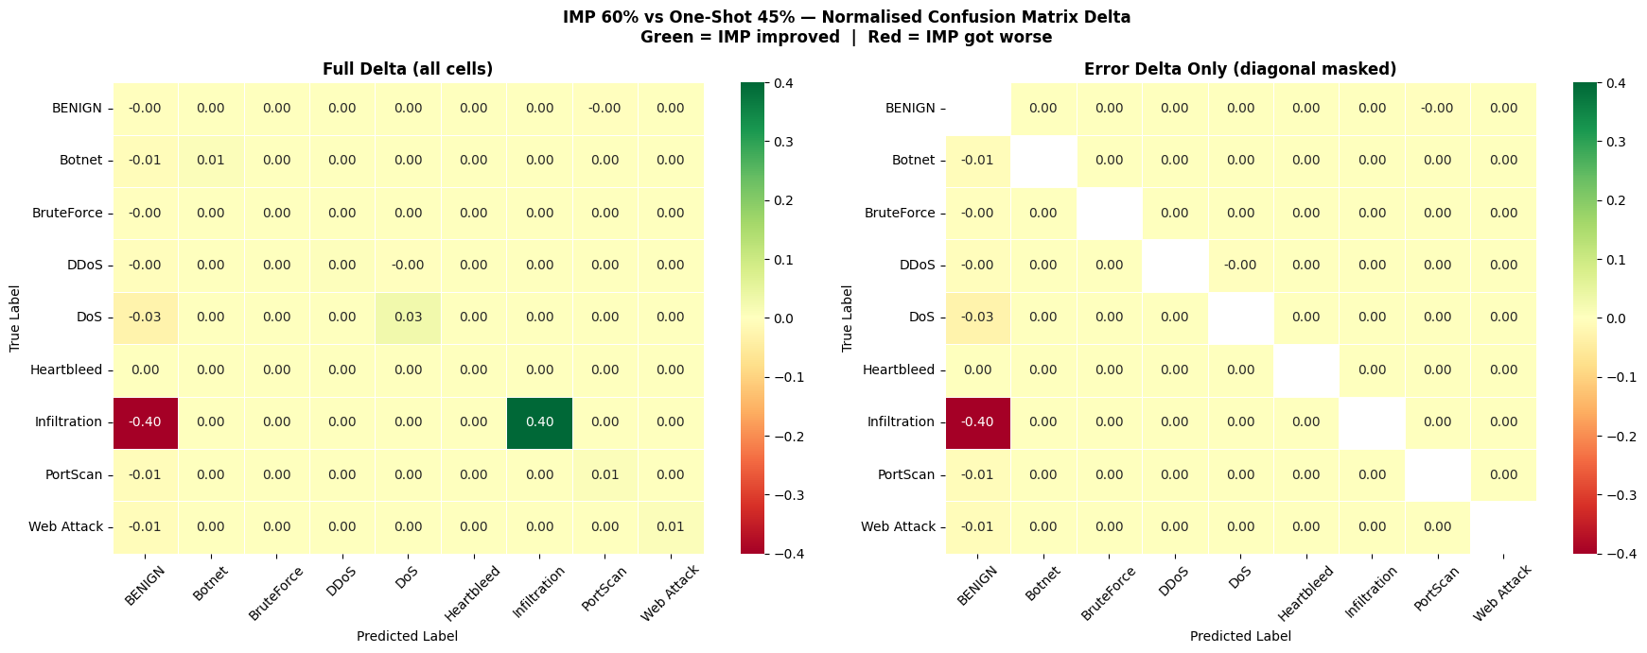
PRUNING CONFUSION MATRICES
Where IMP beats one-shot
Delta: IMP 60% minus One-shot 45% (normalised)
25

Slide 28
MODEL ZOO
Full model comparison
Model | Params | Size | F1 | AUROC | Anomaly?
Vanilla AE | 495K | 1.93 MB | — | 0.759 | Yes
HybridVAE (teacher) | 749K | 2.92 MB | 0.870 | 0.874 | Yes
XGBoost (teacher) | trees | 18.18 MB | 0.916 | — | No
Student C-i (VAE→) | 221K | 0.89 MB | 0.862 | 0.850 | Yes
Student C-ii (XGB→) | 221K | 0.89 MB | 0.814 | — | Yes
One-shot 45% | 416K | ~1.53 MB | 0.877 | 0.870 | Yes
Iterative Magnitude Pruning 60% | 306K | ~1.21 MB | 0.899 | 0.871 | Yes
Best edge candidate: IMP 60% highest Macro F1 (0.899), full anomaly detection, 59% of weights zeroed. Combined with the 221K distilled student for minimum footprint.
26

Slide 29
WHAT WE
LEARNED
01
Dual-path models (VAE + classifier) unify anomaly detection and classification without doubling the architecture.
02
XGBoost wins on closed-set accuracy, but a pure classifier is blind to novel threats a critical gap in security systems.
03
Knowledge distillation can compress a 749K-param teacher to 221K params while retaining 99.1% of Macro F1.
04
Cross-architecture distillation (XGBoost → neural net) is viable and adds anomaly capabilities the teacher never had.
05
IMP (Lottery Ticket) at 60% sparsity surpasses the unpruned baseline pruning can improve, not just maintain, accuracy.
06
One-shot pruning exposes a cliff at 50%; IMP pushes through it by giving the network time to adapt between rounds.

Slide 30
Thank you!
Group 2 · Scalable Computing · UCC 2026
HybridVAE · CICIDS · Knowledge Distillation · Iterative Magnitude Pruning

