Slide 1
Computer Science
Project by Areeb tariq

Slide 2
Objective
Determining the Distinguishing sequence(s) for the initial state identification of FSM
FSM: can be partial and non-deterministic
C code for the determination of distinguishing sequence
Answering the research questions about the distinguishing sequence

Slide 3
Code Algorithm
1. Move from root level to downward levels in a truncated tree.
2. Process all the TST nodes at each level
3. For each node say node_i, it removes the redundant state pairs ({1,2} and {1,2})
4. For node_i, it checks for merging for each state pair ({1,1} --> merging detected).
If yes, truncate node. Else, continue processing.
5. For node_i, it checks for the existence of this node prior in the path from the root.
If yes, truncate node. Else, continue processing.
6. For node_i, it checks for the presence of all singleton sets or empty set at a given node.
If yes, truncate node and the sequence of input from root to this point is distinguishing sequence.
Else, continue processing.
7. For node_i, find the defined inputs for the state pairs.
8. For each input say input_i and node_i, find the next possible node containing possible state pairs.
9. Add all possible next nodes to the next level in the truncated tree.
10. Repeat the same process from Step#2
11. Delete the truncated tree at the end

Slide 4
Code characteristics
Proper commenting for understanding of a reader
Modular and functional approach (12 dedicated functions)
Memory leaks handling
Guard checks and exception handling for invalid data
Explanatory variables, functions, macros naming
No use of magic numbers
Detailed function descriptions
Proper indentation

Slide 5
Experiments for Research Questions
400 FSMs tested (data available in excel file)
FSM state range 3-15
FSM input range 2-8
FSM output range 2-8

Slide 6
Parameters in experiments
FSM total states
FSM initial states (dynamically user-controlled) – NEXT SLIDE
FSM inputs
FSM outputs
FSM size (transitions)
PSM (partiality)
NDSM (degree of non-determinism)
Length of Distinguishing sequence (dynamically user-controlled)
Minimum length of distinguishing sequence

Slide 7
FSM initial states (dynamically user-controlled)
Added a feature for the command line control of the initial state
“isp_ds” is initial state percentage. Varies from 0-100.
Example: FSM: max_S = 5, isp_ds=60 -----> Processing of 3 states

Slide 8
Readme file
Combined distinguishing sequence parameters (and all other information) with the previous file.
Contains information about ‘memory’, ‘length’, ‘time’, and ‘initial state’ for distinguishing sequences

Slide 9
Research Questions and Observations
Existence of distinguishing sequence w.r.t. number of maximum states
Existence of distinguishing sequence w.r.t. number of initial states
Existence of distinguishing sequence w.r.t. partiality of machine
Existence of distinguishing sequence w.r.t. non-determinism of machine

Slide 10
Terminology
Partiality threshold (PT): Value of PSM for a given FSM till that distinguishing sequence can exist. Beyond that, distinguishing sequence doesn’t exist.
Non-determinism threshold (NDT): Value of NDSM for a given FSM till that distinguishing sequence can exist. Beyond that, distinguishing sequence doesn’t exist.
Minimum length of DS (DSLM): Length of shortest distinguishing sequence

Slide 11
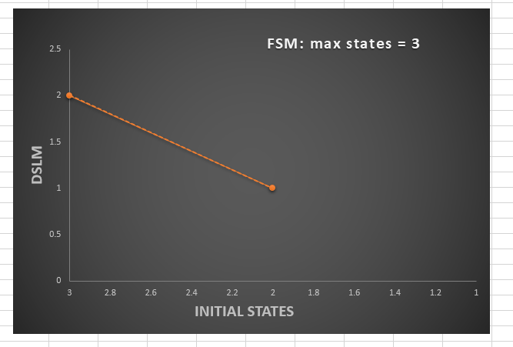
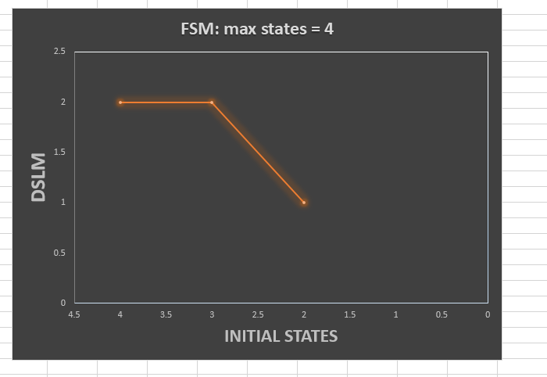
Results: Variation of DSLM vs Initial States

Slide 12
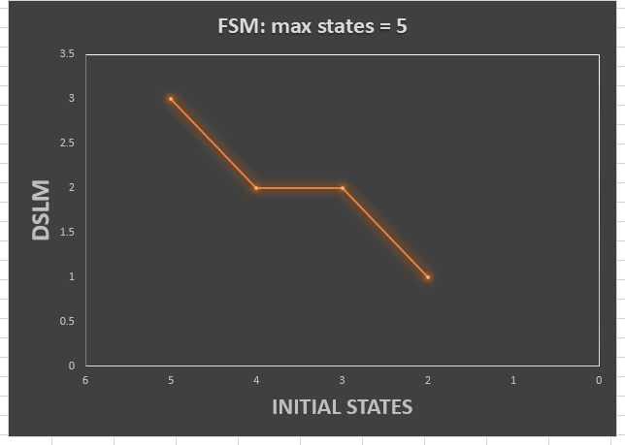
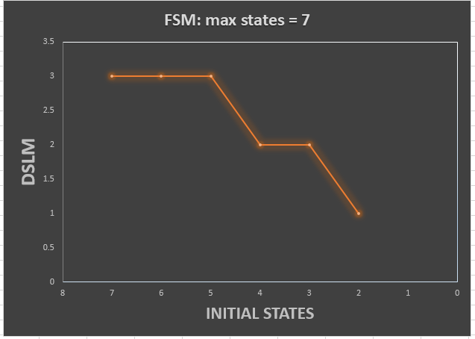
Results: Variation of DSLM vs Initial States

Slide 13
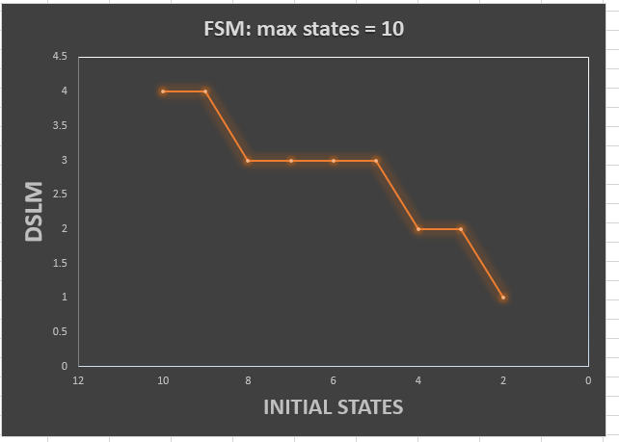
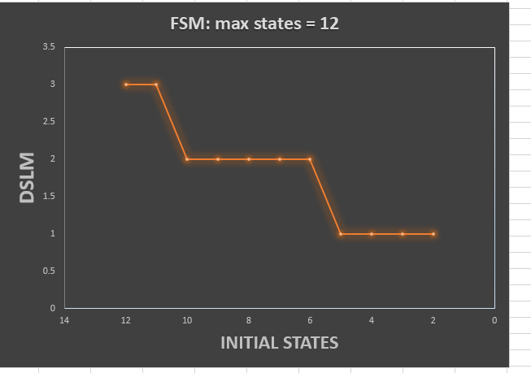
Results: Variation of DSLM vs Initial States

Slide 14
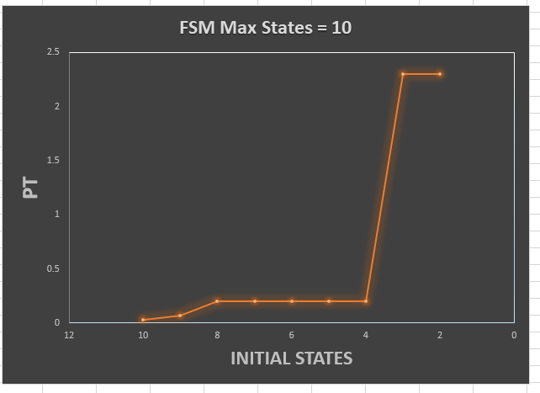
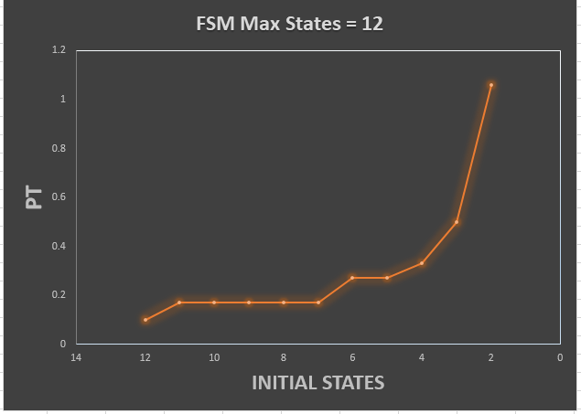
Results: Variation of DSLM vs Initial States

Slide 15
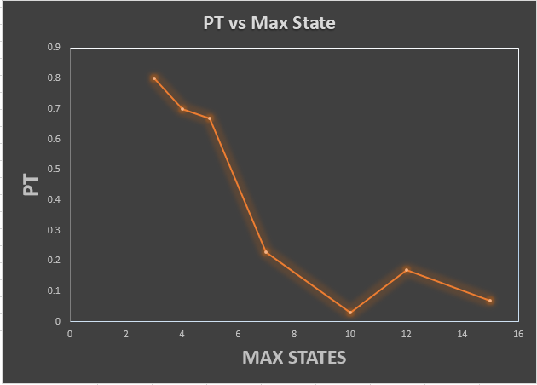
Results: Variation of PT vs Maximum State

Slide 16
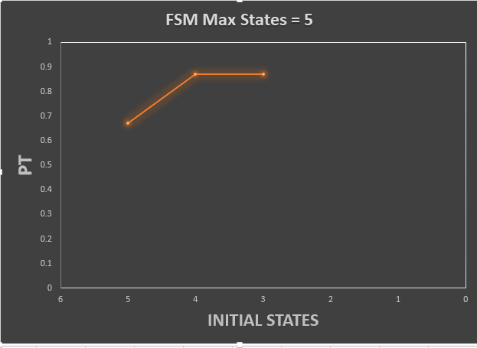
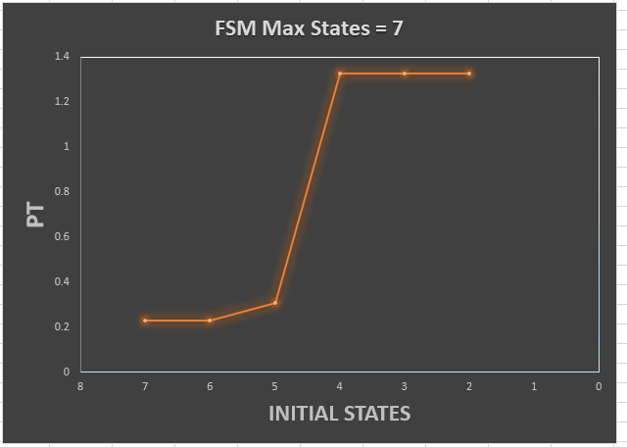
Results: Variation of PT vs Initial State

Slide 17
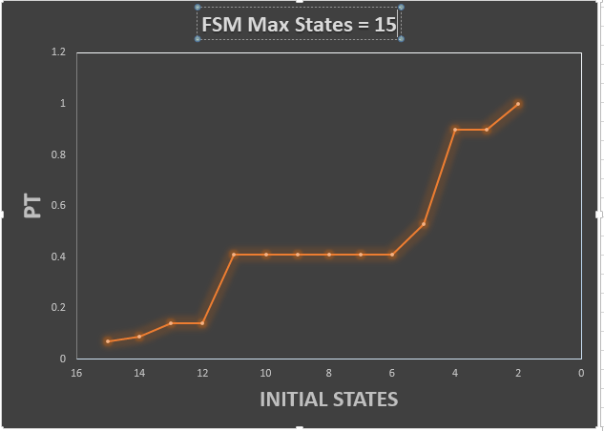
Results: Variation of PT vs Initial State

Slide 18
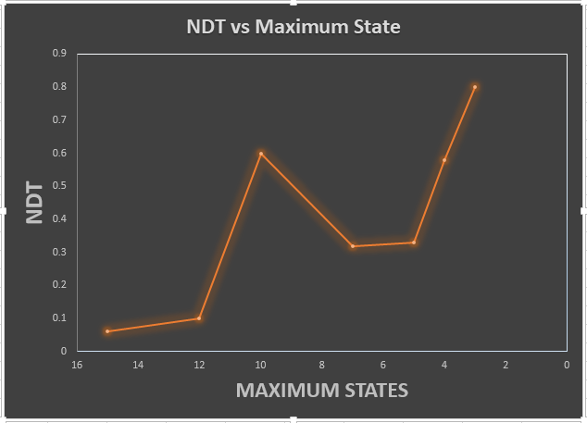
Results: Variation of NDT vs Maximum State

Slide 19
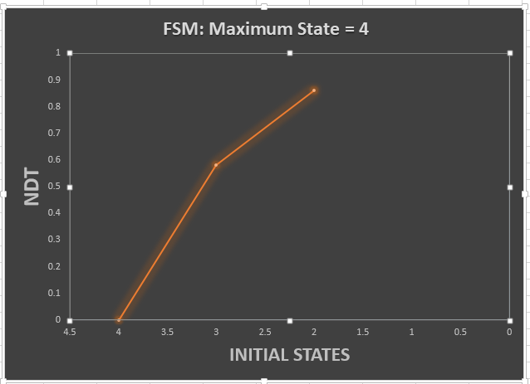
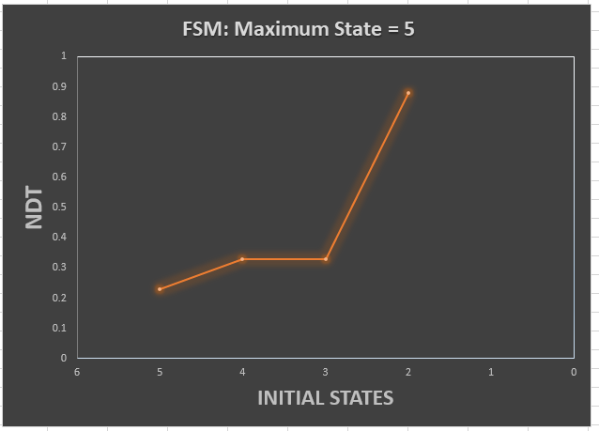
Results: Variation of NDT vs Initial State

Slide 20
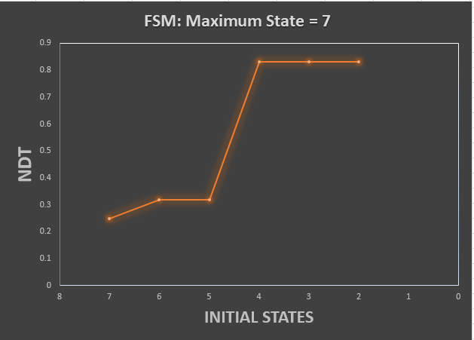
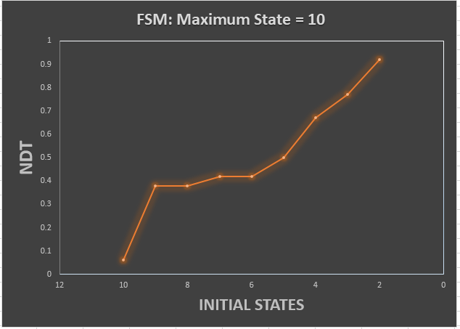
Results: Variation of NDT vs Initial State

Slide 21
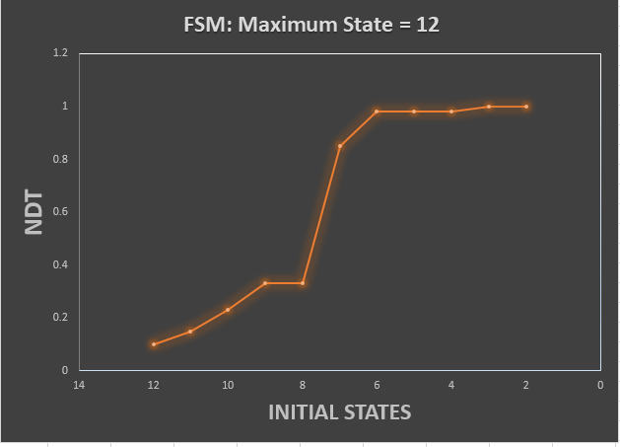
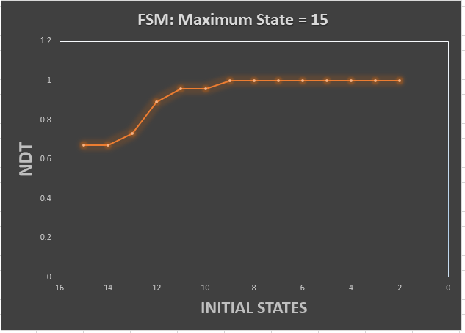
Results: Variation of NDT vs Initial State

Slide 22
Conclusions
FSM with more states requires less partiality for DS (higher completeness)
FSM with more states requires less NDSM (higher determinability)
Reducing the initial states of FSM increases PT (afford more partiality)
Reducing the initial states of FSM increases NDT (afford more non-determinism)
Reducing the initial states of FSM increases likelihood of DS
Reducing the initial states of FSM increases number of DSs
For same NDSM, FSM with less transitions (size) has more likelihood for DS

