Slide 1
Name : Areeba Ali
Topic : InterProcess Communication via Shared Files

Slide 2
Process :
A process is simply a program that is currently running on a computer.
A process has:
Its own memory
A unique PID
CPU time
Resources
Example :
Opening Chrome → creates multiple processes

Slide 3
InterProcessCommunication :
“The way in which processes communicates with each other .”
TYPES : → 2 types
Independent Processes
Cooperating Processes

Slide 4
Reasons to allow Processes To Communicate :
Information Sharing
Computation SpeedUp
Modularity
Convenience

Slide 5
Common IPC Methods:
Pipes
Named Pipes (FIFOs)→2 independent program exchanges the data
Message Queues→ processes to send and receive messages in a structured way.
Shared Memory
Semaphores
Signals
Sockets

Slide 6
IPC via Shared Files :
- Two or more processes communicate using a common file
- One process writes data into the file
- Another process reads the same file
- Simple and persistent communication method

Slide 7
How It Works :
1. Process A opens a shared file and writes data.
2. Process B opens the same file and reads data.
3. File works like a mailbox between processes.

Slide 8
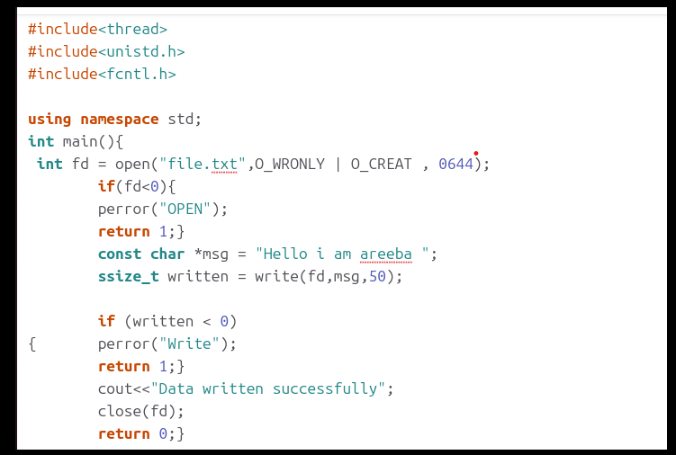
Example 1 :

Slide 9
Example 2 :
#include <iostream>
#include <unistd.h>
#include <fcntl.h>
using namespace std;
int main() {
int fd = open("file.txt", O_WRONLY | O_CREAT, 0644);
if (fd < 0) {
perror("open");
return 1;
}
pid_t pid = fork();
if (pid < 0) {
perror("fork");
return 1;
}
// Child process writes
if (pid == 0) {
const char *msg = "Written by child process\n";
write(fd, msg, 25);
}
// Parent process writes
else {
const char *msg = "Written by parent process\n";
write(fd, msg, 26);
}
close(fd);
return 0;
}

Slide 10
Advantages & Disadvantages
Advantages:
- Simple to implement
- Language independent
- Data persists
Disadvantages:
- Slow compared to other IPC
- Risk of file corruption
- No automatic synchronization

Slide 11
Thank You!

