Slide 1

DSA FOR NATURAL SCIENCE STUDENTS
Stacks in Python
Push, pop, peek and why a Last-In, First-Out
Lesson objectives · class activity · Python implementation
1

Slide 2

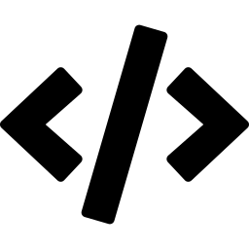

LESSON OBJECTIVES
By the end of this lesson, you will be able to:
Explain LIFO
Understand why a stack stores data Last-In, First-Out, and why Python programs reach for one.
Operate a stack
Perform push, pop, and peek by hand and in code – and recognize overflow and underflow.
Spot hidden stacks
Identify stacks at work inside everyday software: undo history, browser back, and function calls.
2

Slide 3
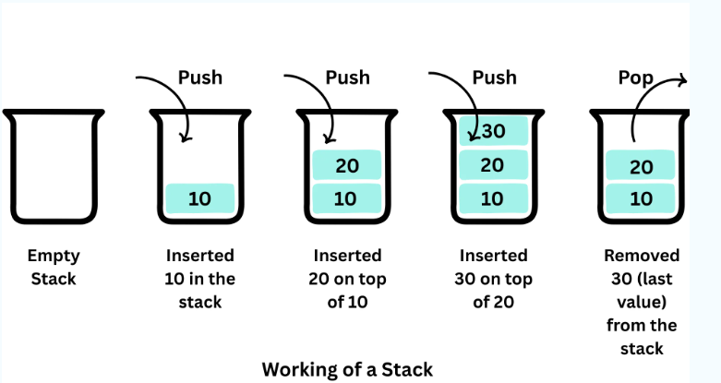
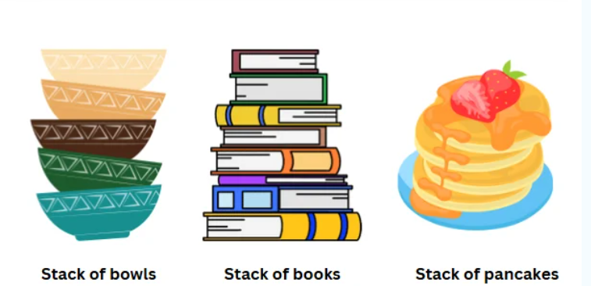
What is a stack?
A stack is a collection where items are only added or removed from one end - the top.
LIFO – Last In, First Out
3

Slide 4


OPERATIONS
Push and pop
Push
Pop
Adds a new item onto the top of the stack.
Removes and returns the item currently on top.
Before push(D)
After push(D)
After pop() → returns D
C
◀ top
D
◀ top
C
◀ top
B
C
B
A
B
A
A
4

Slide 5

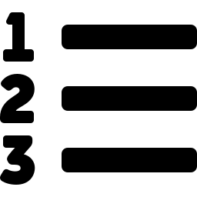
MORE CORE OPERATIONS
Peek, isEmpty, and size
Peek
stack = []
stack.append(x) # push
stack.pop() # pop
stack[-1] # peek
len(stack) == 0 # isEmpty
len(stack) # size
Looks at the top item without removing it — useful when you need to check what's next before deciding whether to act on it.
isEmpty
Returns True if the stack holds no items. Always check this before popping, to avoid an error.
Size
Returns the number of items currently on the stack — e.g., how many unsaved edits are waiting to be undone.
A plain Python list already behaves like a stack.
5

Slide 6

ERROR CONDITIONS
Overflow and underflow
Overflow
Underflow
Happens when you push onto a stack that has a fixed capacity and is already full.
Happens when you pop (or peek) an empty stack — there is nothing left to remove.
Analogy: every slot in a sample rack is filled — there is no room to set down the next tube.
Analogy: reaching for the top tube when the rack is already empty.
In Python, a list-based stack grows automatically, so true overflow is rare. Underflow is the one to guard against — always call isEmpty() before pop().
6

Slide 7

WHERE STACKS HIDE #1
Undo history
3. Added annotation
◀ top
2. Adjusted brightness
Lab notebooks and analysis tools (electronic lab notebooks, Jupyter, ImageJ) push every edit you make onto a stack. Press Undo, and the software simply pops the most recent action off — restoring the state just before it.
1. Cropped image
In practice: you crop an image, adjust its brightness, then annotate a feature. Pressing Ctrl+Z three times pops each action in reverse — annotation, then brightness, then crop.
8

Slide 8
WHERE STACKS HIDE #2
The browser back button
3. Cited paper
◀ top
2. Gene record page
Every page you visit is pushed onto your browser's history stack. Clicking Back pops the most recent page off the stack and returns you to the one before it — in exact reverse order.
1. Search results
9

Slide 9
ARRAY IMPLEMENTATION
The same stack, drawn as an array
Underneath, a stack is just a Python list. Each box below is one element of the array — the top of the stack is always the last element, at index len(arr) - 1.
Operations map straight onto list methods:
push()
arr.append(item)
pop()
arr.pop()
'D'
arr[3]
◀ top
'C'
arr[2]
peek()
arr[-1]
'B'
arr[1]
isEmpty()
len(arr) == 0
'A'
arr[0]
size()
len(arr)
11

Slide 10
PYTHON IN PRACTICE
A list is already a stack
Python's built-in list has everything a stack needs — no import required.
readings = []
readings.append(23.4) # push
readings.append(23.9) # push
readings.append(24.1) # push
latest = readings[-1] # peek
print(latest) # 24.1
readings.pop() # pop -> 24.1
print(readings) # [23.4, 23.9]
append() pushes to the top in O(1) time
pop() removes and returns the top item
Negative indexing (stack[-1]) peeks without removing
12

Slide 11

CLASS ACTIVITY 1
Bracket matching – with cups
Goal: use a physical stack of cups to check whether an expression's brackets are balanced — the same logic a code compiler uses.
Materials
Steps
A stack of paper cups (or petri dishes / vials)
A marker
A bracket expression on the board, e.g. ( [ { } ] )
1
Read the expression on the board, left to right.
2
See an opening bracket ( [ { ? Write it on a cup and stack the cup on top of the pile.
Discuss
Try the unbalanced expression ( [ ) ] with the cups. Where does the mismatch get caught? Why does a stack catch it immediately?
3
See a closing bracket ) ] } ? Pop the top cup. If its bracket doesn't match, the expression is unbalanced — stop.
4
Reached the end with an empty stack of cups? The expression is balanced.
13

Slide 12
CLASS ACTIVITY 2
Implement a stack with an array
Task: using only a Python list as the underlying array, write your own Stack class with push, pop, peek, and isEmpty.
class Stack:
def __init__(self):
self.items = [] # the array
def push(self, item):
# TODO
def pop(self):
# TODO
def peek(self):
# TODO
def isEmpty(self):
# TODO
Your class must:
push(item) — add item to the top
pop() — remove & return the top item
peek() — return the top item without removing it
isEmpty() — return True/False
Stretch: raise a custom error on pop() from an empty stack
Test it: push 3 sample readings, peek the top, pop all 3, then confirm isEmpty() is True.
14

Slide 13
EFFICIENCY
Why stacks are fast
Every stack operation only ever touches the top item - it never has to search through what's underneath. That means each one runs in constant time, no matter how much data is stored.
O(1)
O(1)
O(1)
O(1)
push
pop
peek
isEmpty
Why it matters: when a data-logger is recording thousands of sensor readings per run, constant-time operations keep processing snappy as the dataset grows.
7

Slide 14
RECAP
Stacks, in one page
LIFO: the last item added is the first one out — like a rack of drill cores.
push, pop, and peek all touch only the top, so each runs in O(1) time.
Underflow (popping empty) is the error to guard against with isEmpty().
Stacks power undo, browser back, and every function call your code makes.
15

