Slide 1
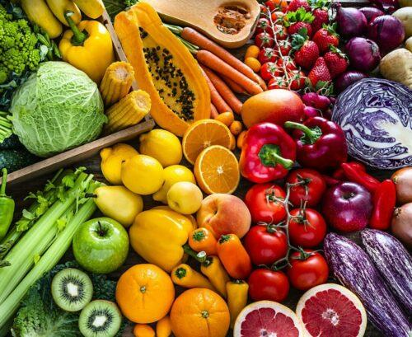
MealMind
Reducing Daily Meal Decision Fatigue
Presented to
Team Members
Dr. Basharat Hussain
Hafsa Imtiaz (22i-0959)
Mahum Hamid (22i-1009)
AI Product Development (AI-4013)
Areeba Riaz (22i-1244)
Jawairia Waseem (22i-1274)

Slide 2
THE PROBLEM
The Daily Meal Decision Burden
What Is the Problem?
Why It Is Frustrating
Repeated daily decision: "What should I eat?"
Too many options → mental overload
Occurs 2–4 times every day
Limited time after work or classes
Happens at home, hostels, workplaces
Budget uncertainty & nutritional confusion
2-4×
∞
This is not lack of food. It is cognitive exhaustion from repeated decisions.
Daily Decisions
Mental Load

Slide 3
WHO HAS THIS PROBLEM?
Who Experiences This?
Primary Users
Secondary Stakeholders
(Direct Pain)
(Indirect Impact)
University Students (Pakistan)
Families managing grocery budgets
•
Limited monthly budgets (~PKR 15–25k)
•
Shared kitchens / hostel constraints
•
Frequent reliance on delivery apps
Parents planning meals for multiple people
Young Urban Professionals
•
45–50 hour work weeks
•
Irregular schedules
Individuals tracking weight or medical diets
•
Health goals but inconsistent execution

Slide 4
WHY THIS PROBLEM MATTERS
Why This Matters
Who Pays the Cost?
If Unaddressed
Students on tight budgets
15–20
minutes lost daily deciding
Professionals seeking healthier lifestyles
Increased
impulse food spending
Families managing rising food prices
Poor
dietary consistency
Accumulated
Why Now?
micro-stress
Rapid growth of food delivery usage in Pakistan
Rising lifestyle-related health concerns
Increasing urban work hours
Small daily friction → long-term behavioral impact

Slide 5
EXISTING PRODUCTS
Existing Alternatives
Partial but Incomplete
MyFitnessPal
Mealime
Yummly
What it does:
What it does:
What it does:
Tracks calories
Structured meal plans
Recipe discovery
Limitation:
Limitation:
Limitation:
Does not reduce daily decision repetition
Requires heavy manual input
Limited budget personalization
These tools assist planning — but the cognitive burden remains

Slide 6
Phase 1:
Business Viability Stress Test

Slide 7
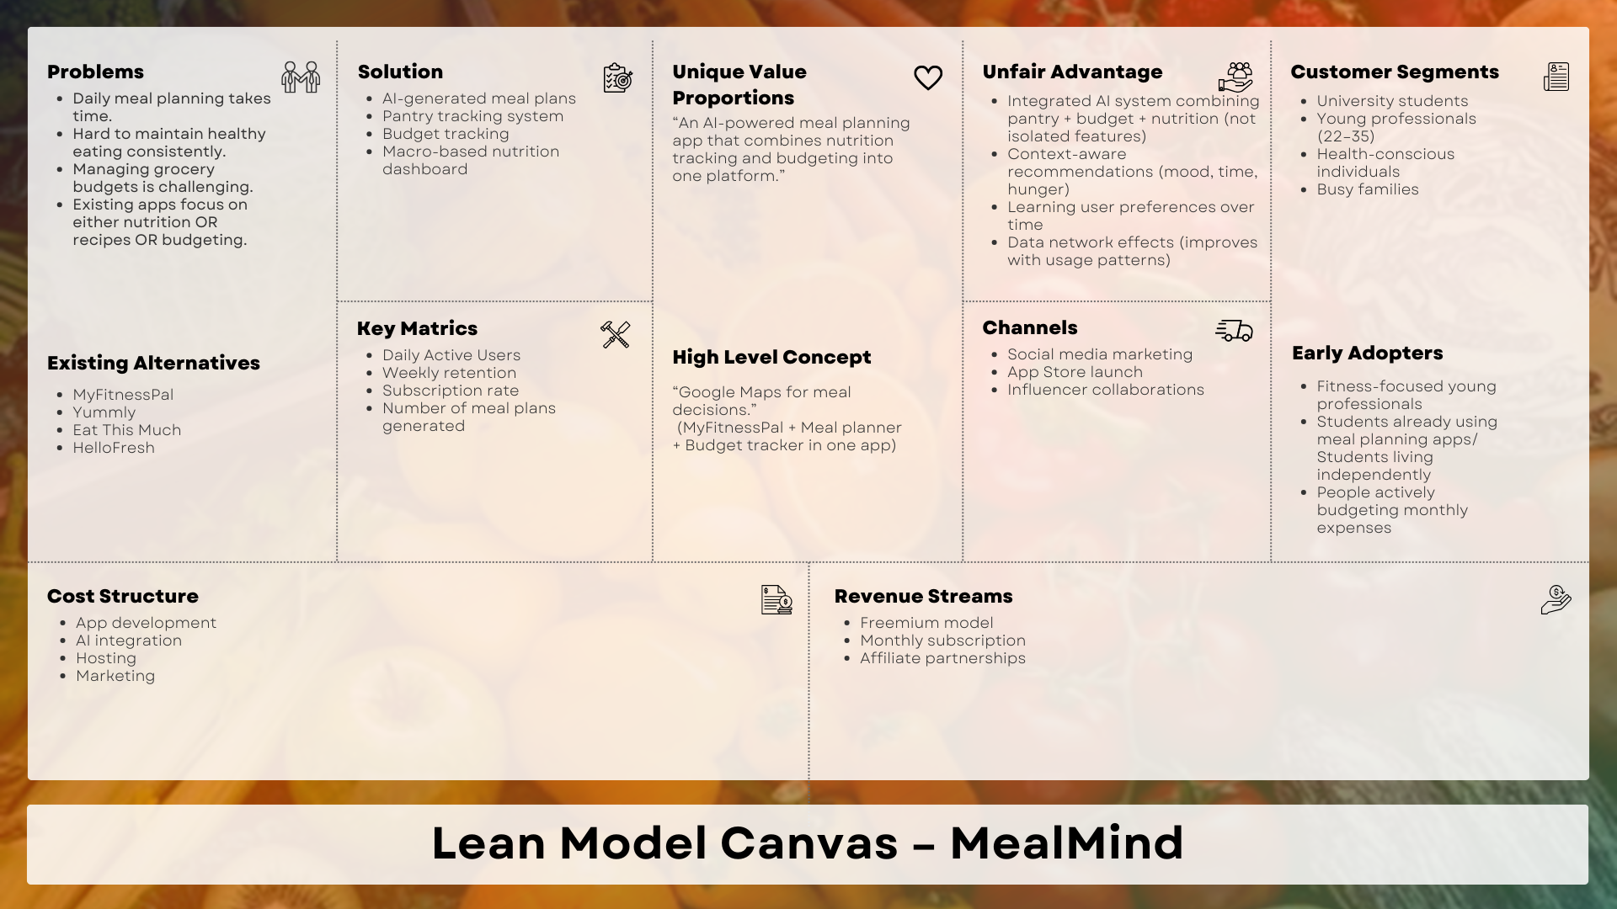
These tools assist planning — but the cognitive burden remains

Slide 8
DELIVERABLE 1.1
Critical Analysis of Initial Lean Canvas
Five critical weaknesses identified through rigorous self-assessment
Problem
Customer Segments
Value Proposition
Solution
Key Metrics
Too General
Broad & Unfocused
Lacked Differentiation
Feature List Only
Usage-Focused
• Described as "difficult" without emotional urgency
• Listed multiple groups simultaneously
• Explained what app does, not why different
• AI meals, pantry tracking mentioned
• Focused on downloads, subscriptions
• Missing context of when it happens
• No clearly defined primary early adopter
• Didn't emphasize integrated system
• Integration logic not explained
• Didn't measure behavioral outcomes
• No mention of daily decision fatigue
• Students, professionals, families all equal
• Sounded similar to existing apps
• Didn't communicate cognitive load reduction
• Missing: food waste reduction
• Lacked stress/after-work scenarios
• Missing pantry+budget+nutrition synergy
• How features work together unclear
• Missing: spending control, nutrition consistency
• Positioning direction unclear
Impact: Failed to convey pain intensity
Impact: Marketing message diluted
Impact: Competitive advantage unclear
Impact: User benefit not compelling
Impact: Success metrics misaligned
These tools assist planning — but the cognitive burden remains

Slide 9
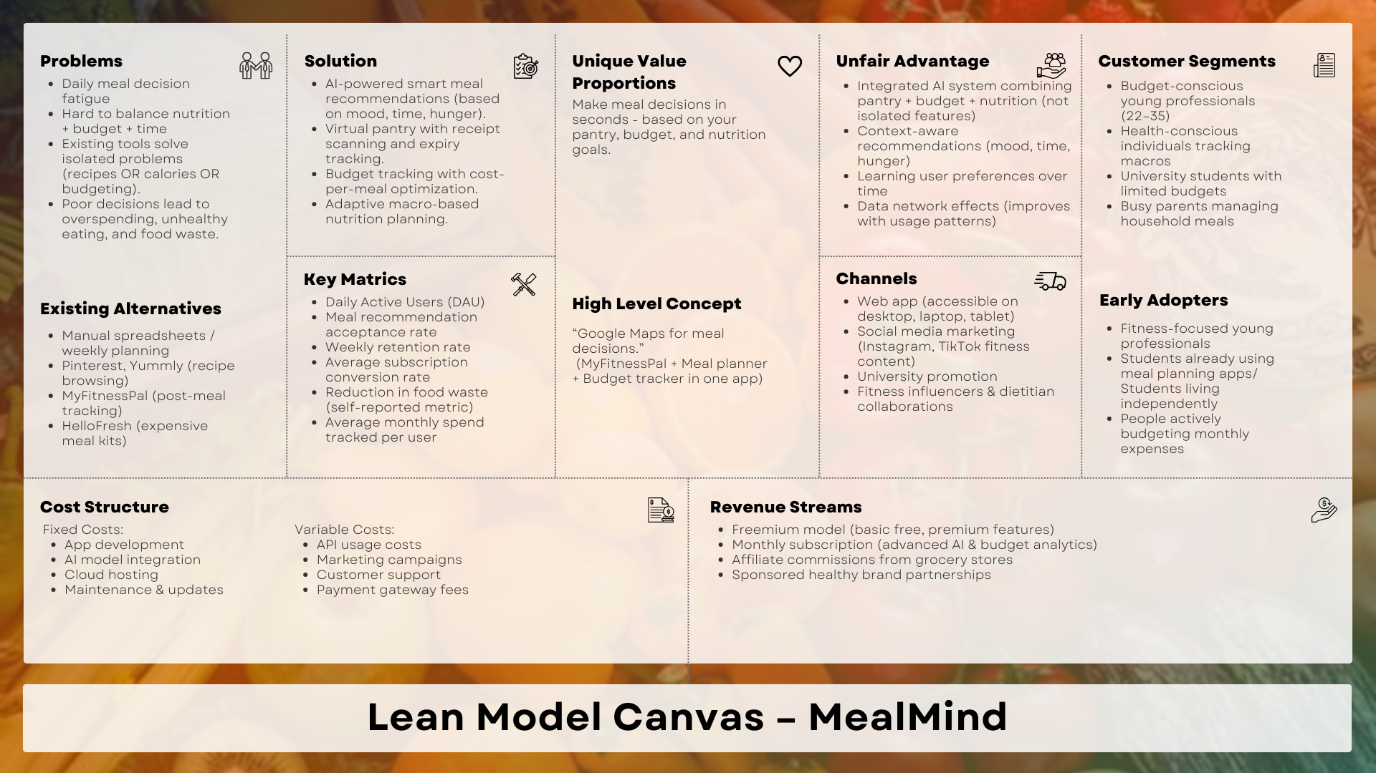
These tools assist planning — but the cognitive burden remains

Slide 10
DELIVERABLE 2.1
1
Customer vs Channel Mismatch
Seven Strategic Vulnerabilities Identified
Mismatch: Busy parents not aligned with university channels; budget users less responsive to influencers
Skeptical evaluation of the Lean Model Canvas reveals critical internal mismatches
Risk: Inefficient targeting, wasted acquisition spend
2
Revenue vs Willingness-to-Pay Gap
3
Customer vs Channel Mismatch
5
Cost Structure Scaling Risk
Gap: Free alternatives exist (Pinterest, ChatGPT, free planners); subscription fatigue concern
Gap: Food waste self-reported & unvalidated; no proof cognitive overload actually reduced
Risk: If revenue/user remains low (budget-conscious segments), costs scale faster than monetization
Risk: Low conversion, "helpful but not essential" perception
Risk: Measuring usage, not problem solution
Risk: Margin compression, unsustainable unit economics
7
6
"Unfair Advantage" Not Defensible
7
Solution Scope Too Broad
7
Enterprise Skepticism
Risk: No proprietary data, partnerships, or switching costs = structurally weak moat
Risk: High development complexity, slower MVP, onboarding friction, feature overload
Concern: No proof of measurable behavior change; self-reported food waste insufficient for enterprise buyers
Risk: Larger competitors quickly replicate features
Risk: Solving too many problems before validating one
Limitation: No data monetization strategy beyond affiliate links.

Slide 11
DELIVERABLE 2.2
Where the Idea Could Fail: Failure Mode Analysis
Scenario 2
Price-sensitive users choose free or manual alternatives.
Flexible Pricing: Offer tiered plans and value-based discounts.
Scenario 1
Users find the problem annoying but not worth paying for.
Show ROI Fast: Prove time/money savings in the first use.
Scenario 4
Big players (MyFitnessPal) copy features easily.
Depersonalization: Build high switching costs through proprietary data.
Scenario 3
API costs for personalization outpace per-user revenue.
Efficiency First: Use caching and limit AI features by tier.
Scenario 5
Complex features launch before validating the core loop.
MVP Focus: Start with one core AI loop, then expand.

Slide 12
DELIVERABLE 3.1
Market Viability: Opportunities & Risks
Six-dimensional assessment of market adoption potential and monetization feasibility
Target Customer
Market Size
Problem Severity
Budget-conscious young professionals, university students, health-conscious people
Nutrition tracking apps, meal planners, health platforms have millions of users worldwide
Frequency: HIGH — meal decisions 2-4× daily, weekly grocery shopping, monthly budgeting
✓: Fitness/nutrition apps demonstrate willingness to pay for health tools
✓: Sustained growth in health apps indicates behavioral interest
✓: Food delivery reliance, meal planning app churn indicate dissatisfaction
✗: Budget-conscious users may have lower conversion rates
✗: Overlap between budgeting & nutrition users may be smaller than expected
✗: Is decision fatigue painful enough to adopt dedicated product vs. existing habits?
Competition
Switching Costs
Willingness to Pay
Direct: Automated meal planners, nutrition trackers, recipe discovery platforms
Switching: LOW — many alternatives free, minimal setup required
Indirect Evidence: Users pay for fitness apps, meal kits, grocery delivery, productivity tools
⚠Pattern: Users often combine multiple tools rather than seeking single integrated solution
✗ Risk: If users don't experience immediate value, abandonment before habit formation
✓: Users will pay if product clearly saves time or money
✗: Crowded landscape with established players; differentiation must be compelling
⚠ Challenge: Must deliver value within first use to overcome adoption friction
✗ : Will product be perceived as essential rather than optional?

Slide 13
DELIVERABLE 3.2
Product Viability: Technical Feasibility & Differentiation
Meaningful Superiority
Technical Feasibility
Claim: Integration of pantry + budget + nutrition + AI reduces cognitive load vs. switching between multiple apps
Core Components: Recommendation systems, OCR receipt scanning, analytics dashboards — all technically feasible with existing tech
✓ Advantage: Single decision point vs. 3-4 separate tools
Infrastructure costs ,strong UX design required, ,external integrations, Ongoing AI model improvements & monitoring
Sustainable Differentiation
AI-Specific Risks
Current Advantage: Multi-feature integration, context-aware AI, learning preferences
Risk Factors:
Long-term Defensibility Requires:
• Incorrect nutritional/cost calculations → credibility loss
• Users distrusting AI for health decisions → adoption barrier
• Proprietary user data & behavior patterns
• System errors/hallucinations → misleading outputs
• Strategic partnerships (grocers, health brands)
Regulatory, Legal & Ethical Constraints
AI Transparency: Requirements for explaining AI-generated recommendations
Nutrition Guidance: Risk of being interpreted as medical advice
Data Privacy: Purchase history & dietary patterns are sensitive personal data
Mitigation: Clear disclaimers, avoid diagnostic language
Mitigation: Secure handling, transparent policies, GDPR compliance
Mitigation: Explainable AI, user control over recommendations

Slide 14
DELIVERABLE 4.1
Objective Business Goals: Measurable Outcomes
Three SMART goals focused on quantifiable business performance metrics
Goal 1: Achieve Sustainable Subscription Conversion
Revenue Critical
Specific
Measurable
Achievable
Relevant
Time-Bound
Convert active users to paying subscribers through premium AI features
Conversion rate (%) & Monthly Recurring Revenue (MRR)
With strong value demonstration & pricing strategy; uncertain due to price-sensitivity
Directly tied to freemium revenue model & business viability
First 6-12 months after launch
Justification: Subscription conversion is central to the freemium business model described in Lean Canvas
Goal 2: Reduce Users' Food-Related Spending
Value Proposition
Specific
Measurable
Achievable
Relevant
Time-Bound
Measurable cost savings using budget tracking & optimized recommendations
Monthly grocery spending trends before vs. after usage
If recommendations meaningfully influence purchasing behavior
Aligns with value proposition of budget optimization & financial benefits
First 1-3 months of consistent product use
Justification: Cost savings is a key claimed benefit that supports willingness to pay
Goal 3: Increase User Retention & Engagement
Long-term Sustainability
Specific
Measurable
Achievable
Relevant
Time-Bound
Repeated usage driven by daily decision support & habit formation
Retention rate, DAU/MAU ratio, session frequency
With good UX & personalization; dependent on onboarding success
Important for long-term sustainability & defensibility
First 3-6 months post-adoption
Justification: Retention reflects whether product truly reduces decision friction and creates value

Slide 15
DELIVERABLE 4.2
Subjective Business Goals: Perception & Experience
Three SMART goals focused on user experience and psychological outcomes
Goal 1: Reduce Perceived Meal Decision Fatigue
Core Problem
Specific
Measurable (Proxy)
Achievable
Relevant
Time-Bound
Lower cognitive effort when deciding what to eat
User surveys, satisfaction scores, self-reported decision effort
If recommendations are timely, relevant, and reduce mental load
Core problem the product claims to solve in Lean Canvas
After several weeks of product usage
Justification: Decision fatigue reduction is the primary problem identified in the Lean Canvas
Goal 2: Build Trust in AI-Generated Recommendations
Adoption Critical
Specific
Measurable (Proxy)
Achievable
Relevant
Time-Bound
Users feel confident following AI suggestions for meals
User trust ratings, feedback scores, error reports, recommendation acceptance rate
With transparency, accuracy, clear explanations, and user control
Critical for adoption of AI-driven features
Evaluated continuously during early iterations
Justification: AI trust directly impacts retention and perceived value
Goal 3: Create Seamless & Convenient User Experience
Differentiation
Specific
Measurable (Proxy)
Achievable
Relevant
Time-Bound
Perceived convenience of having multiple functions in one system
User satisfaction, usability testing scores, onboarding completion rates
With strong UX design; technically complex integration
Supports differentiation strategy of integrated solution
During MVP testing and early releases
Justification: Integration convenience is a key differentiator claimed in the canvas
• Execution risk remains — habit formation & AI accuracy are critical uncertainties

Slide 16
Thanks!
AI Product Development (AI-4013)
Hafsa Imtiaz (22i-0959)
Mahum Hamid (22i-1009)
Areeba Riaz (22i-1244)
Jawairia Waseem (22i-1274)

