Slide 1
UniRide
University Bus Management System: Enhancing Efficiency and Safety in Student Transportation

Slide 2
INTRODUCTION
This project aims to modernize FAST University's bus management, replacing manual processes with features like real-time routes, lost and found, seat reservations, fee verification, and parental tracking, ensuring safety, efficiency, and real-time updates.

Slide 3
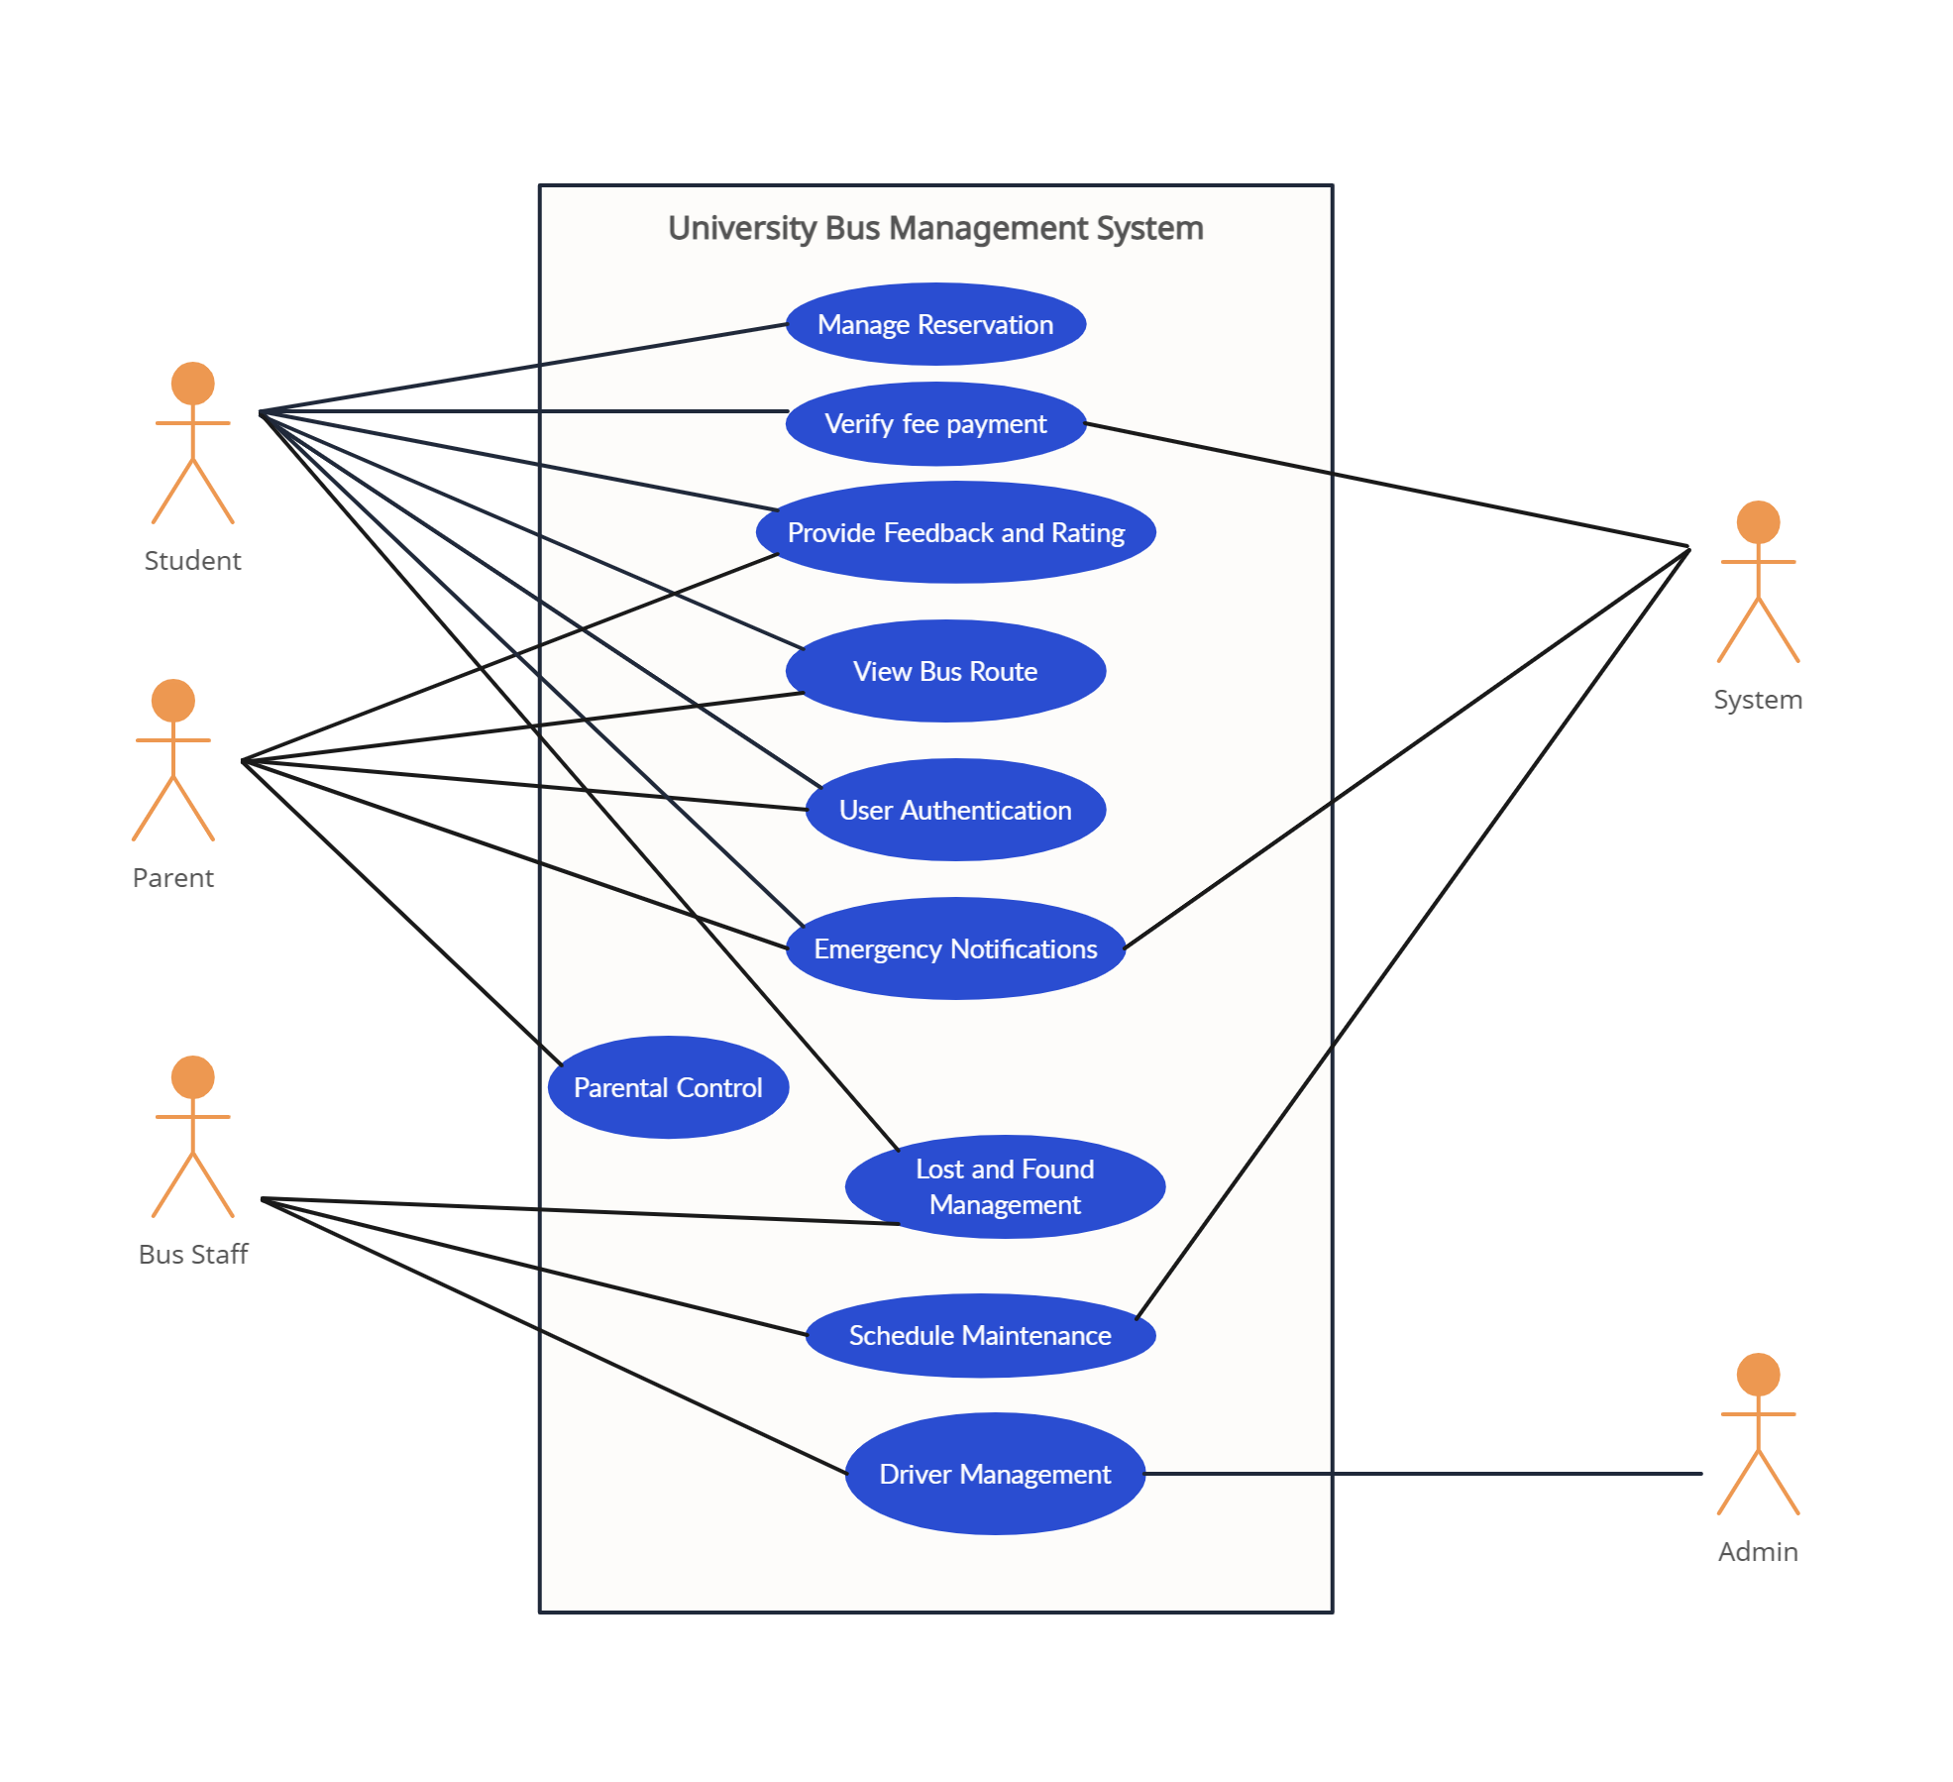
USECASE DIAGRAM

Slide 4
FUNCTIONAL REQUIREMENTS
Automated Bus Reservation: Students can book daily seats for buses via a digital platform.
Fee Verification Integration Only students with up-to-date fee payments can make reservations or board buses.
Real-Time Route Updates: Users receive live updates on bus schedules, route changes, and estimated arrival times.
Dynamic Route Adjustment: System dynamically adjusts and displays routes based on real-time traffic data.
Parental Tracking: Parents can track their child's bus location and routes in real-time.
Interactive Bus Maps: Displays bus locations, routes, and estimated arrival time.
Lost and Found System: Allows users to report and manage lost items on buses.
Emergency Notifications: Real-time alerts for delays, accidents, or schedule changes.
Feedback and Rating System: Users can rate the service and provide feedback for improvement.

Slide 5
NON-FUNCTIONAL REQUIREMENTS
Performance: Fast response time, especially for seat reservations and route updates.
Scalability: Support for growing user base and buses without performance issues.
Availability: The system should have 99.9% uptime to ensure continuous operation.
Security: Secure user authentication and data encryption.
Usability: The interface should be user-friendly and accessible for all stakeholders.
Reliability: Robust against failures with minimal downtime. (e.g network failure)
Maintainability: Easy to maintain, with clear documentation and modular code for future updates.
Compliance: The system should comply with data protection laws and university-specific regulations.

Slide 6
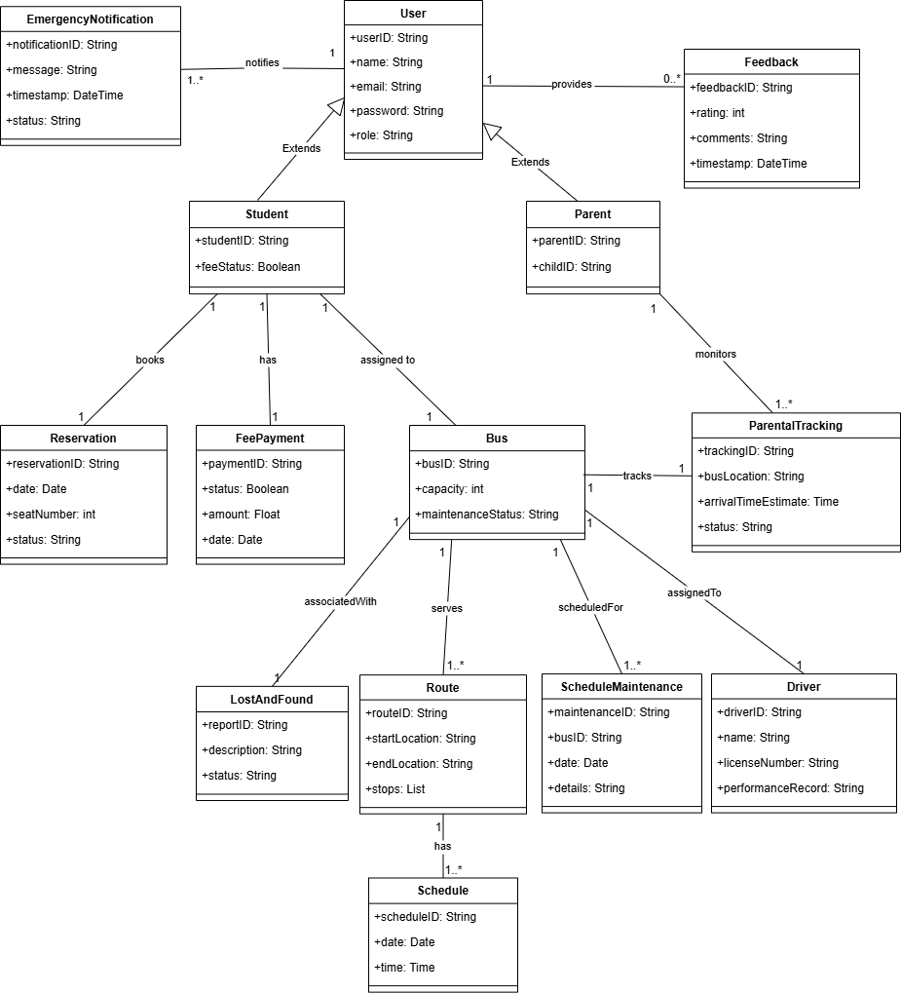
DOMAIN DIAGRAM
Link: github/UniRide/DomainModel.png

Slide 7
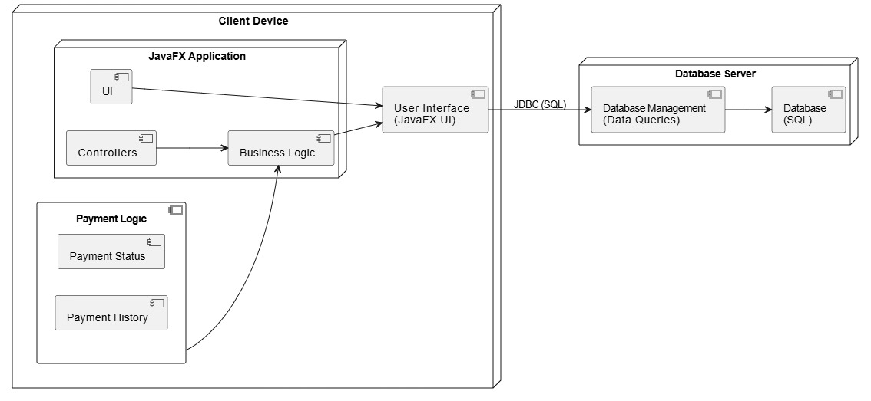
DEPLOYMENT DIAGRAM
Link: github/UniRide/DeploymentDiagram.png

Slide 8
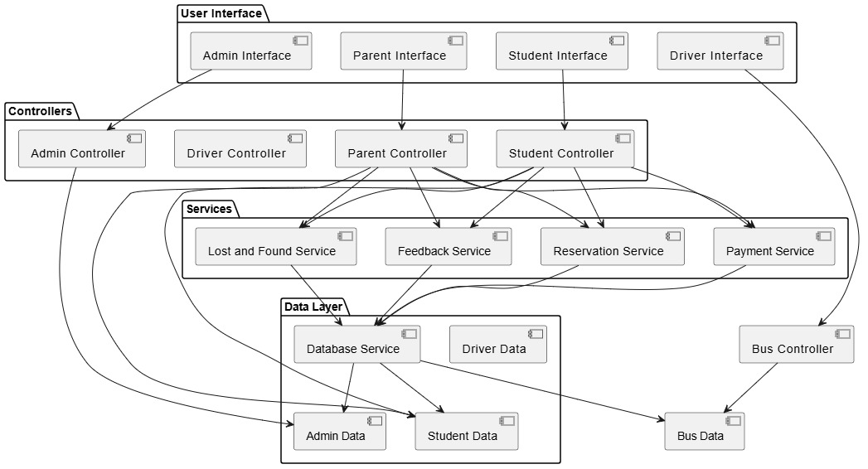
COMPONENT DIAGRAM
Link: github/UniRide/ComponentDiagram.png

Slide 9
PROJECT STRUCTURE
src/
│
├── Users/ # User-related classes (Models)
│ ├── Admin.java # Admin user class
│ ├── Student.java # Student user class
│ ├── Driver.java # Driver user class
│ ├── Parent.java # Parent user class
│
├── BusinessLogic/ # Core business logic classes (Models)
│ ├── Bus.java # Bus details
│ ├── Route.java # Bus route details
│ ├── ViewRoutes.java # Viewing bus routes
│ ├── FeePayment.java # Fee payment processing
│ ├── Reservation.java # Reservation management
│ ├── Feedback.java # Feedback data model
│ ├── LostItem.java # Lost item management
│ ├── Schedule.java # Bus schedule management
│ ├── ScheduleMaintenance.java # Bus schedule maintenance
│ ├── ParentalTracking.java # Parent's bus tracking
│ ├── PaymentRecord.java # Record of payments
│ ├── HelloApplication.java # Main application (entry point)
│ ├── DriverDummyData.java # Dummy data for driver (test data)
│ ├── DriverManagement.java # Driver management functionality
│ └── UserIDGenerator.java # User ID generation logic
src/
│
├── UI/ # User interface files (FXML & CSS)
│ ├── FeeVerification.fxml # Fee verification interface
│ ├── Feedback.css # CSS for feedback interface
│ ├── Reservation.css # CSS for reservation interface
│ ├── feedback.fxml # Feedback form interface
│ ├── hello-view.fxml # Main view (initial interface)
│ ├── hello.css # CSS for main view
│ ├── login.css # CSS for login page
│ ├── login.fxml # Login page interface
│ ├── lostandfound.css # CSS for lost and found page
│ ├── lostandfound.fxml # Lost and found interface
│
├── Controllers/ # Controllers for handling UI actions
│ ├── FeeVerificationController.java # Handles fee verification actions
│ ├── FeedbackController.java # Manages feedback actions
│ ├── HelloController.java # Controls main page actions
│ ├── LoginController.java # Manages login page logic
│ ├── LostAndFoundController.java # Lost and found logic
│ ├── ManageReservationController.java # Reservation management actions
│ ├── ReservationController.java # Manages reservation actions
│ ├── SignUpController.java # Manages sign-up actions
│ ├── StudentController.java # Student-specific actions
│ ├── TrackingController.java # Tracks bus for students/parents

Slide 10
DESIGN PATTERN USED
Factory Pattern: BusFactory
Implementation: The BusFactory class provides a way to create Bus objects without specifying the exact class of the bus being created. Based on specific parameters (like bus type, capacity, etc.), it returns different types of Bus objects, allowing flexible and dynamic object creation.
Parental Tracking:
Observer Pattern:
Plan: Use the Observer Pattern for parental tracking. When a bus reaches a certain location or status, parents will be notified in real-time.
Singleton Pattern: UserIDGenerator
Implementation: The UserIDGenerator class ensures a single instance by using a static counter and a static generateUserID() method to create unique user IDs. It restricts multiple instances, making it a Singleton.

Slide 11
SEQUENCE DIAGRAM
Link: github/UniRide/SequenceDiagram.png

Slide 12
Thank You i22-1244 i22-1238

