Slide 1
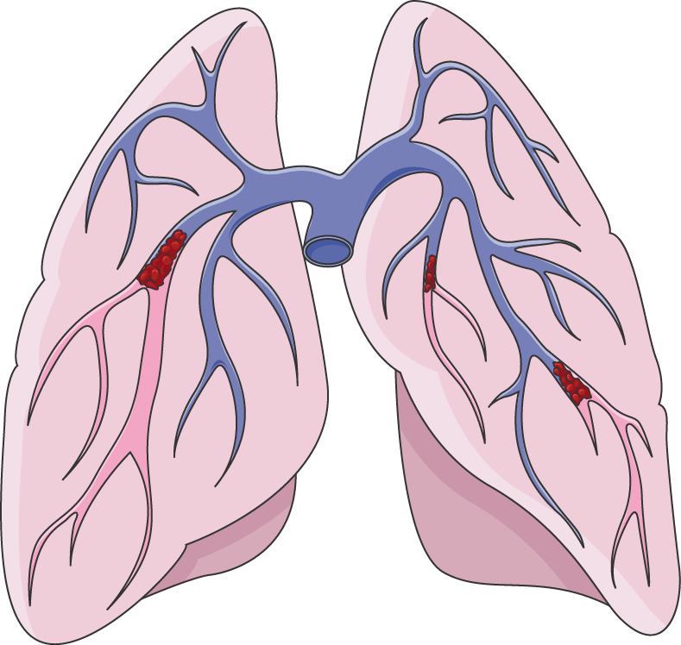
Respiratory System Issues Breakthrough Infographics
Illustration by Smart-Servier Medical Art
Here is where this template begins

Slide 2
About respiratory system issues breakthrough infographics
This template contains an assortment of complementary infographic resources for the Respiratory System Issues Breakthrough presentation.
These infographics are adapted to the style of the aforementioned presentation, so you can insert them easily and have them completely integrated at once. You just need to do the following:
Select the element that you want to copy
Right-click and choose “Copy”
Go to the slide where you want the element to appear
Right-click and choose “Paste”

Slide 3
Respiratory system infographics
Hormones
1
They are chemical substances that are carried by a cell tissue and initiate specific action
Glands
2
These are specialized organs that release hormones
directly into the bloodstream
Test Organs
3
The specific cells which are affected by a hormone are called target cells

Slide 4
Respiratory system infographics
1
3
5
Jupiter
Venus
Jupiter is the biggest planet of them all
Venus is the second planet from the Sun
Mercury
Mars
Saturn
Mercury is the smallest planet of them all
Despite being red, Mars is a very cold place
Saturn is a gas giant has has several rings
2
4

Slide 5
Respiratory system infographics
Treatment | Saturn | Venus | Mars | Neptune
Mercury is the closest planet to the sun
Venus | Venus is the second planet from the Sun | Mars is full of iron oxide dust and a cold place | Saturn is a gas giant and has several rings | Sun is the star in the center of the solar system
Mars | Jupiter is the biggest planet of them all | Neptune is the farthest planet from the Sun | Mercury is the closest planet to the Sun | Earth is the third planet from the enormous Sun

Slide 6
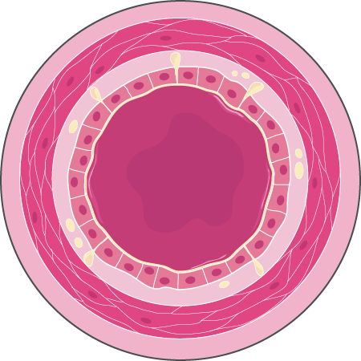
Respiratory system infographics
Healthy bronchus
Mars
Neptune
Despite being red, Mars is actually a very cold place
Neptune is the fourth-largest planet in the Solar System
A
B
Illustration by Smart-Servier Medical Art
Venus
Earth
Yes, Venus has a beautiful name, but it’s terribly hot
It is the third planet from the Sun and it’s where we all live
F
C
Saturn
Mercury
Saturn is composed of hydrogen and helium and is a gas giant
E
D
Yes, Mercury is the smallest planet in the entire Solar System

Slide 7
Respiratory system infographics
Jupiter is a gas giant and very big
Mercury is a very small planet
Mars is actually a cold place
Venus is the second planet from the Sun
Jupiter
Mercury
Mars
Venus
A
B
C
D
Respiratory infections
E
F
G
H
Neptune
Earth
Sun
Saturn
Neptune is far away from Earth
Earth is the third planet from the Sun
The Sun is the star of the Solar System
Saturn is a gas giant with several rings

Slide 8
Respiratory system infographics
Bronchioles of the lung
5%
15%
30%
50%
85%
Jupiter
Mars
Mercury
Saturn
Venus
Jupiter is the biggest planet of them all
Despite being red, Mars is a cold place
Mercury is the smallest planet of them all
Saturn is a gas giant and has several rings
Venus is the second planet from the Sun

Slide 9
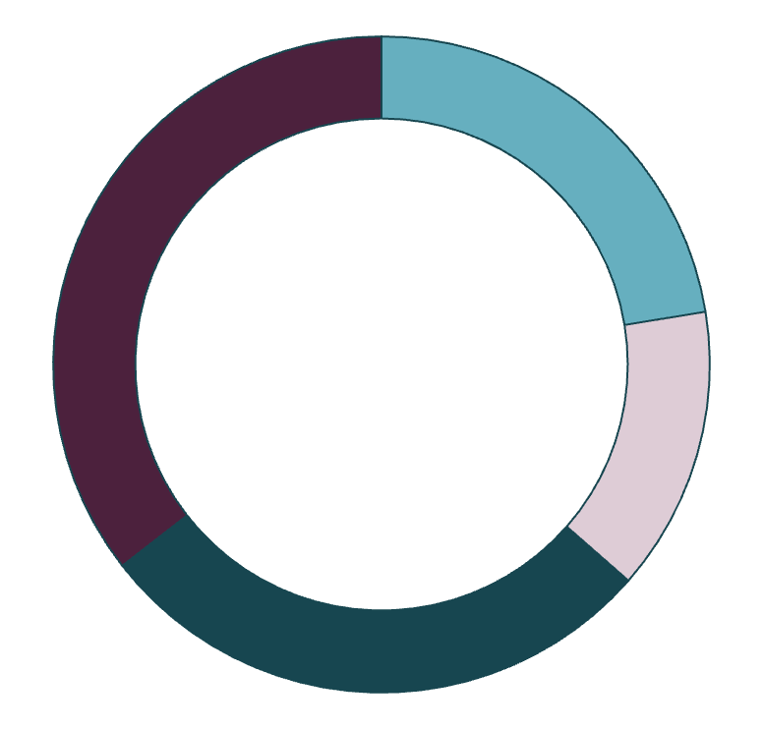
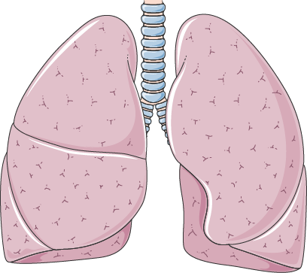
Respiratory system infographics
24%
15%
Mercury
Venus
Mercury is the closest planet to the Sun and the smallest one
It has a nice name and is the second planet from the Sun
Illustration by Smart-Servier Medical Art
30%
38%
Mars
Jupiter
Despite being red, Mars is actually a very cold place
Jupiter is a gas giant and the biggest planet in the Solar System
Follow the link in the graph to modify its data and then paste the new one here. For more info, click here

Slide 10
Respiratory system infographics
Mercury
Venus
Mars
Jupiter
Saturn
Yes, Mercury is the smallest planet in the Solar System
Venus is the second planet from the Sun and it is very hot
Despite being red, Mars is actually a very cold place
Jupiter is the biggest planet and it is a gas giant as well
Saturn is made of hydrogen and helium. It is also a gas giant

Slide 11
Respiratory system infographics
 | Outcome
Group | Test 1 | Test 2 | Test 3
A | 95/100 | 55/100 | 80/100
B | 80/100 | 25/100 | 66/100
C | 72/100 | 70/100 | 45/100
D | 60/100 | 60/100 | 86/100
E | 67/100 | 23/100 | 54/100

Slide 12
Respiratory system infographics
Bronchiectasis
Mercury
Venus
Mercury is the closest planet to the Sun and the smallest one of them all
Venus has a beautiful name and is the second planet from the Sun
Despite being red, Mars is a cold place. It’s full of iron oxide dust
Jupiter is a gas giant and the biggest planet in the Solar System
Mars
Jupiter

Slide 13
Respiratory system infographics
Sample
70%
Success rate
Young healthy people
225 - 407 patients
3 years follow-up
Saturn is a gas giant
30%
Secondary effects
Mars is a cold place
Results
Goal
6 Months
1 Year
What data have we collected in the study?
Check the effectiveness of the treatment
Approximate half of experimentation time
Approximate experimentation time

Slide 14
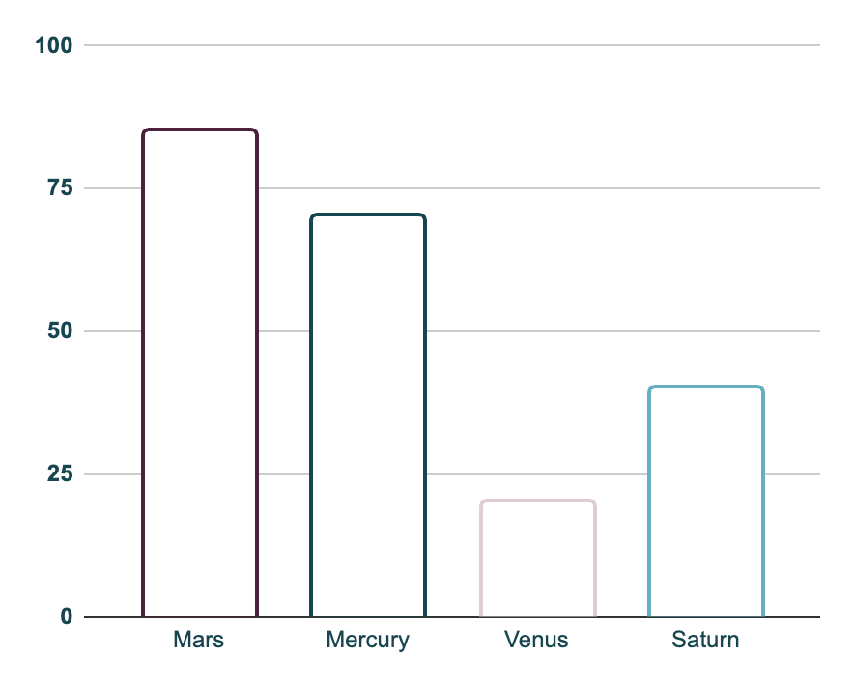
Respiratory system infographics
85%
20%
Mars
Venus
Despite being red, Mars is a cold place
Venus is the second planet from the Sun
70%
40%
Mercury
Saturn
Mercury is the closest planet to the Sun
Saturn is a gas giant with several rings
Follow the link in the graph to modify its data and then paste the new one here. For more info, click here

Slide 15
Glands
Pituitary Gland
Thyroid
Despite being red, Mars is actually a cold place, full of oxide dust
1
2
Neptune is the fourth-largest planet in the Solar System
ParaThyroid
Adrenal Gland
Venus is the second planet to the sun and has a beautiful name
3
4
Earth is the third planet from the Sun and it’s where we all live
Pancreas
Gonads
Saturn is a gas giant and is composed of hydrogen and helium
5
6
Mercury is the smallest planet in the Solar System and closest to the Sun

Slide 16
Respiratory system infographics
Treatment option | Efficacy rate | Side effects | Cost | Availability
Medication A | 80% | Mild | $$ | Widely available
Medication B | 70% | Moderate | $$$ | Available only with prescription
Surgery | 90% | High | $$$$ | Requires specialized facilities
Radiation therapy | 75% | Moderate | $$ | Available in most hospitals
Immunotherapy | 65% | Moderate | $$$$ | Available only in select centers
Physical therapy | 60% | Mild | $$ | Widely available

Slide 18
Respiratory system infographics
Sample
Effects
Results
456
Age: 35 - 45
345
Age: 35 - 45
30%
70%
55%
Despite being red, Mars is a cold place
Venus is the second planet from the Sun
Mercury is the closest planet to the Sun and the smallest one
245
Age: 25 - 45

Slide 20
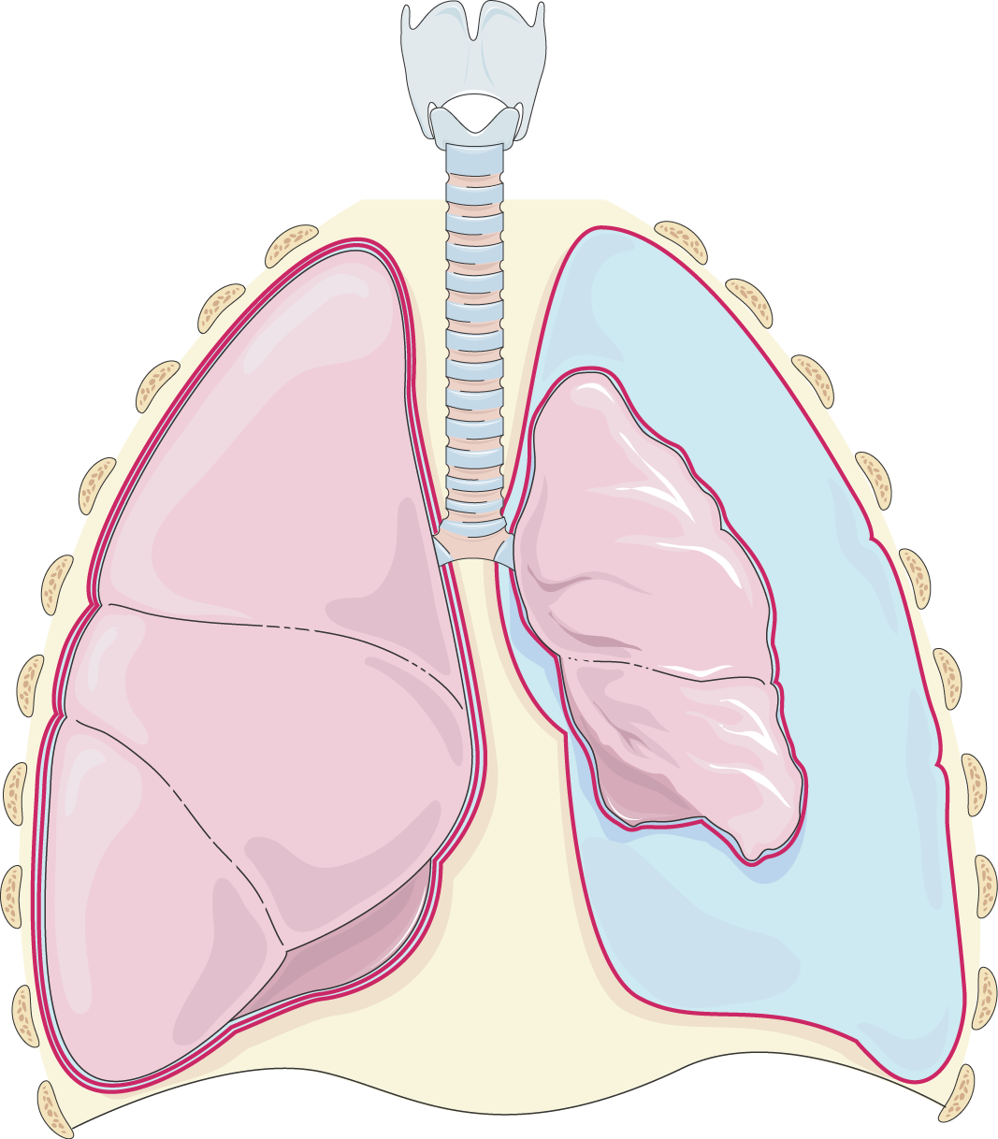
Respiratory system infographics
1
Saturn
5
Mars
1
Saturn is a gas giant with several rings
Mars is a cold place full of iron oxide dust
2
Illustration by Smart-Servier Medical Art
2
Jupiter
6
Venus
Jupiter is the fifth planet from the Sun
Venus is the second planet from the Sun
3
4
3
Neptune
7
Mercury
5
6
Neptune is very far away from Earth
Mercury is the closest planet to the Sun
7
8
4
Earth
8
Sun
Earth is the third planet from the Sun
The Sun is the star that we all orbit

Slide 21
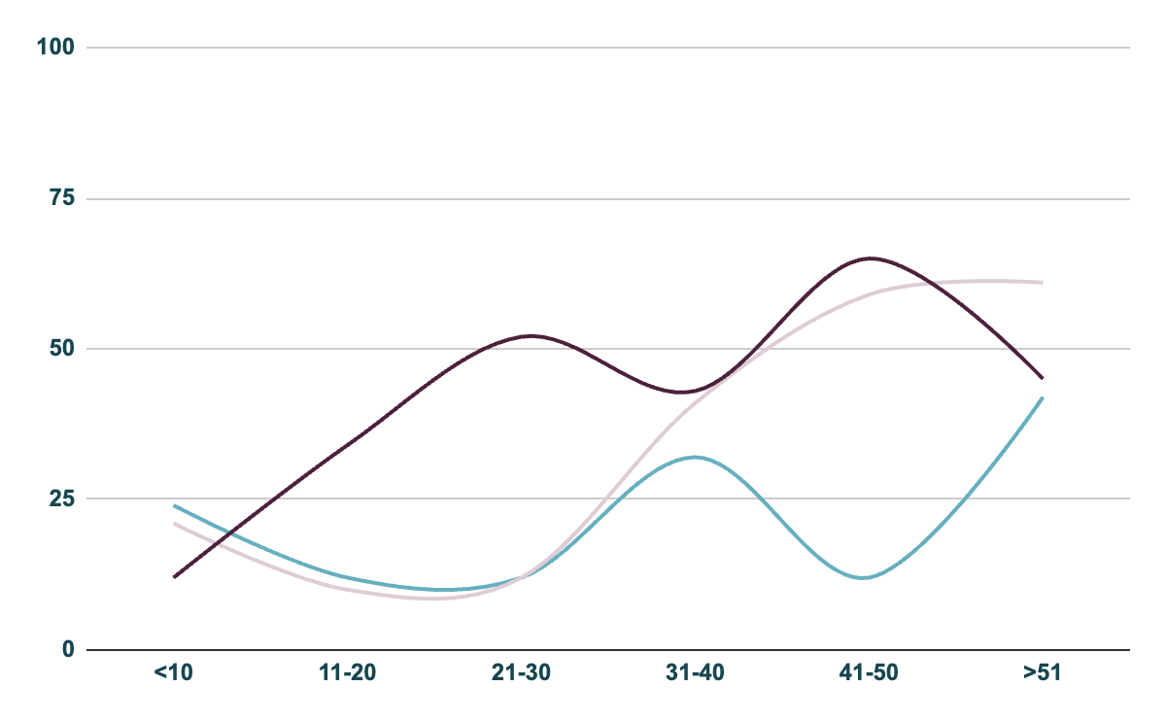
Respiratory system infographics
Mars
25%
Despite being red, Mars is a very cold place
Mercury
40%
Mercury is the smallest planet in the Solar System
Venus
35%
Venus has a nice name, but also high temperatures
Female
Male
Other
Follow the link in the graph to modify its data and then paste the new one here. For more info, click here

Slide 22
Respiratory system infographics
Respiratory system issues
Mercury
Mars
Jupiter
Saturn
Mercury is the closest planet to the Sun and the smallest one of them all
Despite being red, Mars is actually a very cold place full of iron oxide dust
Jupiter is a gas giant and has eighty moons. It is the biggest planet of them all
Saturn is composed mostly of hydrogen and helium and it’s a gas giant
Earth

Slide 23
Respiratory system infographics
Phase 0 | Phase 1 | Phase 2 | Phase 3
Lab studies | Human safety | Expanded safety | Efficacy & safety
10% | 30% | 70% | 90%
Mercury is the smallest planet in the Solar System | Saturn is composed mostly of hydrogen and helium | Despite being red, Mars is actually a very cold place | Neptune is the fourth-largest planet in the Solar System

Slide 24
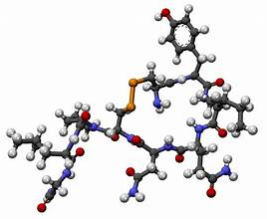
Components of Endocrine System
Hormone
Function of hormone
HORMONES: They are chemical substances that are carried by a cell tissue and initiate specific action. Hormones can have very powerful effects, even when present in very low concentrations. The specific cells which are affected by a hormone are called target cells. Hormones travel through the bloodstream to target cells or organs, where they elicit specific responses. Examples of hormones include insulin, cortisol, thyroid hormones, estrogen, and testosterone.
Regulate the chemical composition and volume of the internal environment (extracellular fluid).
Help regulate metabolism and energy balance.
Help regulate contraction of smooth and cardiac muscle fibers and secretion by glands.
Help maintain homeostasis.
Regulate certain activities of the immune system.
Play a role in the smooth, sequential integration of growth and development.

Slide 25
Com
Brain
Consequences
Venus is the second planet from the Sun. It’s terribly hot and has a toxic atmosphere
Pluto is considered a dwarf planet these days
Ceres is located in the main asteroid belt
Yes, the Moon is Earth’s only natural satellite
Despite being red, Mars is actually a cold place
Saturn is a gas giant and has several rings
Lungs
Mercury is the closest planet to the Sun and the smallest one in the Solar System
Heart
Earth is the third planet from the Sun and the only one of them known to harbor life

Slide 26
Respiratory system infographics
Sample
Secondary effects
You can list here the main secondary effects here
You can list here the main secondary effects here
You can list here the main secondary effects here
445
209
345
Age: 45-65
Age: 20-40
Age: 30-50
56
109
200
Age: 15-25
Age: 60-70
Age: 70-80
Results
Goals
Venus has a beautiful name and is the second planet from the Sun. It’s terribly hot—even hotter than Mercury—and its atmosphere is extremely poisonous
25%
50%
75%
Mercury
Saturn
Neptune

Slide 27
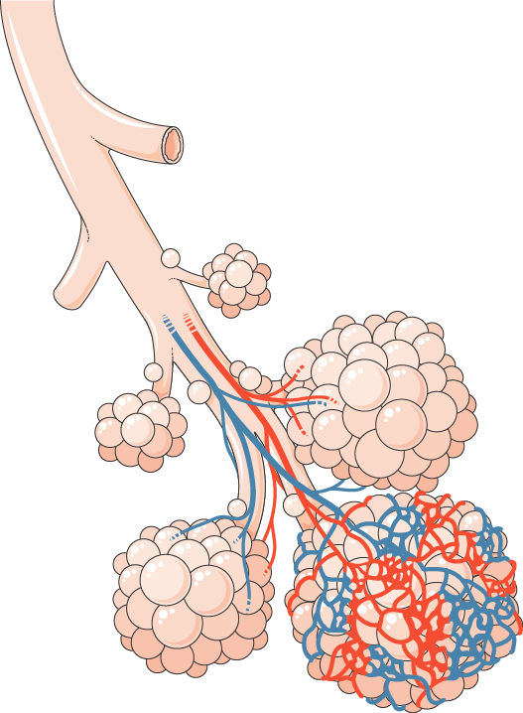
Respiratory system infographics
Venus
Venus has a beautiful name and is is second planet from the Sun
1,200
Illustration by Smart-Servier Medical Art
Mercury
Mercury is the closest planet to the Sun and the smallest one
3,400
Jupiter
Jupiter is a gas giant and the biggest planet in the Solar System
5,600
Saturn
It is a gas giant and has rings. It’s composed of hydrogen and helium
7,800

Slide 28
Respiratory system infographics
Result
Phase 01
25%
Mars is full of iron oxide dust
Preclinical
Human safety
First studies
Result
Phase 02
30%
Mercury is the closest planet to the Sun and the smallest one in the Solar System. This planet’s name has nothing to do with the liquid metal, since Mercury was named after the Roman messenger god
Jupiter is a gas giant and it’s very big
Expanded safety
Result
Phase 03
45%
Earth is the place where we all live
Efficacy & safety

Slide 29
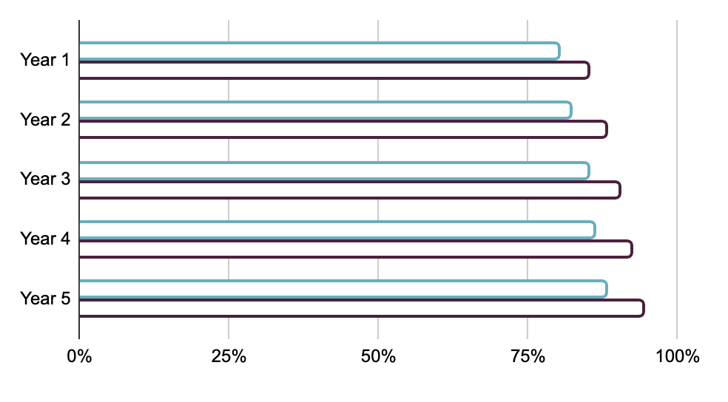
Respiratory system infographics
Trend in patient outcomes
Average patient outcome before breakthrough
The tool increased early diagnosis rates by 50%
100 lives saved by new treatment in the 1st year
Average patient outcome after breakthrough
Key Performance Indicator | Number
Patients treated | 2,500
Success rate | 95%
Average recovery time | 3 days
Follow the link in the graph to modify its data and then paste the new one here. For more info, click here

Slide 30
Respiratory system infographics
Saturn
Mercury
Venus
Yes, Saturn is a gas giant
Mars
Mercury is a small planet
Jupiter
Venus is extremely hot
2XXX
Mars is a very cold planet
2XXX
Planet Jupiter is a gas giant
2XXX
1
2XXX
3
2XXX
5
2
4

Slide 31
Respiratory system infographics
Disease
 | Treatment 1 | Treatment 2 | Treatment 3 | Treatment 4 | Treatment 5
Jupiter | No | No | Yes | No | Yes
Mars | Yes | No | Yes | Yes | No
Saturn | Yes | Yes | No | Yes | No
Neptune | No | No | Yes | No | Yes

Slide 32
Respiratory system infographics
Mars
Despite being red, Mars is a cold place
Factor A
Factor B
Mercury
Venus
Jupiter
Neptune
Mercury is the closest planet to the Sun
Venus is the second planet from the Sun
Jupiter is a gas giant and also a very big planet
Neptune is the farthest planet from the Sun

Slide 33


Respiratory system infographics
John Doe
Sarah James
You can replace the image on the screen with your own
You can replace the image on the screen with your own
Role: Lead Researcher
Role: Clinical trial manager
Contributions:
You can enter a description of their contributions here
You can enter a description of their contributions here
Contributions :
You can enter a description of their contributions here
You can enter a description of their contributions here

Slide 34
Respiratory system infographics
Symptom A
Ceres
10%
Venus has extremely high temperatures
Mars
20%
Symptom B
30%
Earth is the beautiful planet we all live
Mercury
Saturn
40%
Symptom C
50%
Jupiter
Neptune is the farthest planet from the Sun
Symptom D
Jupiter is the biggest planet of them all
Venus
Neptune
Jupiter

Slide 35
Respiratory system infographics
1
Saturn
Saturn is a gas giant with rings
Mars
7
1
Despite being red, Mars is a cold place
7
2
Jupiter
6
Jupiter is the fifth planet from the Sun
5
2
4
Venus
6
3
Venus has a beautiful name
3
Neptune
Neptune is very far away from Earth
4
Earth
Mercury
5
Earth is the third planet from the Sun
Mercury is a very small planet

Slide 36
Instructions for use
If you have a free account, in order to use this template, you must credit Slidesgo in your final presentation. Please refer to the next slide to read the instructions for premium users.
As a Free user, you are allowed to:
- Modify this template.
- Use it for both personal and commercial projects.
You are not allowed to:
- Sublicense, sell or rent any of Slidesgo Content (or a modified version of Slidesgo Content).
- Distribute Slidesgo Content unless it has been expressly authorized by Slidesgo.
- Include Slidesgo Content in an online or offline database or file.
- Offer Slidesgo templates (or modified versions of Slidesgo templates) for download.
- Acquire the copyright of Slidesgo Content.
For more information about editing slides, please read our FAQs or visit our blog:
https://slidesgo.com/faqs and https://slidesgo.com/slidesgo-school

Slide 37
Instructions for use (premium users)
As a Premium user, you can use this template without attributing Slidesgo.
You are allowed to:
Modify this template.
Use it for both personal and commercial purposes.
Share this template in an editable format with people who are not part of your team.
You are not allowed to:
Sublicense, sell or rent this Slidesgo Template (or a modified version of this Slidesgo Template).
Distribute this Slidesgo Template (or a modified version of this Slidesgo Template) or include it in a database or in any other product or service that offers downloadable images, icons or presentations that may be subject to distribution or resale.
Use any of the elements that are part of this Slidesgo Template in an isolated and separated way from this Template.
Register any of the elements that are part of this template as a trademark or logo, or register it as a work in an intellectual property registry or similar.
For more information about editing slides, please read our FAQs or visit our blog:
https://slidesgo.com/faqs and https://slidesgo.com/slidesgo-school

Slide 38
Infographics
You can add and edit some infographics to your presentation to present your data in a visual way.
Choose your favourite infographic and insert it in your presentation using Ctrl C + Ctrl V or Cmd C + Cmd V in Mac.
Select one of the parts and ungroup it by right-clicking and choosing “Ungroup”.
Change the color by clicking on the paint bucket.
Then resize the element by clicking and dragging one of the square-shaped points of its bounding box (the cursor should look like a double-headed arrow). Remember to hold Shift while dragging to keep the proportions.
Group the elements again by selecting them, right-clicking and choosing “Group”.
Repeat the steps above with the other parts and when you’re done editing, copy the end result and paste it into your presentation.
Remember to choose the “Keep source formatting” option so that it keeps the design. For more info, please visit our blog.

