Slide 1

Healthcare Insurance Claim
Notes:
1. Table of contents
2. Introduction
3. Identifying information
4. Patient medical history
5. Review of systems
6. Physical examination
7. Big picture
8. Findings
9. Discussion
10. Discussion summary
11. Comparison
12. Diagnosis
13. Treatment
14. Patient monitoring
15. Contraindications and indications
16. Post-prevention
17. Case timeline
18. Conclusions
19. References
20. Our team

Slide 2
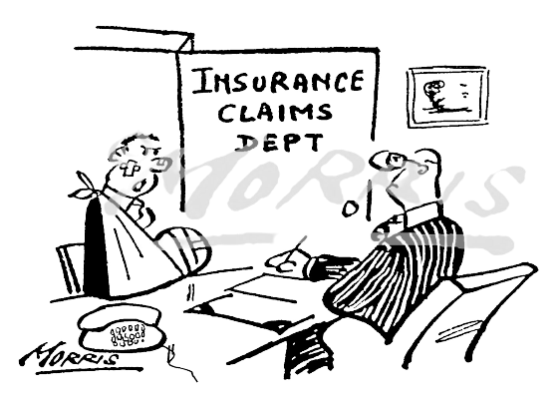
What is a Healthcare Insurance Claim?
A healthcare insurance claim is a formal request submitted by a healthcare provider to an insurance company for reimbursement of medical services provided to a patient.

Slide 3
Type of claims
Institutional Medical Billing
Professional Medical Billing
Institutional medical billing refers to the process of submitting and managing medical claims for services rendered by hospitals, clinics, and other healthcare facilities to insurance companies or government payers.
Professional medical billing refers to the process of submitting and managing medical claims for services rendered by individual healthcare providers, such as physicians or non-institutional practitioners, to insurance companies or government payers.

Slide 4

Capabilities of Professional Billing and Institutional Billing
Medical providers have access to large amounts of data for each insurance company to file medical claims effectively.
Medical billing staff have access to sensitive, confidential client health information and must be aware of HIPAA privacy and security standards.
Experience with the billing system saves time, reduces mistakes, and eliminates problems.
Understanding the importance of benefits verification involves knowing what is covered in the patient’s plan and how to bill claims correctly to avoid payment delays.

Slide 5


Types of Medical Billing Claim forms
CMS-1500 For Professional Billing
UB-04 For Institutional Billing
CMS-1500 form is used for professional billing. The 837-P, which is the electronic counterpart of the CMS 1500 form, is used in professional billing. The letter “P” refers to professional configuration.
The UB-04 form is used for institutional billing. The 837-I is used for electronic claims in institutional billing. The letter “I” represents the institutional configuration.

Slide 6


Claim Submission
Paper Claim: It means to fill out a paper claim form manually and mailing it to insurance’s physical address.
Electronic Claims: It means claim will be created and submitted electronically using an EHR (CureMD) and a Clearing House (CureConnnect).

Slide 7

EHR
An Electronic Health Record (EHR) is a secure digital repository of a patient's comprehensive medical information that allows for efficient storage, management, and exchange of health data among healthcare providers.

Slide 8

Health Care Clearing House
A healthcare clearinghouse is essentially the middleman between the healthcare providers and the insurance payers. A clearinghouse checks the medical claims for errors, ensuring the claims can get correctly processed by the payer.

Slide 9

Claim Status: There are five possible types of claim status that a medical biller might encounter. Claim Not on File: In this scenario, confirm the payer ID or Claim submission address of insurance.
Claim Status | Denial Reason | Denial/ Paid Date | Paid Amount | Check # | Check Amount | Check Issue Date | Claim# | Call Ref | Rep Name | Remarks
Paid
Partially Paid
Denied
In-Process
Not on File

Slide 10
Thank you

