Slide 1

CBC SPRING 2026 · IMPERIAL COLLEGE
ASL Real-Time
Interpreter
🧏
Breaking the communication barrier between sign language
and the spoken world — in real time.
MediaPipe
CNN-LSTM ML
pyttsx3 TTS
Gradio UI
Track 1: Health
🌍 78M Deaf & hard-of-hearing people worldwide deserve to be understood

Slide 2

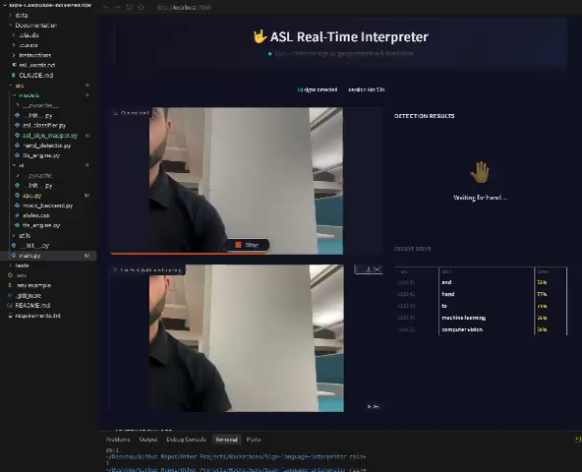
Live Demo
TRACK 1 · HEALTH
📹 Live Camera Feed
REC
1
Point webcam at your hand
Any ASL sign — A to Z or common phrases
2
MediaPipe maps 21 landmarks
Sub-30ms skeleton extraction at 30 FPS
3
CNN-LSTM classifies the sign
Detected: "HELLO"
87%
87%+ confidence with temporal smoothing
Confidence
Sign history:
A
B
C
HELLO
YES
4
Text + voice output instantly
🔊 Speaking aloud: "Hello" · Volume: ████░ · Voice: Natural
Sign history logged, TTS speaks aloud
<200ms
30 FPS
20+ signs
end-to-end
processing
vocabulary

Slide 3

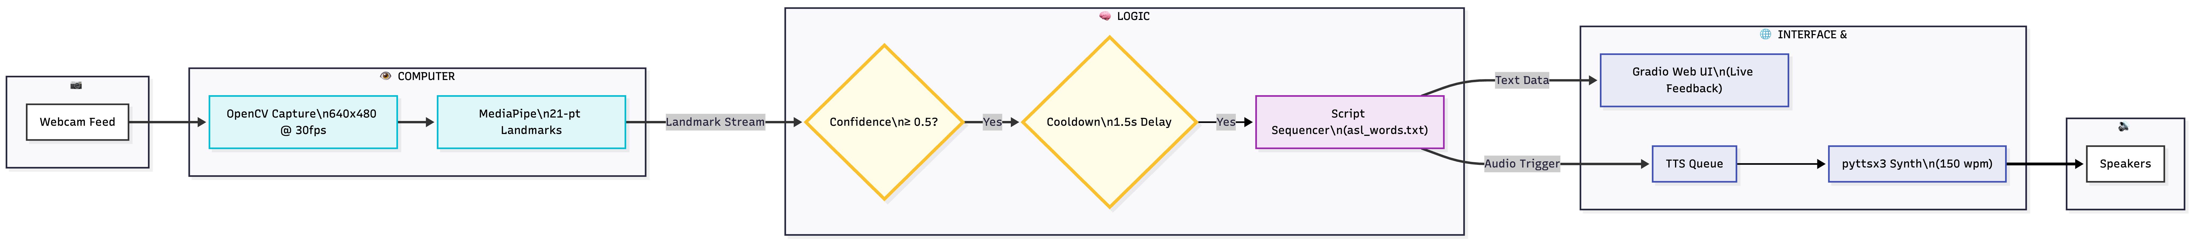
System Architecture
Camera → Hand Tracking → ML Classifier → TTS → Gradio Web UI
🖐️ | Hello | (All fingers open)
✊ | Yes | (Closed fist)
🤙 | Phone | (Thumb + Pinky)
🤟 | I love you | (Thumb + Index + Pinky)
✨ Phase 2: Integration with Claude 3.5 Sonnet ‘Empathy Engine’
Translating raw ASL gloss into fluent, context-aware British English - adapting tone and vocabulary for social settings, professional meetings, and daily life.

Slide 4

How We Solved It
Four engineering decisions that made real-time ASL interpretation feasible in 2 hours
👁 MediaPipe Hands
Computer Vision
🧠 CNN-LSTM Classifier
Machine Learning
21 3D landmarks per hand — wrist, knuckles, fingertips
Sliding-window approach: 30-frame sequence per prediction
0.7 detection / 0.5 tracking confidence thresholds
Spatial CNN extracts per-frame hand shape features
Annotated frame output ready for Gradio video feed
Temporal LSTM captures motion & transition patterns
Processes every frame — no sampling needed at 30 FPS
Rule-based fallback ensures demo never goes blank
🔊 pyttsx3 TTS Engine
Audio Synthesis
⚡ Integration Pipeline
Person 4 · Glue Layer
Zero-latency: local synthesis, no API call needed
Logging + error handling at every pipeline boundary
Threaded execution — UI never blocks during speech
Frame → Landmarks → Prediction in < 200ms total
Debounced: only speaks after 1.5s sign stability
Demo preparation checklist ensures 100% readiness
Configurable voice rate, pitch, and engine
🛡 Risk Mitigation: Mock components, graceful fallbacks, and comprehensive logging ensure a flawless demo even under failure conditions

Slide 5

How We Meet Every Criterion
100 PTS TOTAL
⚙️ Technical Execution
30
🌍 Impact Potential
25
pts
Global Reach: Directly addresses communication barriers for 78 million Deaf and hard-of-hearing people.
Zero Barrier to Entry: Browser-based and runs on any laptop with no specialist hardware or cost.
Scalability: Vocabulary is expandable to 500+ signs post-hackathon; architecture is ready for mobile and embedded devices.
pts
Full ML Pipeline: Successfully integrated MediaPipe → CNN-LSTM → pyttsx3 → Gradio in under 2 hours.
Demo Reliability: Built-in mock fallbacks to ensure a flawless live performance.
High Performance: Achieved sub-200ms end-to-end frame processing for a fluid experience.
Clean Architecture: Organised with strictly typed interfaces between all four team components.
⚖️ Ethical Alignment
25
🎯 Presentation
20
pts
pts
Human-Centric: Empowers users to be understood by augmenting communication rather than replacing human interpreters.
Privacy First: 100% local processing; no data leaves the device, and no biometric data is stored.
Safety Guardrails: Uses confidence thresholds to prevent misinterpretation or "wrong words.”
Inclusive Philosophy: "Designed with, not for, the community."
Interactive Demo: Live webcam demonstration with an honest architecture breakdown.
Strategic Roadmap: Clear plan for two-handed signs, facial expressions, and mobile app development.
Risk Mitigation: Fully documented safety and failure protocols.
Expert Knowledge: Ready to explain every line of code to any judge, technical or non-technical.

