Slide 1



Vulnerability Scanner and Remediation
Areej Zeb 22i-1561
Muhammad Ahmad Mustafa 22i-1591

Slide 2

Introduction
Problem Statement
Solution Overview
Tools & Technologies
Workflow
CVE Extraction – Code & Structure
CVE Extraction – Terminal Output
Raw CVE Master CSV Preview
Automated Remediation Retrieval – Terminal Log
Model Training – Initialization
Model Training – Progress
Environment & Model Initialization
Web UI – Runtime Scan Interface
Scan In Progress – Usage
Vulnerability Analysis Report
Conclusion
Table of Contents

Slide 3


Introduction
Problem Statement
Manual vulnerability scanning yields long lists of findings
Hard to prioritize by business risk or severity
Remediation steps scattered across disparate sources
Solution Overview
Automated network & OS scanning (Nmap)
AI‑based CVE ranking & severity classification
NLP‑driven remediation suggestion (T5)

Slide 4


Tools and Technologies
Scanning & Data
AI & ML
Backend & Frontend
Nmap CLI (–sV version detection)
NVD JSON feeds (2023–2025 CVE data)
ExploitDB mapping
Sentence‑BERT (all‑MiniLM‑L6‑v2) for embeddings
RandomForest classifier for CVE severity
T5‑small fine‑tuned for remediation generation
FastAPI + Uvicorn for REST API
Python‑nmap subprocess integration
HTML/CSS/JavaScript for UI

Slide 5
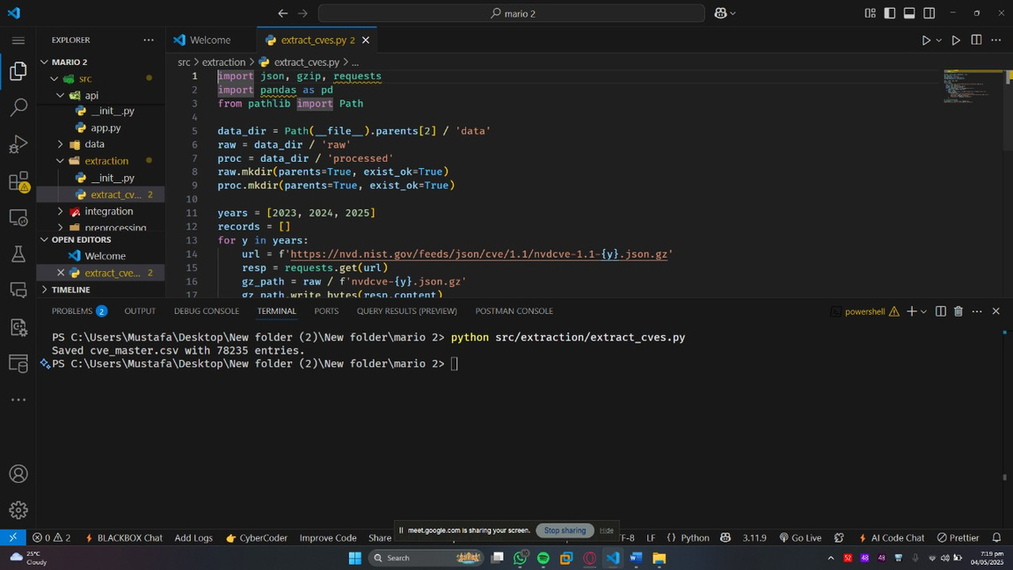
Workflow
CVE Extraction – Code & Structure
Shows the src/extraction/extract_cves.py script in VS Code
Downloads NVD feeds for 2023–2025, parses CVE_ID, description, CVSS, attack vector
Writes out cve_master.csv into data/processed
CVE Extraction – Terminal Output
Ran python src/extraction/extract_cves.py
Script reports “Saved cve_master.csv with 78235 entries”
Confirms successful harvesting of ~78 K CVEs for downstream use

Slide 6
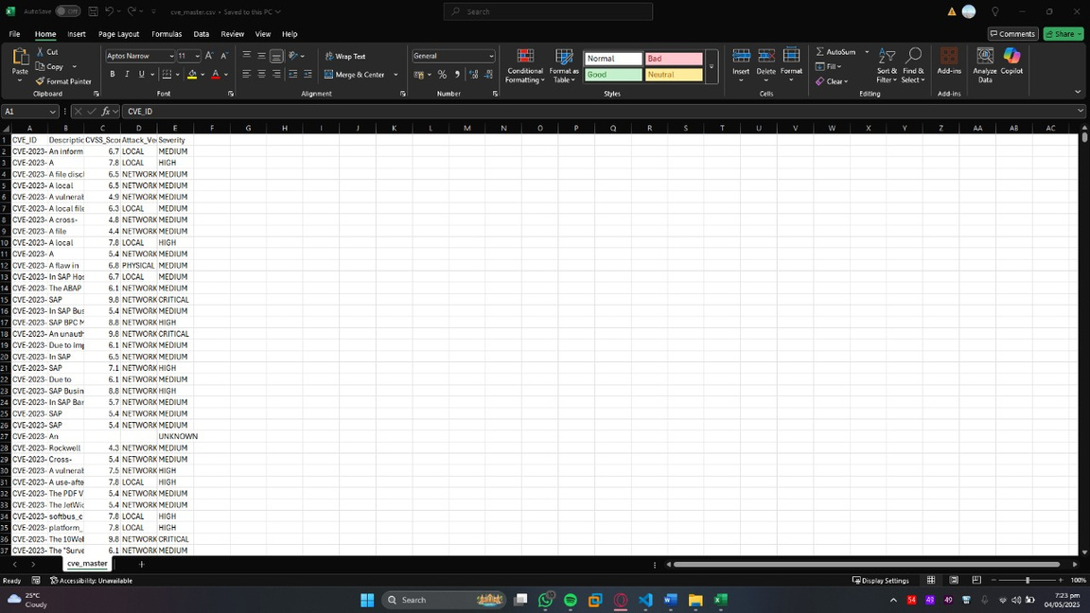
Workflow
Raw CVE Master CSV Preview
Shows the unprocessed cve_master.csv in Excel
Columns: CVE_ID, Description, CVSS_Score, Attack_Vector, Severity
Example rows illustrate varied severities (MEDIUM, HIGH, CRITICAL) and vectors (LOCAL, NETWORK)
This raw table feeds into preprocessing and model training stages

Slide 7
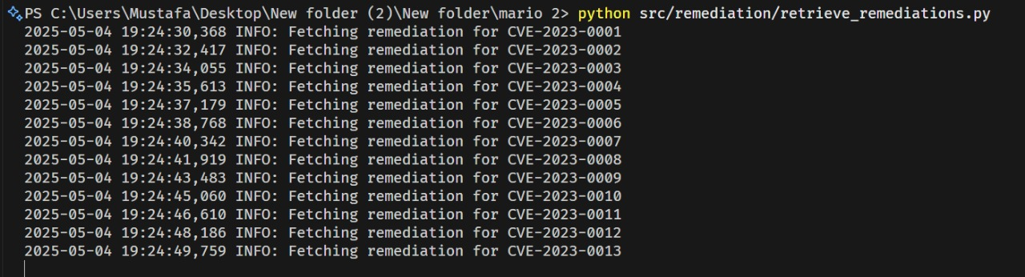
Workflow
Automated Remediation Retrieval – Terminal Log
Command: python src/remediation/retrieve_remediations.py
Info lines show “Fetching remediation for CVE‑2023‑0001”, “CVE‑2023‑0002”, …
Confirms the script iterates through each CVE ID and pulls or generates its remediation steps automatically.

Slide 8
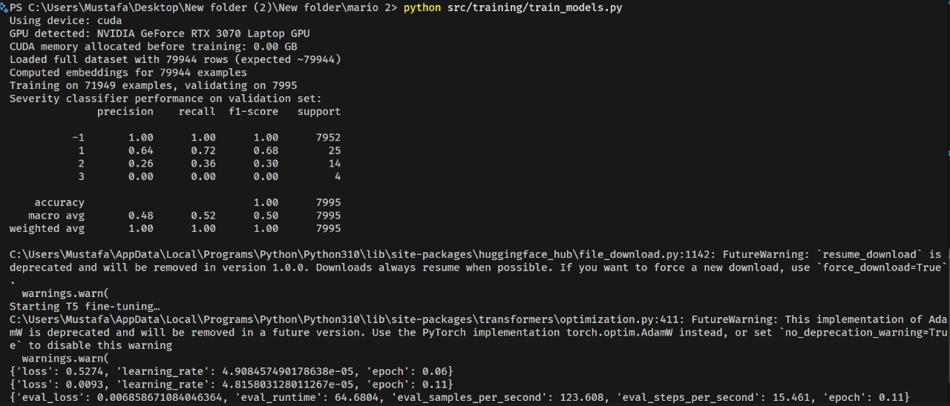
Workflow
Model Training – Initialization
Detects and uses RTX 3070 GPU
Loads full dataset (79 944 CVEs) and computes SBERT embeddings
Trains RandomForest severity classifier (90/10 split) with performance metrics displayed
Kicks off T5‑small fine‑tuning for remediation

Slide 9
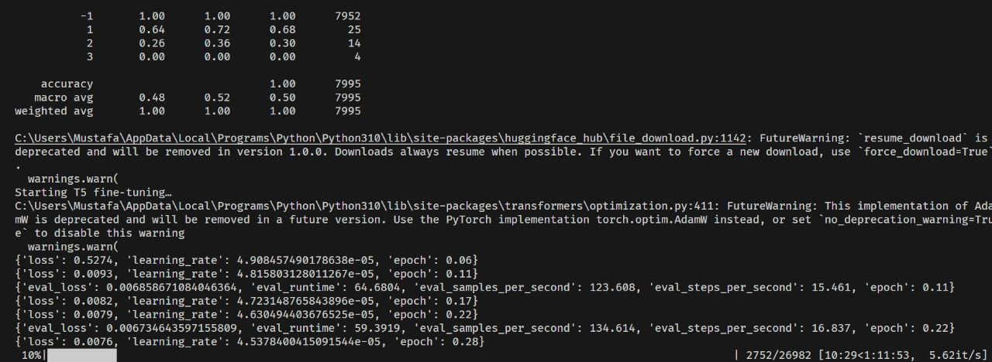
Workflow
Model Training – Progress
Shows training progress bar (10 % complete)
Indicates examples processed (2 752/26 982) and throughput (~5.6 examples/sec)
Estimates time remaining (≈1 h 11 m)
Logs per‑step loss and evaluation loss for monitoring convergence

Slide 10
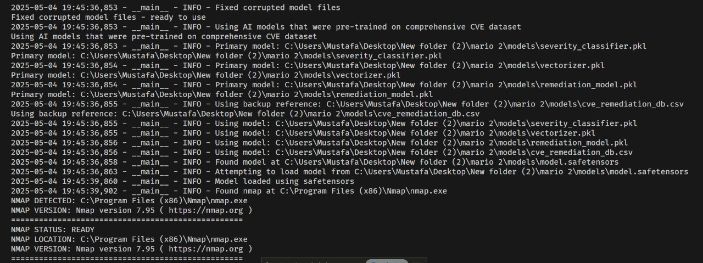
Workflow
Environment & Model Initialization
Loaded pre‑trained severity classifier, vectorizer, and T5 remediation model (safetensors)
Verified Nmap installation at C:\Program Files (x86)\Nmap\nmap.exe (v7.95)
System now primed to scan, classify, and remediate in one seamless pipeline

Slide 11
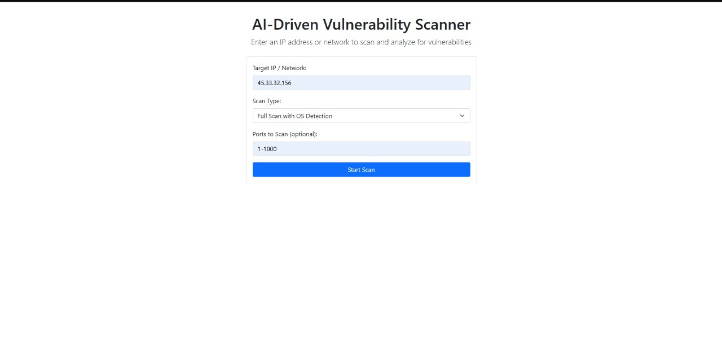
Workflow
Web UI – Runtime Scan Interface
Input form for Target IP/Network, scan type, and port range
“Start Scan” button triggers live Nmap scan via backend
Real‑time progress spinner (0 % → 100 %) displayed below
Results area (ports & services → CVE table) appears upon completion

Slide 12
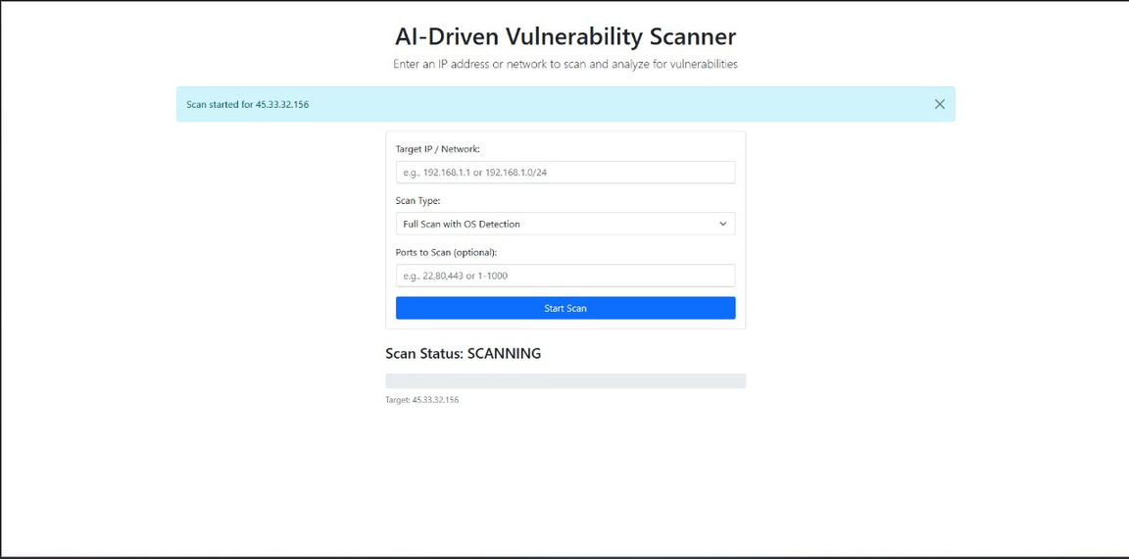
Workflow
In Progress – Usage
Shows runtime scan feedback after clicking “Start Scan”
Displays a dismissible alert: “Scan started for 45.33.32.156”
Progress bar updating under “Scan Status: SCANNING”
Indicates target and dynamic feedback while Nmap and AI mappings run

Slide 13
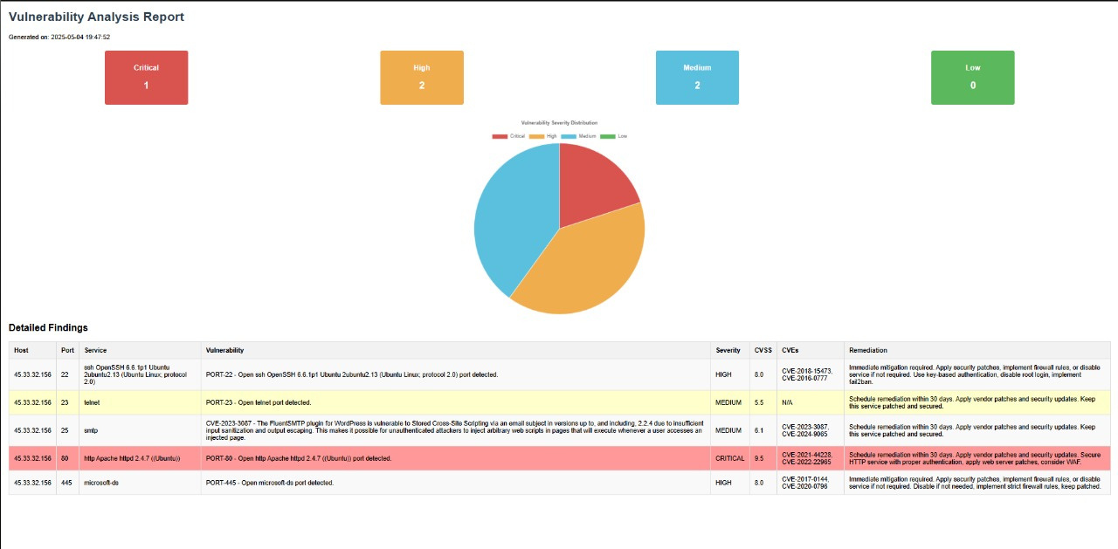
Workflow
Vulnerability Analysis Report
High‑level counts: Critical 1, High 2, Medium 2, Low 0
Severity distribution: Pie chart visualization of findings
Detailed Findings table:
Host & port (e.g. 45.33.32.156:80)
Service and detected issue description
Severity level & CVSS score
Associated CVE IDs
Recommended remediation steps (patch, configuration, firewall rules)

Slide 14
Conclusion
Fully Automated Pipeline: From live Nmap scan to AI‑driven CVE mapping, severity ranking, and remediation suggestions.
Rapid Prioritization: Semantic similarity + RandomForest delivers top‑vulnerabilities in seconds.
Actionable Fixes: T5‑generated remediation steps tailored to each CVE.
Scalable & Extensible: Modular Python/FastAPI backend and web UI, easily integrates new data sources or threat feeds.
Future Directions: Asset‑based risk scoring, UDP scanning, MITRE ATT&CK integration, and conversational remediation assistant.

Slide 15


Thank You!

