Slide 1
Variational Auto-encoders
Shuwen Yue
i-CoMSE ML for Molecular Science

Slide 2
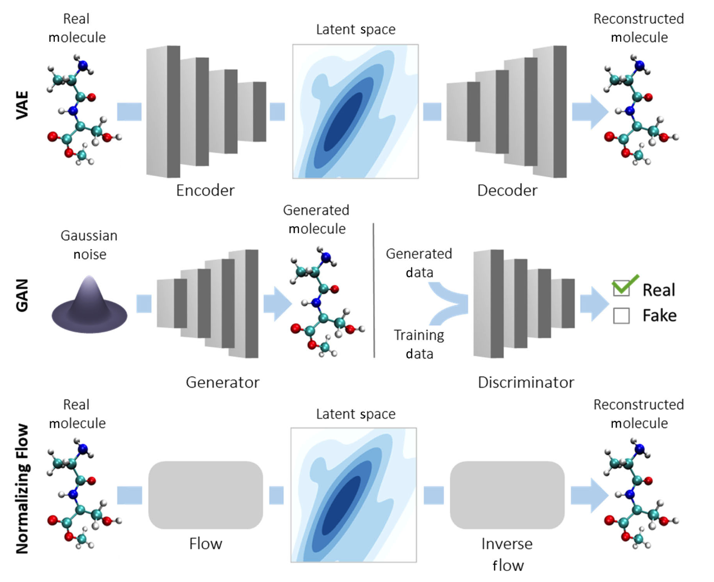
Types of Generative models
Generation tries to recover correct molecule reconstruction AND regularization from learned molecular embedding
Generates molecules from Gaussian noise, where a discriminator learns to identify molecules as real or fake. Two networks competing against each other.
Model learns a series of invertible transformations between a prior distribution and molecular data. Can calculate exact data likelihood.
Bilodeau et al. WIREs Computational Molecular Science. (2022)

Slide 3
Auto-encoders vs PCA
PCA is a linear transformation, auto-encoders can describe complicated non-linear processes
PCA features projects in orthogonal basis. Auto-encoders features optimize for reconstruction, could have correlated features
PCA is cheaper to compute than autoencoders
Auto-encoders have a large number of parameters, prone to overfitting

Slide 4
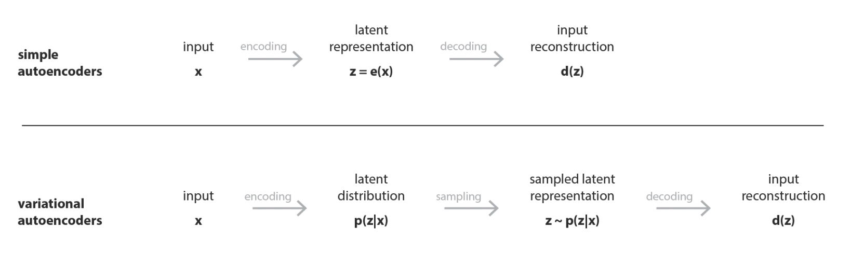
Autoencoder vs variational autoencoder
VAE encodes data as probability distribution instead of a single point
https://towardsdatascience.com/understanding-variational-autoencoders-vaes-f70510919f73

Slide 5
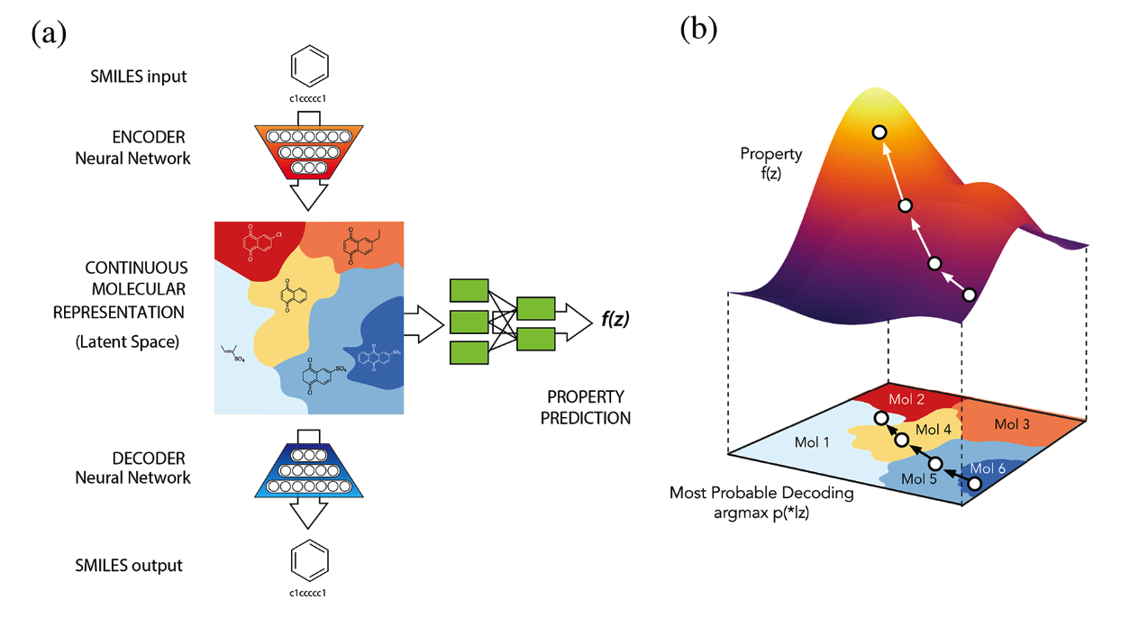
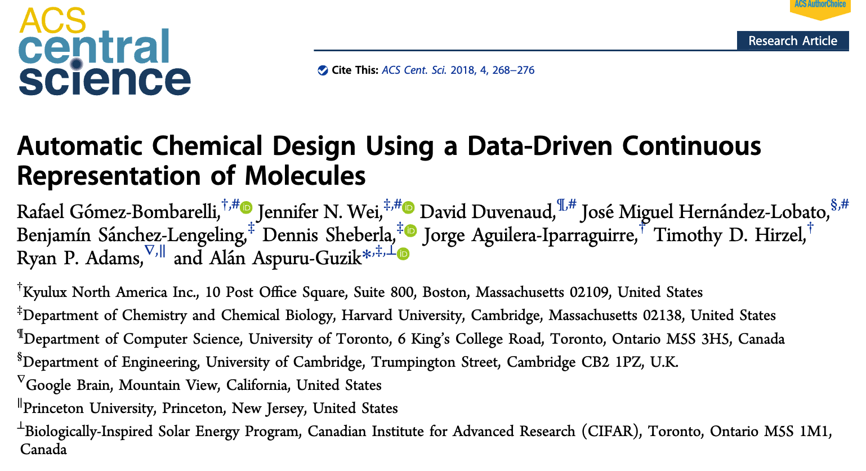
Example of generative models in Molecular Science

Slide 6
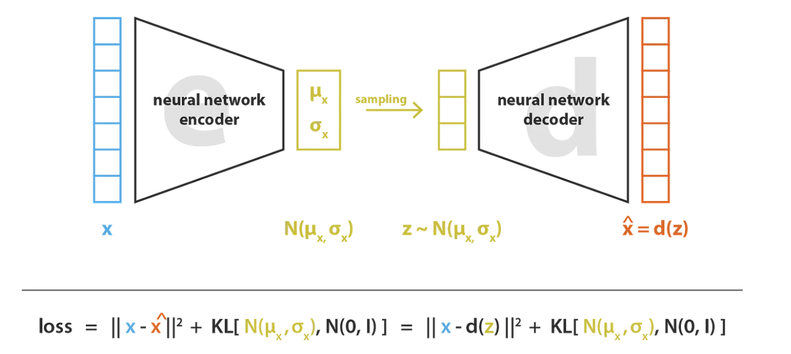
Autoencoder vs variational autoencoder
Regularization in the form of the Kullback-Leibler divergence -> this induces better organization in the latent space
https://towardsdatascience.com/understanding-variational-autoencoders-vaes-f70510919f73

Slide 7
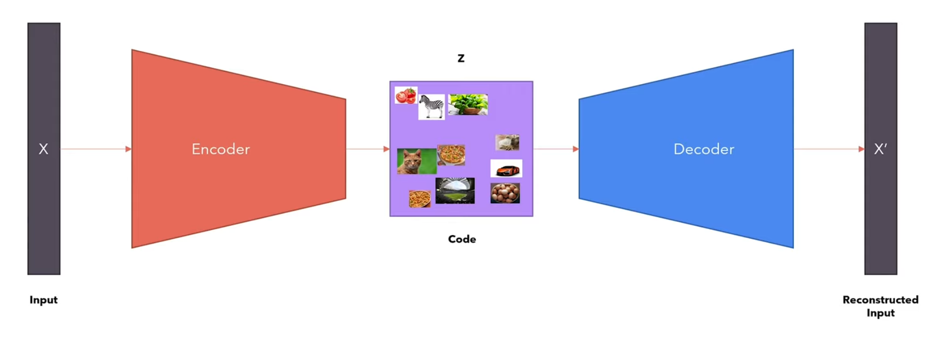
Autoencoder
https://www.youtube.com/watch?v=iwEzwTTalbg
Notes:
What make good autoencoder?
Dimension of z as small as possible, and reconstructed input should be as close as possible to original input

Slide 8
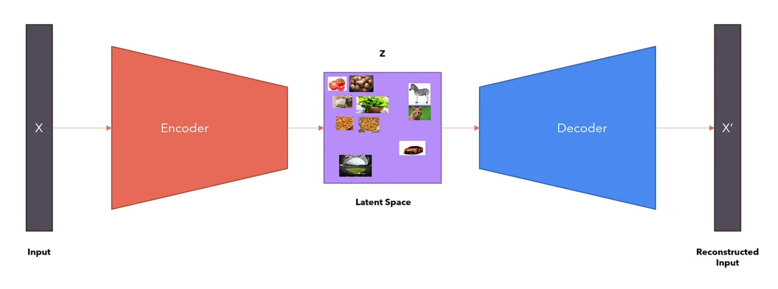
Variational Autoencoder
https://www.youtube.com/watch?v=iwEzwTTalbg

Slide 9
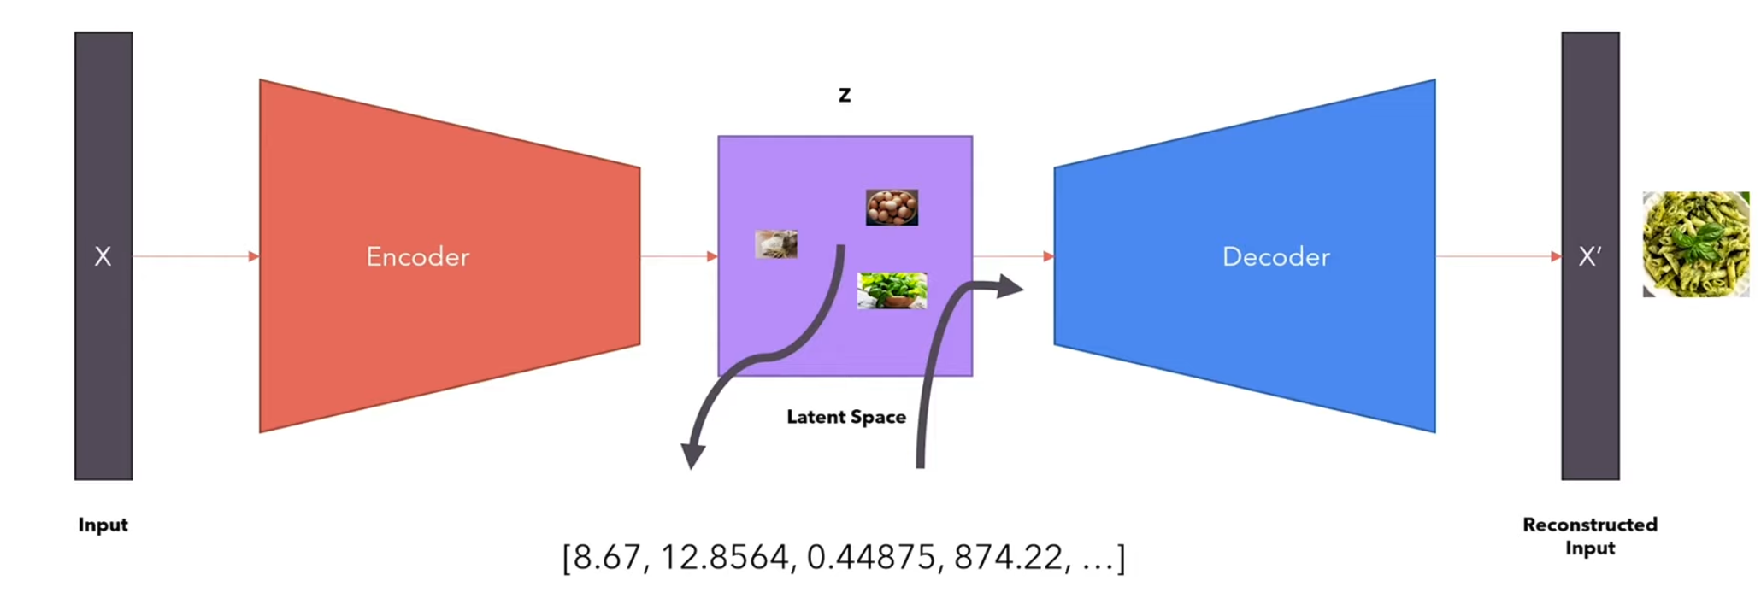
Sampling the latent space
https://www.youtube.com/watch?v=iwEzwTTalbg

Slide 10
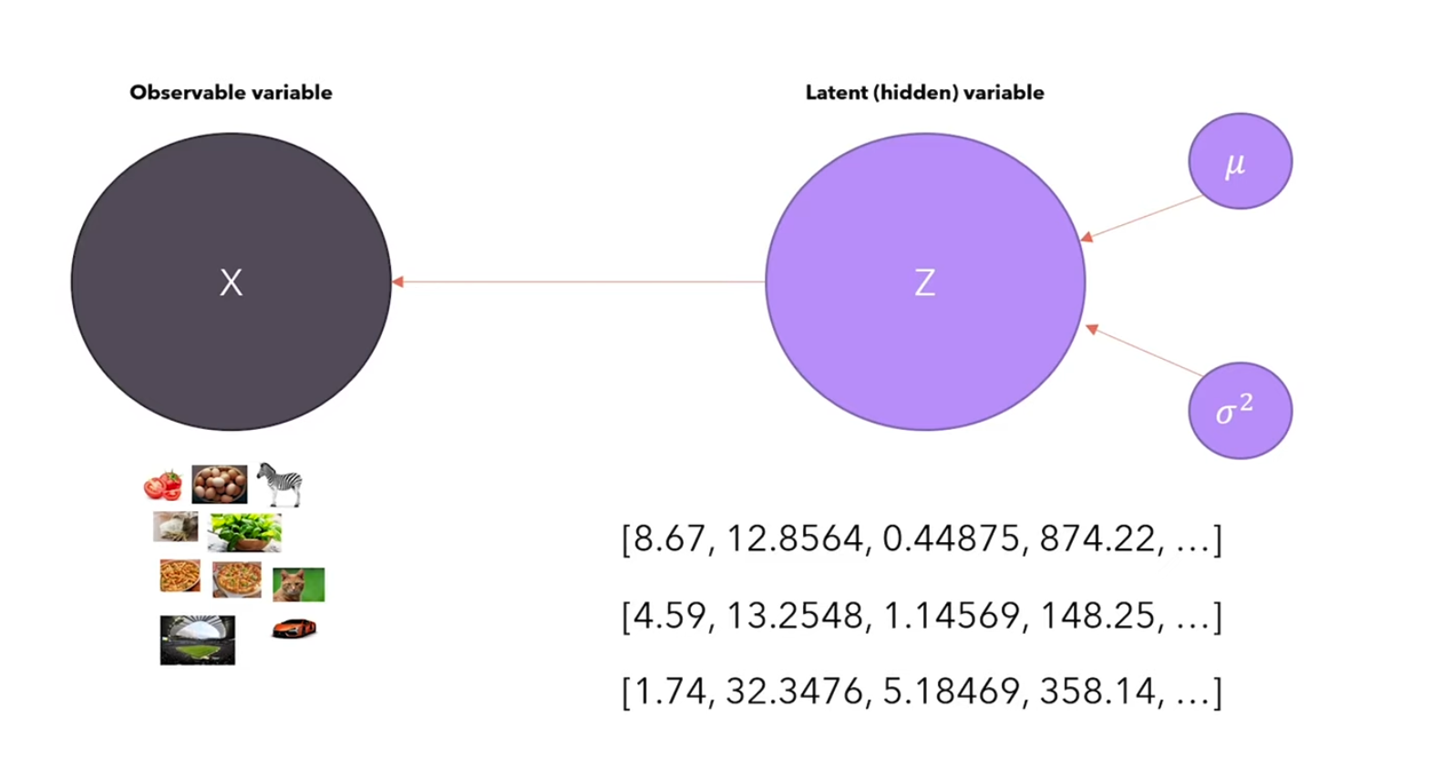
Distributions in the latent space
https://www.youtube.com/watch?v=iwEzwTTalbg
Notes:
Data is coming from variable X that we can observe. Variable is conditioned on another variable Z that is not visible to use, that is hidden

Slide 11
Math

Slide 12
VAE notebook

Slide 13
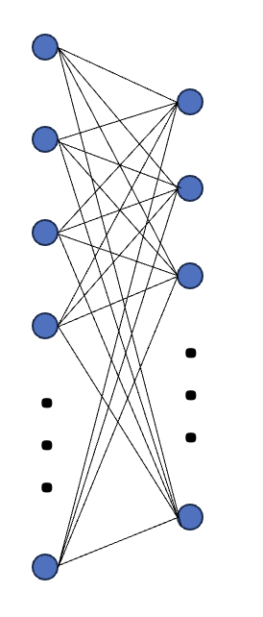
VAE Schematic
. . .
. . .
. . .
. . .
. . .
. . .
. . .
. . .
. . .
. . .
latent_dim
hidden_units
input_dim
num_layers

Slide 14
Bead-Spring Polymer Model
Used to simulate polymer dynamics
Approximate distance between ends of a polymer as springs
Model larger polymer as sequence of smaller polymers which individually act as springs

Slide 15
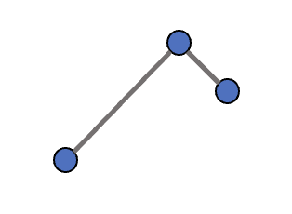
Translation and Rotation Invariance:
Rotating/translating data should not affect predictions:
y
y
x
x
Align data
Align data
y
y
x
x

Slide 16
Considerations when generating molecules
Lack of benchmarks for generated molecule validity, synthesizability, uniqueness, diversity
Synthesizability scores
Representation considerations
Generative model vs genetic algorithm vs enumeration vs high throughput screening…etc

