Slide 1
Generative models and Variational Autoencoders (Part 2)
Shuwen Yue
Assistant Professor, Cornell University
May 2, 2025

Slide 2
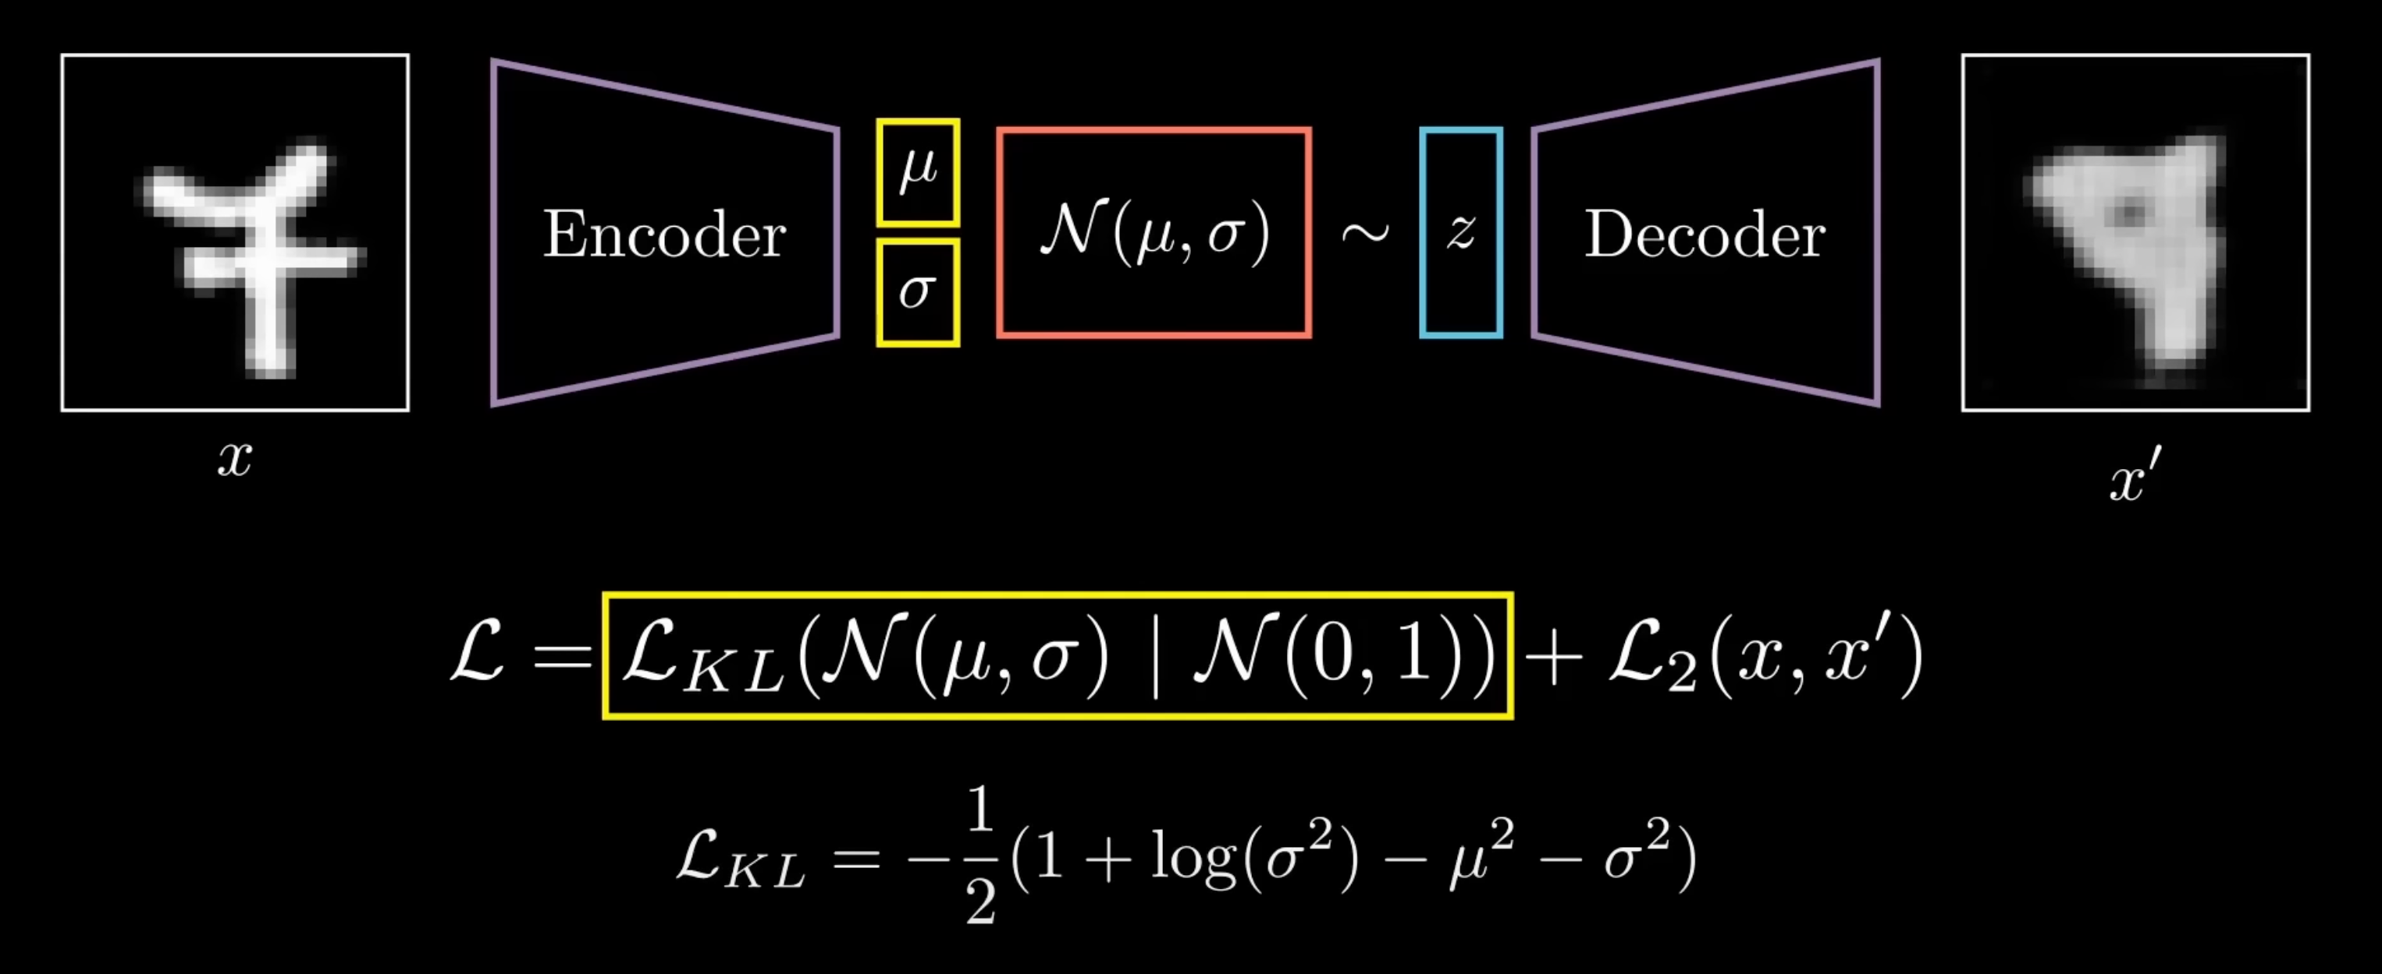
https://www.youtube.com/watch?v=qJeaCHQ1k2w
Notes:
Encoder maps to 2 outputs -> mean and standard deviation -> these parameterize a gaussian distribution in latent space
Decoder samples z, and reconstructions an output x’
Define varaibles: x: your molecule (e.g., SMILES or graph)
zz: a vector representing high-level chemical structure
x′x′: reconstructed molecule — ideally valid and chemically similar
KL ensures smooth sampling space (good for generation)
Reconstruction ensures accuracy and chemical validity

Slide 3
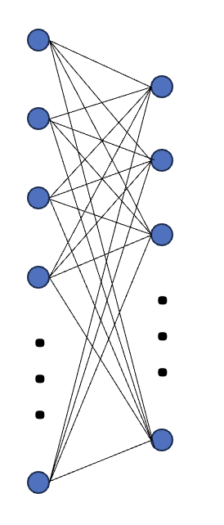
VAE Schematic
. . .
. . .
. . .
. . .
. . .
. . .
. . .
. . .
. . .
. . .
latent_dim
hidden_units
input_dim
num_layers

Slide 4
Bead-Spring Polymer Model
Used to simulate polymer dynamics
Approximate distance between ends of a polymer as springs
Model larger polymer as sequence of smaller polymers which individually act as springs

Slide 5
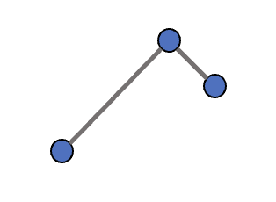
Translation and Rotation Invariance:
Rotating/translating data should not affect predictions:
y
y
x
x
Align data
Align data
y
y
x
x

