Slide 1
Content Provider
Members:
Faiqa Iftikhar (17L-4264)
Sameen Akram (17L-4261)
Areej Afzaal (17L-4189)
Noor-Ul-Ain Haider (17L-6325)

Slide 2
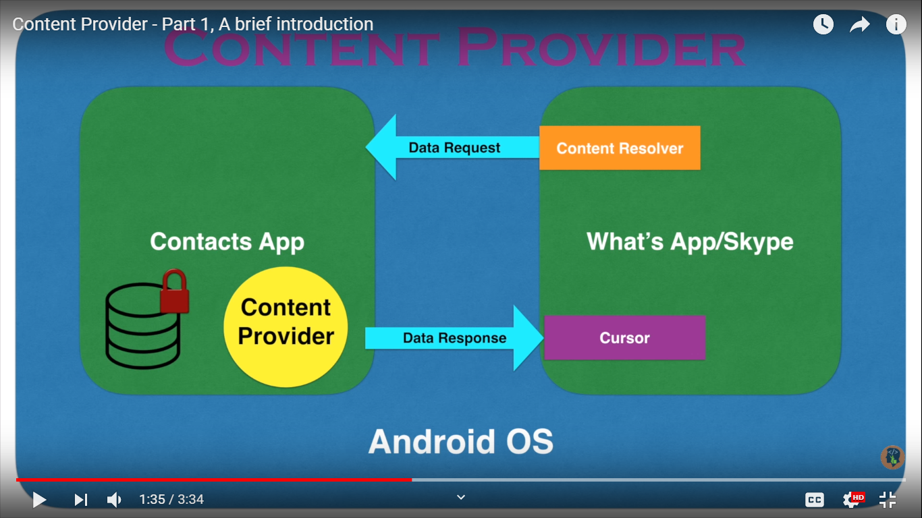
What is content Provider?
Supplies data from one application to others on request.
Requests are handled by the methods of the ContentResolver class.
Results are in a format called Cursor.
Uses different ways to store its data.

Slide 3
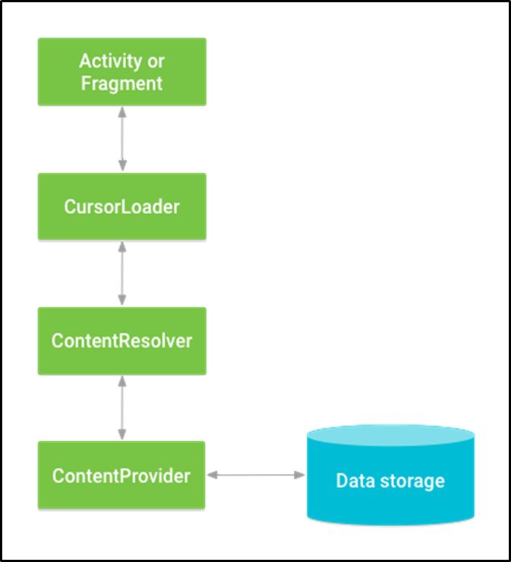
What is Content Resolver?
ContentResolver is used to select the right ContentProvider based on the ContentUris.
The ContentResolver object communicates with the provider object—an instance of a class that implements ContentProvider.
It provides the same methods as content provider.

Slide 4
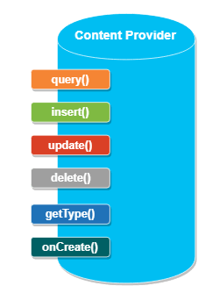
Methods of Content Provider
query() - It receives a request from the client. By using arguments it will get a data from requested table and return the data as a Cursor object.
insert() - This method will insert a new row into our content provider and it will return the content URI for newly inserted row.
update() - This method will update an existing rows in our content provider and it return the number of rows updated.
delete() - This method will delete the rows in our content provider and it return the number of rows deleted.
getType() - This method will return the MIME type of data to given content URI.
onCreate() - This method will initialize our provider. The android system will call this method immediately after it creates our provider.

Slide 5
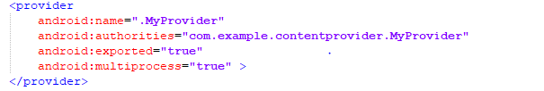
Content Provider App (1st app)
This is the app that inputs data, save in database and create a content provider
We need to create a content provider class that extends the ContentProvider base class.
We need to define our content provider URI to access the content.
Implement six abstract methods (insert(), update(), delete(), query(), getType())
We need to register our content provider in AndroidManifest.xml using <provider> tag.

Slide 6
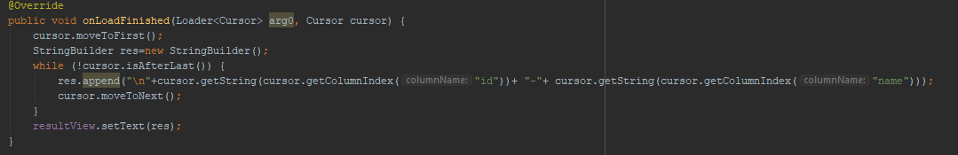
MyUser App(Second app)
This class requests for data and displays it.
Activity implements LoaderManager
Here a cursorLoader object is created.
Upon clicking the display button following methods are called.

Slide 7
~Thank You!~

