Slide 1
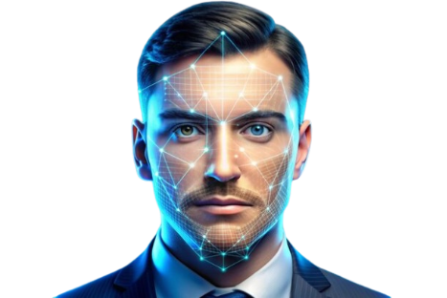
Home
Service
About Us
Contact
EMOTION Recognition
USING FACIAL EXPRESSIONS
Project Deep Learning
01

Slide 2

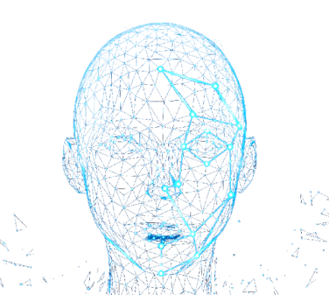

Home
Service
About Us
Contact
Introduction
Facial expression analysis is an advanced field in artificial intelligence, and it can be used to accurately recognize human emotions. This field has wide applications in areas such as security, healthcare, and entertainment. The emotion recognition project using deep learning aims to develop a system capable of identifying human emotions through facial expression analysis. The project relies on deep learning techniques to process images and extract features that distinguish each facial expression. A deep neural network model is trained on a large dataset to classify emotions such as happiness and sadness.
Project Objectives
Leverage Pre-Trained Models:
Pre-trained models such as ResNet-50 and EfficientNet were utilized for emotion recognition tasks.
These models were effectively applied to the dataset, achieving high in classifying emotions.
Develop a Custom Convolutional Neural Network (CNN):
A custom CNN was specifically designed and trained for emotion recognition.
The architecture was tailored to the dataset, addressing the unique characteristics of facial expression data and improving classification performance.
02

Slide 3
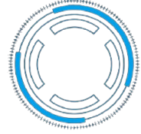

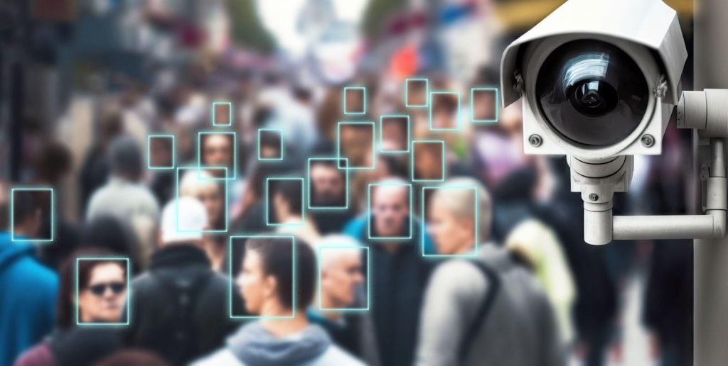
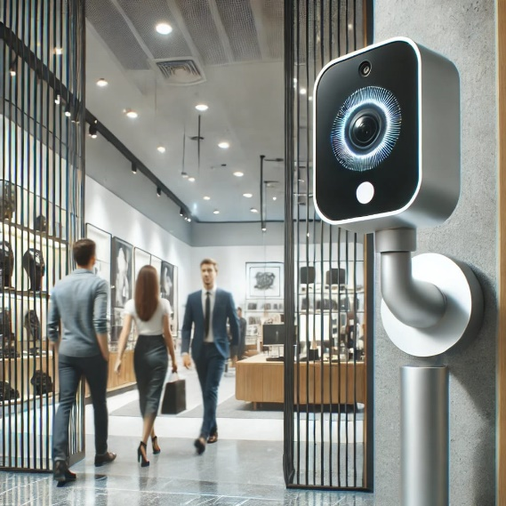
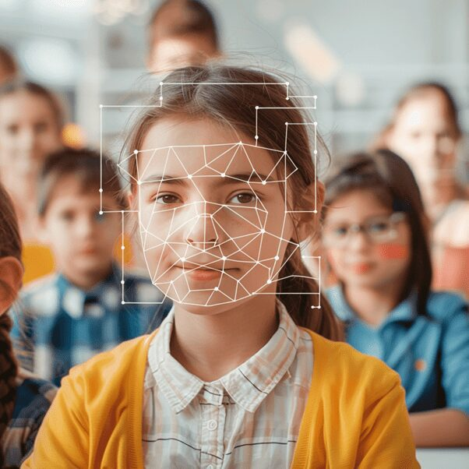
Home
Service
About Us
Contact
Applications
Mental Health
Education
Safety, Surveillance
Customer Experience
03

Slide 4

Home
Service
About Us
Contact
Applications
Deep learning supports mental health using facial recognition models.
It detects expressions of sadness, anxiety, and depression.
Analyzes facial features to understand emotional states.
Sends alerts or suggests seeking help when needed.
Acts as a preventive tool for mental health.
Mental Health

Slide 5
Home
Service
About Us
Contact
Applications
Deep learning monitors for stress, discomfort, or suspicious behavior.
Facial expression analysis detects emotional distress or unusual actions.
Real-time alerts are sent to security for investigation.
Proactive approach enhances safety with immediate behavioral insights.
Safety, Surveillance

Slide 6
Home
Service
About Us
Contact
Applications
Retailers can use deep learning to monitor facial expressions while shopping.
Analyzing emotions like happiness or frustration helps improve customer service.
Store design, displays, and sales strategies can be adjusted based on emotional insights.
This analysis enhances marketing strategies and customer satisfaction.
Customer Experience

Slide 7
Home
Service
About Us
Contact
Applications
Deep learning with CNNs detects emotional cues from students' faces.
Identifies expressions of attention, boredom, confusion, or engagement.
Provides real-time feedback to teachers on student engagement.
Enables personalized and adaptive teaching methods.
Education

Slide 8

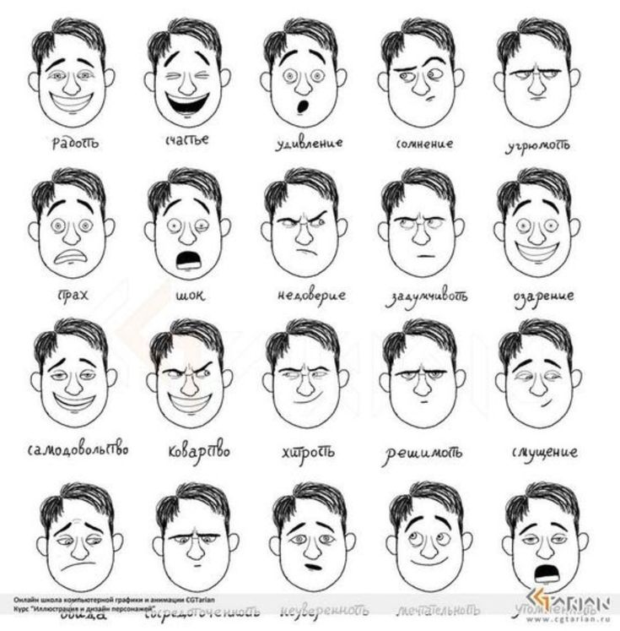
Home
Service
About Us
Contact
Dataset Overview: 5000 images for classifying human facial expressions.
Image Analysis: Tools like OpenCV or PIL are used to analyze the class distribution.
Categorical Distribution: Divided into six classes: Angry, Fear, Happy, Neutral, Sad, Surprise.
Dataset Description
Image Organization: Images stored in .jpg format, organized in folders for Train, Test, and Validation sets.
Dataset Structure:
Training (Train): Used to train the model.
Testing (Test): Used to evaluate the model's performance.
Validation: Used to fine-tune parameters during training.
AI Model Development: Model is trained with the training set, fine-tuned with the validation set, and evaluated on the test set.
08

Slide 9
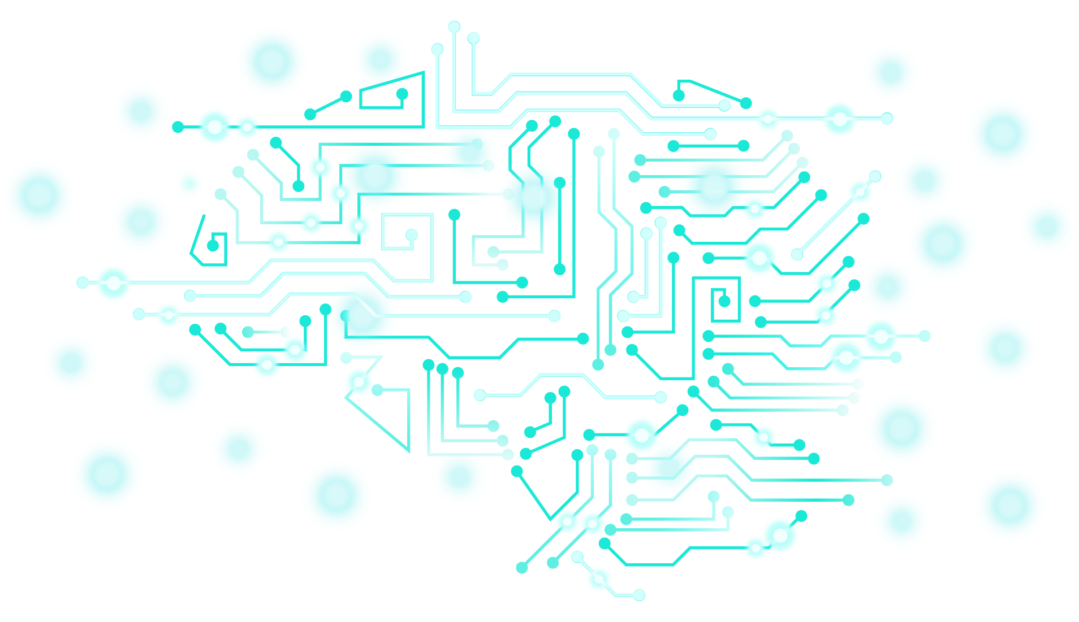
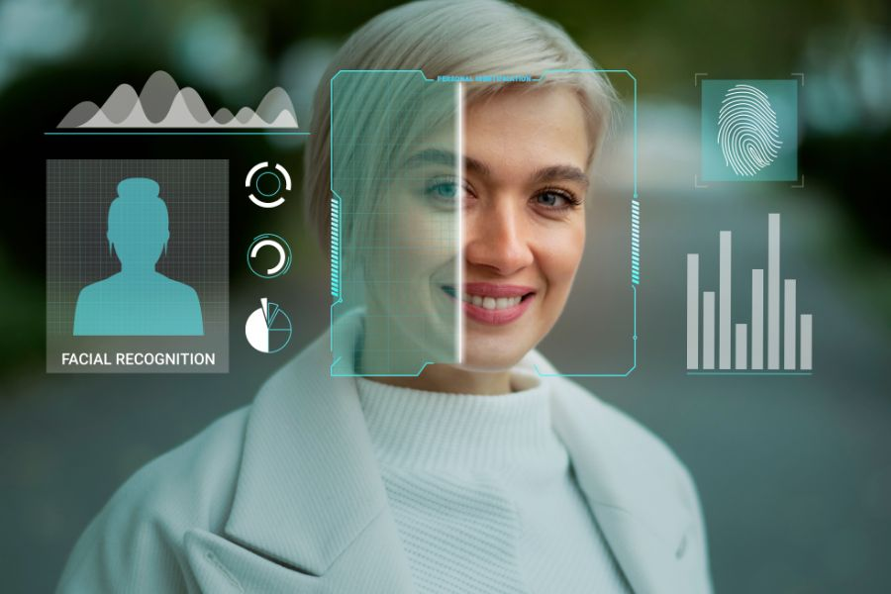
EfficientNet-B0
Home
Service
About Us
Contact
Architecture:
Techniques Used:
The EfficientNet-B0 model is based on compound scaling techniques that balance the model's depth, width, and image resolution. It is highly efficient, achieving strong performance with limited resources compared to traditional models.
Fine-Tuning: The base layers responsible for general feature extraction were frozen to reduce the need for full model training. The final layer was customized to fit the six categories.
Significance: Reduces training time and leverages pre-extracted features.
Dropout: A 50% dropout layer was added to the final classification layer.
Significance: Reduces overfitting by randomly deactivating some connections during training.
Learning Rate Scheduler: ReduceLROnPlateau was used to dynamically reduce the learning rate when performance plateaus.
Significance: Prevents resource wastage on inefficient learning rates.
Optimization Using Adam: Combines the advantages of SGD and RMSProp for stable and fast gradients.
Significance: Enhances the speed of convergence to optimal solutions.
09

Slide 10
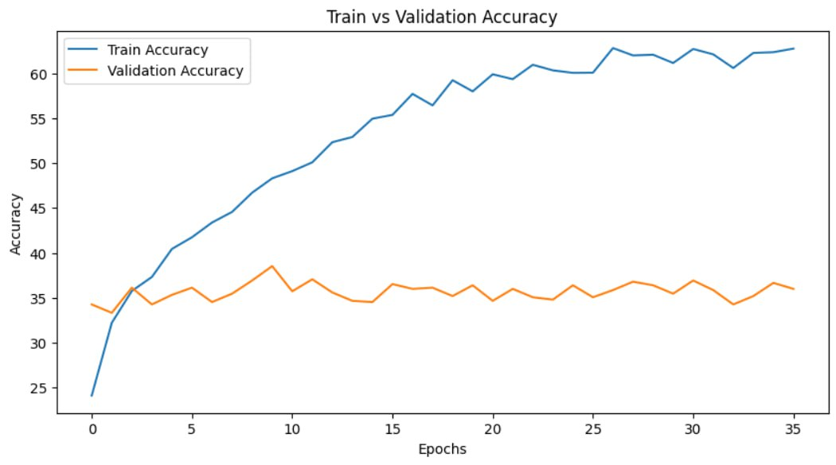
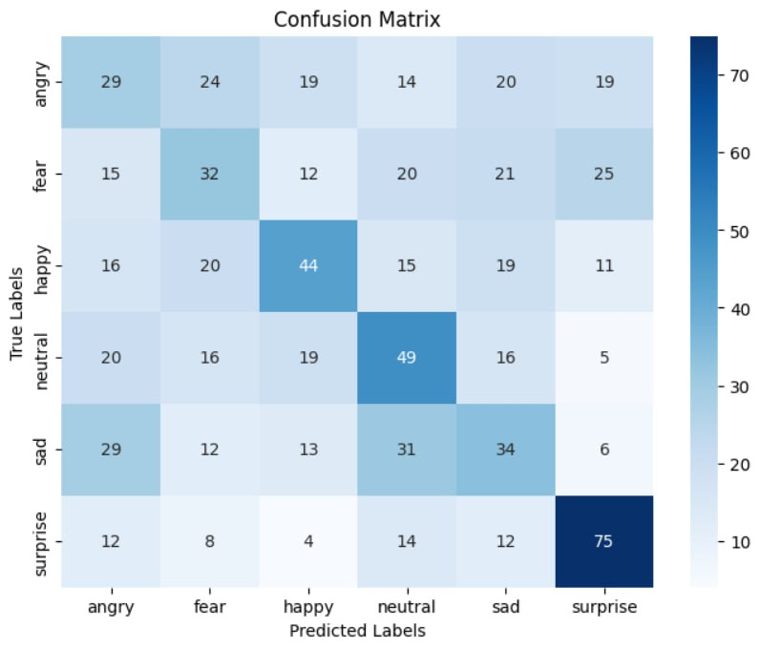
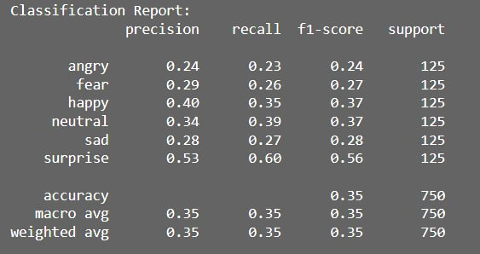
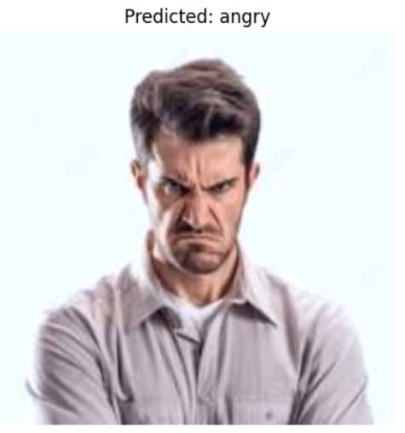
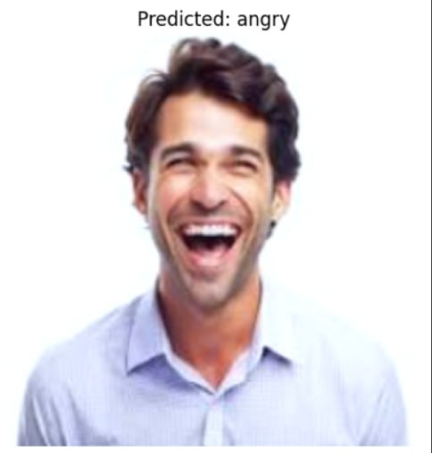
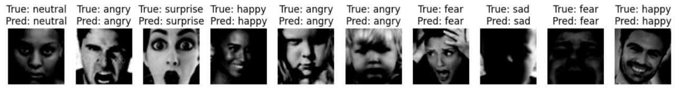
EfficientNet-B0
Home
Service
About Us
Contact
Results:
Train Acc:
62.75%
Val Acc:
36.00%
Test Acc:
35.07%
10

Slide 11
EfficientNet-B0
Home
Service
About Us
Contact
Results:

Slide 12
EfficientNet-B0
Home
Service
About Us
Contact
Results:

Slide 13
EfficientNet-B0
Home
Service
About Us
Contact
Results:

Slide 14
EfficientNet-B0
Home
Service
About Us
Contact
Results:

Slide 15
EfficientNet-B0
Home
Service
About Us
Contact
Results:

Slide 16
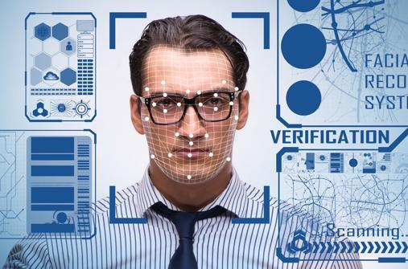
ResNet-50
Home
Service
About Us
Contact
Architecture:
Techniques Used:
ResNet-50 is based on residual connections that allow training very deep networks without facing gradient vanishing issues. The model consists of 50 layers, making it robust in extracting complex features.
Residual Connections: Enable information bypassing between layers, preventing gradient vanishing.
Significance: Helps train deep models efficiently.
Fine-Tuning: Early layers were frozen, and deeper layers (layer2, layer3, layer4) were retrained.
Significance: Improves model accuracy while reducing computational costs.
Dropout: Added at 70% after the pooling layer.
Significance: Reduces overfitting.
Learning Rate Scheduler: Dynamically schedules the learning rate to gradually decrease upon performance stabilization.
Optimization Using Adam: Added for stable training and faster gradients.
Data Augmentation: Similar techniques to Custom CNN with slight adjustments in transformation intensity.
Significance: Enhances generalization capability.
11

Slide 17
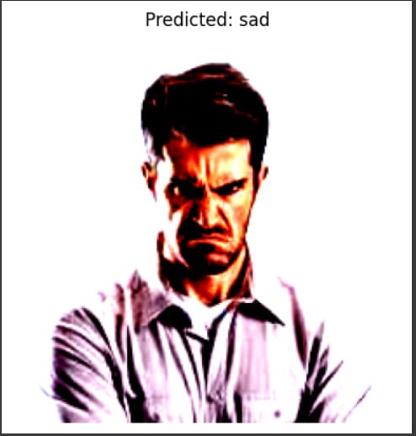
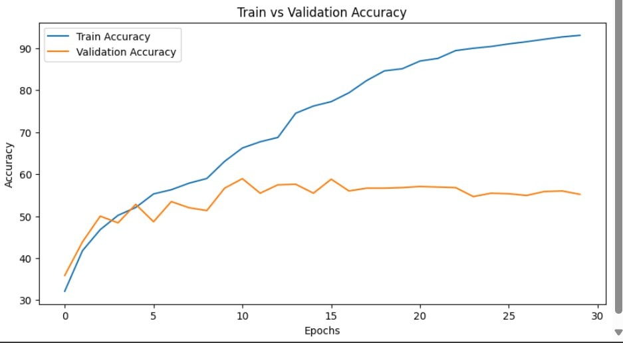
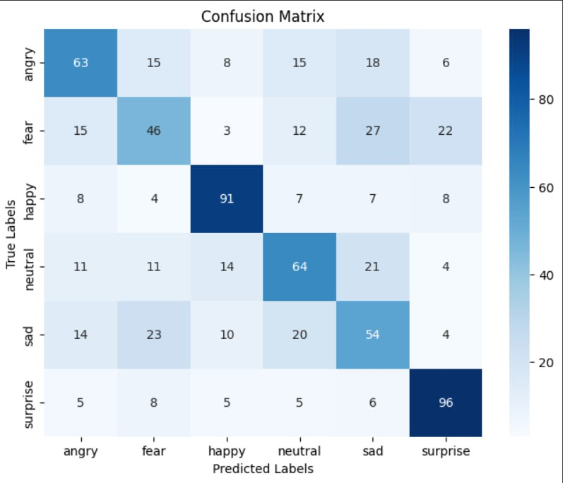
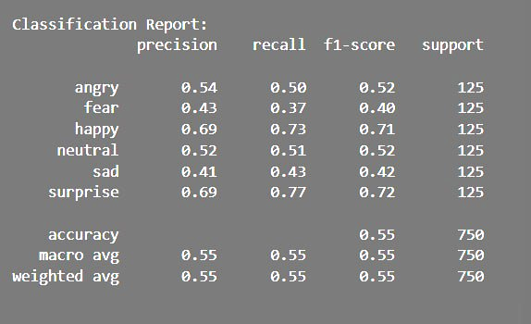
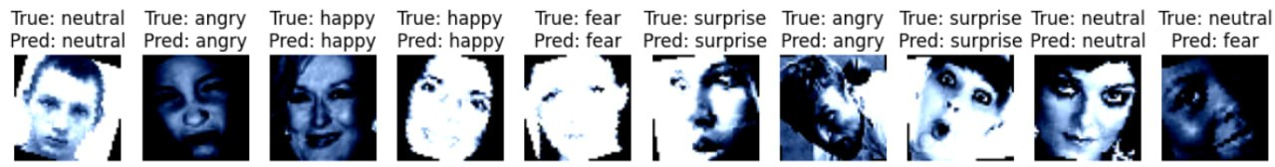
ResNet-50
Home
Service
About Us
Contact
Results:
Train Acc:
93.20%
Val Acc:
55.20%
Test Acc:
55.20%
12

Slide 18
ResNet-50
Home
Service
About Us
Contact
Results:

Slide 19
ResNet-50
Home
Service
About Us
Contact
Results:

Slide 20
ResNet-50
Home
Service
About Us
Contact
Results:

Slide 21
ResNet-50
Home
Service
About Us
Contact
Results:

Slide 22
ResNet-50
Home
Service
About Us
Contact
Results:
12

Slide 23
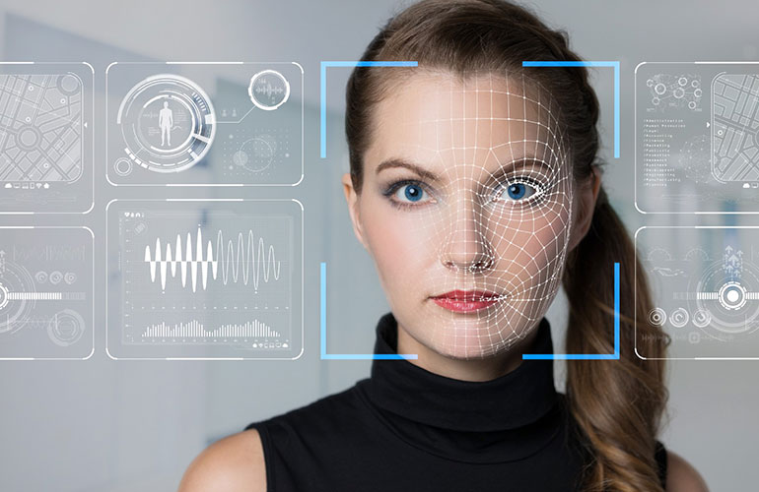
Custom CNN
Home
Service
About Us
Contact
Architecture:
Techniques Used:
A custom convolutional neural network consisting of three convolutional layers with batch normalization, global average pooling (GAP), and two fully connected layers with a 50% dropout.
Significance: Offers flexibility for experimenting with layer numbers and kernel sizes.
Data Augmentation: Random rotation, cropping, horizontal flipping, and color jittering were applied.
Significance: Increases data diversity and reduces overfitting.
Batch Normalization: Added after each convolutional layer to accelerate training and improve model stability.
Significance: Reduces dependency on initial parameter values and speeds up convergence.
Global Average Pooling: Replaces flattening layers to summarize features in each channel.
Significance: Reduces parameter count and the risk of overfitting
Dropout: Applied at 50% in the final layers.
Significance: Minimizes overfitting.
13

Slide 24
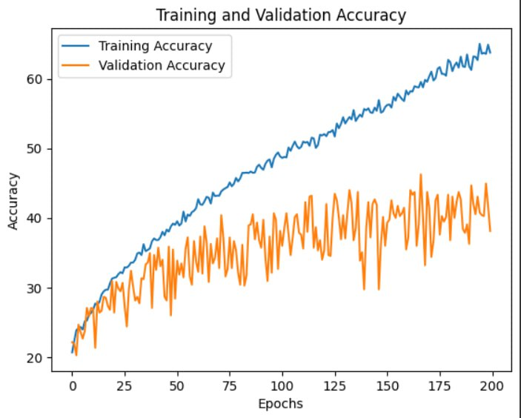
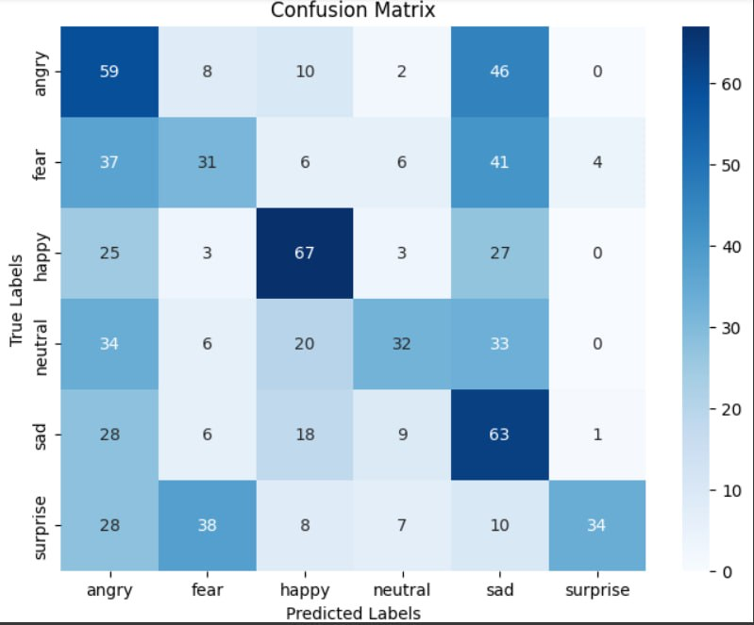

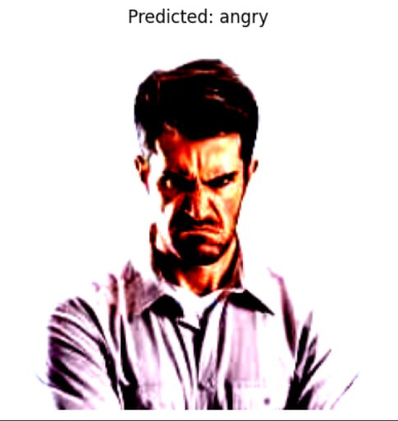
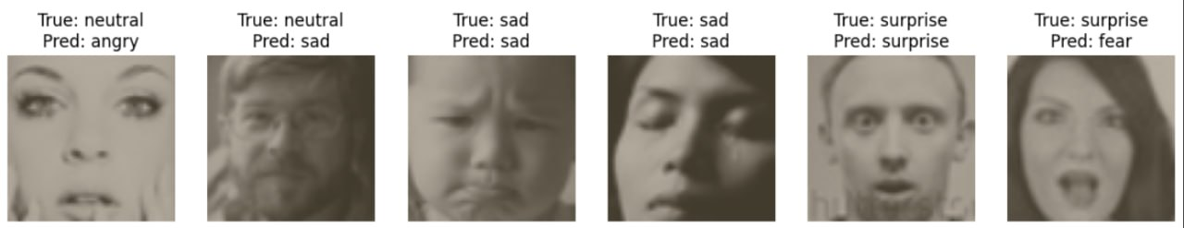
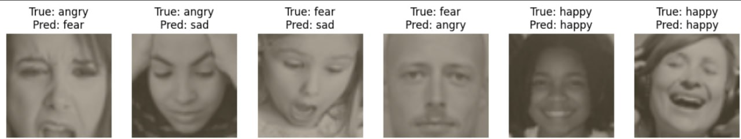
Custom CNN
Home
Service
About Us
Contact
Results:
Train Acc:
63.75%
Val Acc:
38.13%
Test Acc:
38.53%
14

Slide 25
Custom CNN
Home
Service
About Us
Contact
Results:
14

Slide 26
Custom CNN
Home
Service
About Us
Contact
Results:
14

Slide 27
Custom CNN
Home
Service
About Us
Contact
Results:
14

Slide 28
Custom CNN
Home
Service
About Us
Contact
Results:
14

Slide 29
Custom CNN
Home
Service
About Us
Contact
Results:
14

Slide 30
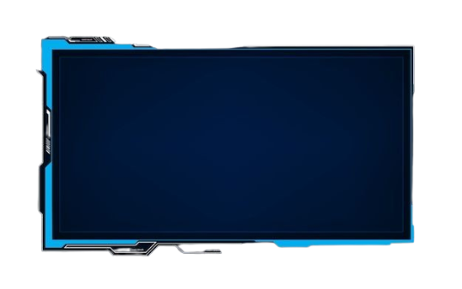
Home
Service
About Us
Contact
comparison
MODEL | Key Techniques Used | Training Accuracy | Validation Accuracy | Test Accuracy | Epoch | Observations
EfficientNet-B0 | Fine-Tuning, Dropout, Learning Rate Schedule, Adam Optimizer, Data Augmentation | 62.75% | 36.00% | 35.07% | 36 | Excellent balance between performance and size.
Custom CNN | Data Augmentation, BatchNorm, GAP, Back propagation, Dropout | 63.75% | 38.13% | 38.53% | 200 | Acceptable performance with a simple designedited
ResNet-50 | Residual Connections, Fine-Tuning, Dropout, Adam Optimizer, ReduceLROnPlateau | 95.20% | 55.20% | 55.20% | 30 | Strong feature extraction, prone to overfitting.
15

Slide 31
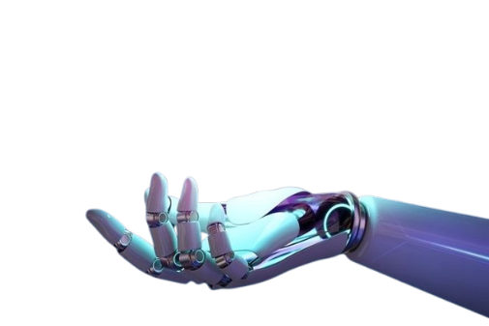
Home
Service
About Us
Contact
Challenges and Future Work
Challenges :
The quality of the dataset requires improving the image quality and the way they are distributed across the classes.
Overfitting: Evident in ResNet-50 despite using Dropout.
Resource Constraints: EfficientNet required large memory, limiting the number of possible experiments
Future Work :
Enhanced Data Augmentation: Explore more comprehensive techniques to balance classes.
(Ensemble Models): Explore the possibility of combining the advantages of EfficientNet and ResNet-50 to improve performance.
Emotion Intensity Classification: This approach focuses on determining the level of intensity of emotions.
16

Slide 32

Home
Service
About Us
Contact
In conclusion
Facial expression recognition is a groundbreaking advancement in modern technology, enabling smart systems to read and understand human expressions in ways that address our needs. With continuous progress, this technology opens new doors to improve our lives in fields such as education, healthcare, and interactive technology, making it an essential part of a more advanced and innovative future.
Despite the challenges related to accuracy and privacy concerns, the work on developing these technologies opens new horizons toward a future where technology becomes a true partner that understands our emotions and meets our needs.
17

Slide 33
Home
Service
About Us
Contact
Thank you
By Team:
Huda shqerat
Areen Alakaleek
Lujain toma
We would like to express our sincere gratitude to Dr. [Rasha Obeidat]
for her valuable guidance and support.
In conclusion
Facial expression recognition is a groundbreaking advancement in modern technology, enabling smart systems to read and understand human expressions in ways that address our needs. With continuous progress, this technology opens new doors to improve our lives in fields such as education, healthcare, and interactive technology, making it an essential part of a more advanced and innovative future.
Despite the challenges related to accuracy and privacy concerns, the work on developing these technologies opens new horizons toward a future where technology becomes a true partner that understands our emotions and meets our needs.
17

