Slide 1


A PRACTICAL GUIDE FOR AI AGENTS
Context Graph
vs
Knowledge Graph
One maps what is known.
The other assembles what matters now.
Swipe →
01 / 10
Notes:
[Sources]
- https://arxiv.org/html/2003.02320
- https://www.ibm.com/think/topics/context-graph
- https://github.com/AreevAI/areev/blob/main/README.md
The term context graph is emerging and is defined operationally in slide 2.

Slide 2
START WITH THE JOB
They answer different questions.
KNOWLEDGE GRAPH
CONTEXT GRAPH
What exists - and how is it connected?
What matters now - for this task, policy, and time?
ENTITIES
RELATIONSHIPS
FACTS
INTENT
STATE
EVIDENCE + CONSTRAINTS
'Context graph' is an emerging term. Here, it means the execution-time view an agent acts from.
02 / 10
Notes:
[Sources]
- https://arxiv.org/html/2003.02320
- https://arxiv.org/abs/2406.11160
- https://www.ibm.com/think/topics/context-graph
- https://www.w3.org/groups/cg/context-graph/

Slide 3
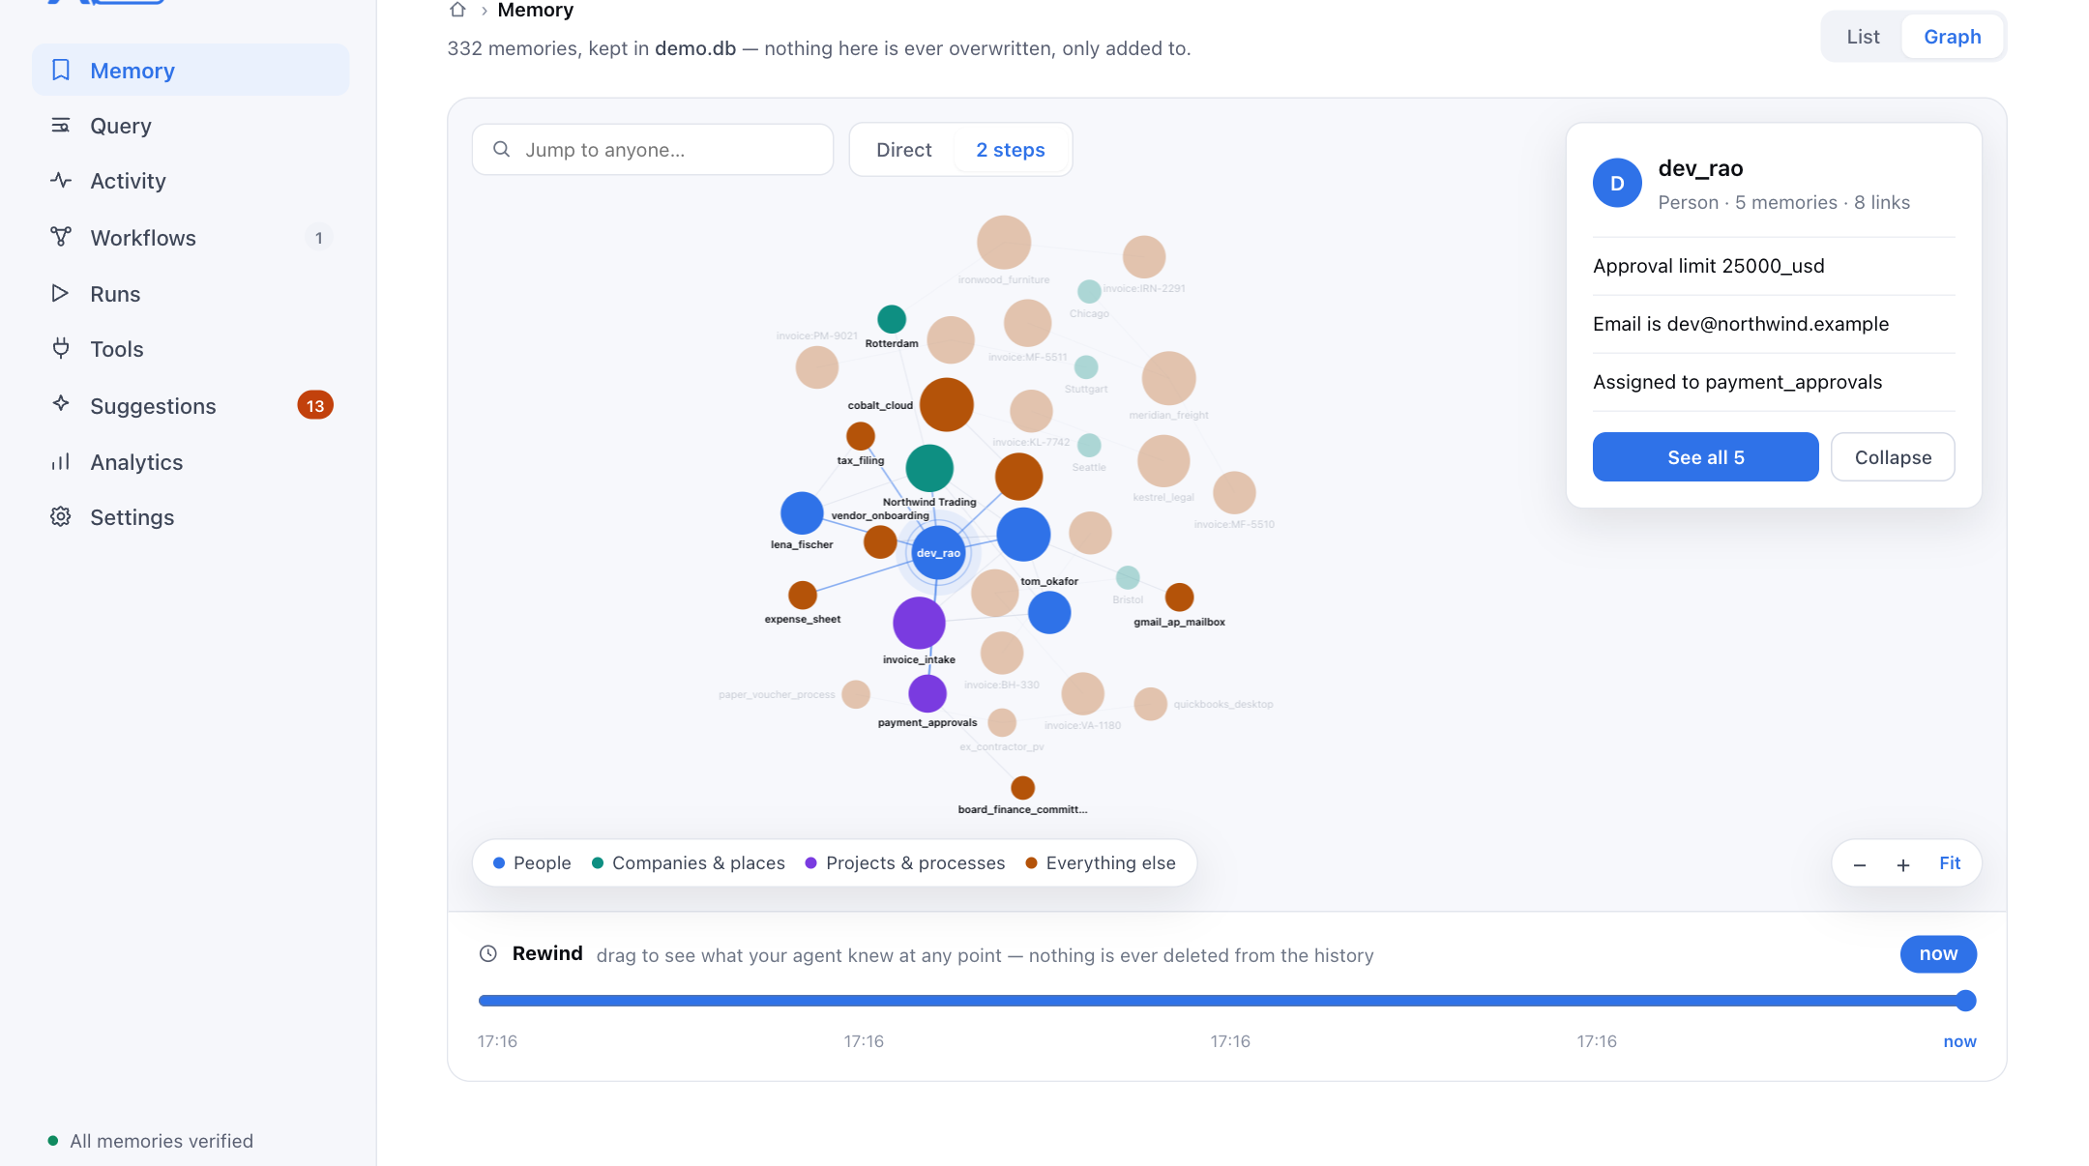
THE DURABLE MAP
Knowledge graphs make meaning durable.
Entities + relationships + typed facts
QUERY THE CONNECTIONS
Walk the graph.
Rewind the history.
Good for integration, discovery, analytics, recommendations, and multi-hop reasoning.
03 / 10
Notes:
[Sources]
- https://arxiv.org/html/2003.02320
- https://github.com/AreevAI/areev/blob/main/README.md
- /Users/sathish/mg/products/areev/demo/screens/graph-light.png

Slide 4
WHERE FACTS STOP BEING ENOUGH
An action depends on more than the domain map.
TIME
PROVENANCE
Which version is valid now?
Where did this belief come from?
STATE
AUTHORITY
What happened in this run?
Who may approve this action?
The same fact can be relevant, stale, forbidden - or too costly to include.
04 / 10
Notes:
[Sources]
- https://arxiv.org/html/2003.02320
- https://arxiv.org/abs/2406.11160
- https://www.ibm.com/think/topics/context-graph
- https://foundationcapital.com/ideas/context-graphs-ais-trillion-dollar-opportunity

Slide 5
THE RUNTIME VIEW
A context graph adds the situation around the facts.
CONTEXT GRAPH
Execution-time activation layer
CURRENT TASK
HISTORY + TIME
What is the goal?
What changed?
KNOWLEDGE
GRAPH
EVIDENCE
WORKFLOW
Why believe it?
Where are we?
PERMISSIONS
BUDGET
What is allowed?
What can fit?
Not a second graph database. A decision-ready view.
05 / 10
Notes:
[Sources]
- https://arxiv.org/abs/2406.11160
- https://www.ibm.com/think/topics/context-graph
- https://foundationcapital.com/ideas/context-graphs-ais-trillion-dollar-opportunity
- https://github.com/AreevAI/areev/blob/main/README.md

Slide 6
SIDE BY SIDE
The difference is purpose - not storage technology.
LENS
KNOWLEDGE GRAPH
CONTEXT GRAPH
PRIMARY JOB
Represent durable meaning
Assemble situational relevance
TYPICAL UNIT
Entity-relation-entity fact
Contextualized fact, event, or trace
HORIZON
Long-lived domain memory
This task, turn, or run
EDGES EMPHASIZE
Semantic relationships
Temporal, causal, operational, policy
OUTPUT
Queryable subgraph
Budget-shaped context for a decision
Both can live in the same underlying graph and store.
06 / 10
Notes:
[Sources]
- https://arxiv.org/html/2003.02320
- https://arxiv.org/abs/2406.11160
- https://www.ibm.com/think/topics/context-graph

Slide 7
ILLUSTRATIVE EXAMPLE
Should the agent pay this invoice?
THE KNOWLEDGE GRAPH KNOWS
THE CONTEXT GRAPH ADDS
•
Acme is an approved vendor
→
Bank details changed yesterday
•
Invoice total is $24,700
→
A prior run flagged a mismatch
•
Dev is the approver
→
Dev's credential is valid now
•
Approval limit is $25,000
→
The workflow is waiting on review
Same knowledge. Different action: hold and escalate.
07 / 10
Notes:
[Sources]
- https://arxiv.org/html/2003.02320
- https://www.ibm.com/think/topics/context-graph
- https://github.com/AreevAI/areev/blob/main/README.md
Illustrative scenario. It demonstrates how operational context can change an action without changing the underlying facts.

Slide 8
FROM MEMORY TO ACTION
Retrieval finds candidates. Context assembly makes the call.
01
RECALL
Lexical, semantic, structural, graph
↓
02
FILTER
Time, policy, provenance, permissions
↓
03
RANK
Task relevance, priority, diversity
↓
04
SHAPE
Fit the model's token budget
MODEL-READY CONTEXT → ACTION → NEW EVIDENCE
08 / 10
Notes:
[Sources]
- https://www.ibm.com/think/topics/context-graph
- https://github.com/AreevAI/areev/blob/main/README.md

Slide 9
A PRACTICAL RULE
Use both when the system can act.
SEARCH + DISCOVERY
DECISIONS + ACTIONS
A knowledge graph may be enough.
Add a context graph.
Catalogs
Enterprise search
Analytics
Recommendations
Agents
Workflow automation
Approvals
Triggers + tools
The higher the consequence, the more context must be explicit.
09 / 10
Notes:
[Sources]
- https://www.ibm.com/think/topics/context-graph
- https://foundationcapital.com/ideas/context-graphs-ais-trillion-dollar-opportunity
- https://github.com/AreevAI/areev/blob/main/README.md

Slide 10


THE TAKEAWAY
Store facts as a
knowledge graph.
Run agents on a
context graph.
See the implementation. Run the demo.
★ Star Areev on GitHub
github.com/AreevAI/areev
10 / 10
Notes:
[Sources]
- https://arxiv.org/html/2003.02320
- https://www.ibm.com/think/topics/context-graph
- https://github.com/AreevAI/areev/blob/main/README.md
- https://github.githubassets.com/images/modules/logos_page/GitHub-Mark.png

