Slide 1
Efficient Graph-Based Image Segmentation
Authors: P. F. Felzenszwalb and D. P. Huttenlocher
Present by: Aref Moqadam Mehr

Slide 2
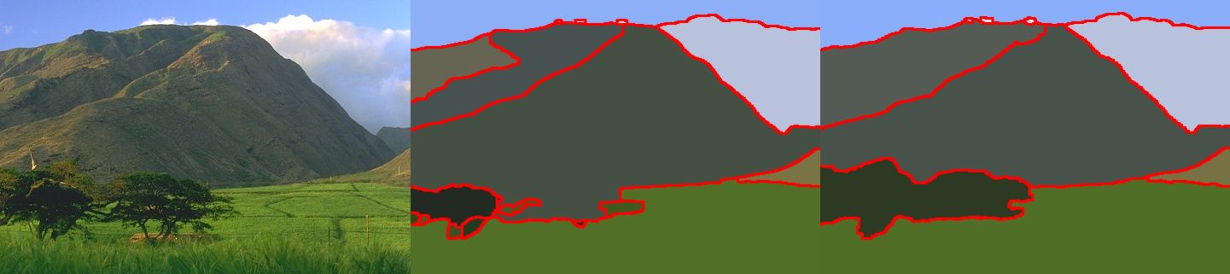
What is Image Segmentation?
Partitioning pixels
Collectively cover entire image

Slide 3
Where can Segmentation be used?
Machine Vision
Object Detection
Medical Imaging
Content-based Image Retrieval

Slide 4
Related Works
Tresholding
Clustering
Histogram-Based methods
Edge Detection
Graph-Based methods

Slide 5
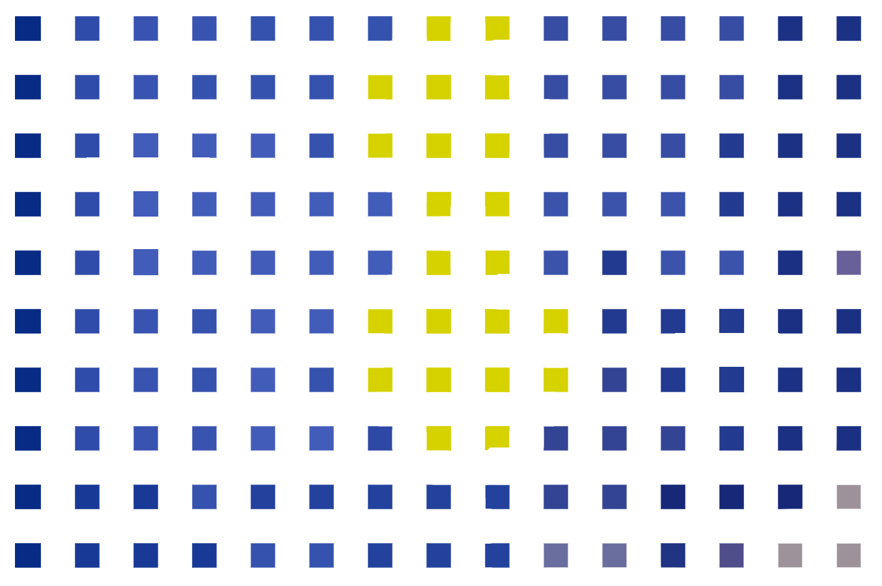

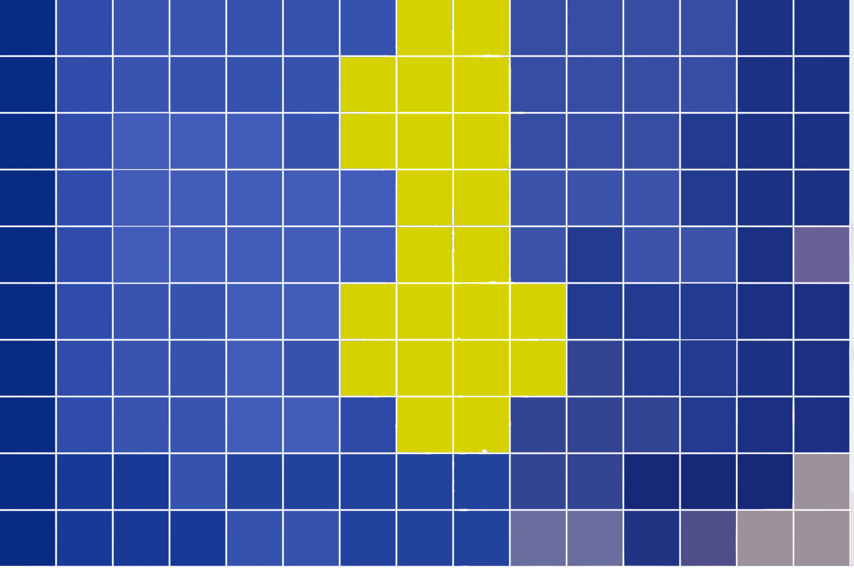
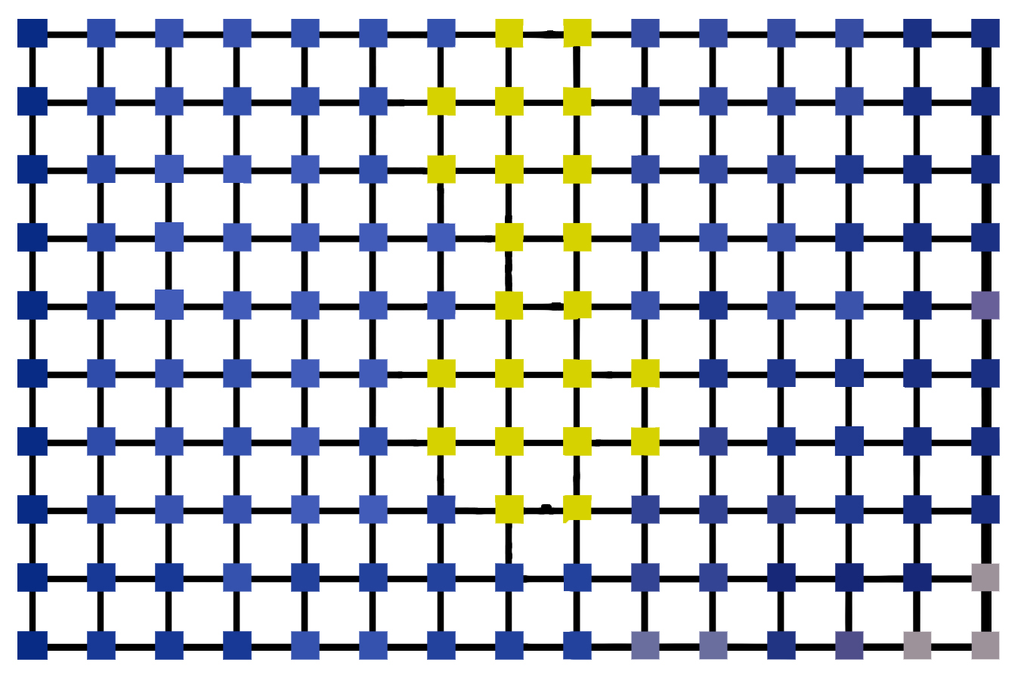
What is Image Graph?
Set of selected pixels
Sampling
Neighbor pixels
Non-negative weights

Slide 6
Previous Graph-Based methods
Early Graph-Based methods
Zahn Method (MST)
Graph-Cut
Normalized-Cut
Region Merging
etc.

Slide 7
Efficient Graph-Base

Slide 8
Algorithm
Create Graph
Sort
Merge
Extract Results

Slide 9
Algorithm
Create Graph
Sort
Merge
Extract Results

Slide 10
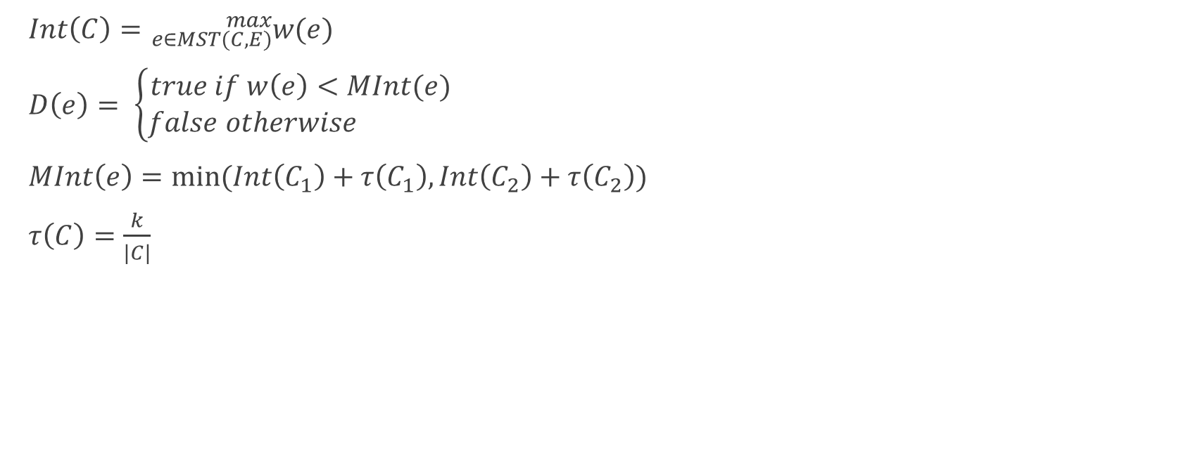
Internal Weight
$Int\left(C\right)={}_{e∈MST(C,E)}^{max}{w(e)}$
$D\left(e\right)= \left\{\begin{aligned}true if w\left(e\right)<MInt(e) \\ false otherwise \end{aligned}\right.$
$MInt\left(e\right)=min⁡(Int\left(C_{1}\right)+τ\left(C_{1}\right),Int\left(C_{2}\right)+τ\left(C_{2}\right))$
$τ\left(C\right)=\frac{k}{|C|}$

Slide 11
Time Cost
Create Graph
Sort
Merge
Extract Results
O(n)
O(n log n)
O(n)
O(m)
n = number of pixels
m <= n
O(n log n)

Slide 12
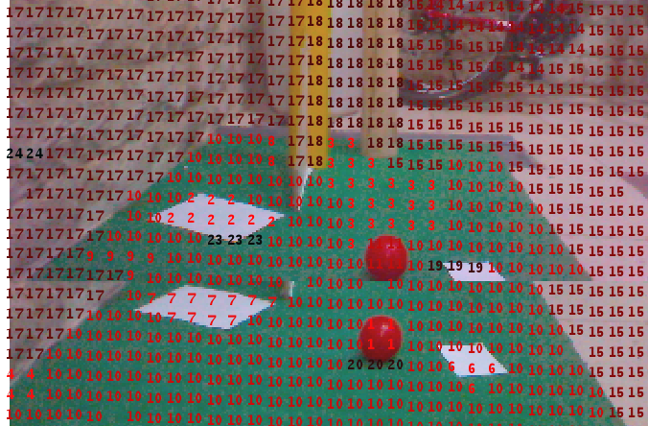
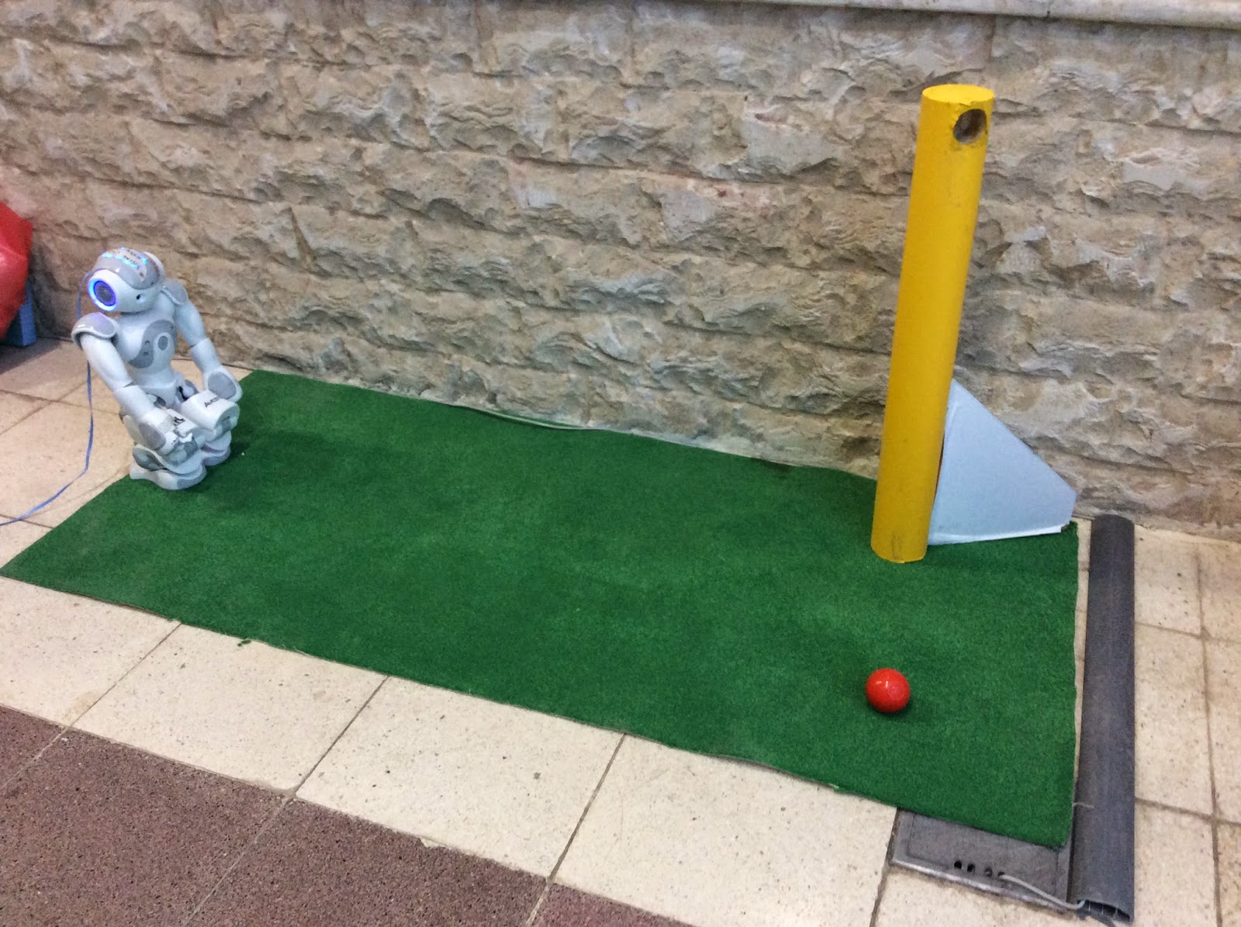
Implementation Parameters
Image Preparation
Mesh Step
Sorting Method
Weight Calculation
K parameter

Slide 13
Conclusion
Time Efficiency
Performance
  Not too fine
  Not too coarse
Implementation
Scalability

Slide 14
Any Question?
Thanks for your patience!

