Slide 1
﻿UniCast: A Unified Multimodal Prompting Framework for Time Series Forecasting
ArXiv, Submitted to AAAI 2026

Slide 2
Motivations
Exploit multimodal information from a timeseries data to improve downstream performance
Use soft prompting for parameter efficient model tuning

Slide 3
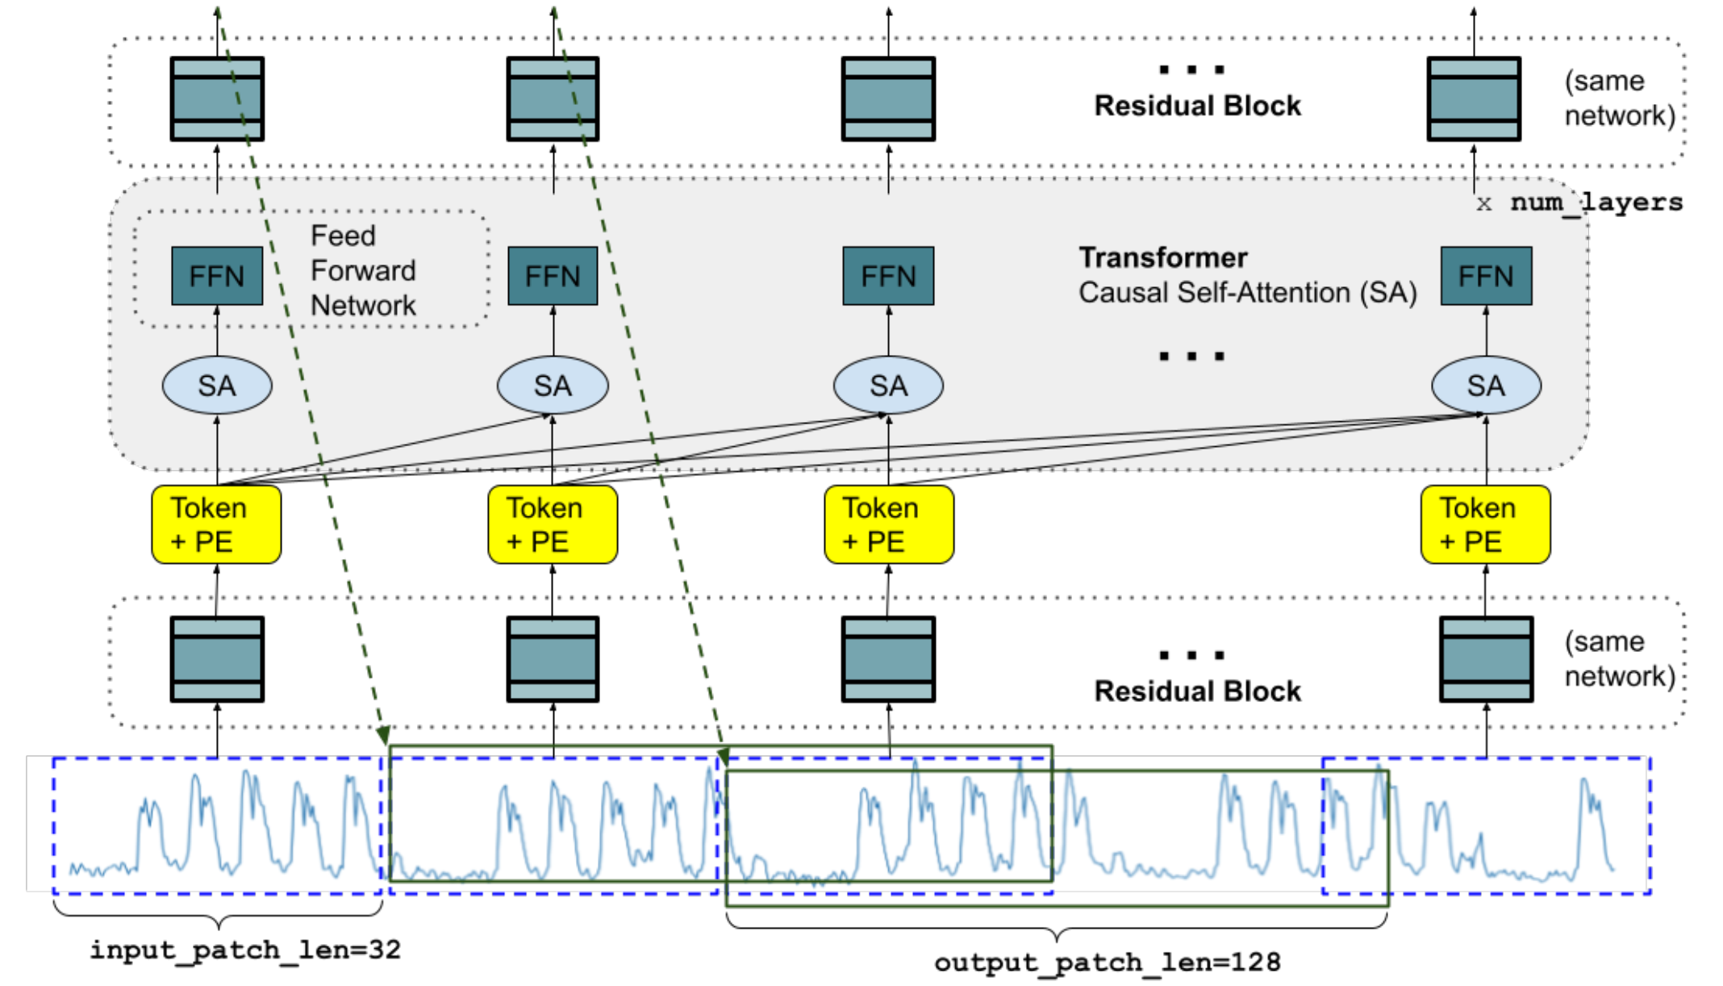
Recap: TimesFM

Slide 4
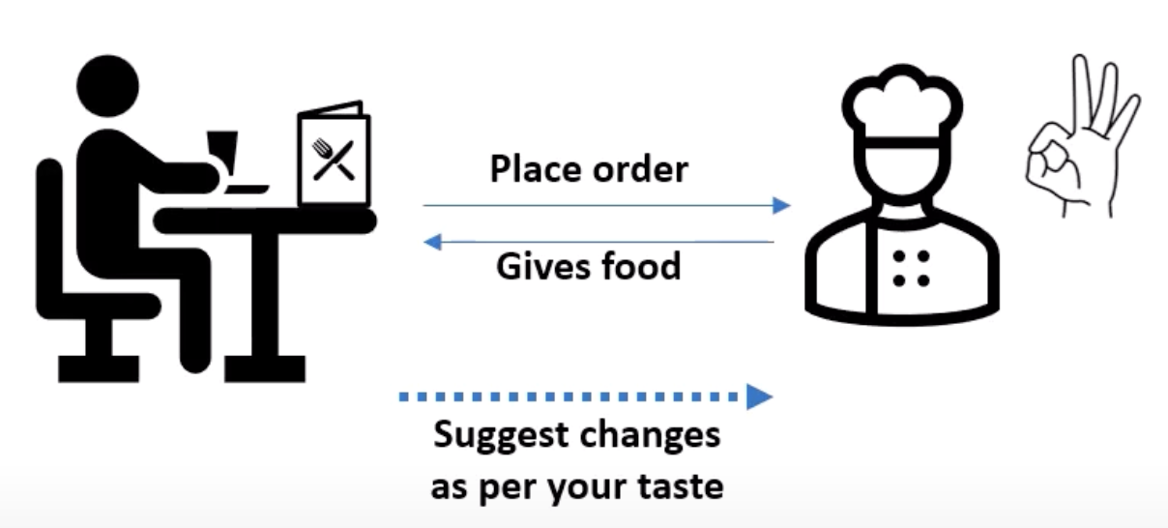
What is prompt tuning?

Slide 5
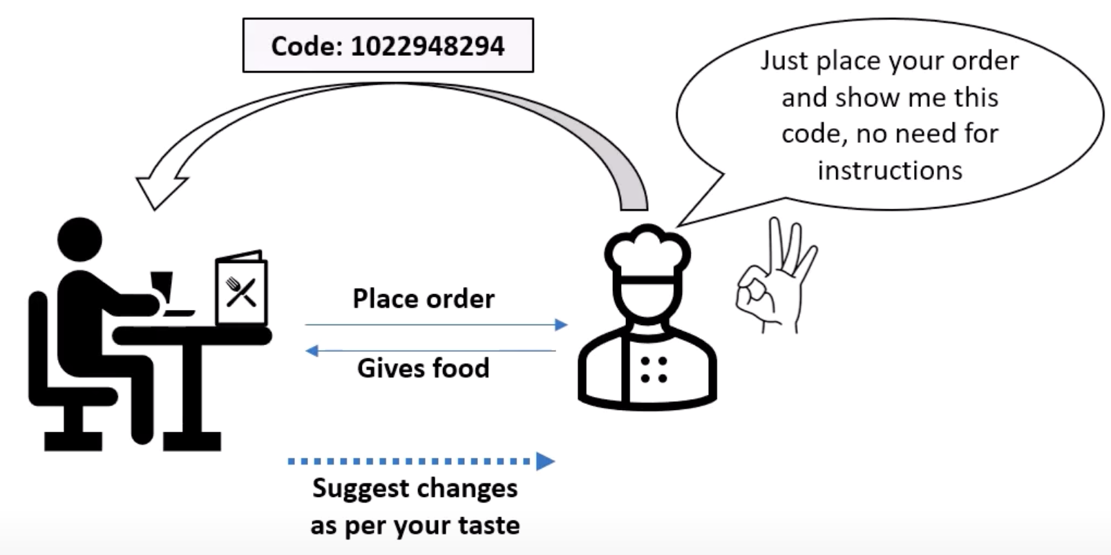
What is prompt tuning?

Slide 6
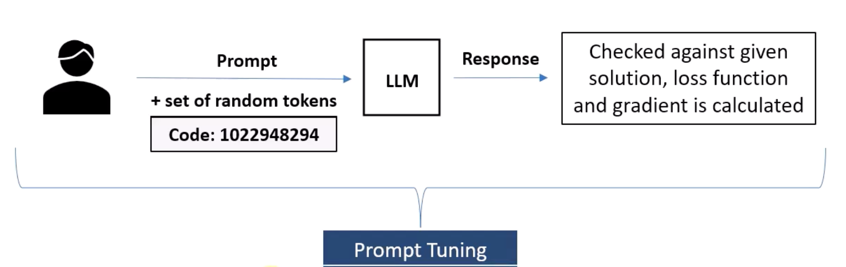
What is prompt tuning?
Option 1: Hard Prompt
Option 2: Fine-tuning
Option 3: Soft prompt

Slide 7
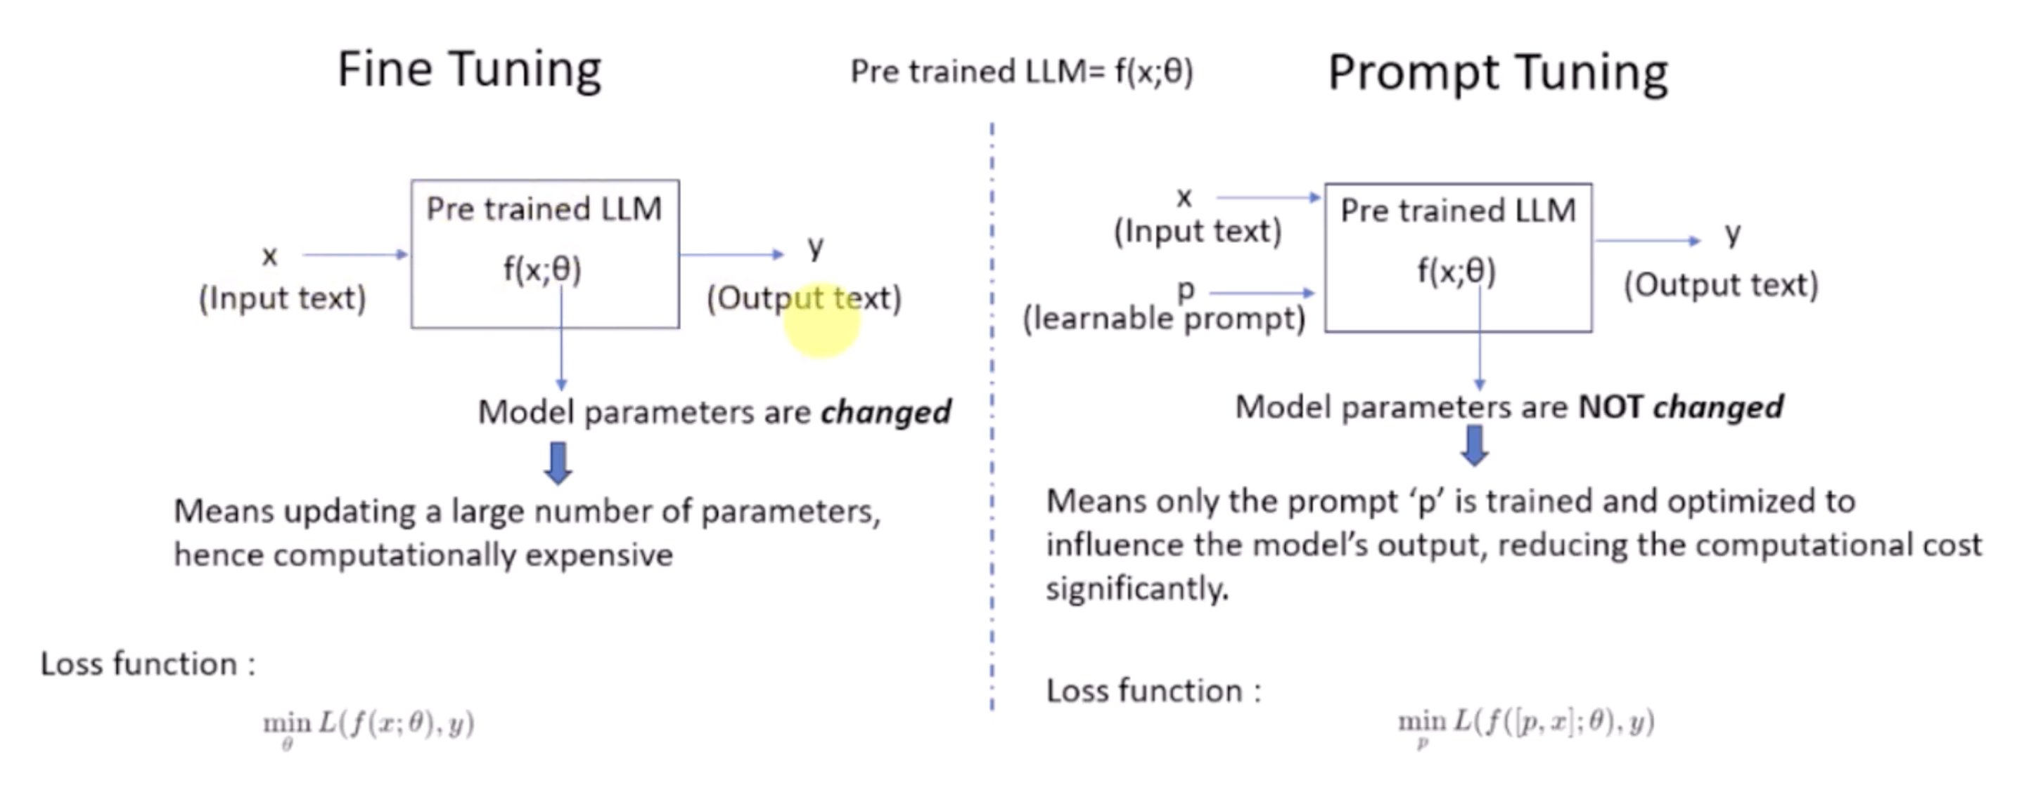
Fine-tuning VS. Prompt tuning
image credit: IBM

Slide 8
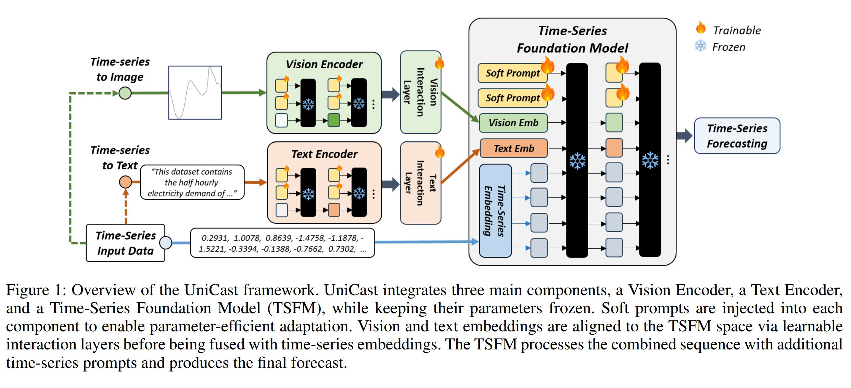
UniCast
A Unified Multimodal Prompting Framework for Time Series Forecasting
CLIP/BLIP
QWEN2/Llama
Timer/Chronos

Slide 9











Visualizing prompt tuning
After prompt tuning
$$P_{t}=\{P_{t}^{1},P_{t}^{2},…,P_{t}^{j}\}$$
Before
$$O_{t}^{0}=token(X)$$
$$O_{t}^{0}=token(X)$$
$$O_{t}^{0}$$
$$O_{t}^{0}$$
Layer 1
Layer 1
$$O_{t}^{1}=f_{t}^{1}(O_{t}^{0})$$
$$O_{t}^{1}=f_{t}^{1}([P_{t}^{1},O_{t}^{0}])$$
Layer 2
Layer 2
$$O_{t}^{2}=f_{t}^{2}(O_{t}^{1})$$
$$O_{t}^{2}=f_{t}^{2}([P_{t}^{2},O_{t}^{1}])$$
Layer 3
Layer 3
Layer j
Layer j
$$O_{t}^{j}=f_{t}^{j}(O_{t}^{j−1})$$
$$O_{t}^{j}=f_{t}^{j}([P_{t}^{j}, O_{t}^{j−1}])$$

Slide 10
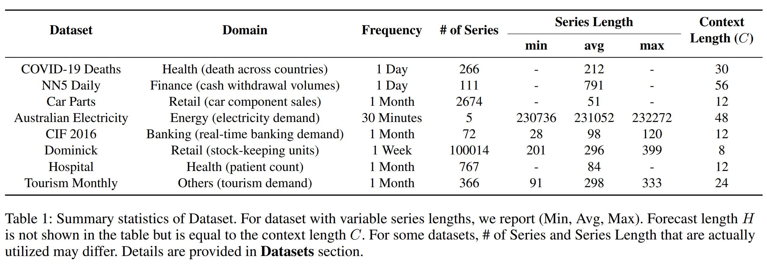
Datasets

Slide 11
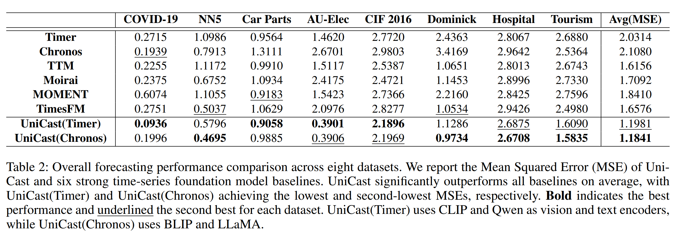
Results

Slide 12
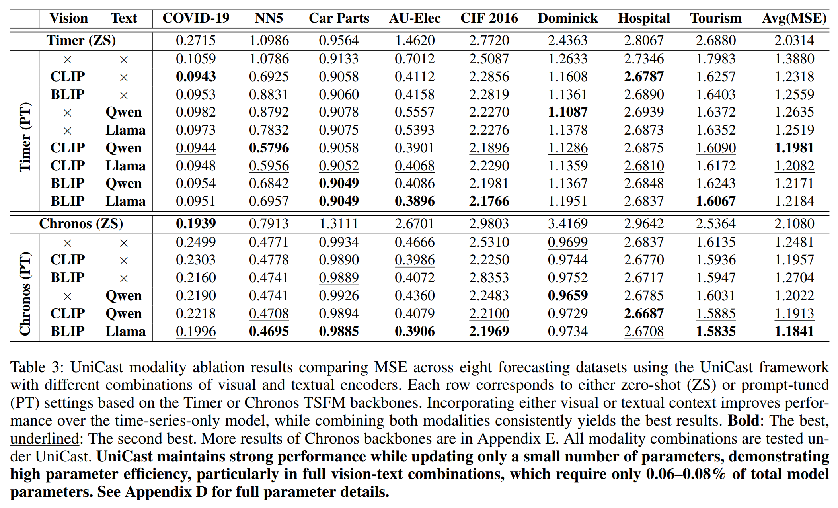
Ablation Study

Slide 13
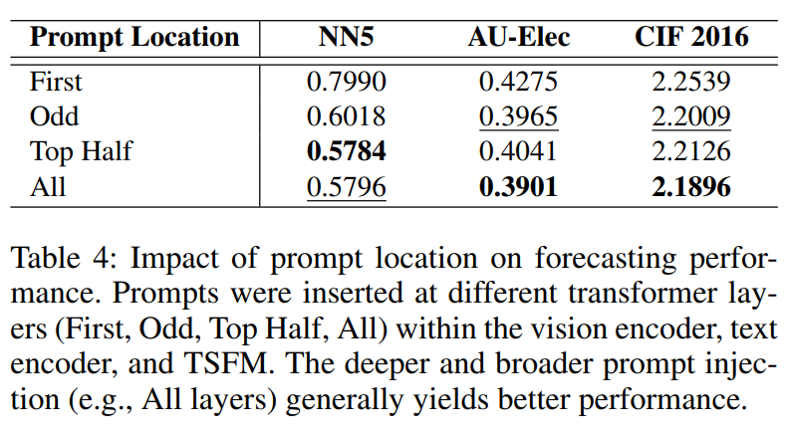
Where to apply soft prompts?

Slide 14
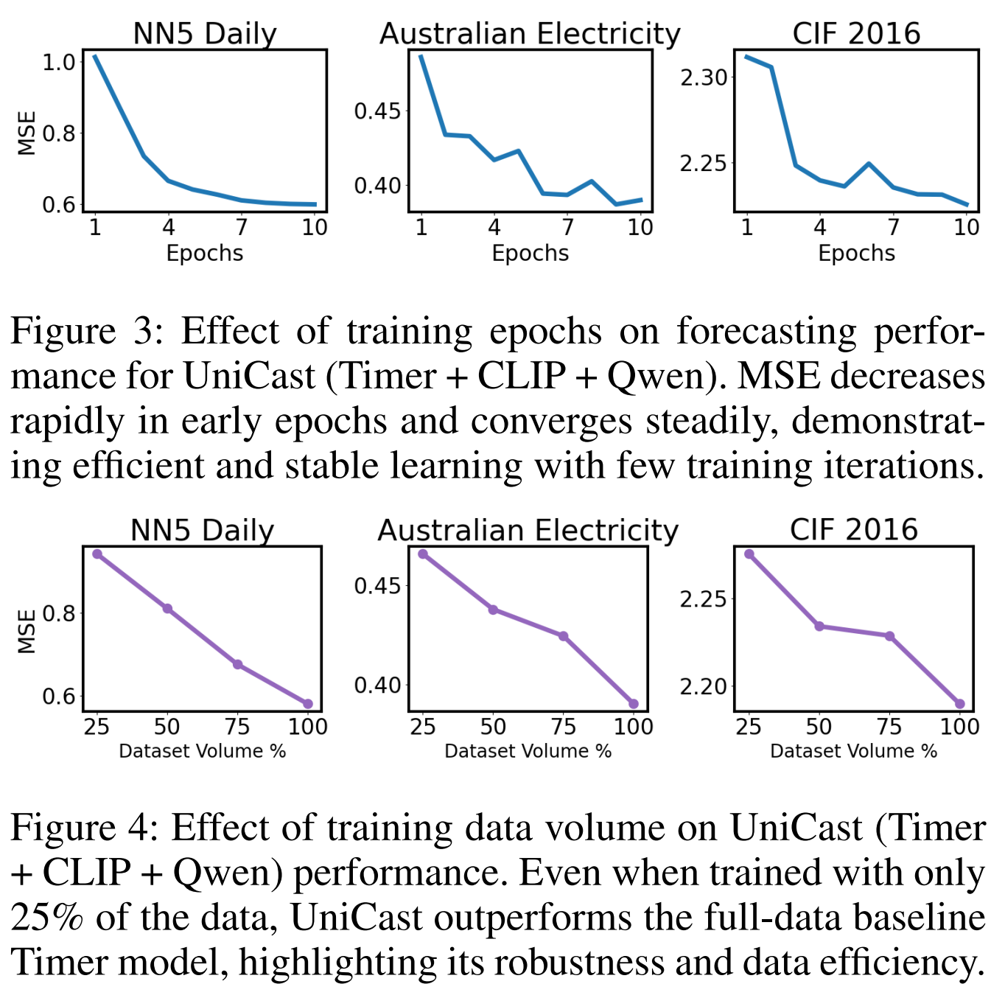
More Ablation Studies

Slide 15
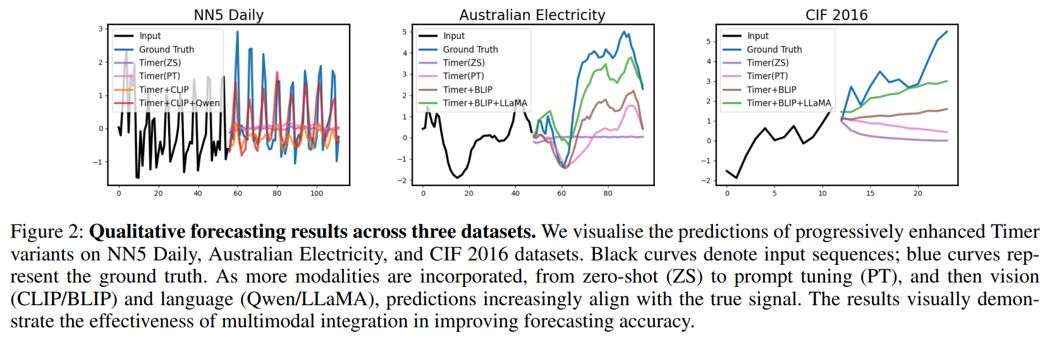
Examples

